Slide 1
CLIMATE CHANGE – AN ACTUARIAL PERSPECTIVE
Michael Howard
Most slides are from the Actuaries Institute microsite
which discusses the Australian Actuaries Climate Index
https://www.actuaries.asn.au/microsites/climate-index

Slide 2
What is an actuary?
Reputation for a high level of technical financial expertise and integrity.
Actuaries are experienced in the assessment and management of the financial consequences of risks and in the summarisation and presentation of complex data. They apply their risk management expertise to allocate capital efficiently, identify and mitigate emerging risks and help maintain system integrity across multiple segments of the financial and other sectors.
Many of the organisations that actuaries support are concerned with climate risk and with how it will affect their business – for example general insurers, banks and investment managers.

Slide 3
Last week we looked at long term cycles (>10,000 years)
We know our weather is volatile, being influenced by
ENSO (El Nino Southern Oscillation)
IOD (Indian Ocean Dipole)
SAM (Southern Annular Mode)
Posit that there is an additional increase in volatility due to our activities leading to an adverse impact on the “greenhouse gas effect”.

Slide 4
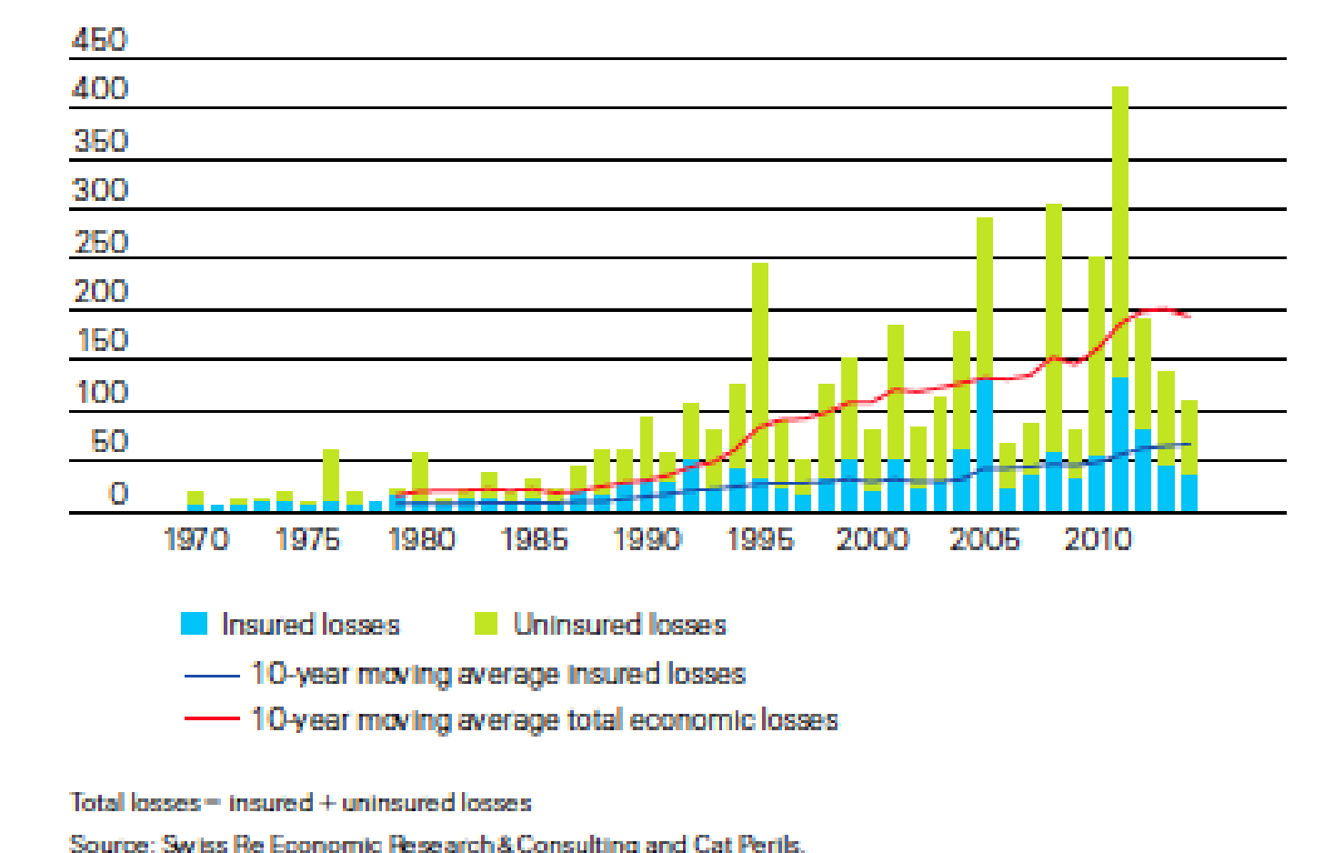
Global financial losses
(US$billion adjusted for inflation)

Slide 5
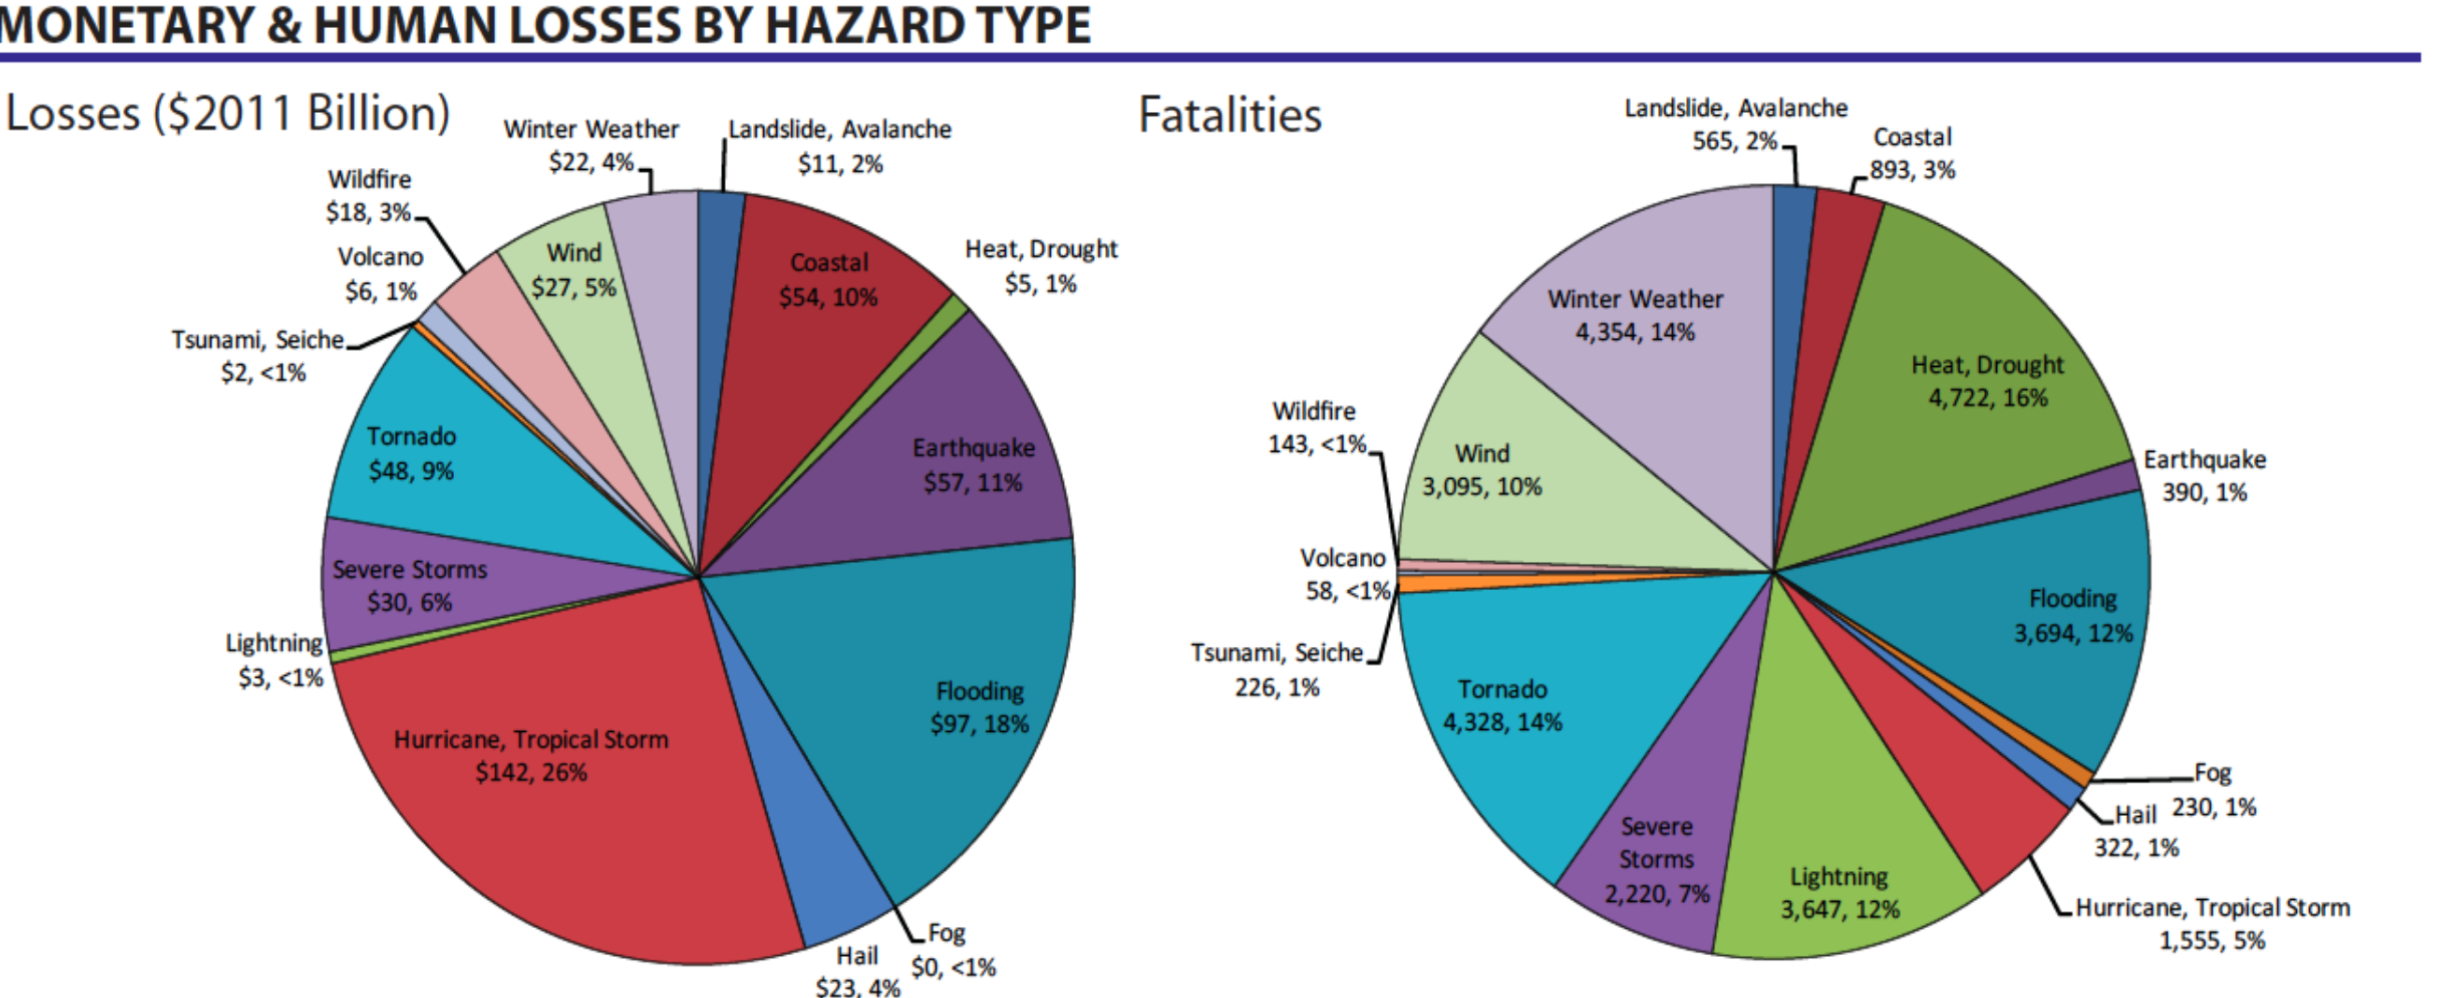

Slide 6
Some Broad Categories of Climate Change Risks
Physical
Liability
Transition

Slide 7
Australian Actuaries Climate Index (AACI)
The index is intended to provide a useful measure of how the extremes of weather are changing in order to support assessment of the change in risk.
It examines changes in the frequency and duration of extreme temperatures (high and low separately), heavy precipitation, drought, strong wind, and changes in sea level. The index is available for 12 regions of Australia.
It is easy to understand but not simplistic

Slide 8
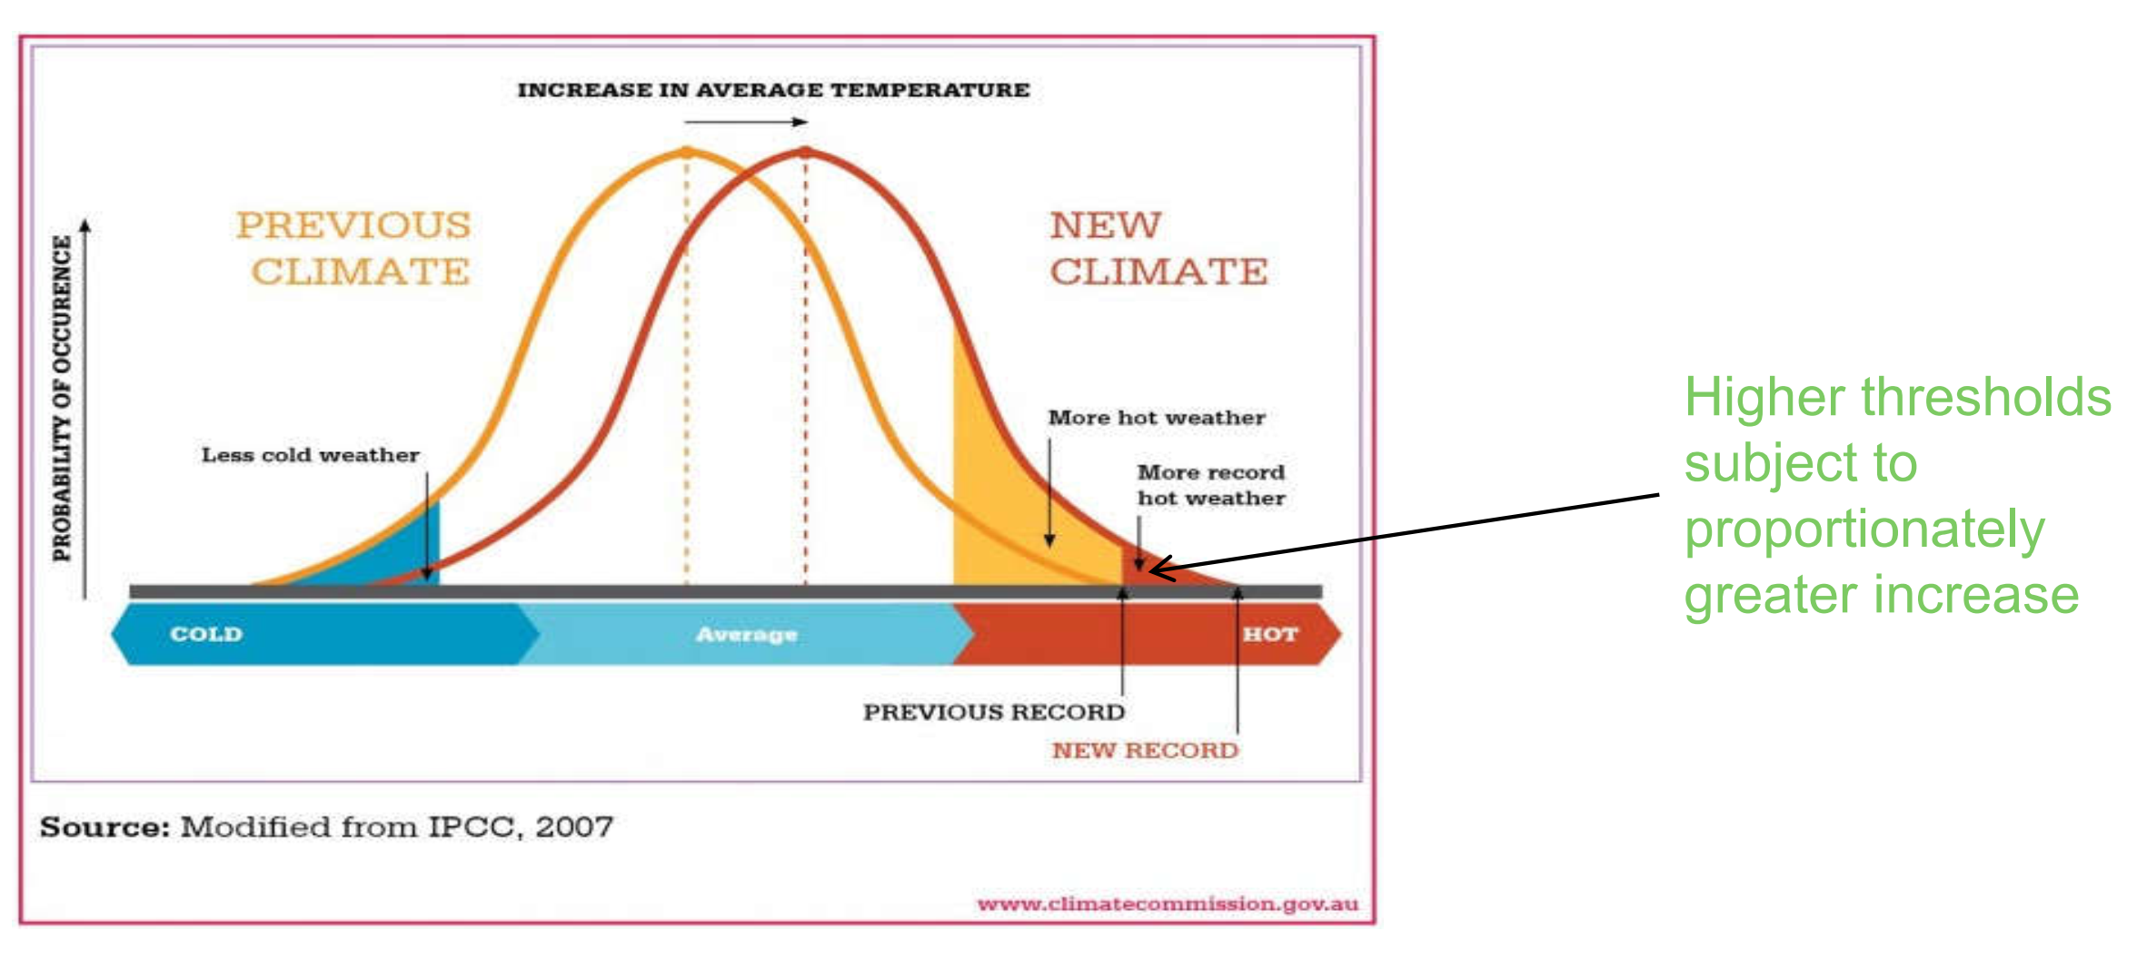
Extremes – in theory

Slide 9
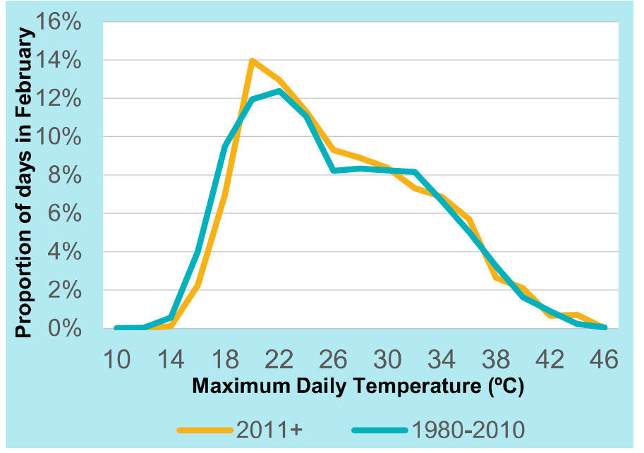
In practice - Victoria

Slide 10
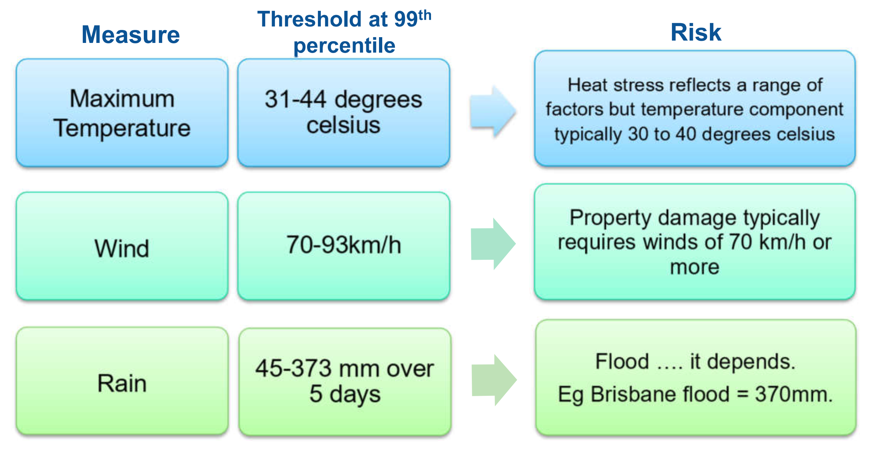
Link between Extremes and Risk

Slide 11
Six components
Frequency of daily maximum and minimum temperatures above the 99th percentile.
Frequency of daily maximum and minimum temperatures above the 1st percentile.
Frequency of rainfall over five consecutive days above the 99th percentile.
Seasonal maximum consecutive dry days.
Frequency of daily wind speed above the 99th percentile.
Seasonal maximum sea level.

Slide 12
Index available by Region
The regions are based on CSIRO’s 15 sub-clusters used for their ‘Climate Change in Australia’ data.
There are only 12 zones in the index as some clusters were grouped because there was insufficient data for them to be assessed in isolation.
These zones are intended to be climatologically consistent regions of Australia.

Slide 13
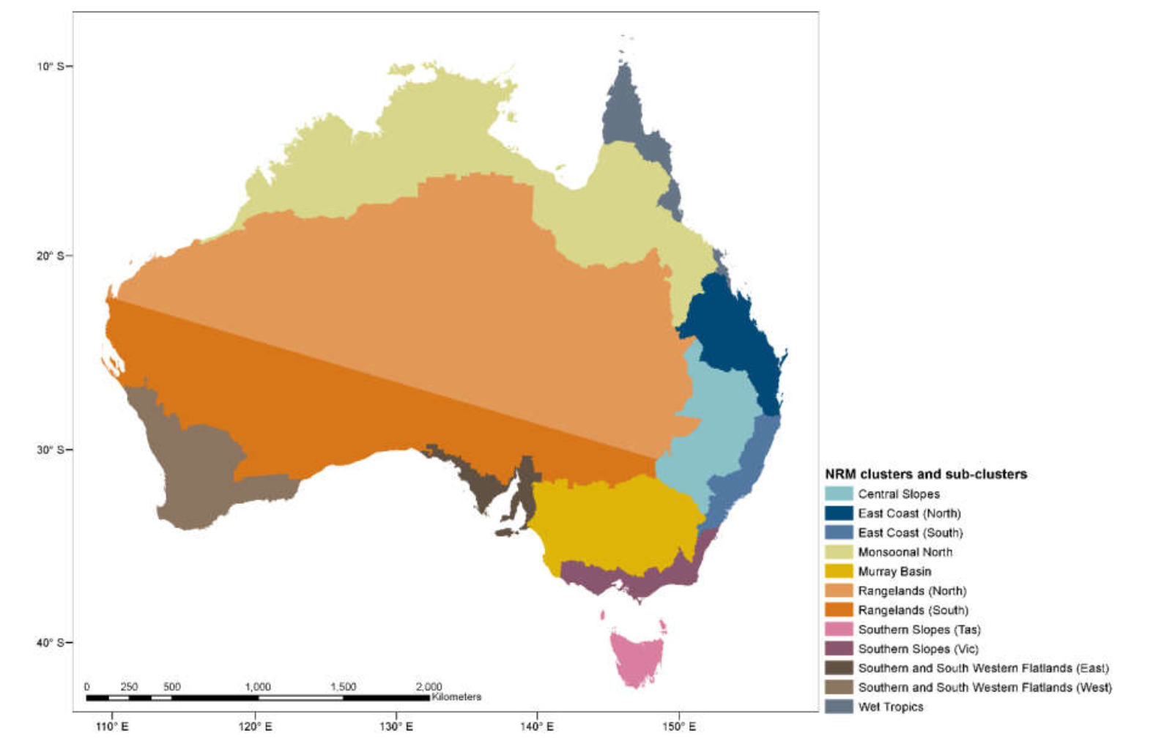

Slide 14
AACI Components
INCLUDE
High temperature
Rain fall
Sea level
EXCLUDE
Wind data as data not available back to 1981
Low temperature so temperature not over weighted
Low rainfall as is naturally associated with consecutive dry days

Slide 15
What does the index score represent for each component?
A positive value in the index represents an increase in climate-related extremes relative to the reference period.
The value is expressed as a standardised anomaly.
This means that for an individual metric, the standardised anomaly corresponds to how unusual that season’s value is compared to the reference period mean and standard deviation for that season.
Each component is in units of the standard deviation of that quantity (e.g. an index of 0.5 means the metric has increased by half a standard deviation).
Using standardised anomalies allows us to combine underlying metrics in a consistent way relative to their natural variability.

Slide 16
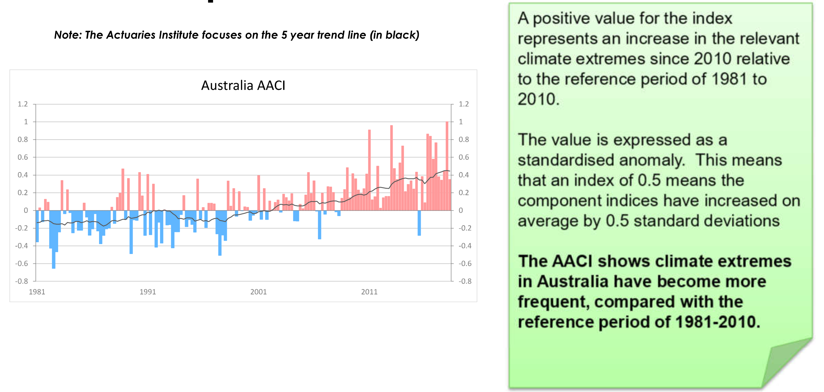

Slide 17
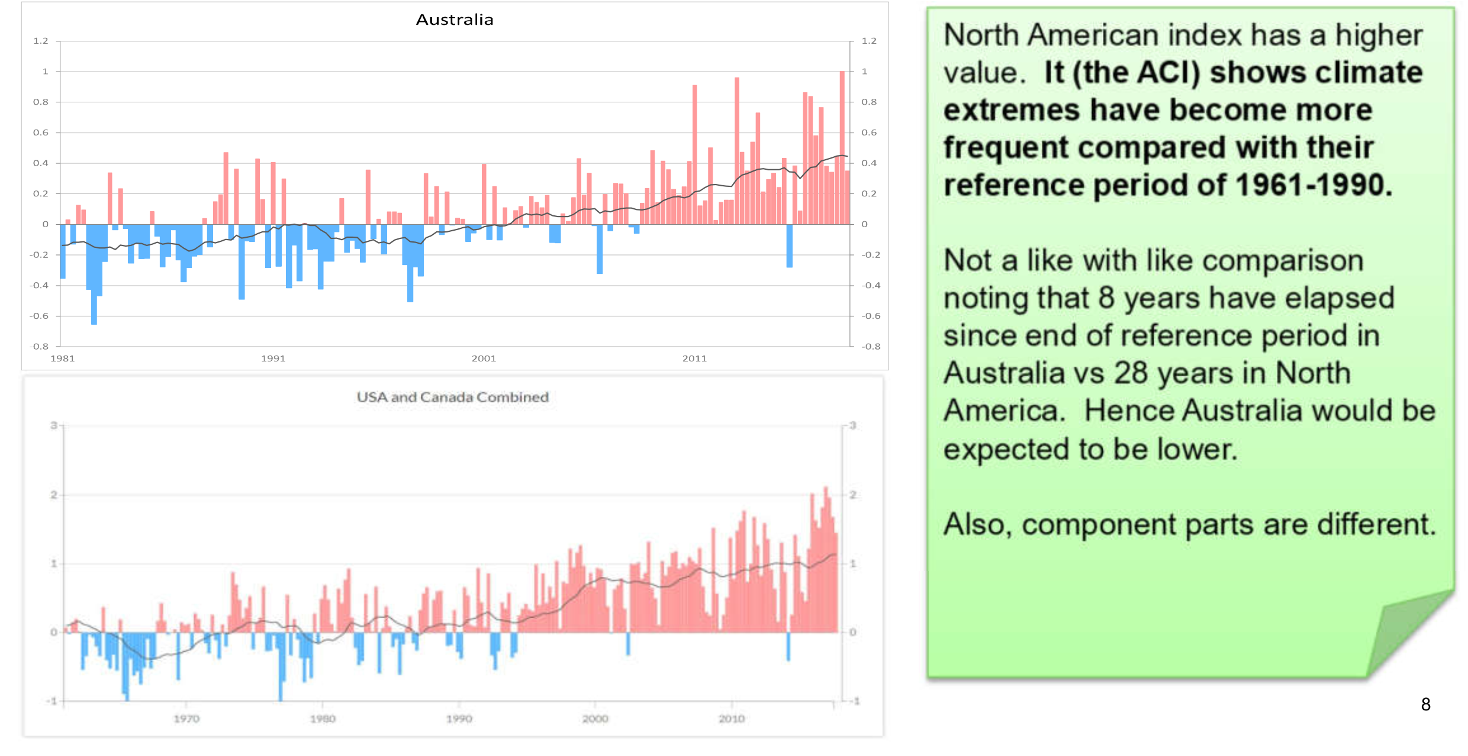
Comparison with USA/Canada

Slide 18
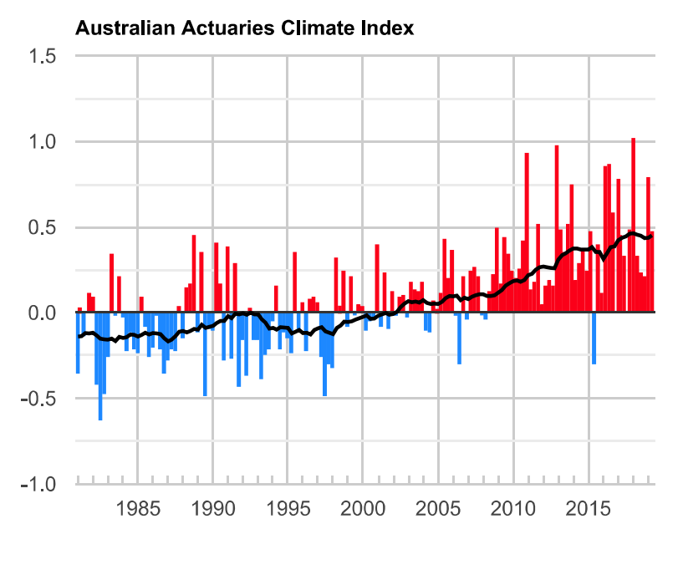
Australia

Slide 19
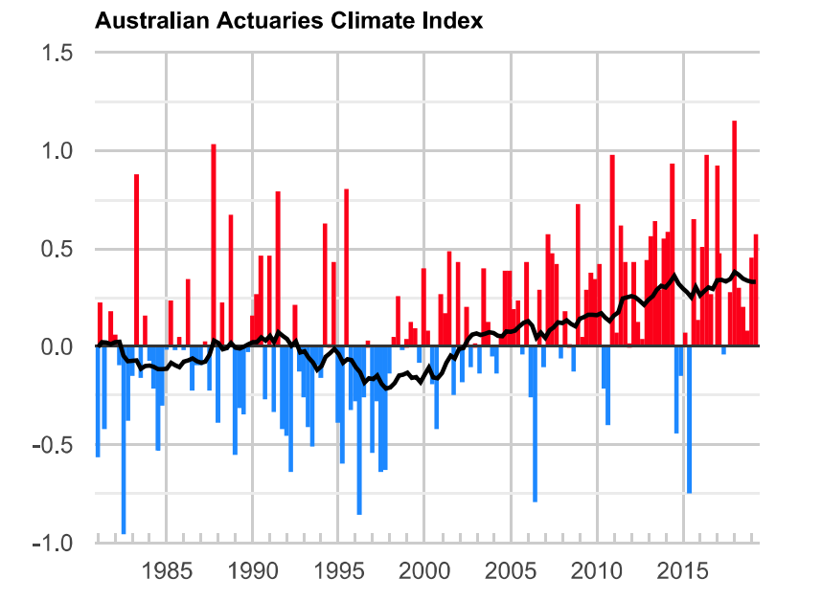
Southern Region (Victoria)

Slide 20
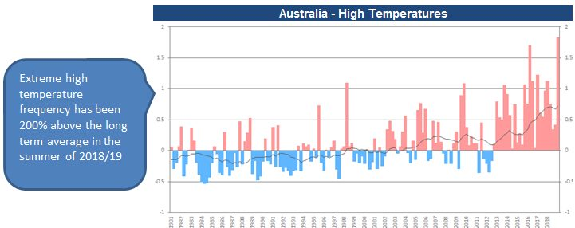
AACI Summer 2018/19 Region High Temperatures

Slide 21
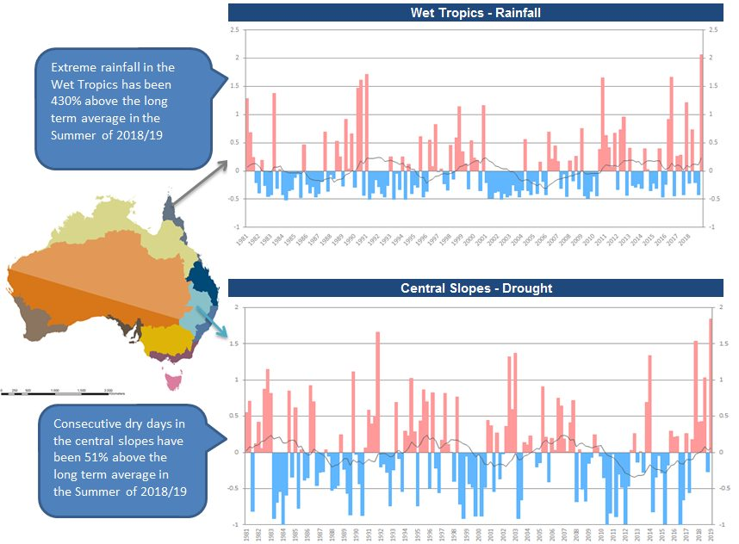
AACI Summer 2018/19 Region Rainfall

Slide 22
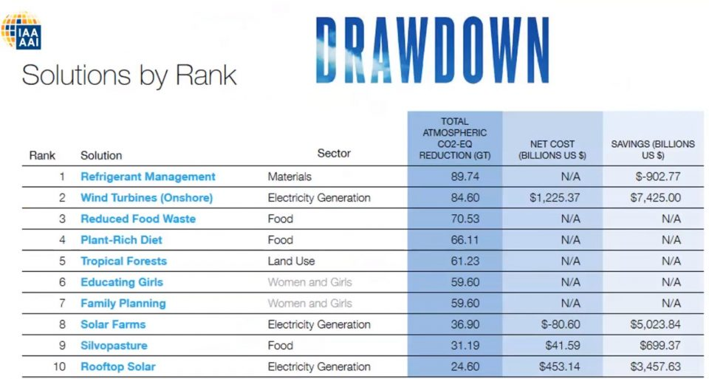
Drawdown, a global research and communication organisation, recently ranked 100 potential solutions.

Slide 23
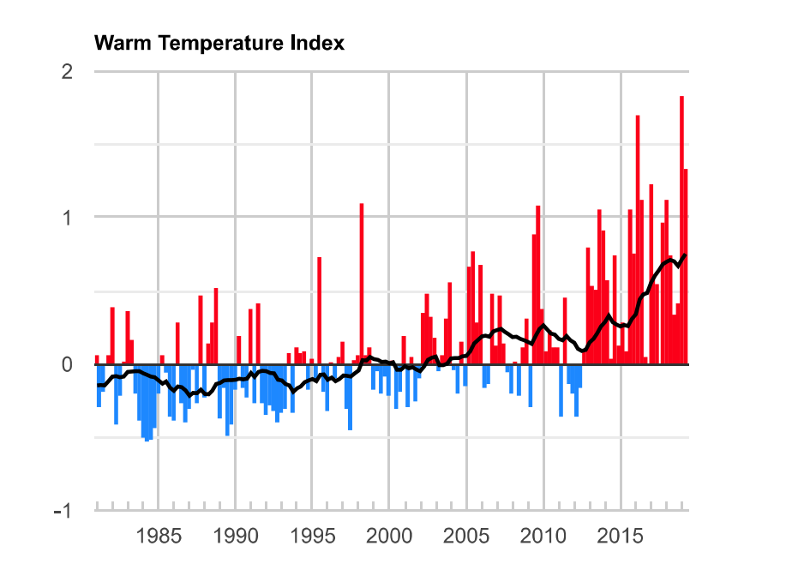
Australia

Slide 24
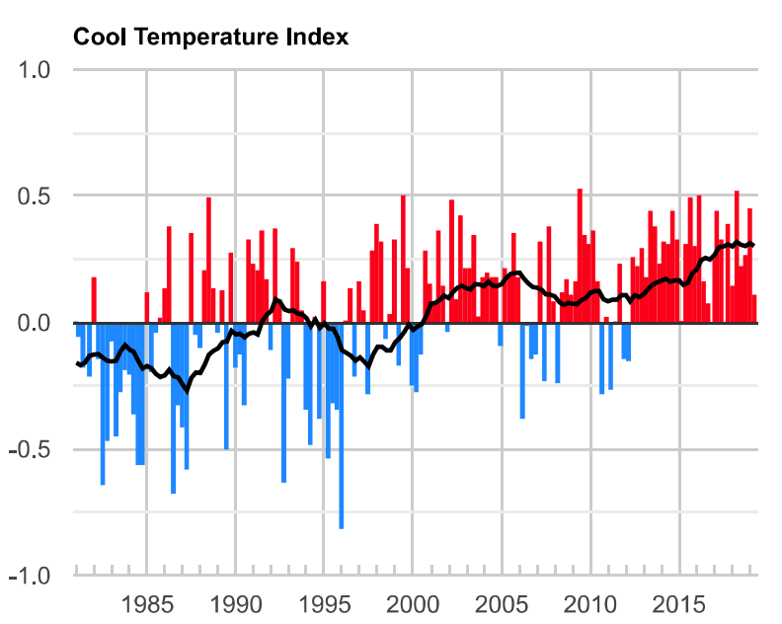
Australia

Slide 25
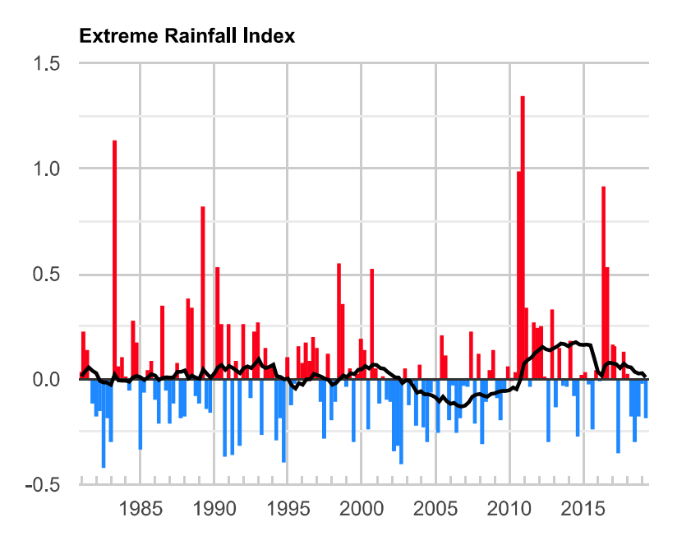
Australia

Slide 26
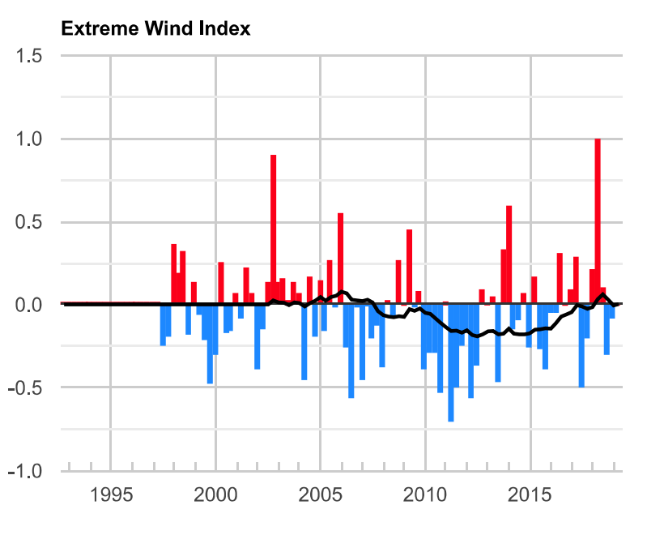
Australia

Slide 27
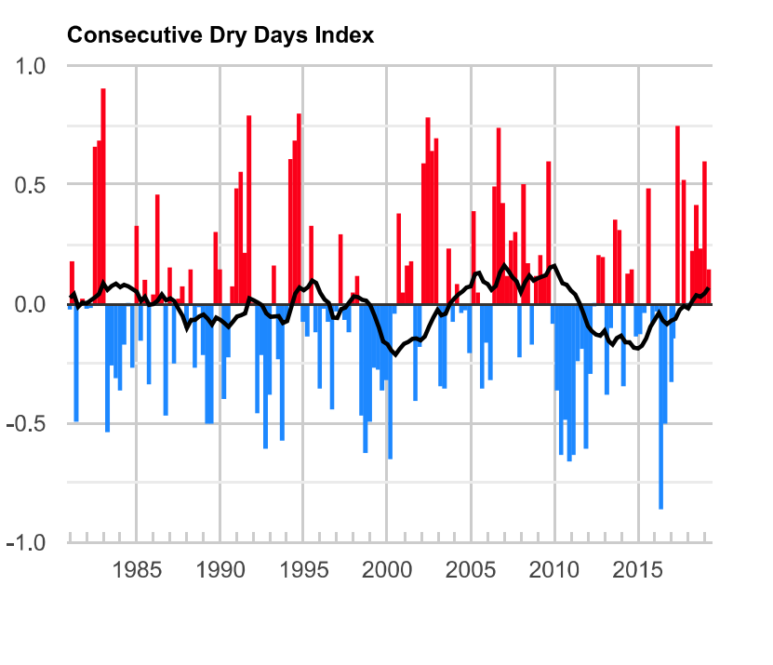
Australia

Slide 28
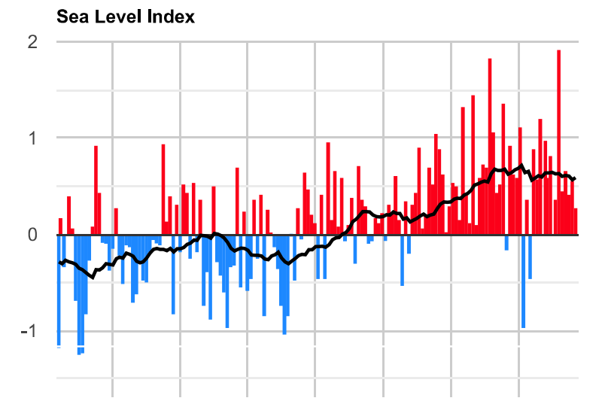
Australia

Slide 29
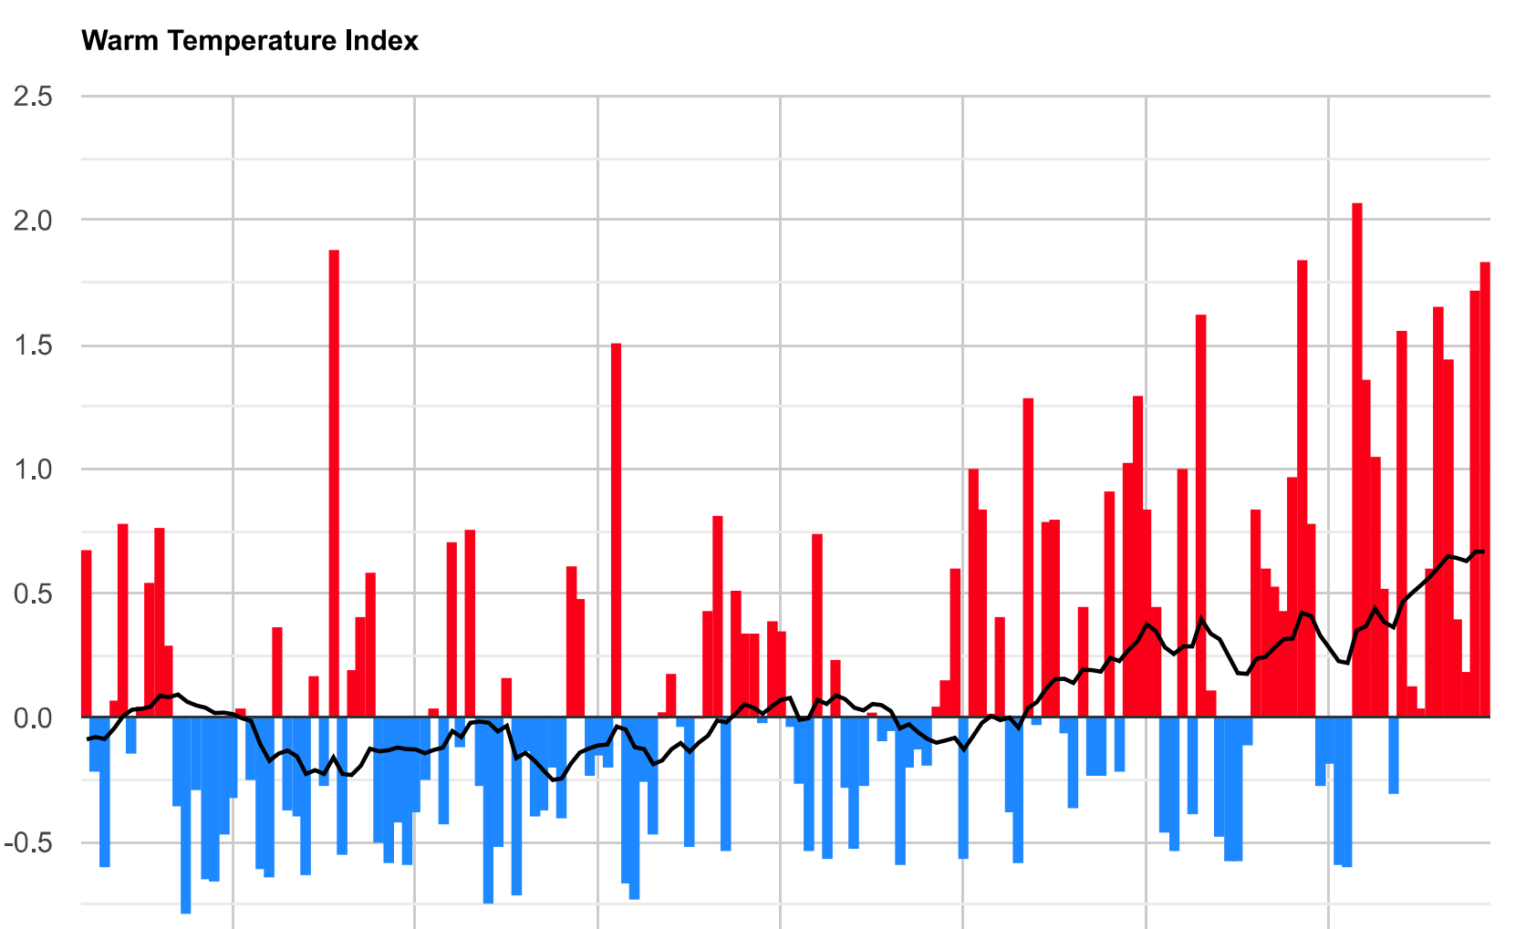
Southern Slopes (Victoria)

Slide 30
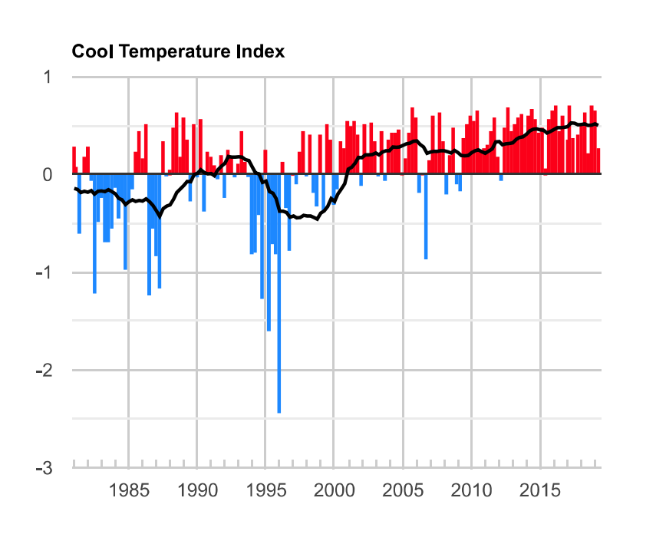
Southern Slopes (Victoria)

Slide 31
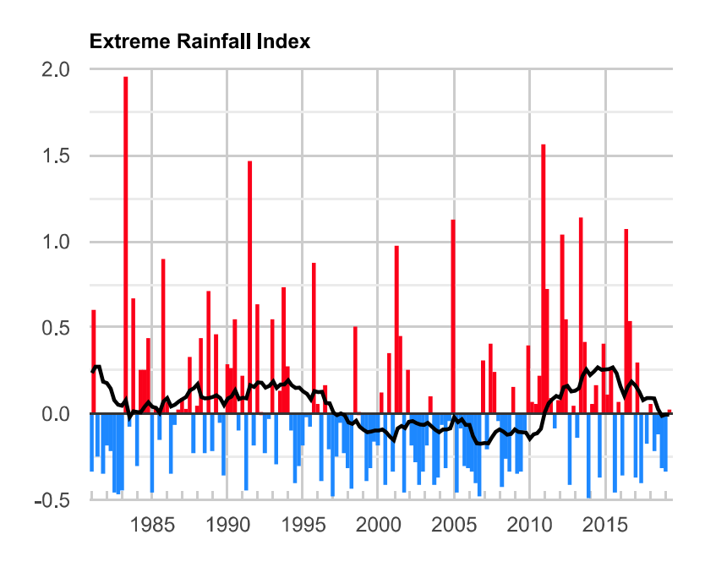
Southern Slopes (Victoria)

Slide 32
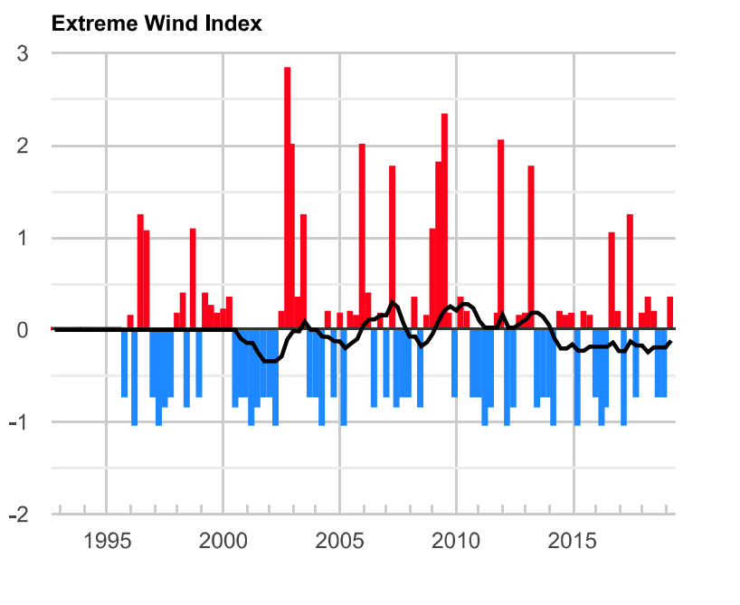
Southern Slopes (Victoria)

Slide 33
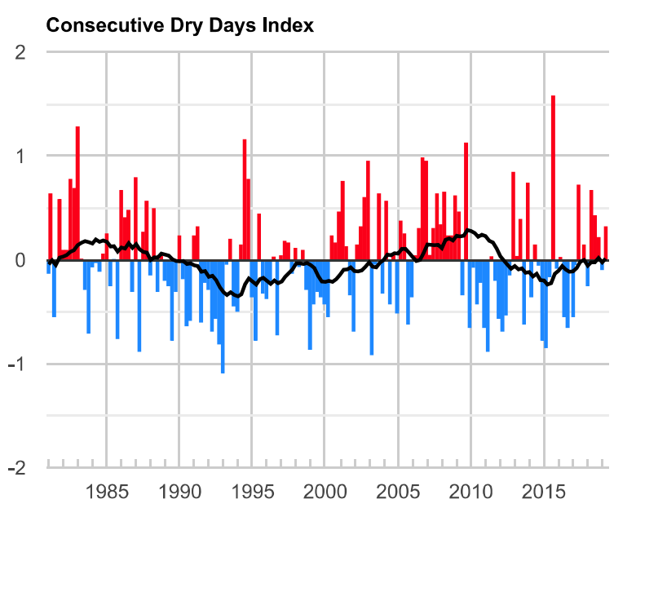
Southern Slopes (Victoria)

Slide 34
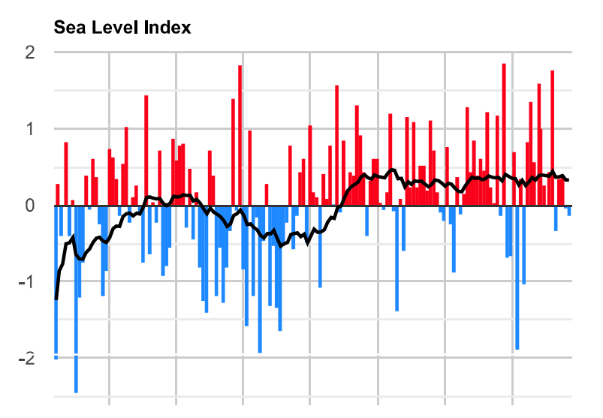
Southern Slopes (Victoria)

Slide 35
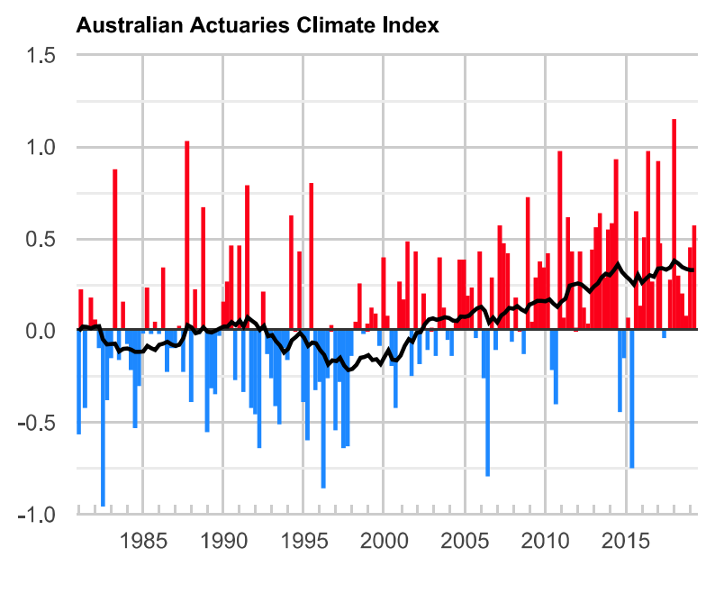
Southern Slopes (Victoria)

Slide 36
