Slide 2
hello
Hi everybody.
Welcome back to school

Slide 4
Let’s know
each other
What is my name?
What is your name?
How old am I?
How old are you?
Where am I from?
Where are you from?
Where do I live?
Where do you live?
Have I got any brothers or sisters?
Have you got any brothers or sisters?
GUESSING
GAME

Slide 5
Let’s
know
each
other
Can you tell me…
What do I teach?
What is your favourite colour?
Can you count from 1 to 25?
What is your favourite day of the week?
Can you talk about your family?
What is your favourite book?

Slide 6
MY ENGLISH
AND MY RULES

Slide 7
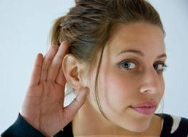
MY ENGLISH AND MY RULES
Listen to your teacher carefully!

Slide 8
MY ENGLISH AND MY RULES
Don’t speak!

Slide 9
MY ENGLISH AND MY RULES
Raise your hand!

Slide 10
MY ENGLISH AND MY RULES
Speak English!

Slide 11
MY ENGLISH AND MY RULES
Don’t hesitate!

