Slide 1
SIP #3 - Generational Distinctions
Speaker: Pam Spinks
Notes:
SIP #3 – Generational Distinctions

Slide 2
Notes:
The events and conditions each of us experiences during our formative years determines who we are and how we see the world.
Formative Years: During our teens and early adulthood, we begin to create our own perceptions of the world around us, apart from our parents. The events of this time for a cultural; backdrop that impacts the way each generation views everything from social justice to politics, work ethic and consumption. General Theory explores how these shared experiences result in behavioral patterns and consumer trends.

Slide 3
When are You From?
Generation (Birth Year* ) Timeline:
1922-1945 *
Silent
Generation
Veterans
1946-1964
Baby Boomers
1965-1979 *
Generation X
1980-1995 *
Generation Y
Millennials
1996-2012 *
Gen Z
iGen
* Birth Year dates vary depending on the research source.
Notes:
Research indicates that people communicate based on their generational backgrounds.
Every Gen has created its own commotion as it has entered the work force.
Each Gen has distinct attitudes, behaviors, expectations, habits and motivational buttons.
Every Gen says the same things about New Gen: “They don't get it.” or “They have it so much easier than we did.”
Avoid Rigid Stereotyping: Not all traits apply to all members of a generation

Slide 4
5 Generations in the Workplace (Ages in 2019)
Grew Up With:
Silent Gen.: 74 + Radio
Baby Boomers: 55 - 73 TV
Generation X: 40 - 54 PC
Millennials (GEN Y): 24 - 39 www:
Generation Z: 7 - 23 Smart Phone
Notes:
Note: Ages updated for 2019.
Five generations share the workplace. “When are you from?”
An unprecedented workplace convergence of four generations will be fraught with conflict, unless awareness and understanding of cross-generational differences increase.
Diversity, will be further complicated by the aging of the workforce.
Each of the five generational groups currently in the workforce is defined by its common experiences and shared values. Each of them operates under different expectations and understandings of values such as sacrifice and loyalty. We can view these differences as a great problem or as part of the greatness that is America.

Slide 5
Birth Year Ranges ≠ cast in stone
CUSPERS: Wedged Between Two Generations,
You may Identify with more than one generation, IF you were born near the beginning or end of a Generation Range
3 Cuspers in workforce today:
☑ Traditionalist/Baby Boomer (B-1940-45)
☑ Baby Boomer/Generation Xer (B-1960-65)
☑ Generation X/Gen Y (B-1975-79)
☑ Generation Y/Gen Z (B-1990-95)
Notes:
CUSPERS: Wedged Between Two Generations
You may Identify with more than one generation, IF you were born near the beginning or end of a Generation Range
Trad/BBoomer: value strong work ethic on Trad, but some like to challenge the status quo, a BB trait.
BBoomer/Gen X: Witnessed success of older BB but they experienced the recession on the early GenXers. Computers didn’t come into elem and high schools until after they graduated.
Gen X/Mill: Possess an interesting mix of Gen X skepticism and Mill optimism. They are quite comfortable with technology.

Slide 6
Notes:
How would you describe the younger generation?
No matter what generation you belong to, this is exactly what your parents' generation thought about you, once upon a time, when you were entering the workforce:
They're rude. They're slackers. They dress unprofessionally. They love loud, raunchy music. They don't respect their elders. They're . . . Generation X, Y or Z? Wrong. They're you.

Slide 7
Notes:
Here is the “Visual Technology/Generation Gap”.
This is the picture of the technology that each generation grew up with.

Slide 8
Silent Gen
Age:74+
Notes:
Athletes were heroes
Government solved problems
Politicians were inspirational leaders
The Military; Big Corporations lead by white males, Seniority driven. Rationing, Save for a Rainy Day, “Waste Not, Want Not”. 50% of them served in WW II.
Defining Moment----Pearl Harbor.
Loyalty to the Institution. Patriotism.
Attributes: LOYALTY, Dedicated Work Ethic, Personal Sacrifice, Respectful view of authority,
Lead by Hierarchy, Courageous, Practical Outlook, Turned off by Vulgarity.

Slide 9
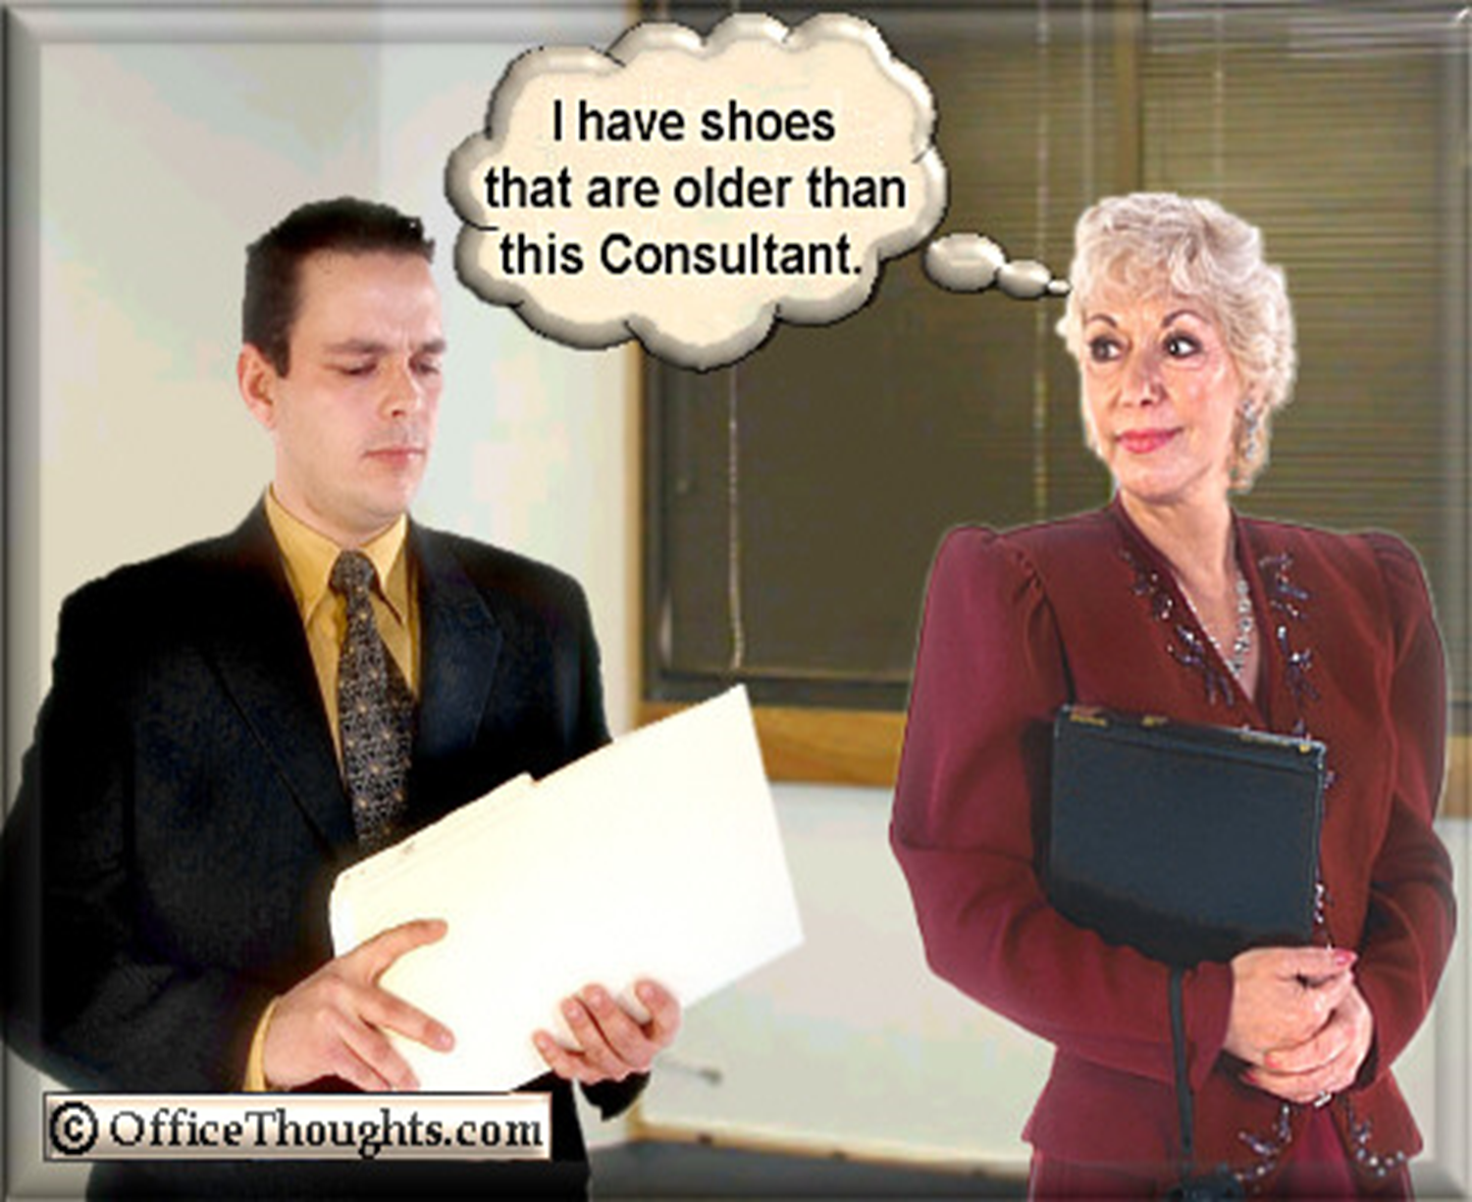
Notes:
This could be a condescending statement to the younger generation.
The reverse is also true if the young auditor says,” Gee, I think you are older than my grandmother.”

Slide 10
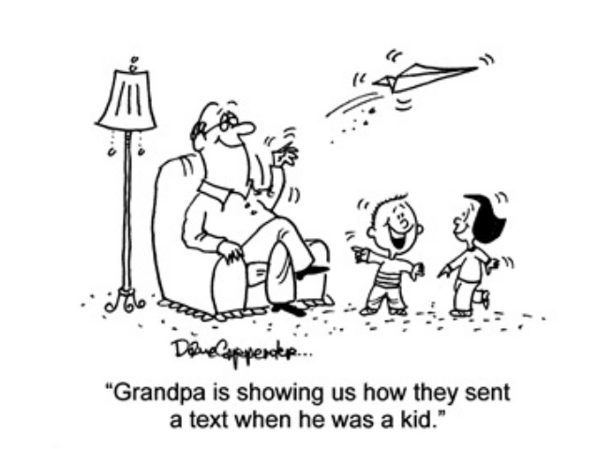

Slide 11
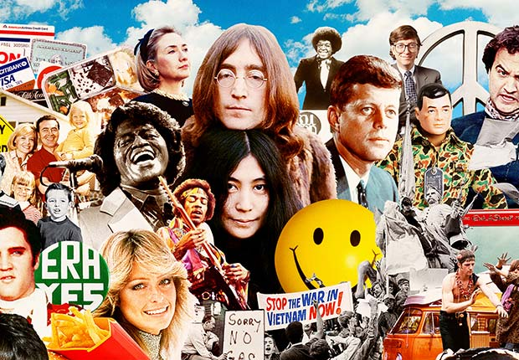
Baby Boomers – Age: 55-73
Notes:
Baby Boomers=
Ages 55 to 73 in 2019 (Born 1946 to 1964)
Marked by the cold war of the 1950’s
& the Societal revolution of the 1960’s
Distrustful of authority
Propensity for rebellion
Love, Sex, Drugs and Rock & Roll. Woodstock. Highly Confident Generation. Babies born every 17 minutes for 20 years.

Slide 12
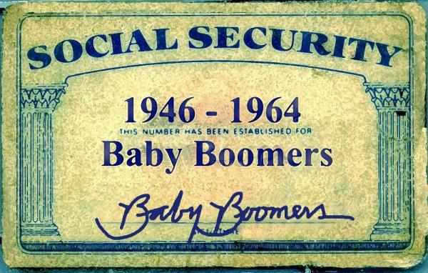
Redefining
Retirement!
(80 million)
Notes:
Baby Boomers are redefining Retirement.
BB Birth Years are universal.
From WWII until the time the Beatles released Revolver Album. Boomers are Workaholics whose Traditionalist parents taught them to “Earn Your Keep”.
Technology was TV, but it was Coast to Coast = same show, same game, same news. Social Awakening in America = civil Rights. Most popular poster: Farah Fawcett. Don’t want to grow old; Want to Age with Attitude.
Attributes: OPTIMISTIC, Driven work ethic, Leadership by consensus, Love/Hate View of Authority, Most Politically Correct, Relationships = personally gratifying.
Music - Elvis, Beach Boys, The Beatles, Motown.

Slide 13
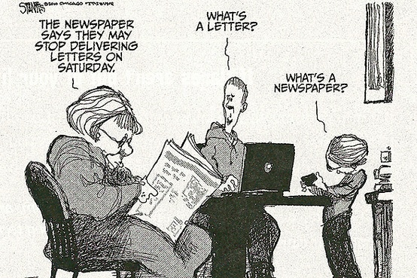
Grandma speaking to Gen Y grandchildren
Notes:
Grandma speaking to Gen Y grandchildren.
“What’s a Letter?”
“What’s a Newspaper?”

Slide 14
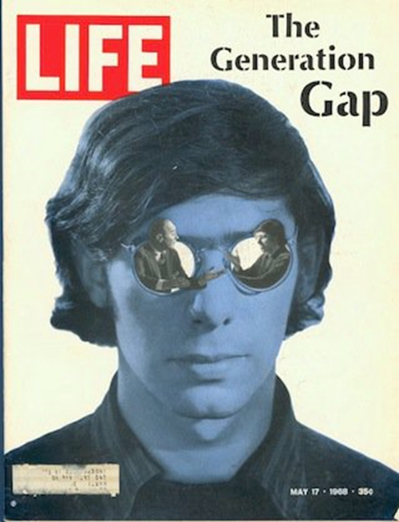
May 17, 1968
Note: Gen X were 3 in 1968
Notes:
"In my talks, I give people an exercise where I ask them to describe the younger generation," says Meagan Johnson, a Phoenix-based speaker on generational issues in the workplace. "They usually list things like, 'bad attitude,' 'sense of entitlement,' 'lack of work ethic,' 'rude,' 'disloyal.' Then I show them a PowerPoint slide of a 1968 issue of Life magazine about the generation gap--where the same words were used to describe the baby boomers!

Slide 15
Parent-Teacher Conferences
Notes:
Is this True? Is this a Problem?
What do you think?

Slide 16
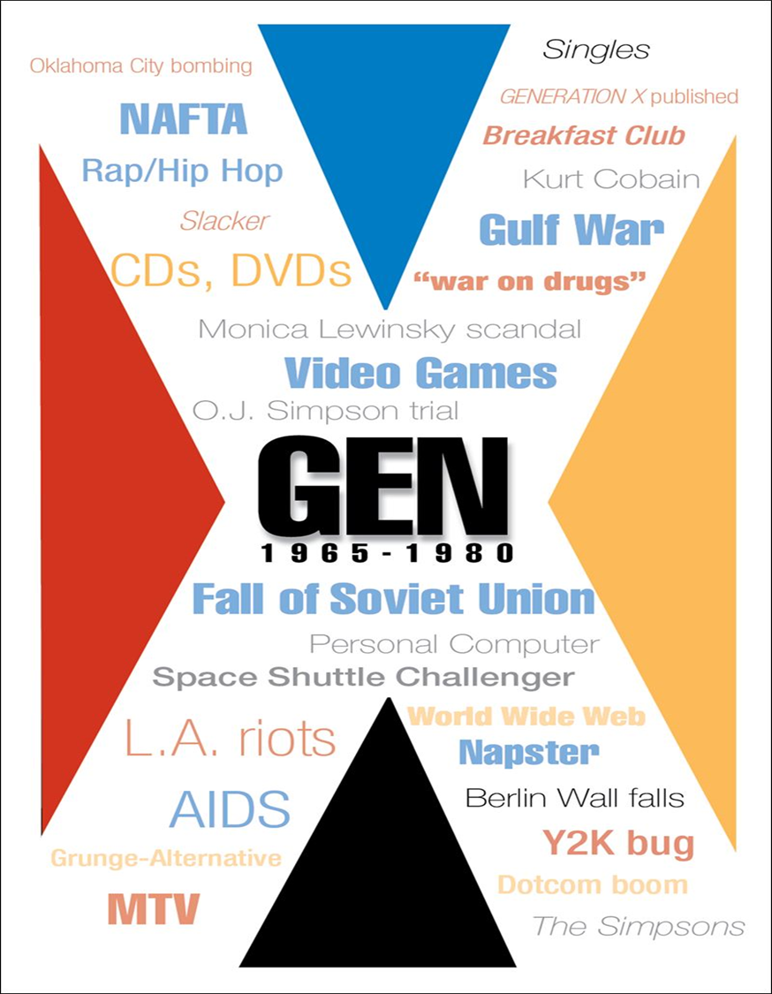
GEN X
Ages in 2019:
40 to 54
Notes:
Generation X (Born 1965-1989)
Experienced family upheaval – job loss
Were often children of divorced parents
Skeptical. Color Black resonates. Gothic, In Your Face, Anger.
Latch Key Generation. Excellent Change Agents, changing parents, households. Tech. Savvy.
Motto: Get In, Get Out, Get On With It.

Slide 17
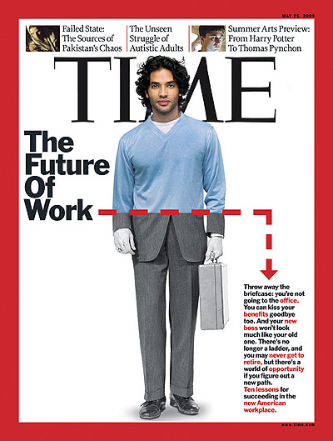
Gen Xers created Casual Friday.
May 25, 2009
TIME Magazine.
Notes:
May 25, 2009 Issue of TIME Magazine.

Slide 18
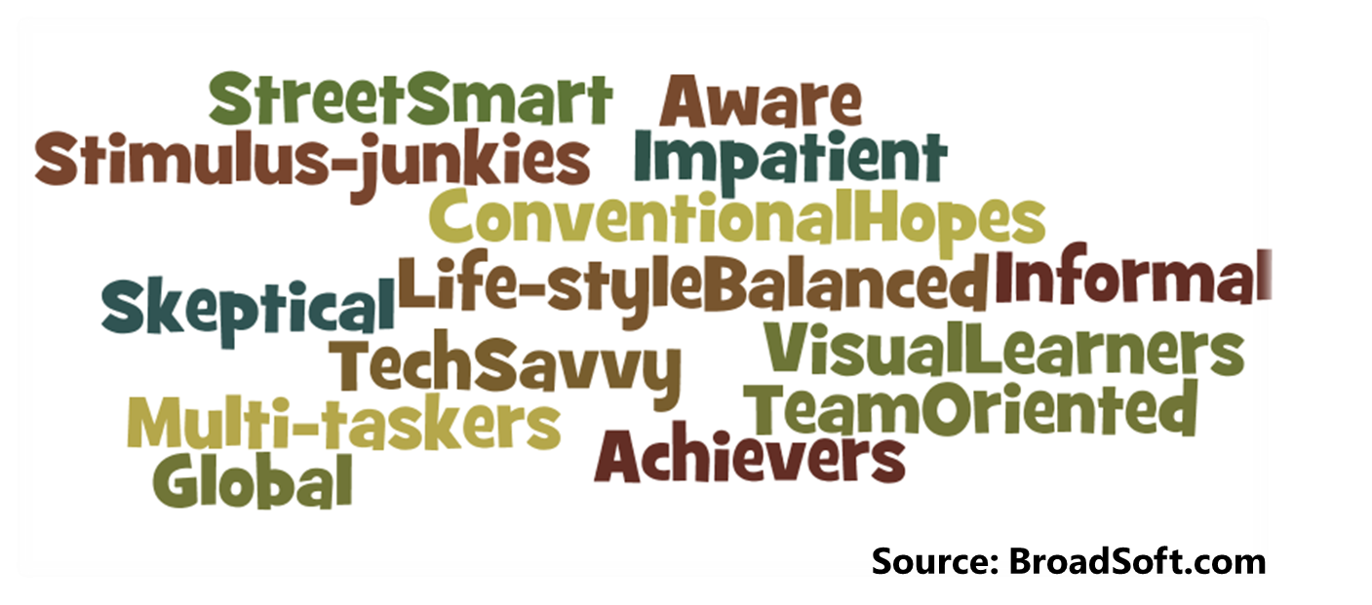
Millennials (Gen Y)
(80 million)
2019 Ages
24-39
Notes:
Millennials (Gen Y) - (Born 1981-1995)
Individualistic, yet group-oriented
Entrepreneurial
Short attention span. 80% of parents are Boomers; 20% are Gen X.
Own the WWW; check out things on the Web. Most protected children. 1/3 born to single, unwed mothers. 1/3 under age 18 work 20+ hours/week.

Slide 19
Notes:
Have Millennials or Z’s ever used a Dictionary?

Slide 20
Age 7 – 23 (in 2019)
Notes:
Generation Z follows Gen Y (Millennials).
They grew up during times of recessions and financial crises, war and terror threats, and technology overload. Many of them knew how to operate a tablet or cellphone before they could put sentences together. They don’t remember a life without social media and spend up to nine hours a day consuming media. They have a rather short attention span and it can difficult to keep them engaged. In the next ten years, it is estimated that Gen Z will consist of 22% of the workforce and many will be working in jobs that don’t even exist yet.
Source: C:\Users\pspinks\Documents\C-Go Presentations\SIP #3\SIP #3 - MASTER 2019\Gen Z_SIP #3_Article_5-1-19.docx

Slide 21
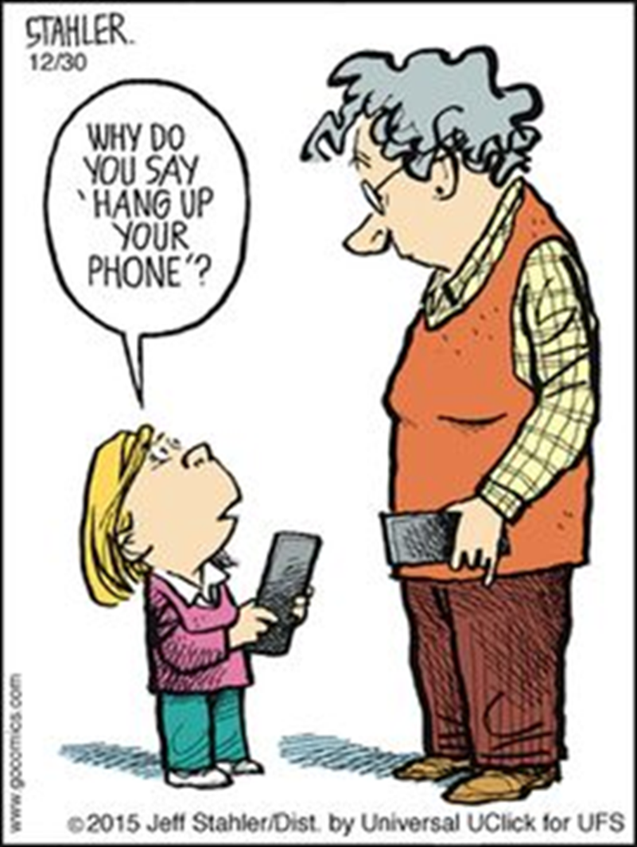
Notes:
Gen Z asking grandparent, “Why to you say ’Hang up your phone’?

Slide 22
Who Said this?
“The Children now love luxury. They have bad manners, contempt for authority, they show disrespect for adults, and love to talk rather than work or exercise…”
Notes:
“The Children now love luxury. They have bad manners, contempt for authority, they show disrespect for adults, and love to talk rather than work or exercise… They contradict their parents, chatter in front of company, gobble down their food at the table, and intimidate their teachers.”
Who made that astute pronouncement? Socrates (469-399 B.C.E.)! As the quote from Socrates demonstrates, every generation thinks the younger generation has it too easy and is obnoxious. And, that holds true for the older three generations currently in the workforce with Gen Y. It is probably felt more intently because Gen Y workers now make up the largest segment of workers and are growing.

Slide 23
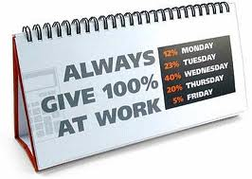
Is this how you see the younger generations?
Notes:
Always give 100% at Work:
12%- Monday
23%- Tuesday
40%- Wednesday
20%- Thursday
5%- Friday
WELL – GET OVER IT! People will generally do what you expect of them – change your expectations. (Especially supervisors.)

Slide 25
Tips for Managing Across Generations
Be aware of generational differences, but avoid generational bias
Encourage their feedback
Create opportunities for cross-generational mentoring
Notes:
Generational bias, or generational tension, means you believe that everyone of a certain generation is either inferior to your generation, or displays a certain negative behavior.
Get to know your employees as individuals. People are complex, so don’t try to drop them into a bucket and assume everyone of a certain generation is the same.
The better you work to get the know the person – their interests and goals – the easier it will be to lead them. They’ll trust you more, and you’ll know how to better motivate them.
By asking everyone on your team for feedback, you help them feel heard. You make them feel like they have a say in what’s going on, and that you value their input. Keep in mind, Feedback is a two way street for you and your team.
For problems within your teams, you can create opportunities for members of different ages to work with and coach one another. By doing so, they can build rapport and trust with each other and trade knowledge and skills. “Studies show that colleagues learn more from each other than they do from formal training, whish is why it is so important to establish a culture of coaching across age groups.
Source: C:\Users\pspinks\Documents\C-Go Presentations\SIP #3\SIP #3 - MASTER 2019\Tips for Generations_SIP #3_Article_11-19.docx

Slide 26
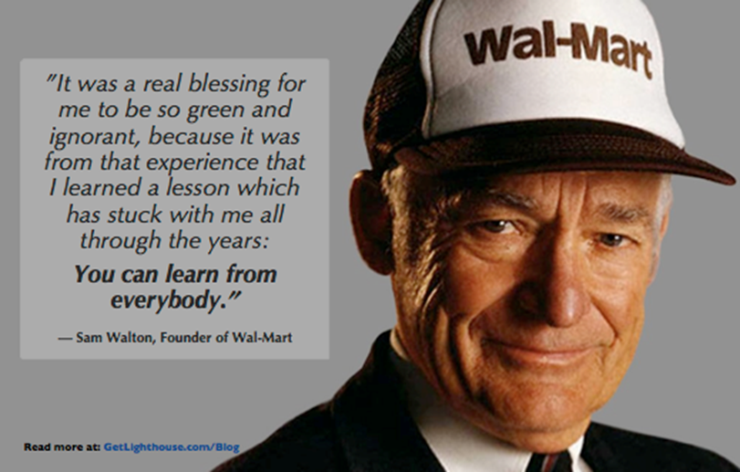
Tap into the wisdom and experience of your team
Notes:
Older employees are more likely to fall into mentor roles if you create an environment that encourages collaboration. This is valuable because it also allows for an environment to grow that doesn’t always need your presence to solve a problem.
Also, let the younger employees mentor and coach the older employees on the technology they are more comfortable with.
C:\Users\pspinks\Documents\C-Go Presentations\SIP #3\SIP #3 - MASTER 2019\Tips for Generations_SIP #3_Article_11-19.docx

Slide 27
Bridging the Generation Gap:
Respect each person!
Be aware of the differences
(Events of your Formative Years)
Appreciate the Strengths
of each generation
Manage the differences effectively
Communication is Key!
Find ways to interact that are mutually beneficial
Notes:
No matter what generation you belong to, this is exactly what your parents' generation thought about you, once upon a time, when you were entering the workforce:
They're rude. They're slackers. They dress unprofessionally. They love loud, raunchy music. They don't respect their elders. They're . . . Generation Y? Wrong. They're you.
"In my talks, I give people an exercise where I ask them to describe the younger generation," says Meagan Johnson, a Phoenix-based speaker on generational issues in the workplace. "They usually list things like, 'bad attitude,' 'sense of entitlement,' 'lack of work ethic,' 'rude,' 'disloyal.' Then I show them a PowerPoint slide of a 1968 issue of Life magazine about the generation gap--where the same words were used to describe the baby boomers!

Slide 28
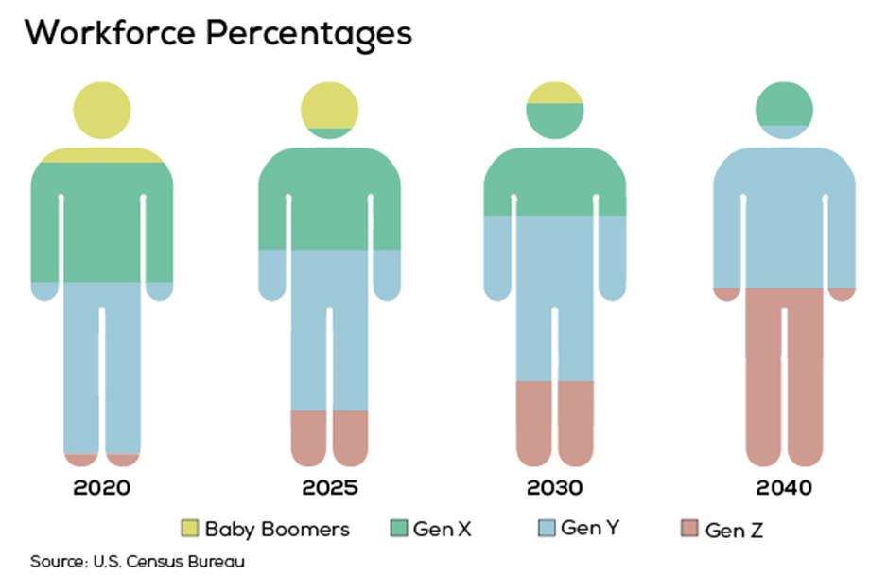
Notes:
In chart above:
Baby Boomers are Yellow,
Gen Xers are Green,
Gen Y (Millennials) are Blue,
Gen Z is pink.

Slide 29
Gen Z’s are The Future!
Respect
Them
Be Nice – Flatter Them
Motivate Them - with New Challenges and learning New Skills
Collaborate – They are Team Players
Communication is Key!
Find ways to interact that are mutually beneficial
Notes:
No matter what generation you belong to, this is exactly what your parents' generation thought about you, once upon a time, when you were entering the workforce:
They're rude. They're slackers. They dress unprofessionally. They love loud, raunchy music. They don't respect their elders. They're . . . Generation Y? Wrong. They're you.
"In my talks, I give people an exercise where I ask them to describe the younger generation," says Meagan Johnson, a Phoenix-based speaker on generational issues in the workplace. "They usually list things like, 'bad attitude,' 'sense of entitlement,' 'lack of work ethic,' 'rude,' 'disloyal.' Then I show them a PowerPoint slide of a 1968 issue of Life magazine about the generation gap--where the same words were used to describe the baby boomers!

Slide 30
Good Advice for All!

