Slide 1
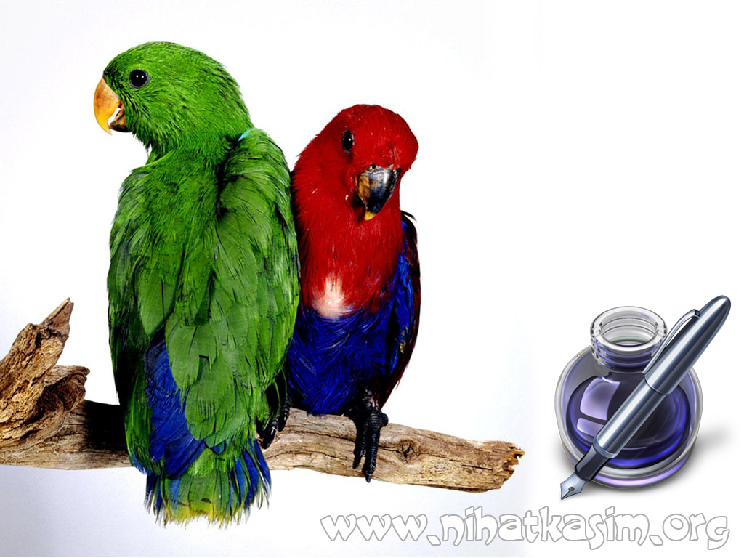
THERE IS THERE ARE

Slide 2
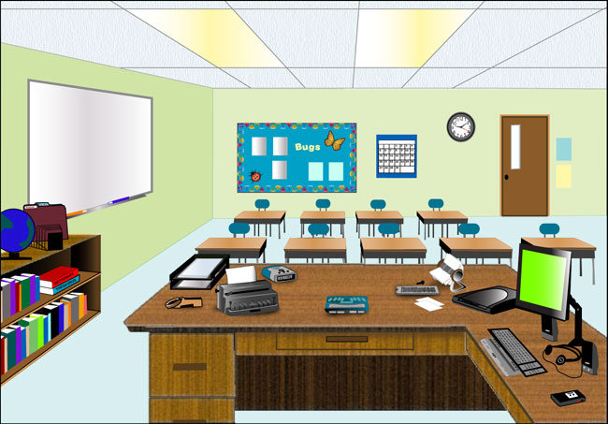
THERE IS
Used for:
Singular nouns
a clock
(singular, one item)
a board
(singular, one item)
a computer
(singular, one item)
a classroom
There is a computer in the classroom.
There is a clock in the classroom.
There is a board in the classroom.

Slide 3
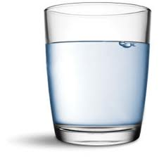
THERE IS
Used for:
Singular nouns
uncountable nouns
water
(uncountable)
a glass
There is some water in the glass.

Slide 4
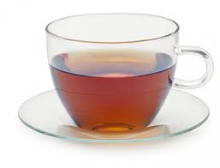
THERE IS
Used for:
Singular nouns
uncountable nouns
tea
(uncountable)
a cup
There is some tea in the glass.

Slide 5
THERE ARE
Used for:
plural nouns
9 desks
(plural, more than one item)
9 chairs
(plural, more than one item)
a classroom
There are nine desks in the classroom.
There are nine chairs in the classroom.

Slide 6
THERE IS, THERE ARE
We use “there is, there are” when we want to say that something exists or doesn’t exist.
There is
There are
used for
used for
Singular nouns
(one item)
Plural nouns
(more than oneitem)
Uncountable nouns
There is a pen on the desk.
There are two pens on the desk.

Slide 7
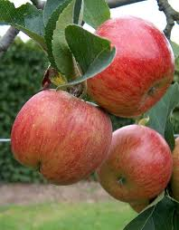
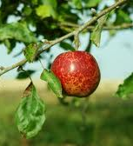
THERE IS, THERE ARE
We use “there is, there are” when we want to say that something exists or doesn’t exist.
There is an apple on the tree.
There are three apples on the tree.

Slide 8
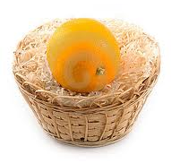
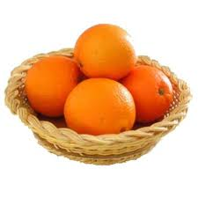
THERE IS, THERE ARE
We use “there is, there are” when we want to say that something exists or doesn’t exist.
orange
basket
There is an orange in the basket.
There are four oranges in the basket.

Slide 9
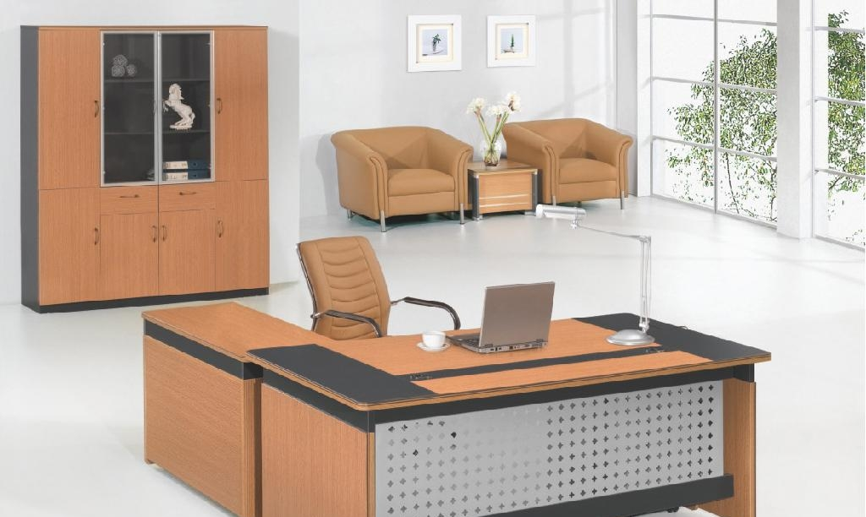
THERE IS, THERE ARE
armchair
chair
table
There are two armchairs in the office.
There is a chair in the office.
There is a table in the office.

Slide 10
THERE IS, THERE ARE
POSITIVE
There is a chair in the office.
There are two chairs in the office.
There is a chair in the office.
There are two chairs in the office.
NOT
NEGATIVE
NOT
There a chair in the office.
There two chairs in the office.
is
?
QUESTION
are
?
Yes, there is. Or No, there isn’t.
Yes, there are. Or no, there aren’t.
SHORT ANSWERS
There isn’t / aren’t means that something doesn’t exist.

Slide 11
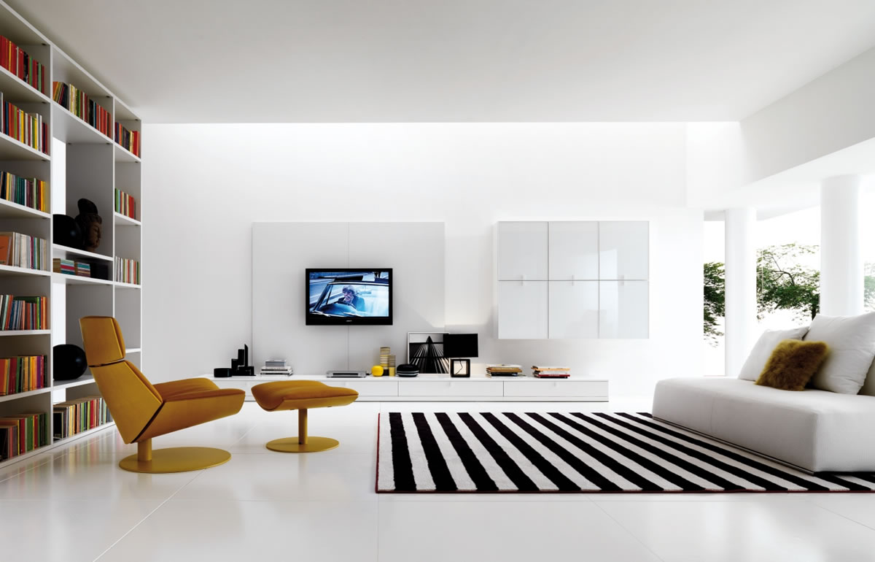
THERE IS, THERE ARE
EXERCISES:
There is a chair in the living room.
There is a TV in the living room.
There isn’t a table in the living room.
There are many books in the living room.
Are there any plants in the living room?
Is there anybody in the living room?

Slide 12
THERE IS, THERE ARE
are
EXERCISES:
There _______ 21 students in our class.
There __________ any milk in the fridge.
_____ there anybody inside?
_______ there any students in the classroom?
There _________ many books on the bookshelf.
_____ there any water in the glass?
___________ two people in the garden.
_____________ any money in my pocket.
isn’t
Is
Are
are
Is
There are
Is there

Slide 13
IF THE TOPIC IS NOT CLEAR ASK YOUR TEACHER AGAIN!
THANKS.
Please visit
www.nihatkasim.org
to download this lesson

