Slide 1
Lecture – 1 Introduction
Risk
Risk Management
Risk Management Dimensions

Slide 2
Definition of Risk
Risk is defined as uncertainty, that is, as the deviation from an expected outcome.
The uncertainty must be quantifiable
Statistics allows us to quantify this specific uncertainty by using measures of dispersion.
In a business context, risk is usually expressed only the negative deviations from expected values
Is standard deviation a risk?

Slide 3
One more definition
Risk can be defined as any source of randomness that may have an adverse impact on a person or corporation.
Risk management is really about how firms actively select the type and level of risk that it is appropriate for them to assume.
In other words, risk management does not mean risk minimization

Slide 4
Some Fallacies about risk
Risk is always bad
Some risks are so bad that they must be eliminated at all costs
Playing it safe is the safest thing to do

Slide 5
Classification of Risk
In general, the conceptual definition of risk varies with the perspective.
Culp (2001) offers the following perspectives for how to define risk.
1. Event Driven definition of risk
  Market Risk
  Credit Risk
  Operational Risk
  Liquidity Risk
  Legal Risk
2. DIVERSIFIABILITY
-Systematic
-Unsystematic

Slide 6
Risk Management Process
Risk management can be defined as a distinct process, that is, as a set of activities.
Identification, classification, and setting tolerance level of a firm’s risk exposure and the source of risk (risk factors).
Analysis of the risk exposure on firm value, i.e. the understanding of the relationship between and the measurement of how much the cash flows and the value of a firm are affected by a specific source (risk factor).

Slide 7
Risk Management Process
Allocation of (risk) capital to the business units
(Ex ante) decision of whether a new transaction should be accepted from a portfolio perspective and consideration of whether the risk taking is compensated appropriately from a risk-return perspective.

Slide 8
Risk Management Process
5. Limitation of risk taking to ensure a constant risk profile by “mitigating” risk.
In order to “mitigate” risk, various (hedge) instruments and policies can be applied, such as, for example,
  (1) complete avoidance of risk,
  (2) reduction of risk,
  (3) transfer of risk to third parties, and

Slide 9
Risk Management Process
6. Risk controlling
Usually encompasses the documentation and controlling of risk-management actions to ensure the achievement of the goals that have been set.
Deviations between targets and actual performance are analyzed to identify causes
Additionally, risk control also covers controlling the involved people and business units by checking whether methods and instruments are applied properly

Slide 10
Risk Management Process
7. (Ex post) performance evaluation in order to link risk-management actions to the overall corporate goals.
The goal of risk management should, therefore, be to identify any uneconomic risk taking, to ensure that any risk-management activity is consistent with value maximization.
The goal, however, cannot and should not be to avoid or minimize all risk taking.
Rather, it should be to find the optimal balance between risks and expected returns by concentrating on the competitive

Slide 11
Do firms eliminate all risks?
“Empirical Evidence suggests many firms choose “selective” hedging strategies, that is, that they leave 70% of their risk exposure open (only 30% are therefore hedged), if they believe markets move in their favor. On the contrary, almost 100% are hedged when the firms believe that markets will move in the opposite direction. However, decision makers, in the belief that they can generate superior cash flows by leaving positions unhedged, are running the risk of substantial losses. It seems very difficult that someone can consistently earn superior returns in highly liquid and (information) efficient markets.

Slide 12
Can Risk Management Create Value?
Can risk management at firm’s level create value?
In perfect capital markets, the answer is no.
The reason is that investors are capable of home-made risk management
A firm’s risk can be decomposed into systematic and un-systematic risk
There is no rationale in hedging un-systematic risk if capital markets are efficient as investors can eliminate it through portfolio diversification
Eliminating unsystematic risk subjects the firm to additional costs of hedging, with no additional gain

Slide 13
Value of the firm =
Discount Rate = R_{f}+B(R_{m}-R_{f})
Beta is a measure of systematic risk
Reducing unsystematic risk will reduce the cash flows, not the discount rate
In attempting to reduce systematic risk(i.e. by making changes to operations), there will be reduction in both cash flows and the discount rate, and hence the firm value remains unchanged

Slide 14
Reducing unsystematic risk
What if a firm uses financial instruments to reduce systematic risk?
Suppose a firm has beta of 1.5, how this beta can be reduced to zero through financial instruments?
Would that be good for shareholders?

Slide 15
Value creation in imperfect markets
Risk management by a firm, compared to home-made risk management, delivers the following advantages:
  Avoid passing up (help you in availing) profitable investment opportunities
  Avoid bankruptcy costs and financial distress costs
  Corporate tax management
  Risk management helps in using more debt financing, which has tax shield benefits
  Better incentives to managers
  Retain valuable large shareholders
  Attract stakeholders to make firm specific investments

Slide 16
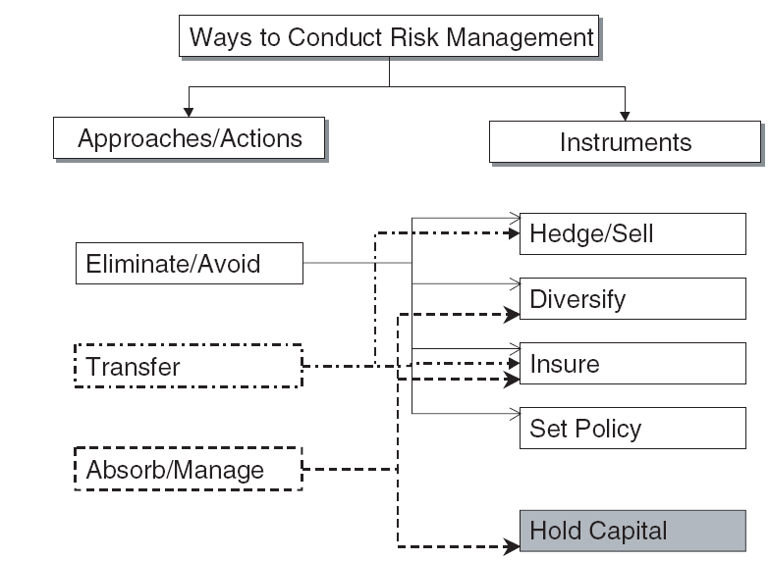
Ways to Conduct Risk Management

Slide 17
Ways to Conduct Risk Management
There can be three approaches or sets of actions and within them the various instruments that are available to firms for risk management.
Eliminate/Avoid
A firm can decide to eliminate certain risks that are not consistent with its desired financial characteristics or not essential to a financial asset created.

Slide 18
Ways to Conduct Risk Management
Moreover, the firm like a bank can use portfolio diversification in order to eliminate specific risk.
Additionally, it can decide to buy insurance, for event risks.
Furthermore, the firm can choose to avoid certain risk types up front by setting certain business practices/policies (e.g., underwriting standards, process control) to reduce the chances of certain losses and/or to eliminate certain risks ex ante
If the firm has no comparative advantage in managing a specific kind of risk, there is no reason to absorb and/or manage such a risk

Slide 19
Ways to Conduct Risk Management
Absorb/Manage
Some risks must or should be absorbed and managed at the firm level, because they have one or more of the following characteristics:
They cannot be traded or hedged easily
They have a complex, illiquid, or proprietary structure that is difficult, expensive, or impossible to reveal to others
They are a business necessity. Some risks play a central role in the bank’s business purpose and should therefore not be eliminated or transferred

Slide 20
Ways to Conduct Risk Management
Transfer
The transfer of risks to other market participants is decided on the basis of whether or not the firm has a competitive advantage in a specific (risk) segment
Any element of the systematic risk that is not required or desired can be either shed;
  by selling it in the spot market or
  hedged by using derivative instruments such as futures, forwards, or swaps

Slide 21
Ways to Conduct Risk Management
In all such circumstances, the bank needs to actively manage these risks by using one of the following instruments:
Diversification: The bank is supposed to have superior skills (competitive advantages), because it can provide diversification more efficiently/at a lower cost than individual investors could do on their own
This might be the case in illiquid areas where shareholders cannot hedge on their own.

Slide 22
Ways to Conduct Risk Management
Management of credit portfolio is necessary, because the performance of a credit portfolio is determined not only by exogenous factors but also by endogenous factors such as superior ex ante screening capabilities and ex post monitoring skills.
Diversification, typically, reduces the frequency of both worst-case and best-case outcomes, which generally reduces the bank’s probability of failure.

Slide 23
Ways to Conduct Risk Management
Holding capital:
For all other risks that cannot be diversified away or insured internally and which the bank decides to absorb, it has to make sure that it holds a sufficient amount of capital in order to ensure that its probability of default is kept at a sufficiently low level.
Note that equity finance is costly
The cost of economic capital and the decision of not eliminating risk provide a trade-off
Both risk and return need to be monitored

