Slide 1
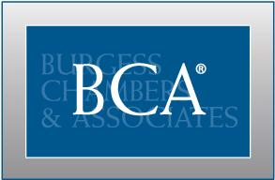
FIDUCIARY CONSIDERATIONS FOR GOVERNMENTAL RETIREMENT PLANS
August 2017
June 9, 2017
Presented by: Frank Wan
Senior Vice President
Presented by: Frank Wan, Senior Vice President
Burgess Chambers & Associates, Inc.
315 E. Robinson Street, Suite 690. Orlando, FL 32801

Slide 2
BIOGRAPHY
Mr. Frank Wan is a senior consultant responsible for economic research, plan design and investment consulting. Mr. Wan is the Chair of the Investment Committee and oversees all client investments valued in excess of $3.6 billion. His research has been published by Investor Business Daily and Forbes. Prior to joining BCA, Frank was an equity analyst for a market-neutral hedge fund, where he was responsible for financial modeling. Frank received his undergraduate degree from Stetson University and MBA from Rollins College. Frank is an Accredited Investment Fiduciary (AIF).
Frank Wan, MBA, AIF
Senior Vice President

Slide 3
AGENDA
INTRODUCTION
FIDUCIARY RESPONSIBILITY
FIDUCIARY FUNCTIONS
LIMITING FIDUCIARY LIABILITY
TYPES OF FIDUCIARY ADVISORS
ILLUSTRATIVE EXAMPLES
LAWSUITS AND LESSONS
INDUSTRY TRENDS
INTERACTIVE QUIZ
RESOURCES

Slide 4
INTRODUCTION
Fiduciaries of 403(b), 401(a) and 457(b) retirement plans have come under increased scrutiny in recent years, in part due to participant lawsuit filed against plan sponsors and the resulting media attention.
The Internal Revenue Services and Department of Labor have also increased the number of plans they audit each year. Because significant consequences can result from a fiduciary breach, you are encouraged to understand the responsibilities that apply to plan related-decisions or lack-of.
Who is a Fiduciary? A person acts in a fiduciary capacity when he or she handles money or property for the benefit of another.
Why is it important? Unlike Defined Benefit plans, the responsibility and control of investment outcomes is substantially shifted from the plan sponsor to the participant.
The plan sponsor is solely responsible for maintaining the plan, meeting regulatory requirements, educating participants, prudently selecting and monitoring both investment options and service providers, and controlling plan expenses.

Slide 5
PLAN FIDUCIARIES
A fiduciary is a legal term that can be simply defined as anyone who:
Exercises discretionary control over plan assets
Has discretionary responsibility in the administration of the plan
Provides investment advice for a fee
Makes decisions regarding investments
Is appointed to a Committee or Board, responsible for the plan oversight
Is responsible for choosing and terminating service providers
Has the authority to bind the plan sponsor through plan-related contracts
Establishes policies and procedures for the plan
Fiduciaries may be a designee by function, or duties may be delegated to others, but this does not remove fiduciary responsibilities. Also, you do not have to make decisions to be a fiduciary; simply having authority to make decisions makes you a fiduciary.

Slide 6
FIDUCIARY RESPONSIBILITY
State law governs Non-ERISA plans; Non-ERISA does NOT mean Non-Fiduciary.
“Each retirement system or plan shall have one or more named fiduciaries with authority to control and manage the administration and operation of the retirement system or plan.” Florida Statute 112.656
Fiduciary responsibility: the obligation to make every plan-related decision prudently and with only the best interests of the plan participants in mind.
Employers sponsoring a DC plan act in a dual capacity:
Fiduciary
Functions
Employer
Functions

Slide 7
FIDUCIARY FUNCTIONS
Fiduciary Functions
Establishing policies and procedures for the plan.
Administering the plan in compliance with the plan document.
Ensuring regulatory compliance and updates.
Developing formal written Investment Policy Statements (IPS).
Monitoring the fees, ensuring reasonableness.
Selecting and monitoring service providers, trustees, and consultants.
Selecting and monitoring investment options.
Promote participation and increase awareness.
Educating participants about the plan’s investment options.
Providing the tools to help them save for a secure retirement.

Slide 8
FIDUCIARY FUNCTIONS
DUTY OF LOYALTY
DUTY OF PRUDENCE
DUTY TO DIVERSIFY
DUTY TO SELECT/
MONITOR INVEST.
DUTY TO FOLLOW
PLAN DOCUMENTS
Expected Result
Broad level plan design and risk parameters.
ERISA Fiduciary:
Duty of care
Duty of loyalty
Ensure plan fees are reasonable.
Avoid conflicts of interest.
Act with care, skill,
prudence, and diligence.
See (Florida Prudent
Investor Rule; FS 518.11)
Establish prudent process for administrative decisions of the plan.
Duty to diversify plan assets to minimize risk unless it is clearly prudent to do otherwise.
Obligated to offer diversified investment choices.
Investment Policy Statement (IPS)
Strong encouraged to adopt an IPS, which may be the single most important document to help you manage your fiduciary duty.
Fiduciaries must act in accordance with an executed plan document and other governing instruments.
Must maintain compliance with all Internal Revenue Code (IRC).
IRS determination letter: remedial amendment cycles eliminated on January 1, 2017.
The determination letter program has never applied to eligible 457(b) plans.
Plan sponsor wanting assurance from the IRS may request a “private letter ruling”.

Slide 9
INVESTMENT BEST PRACTICES
Practice 1.1
Practice 1.2
Practice 1.3
Practice 1.4
Practice 1.5
demonstrate fiduciary awareness
investments: consistent with governing doc.
responsibilities are defined and documented
address conflict
of interest
review of all related agreements
Practice 2.1
Practice 2.2
Practice 2.3
Practice 2.4
Practice 2.5
Practice 2.6
develop time horizon for each
Investment
identify risk parameters
set an expected return for each investment
select appropriate asset classes
establish monitoring constraints
review investment policy
Practice 3.1
Practice 3.2
Practice 3.3
due diligence process for service provider
administer plan in compliance with required doc.
document all decisions made with fiduciary care
Practice 4.1
Practice 4.2
Practice 4.3
Practice 4.4
Practice 4.5
periodic review: benchmark & peer objectives
review service providers
update policies & compliance requirements
periodic reviews: reasonable fees
review of fiduciary responsibilities: checklist
1. Organize -> 2. Formalize -> 3. Implement -> 4. Monitor

Slide 10
LIMITING FIDUCIARY LIABILITY
Develop plan objectives
-Maximize wealth; income replacement
Measure effectiveness
-Measure participation, savings rate, median account balance
Reduce complications and oversight obligations
-Limit loan obligations
Consolidate to a single record keeper
-Economy of scale
-Reduce administrative burdens
Limit number of core investment options
-Customize menu: less is more
Compliance with ERISA 404(c)
-Provide participant education
-Qualified Default Investment Alternative (QDIA)
Hire a fiduciary advisor to provide ongoing oversight
-Provide assistance with RFPs, benchmarks, and compliance
The more satisfied participants are with their plan, the less likely they will be to blame plan fiduciaries for a negative outcome.

Slide 11
ERISA 3(21) vs. 3(38) INVESTMENT FIDUCIARIES
What is the difference?
3(21)
-State in writing co-fiduciary status
-Assist in drafting IPS
-Helps design initial fund menu
-Provides monitoring
-Recommends changes
-Recommends mapping strategies
-Provides documentation
3(38)
-State in writing co-fiduciary status
-Draft IPS
-Builds initial fund menu
-Monitor menu
-Makes changes
-Determines mapping strategies
-Provides documentation
Plan sponsor retain the responsibility to select and monitor the adviser, regardless of their adviser’s fiduciary status.

Slide 12
ILLUSTRATIVE INVESTMENT MENU

Slide 13
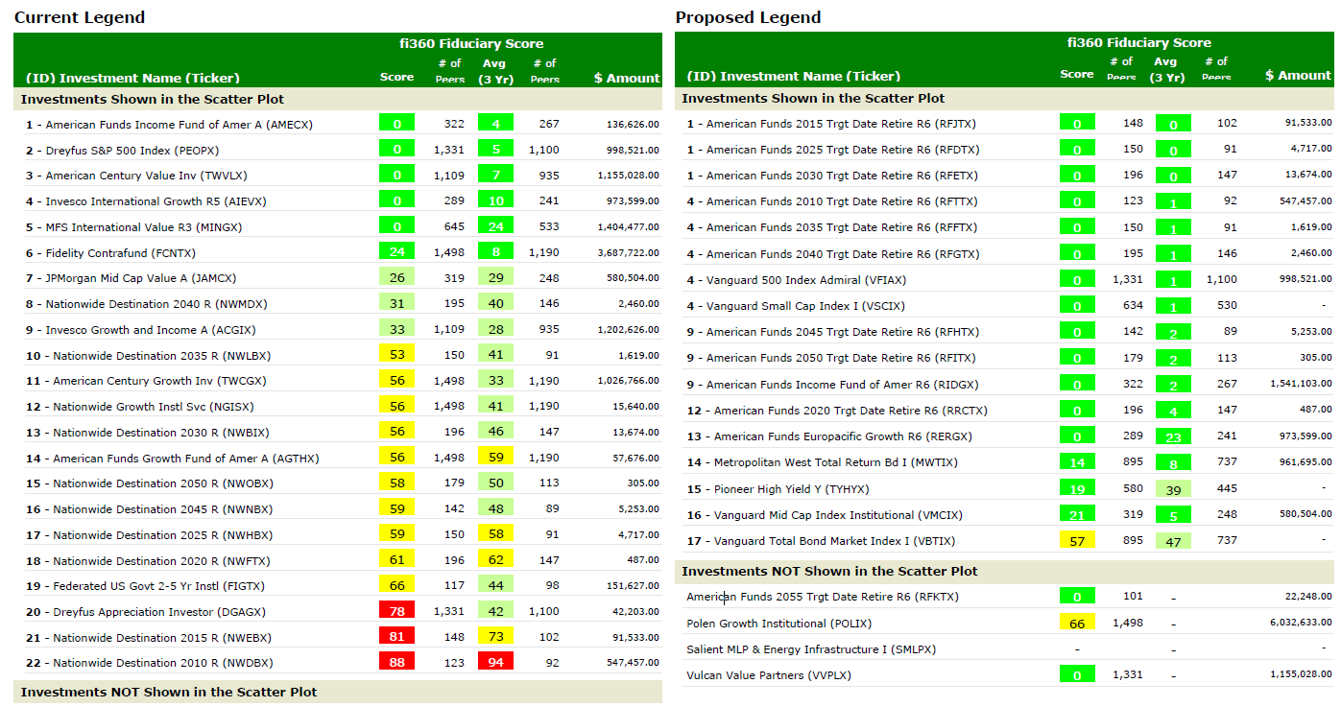
ILLUSTRATIVE FUND REPORT CARD
The fi360 Fiduciary Score is a peer percentile ranking of an investment against a set of quantitative due diligence criteria selected to reflect prudent fiduciary management. Criteria include total returns, risk-adjusted returns, expenses, and other portfolio statistics. Investments are ranked according to their ability to meet due diligence criteria every month.

Slide 14
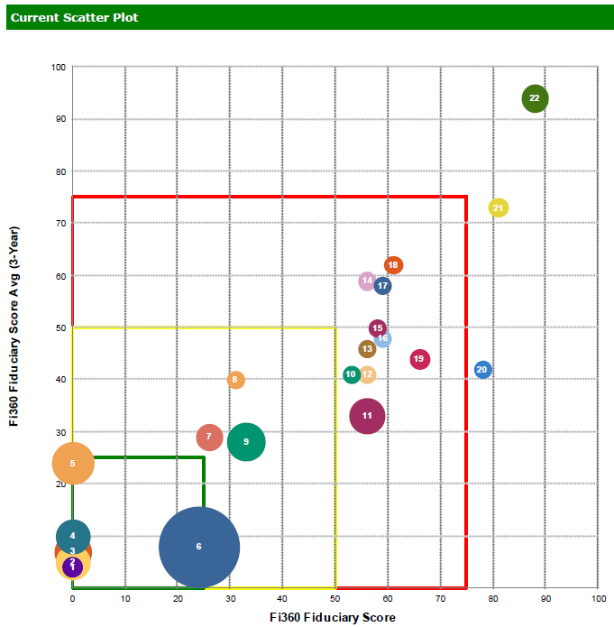
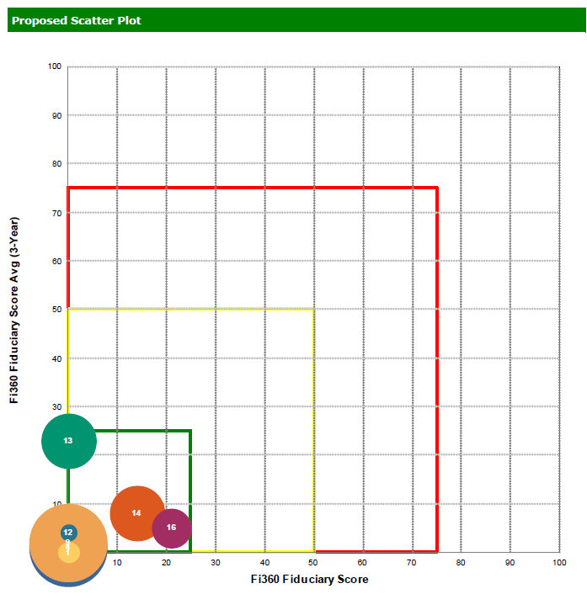
ILLUSTRATIVE FUND REPORT CARD
A simple change in the fund line-up and/or share class change quickly resulted in a superior portfolio.
This also reduced the management fees from to 0.67 from 0.83, resulting in savings of more than $20,000.
Notes:
Other important things to note and potentially options:
-target date funds / to and through – often times too aggressive and not a value add
-different level of fees
-savings through models

Slide 15
PARTICIPANT LAWSUITS
Recent class action lawsuits place new emphasis on:
Fees charged by plan’s investment options
Fees charged by service providers and recordkeepers
Multiple recordkeepers and too many options
Allocation of fees to participant accounts
Allocation of revenue sharing
Lessons for plan sponsors:
Courts have based their decisions more on the process rather than the decisions.
U.S. Supreme Court has held unanimously that plan fiduciaries have an ongoing duty to monitor the investment they make available to plan participants.
It is the responsibility of plan fiduciaries to prudently monitor service providers.
Documenting prudent decision making process will limit fiduciary liability.

Slide 16
PARTICIPANT LAWSUITS
Claim | Henderson v. Emory | Clark v. Duke
Plan fiduciaries acted imprudently by offering too many investment options | Dismissed | Allowed to proceed
Various claims based on damages incurred more than six years ago | Dismissed | Dismissed
Investing in TIAA mutual funds created a prohibited transactions because TIAA is a plan recordkeeper | Dismissed | Dismissed
Plan fiduciaries failed to engage in prudent process for selecting recordkeeper | Allowed to proceed | Allowed to proceed
Plan fiduciaries imprudently retained underperforming or higher-cost investment options | Allowed to proceed | Allowed to proceed
The agreement between TIAA and the plan fiduciaries was unreasonable, in part because participants were “locked in” to annuity products | Allowed to proceed | Dismissed
Current round of rulings in the university litigation cases:
Northern District of Georgia
Middle District of North Carolina
University of Chicago and Princeton University Lawsuits: filed in May 2017

Slide 17
INDUSTRY TREND
Roth 457
Fee Equalization
Re-Enrollment
Auto Escalation [Prohibited in Florida]
Provider consolidation
Stable Value
Pre-Approved 403(b) Plans:
The Internal Revenue Service has recently started issuing opinion letters approving the form of pre-approved 403(b) plans. These opinion letters provide assurance from the IRS that the pre-approved plan document complies in form with the Internal Revenue Code. In late 2017 or early 2018, plan sponsors likely will need to begin restating their plan documents in connection with this process. Pre-approved 403(b) plan documents will be less flexible than the documents previously used by service providers. As a result, plan sponsors should anticipate completing a plan design review and assessment of their options to obtain assurance that their documents comply with the Code.

Slide 18
ADDITIONAL BEST PRACTICES TO CONSIDER
Obtain fiduciary liability insurance coverage
Form fiduciary/investment committee
Hold regular meetings
Promote continuing education
Establish an Education Policy Statement (EPS)
Document all minutes and decisions
Hire advisers for guidance / RFP

Slide 19
FIDUCIARY CHECKLIST
Maintain IRS related documents [determination letter, private ruling, etc.]
Maintain records of all amendments
Plan documents are properly executed
Plan trustees are properly appointed
Develop and maintain Investment Policy Statement (IPS)
Follow a process, described in the IPS, for changes in the investment menu
Have proper benchmarks in place
Have an investment advisor; 3(21) or 3(38)?
Properly outline responsibilities of service providers
Fiduciary liability insurance coverage
All fiduciaries have received sufficient training
Periodic review of plan success metrics: participation, savings, diversification, readiness
Periodic review of plan design and consider changes to improve success
No conflict of interest
Evaluate loan procedures
Ensure proper administration and compliance
Unallocated amounts in a plan account (forfeitures and/or revenue shares), if applicable, have been used to pay allowable plan expenses or have been allocated to participant accounts
Fees paid are reasonable
Receiving proper disclosures
Vendor selecting and award is documented
Maintaining broad menu of investment options
Review quarterly statements
Evaluate employee communication
Provide employee education and basic tools
Use ERISA 404(c) as a best practice to inform participants
Periodic meetings along with documentations (minutes, notes, etc.)
Maintain file supporting fiduciary process
Have all property executed plan documents in an easily accessible location

Slide 20
RESOURCES & REFERENCES
Pension & Investments – www.pionline.com – East Coast Defined Contribution Conference
National Association of Government Defined Contribution Administrators – www.nagdca.org
Government Finance Officers Association – gfoa.org
Global Fiduciary Standard of Excellence – www.fi360.com/main/pdf/handbook_steward.pdf
Notes:
Recommend conferences from P&I. free for plan sponsors.

Slide 21
THANK YOU
Since 1988, BCA has specialized in Florida retirement plans, providing our clients with independent and objective advice. We are committed to the highest level of fiduciary care, and it would be our pleasure to serve you and your employees.
-Frank Wan, Senior Vice President
Phone: 407 644 0111
Direct: 407 218 6451
Email: fwan@burgesschambers.com
Disclosure: All slides should be used for illustrative purposes only. Content should not be regarded as a complete analysis of the subjects discussed or as personalized investment advice. Neither BCA nor its employees provide tax, accounting, or legal advice. This presentation should be construed as tax, accounting or legal advice; it is provided solely for informational purposes.

