Slide 1
Branding & Integrated Marketing
Case Study

Slide 2




We Began With A Disjointed Identity

Slide 3

And Created, A Bold New Look & Name

Slide 4
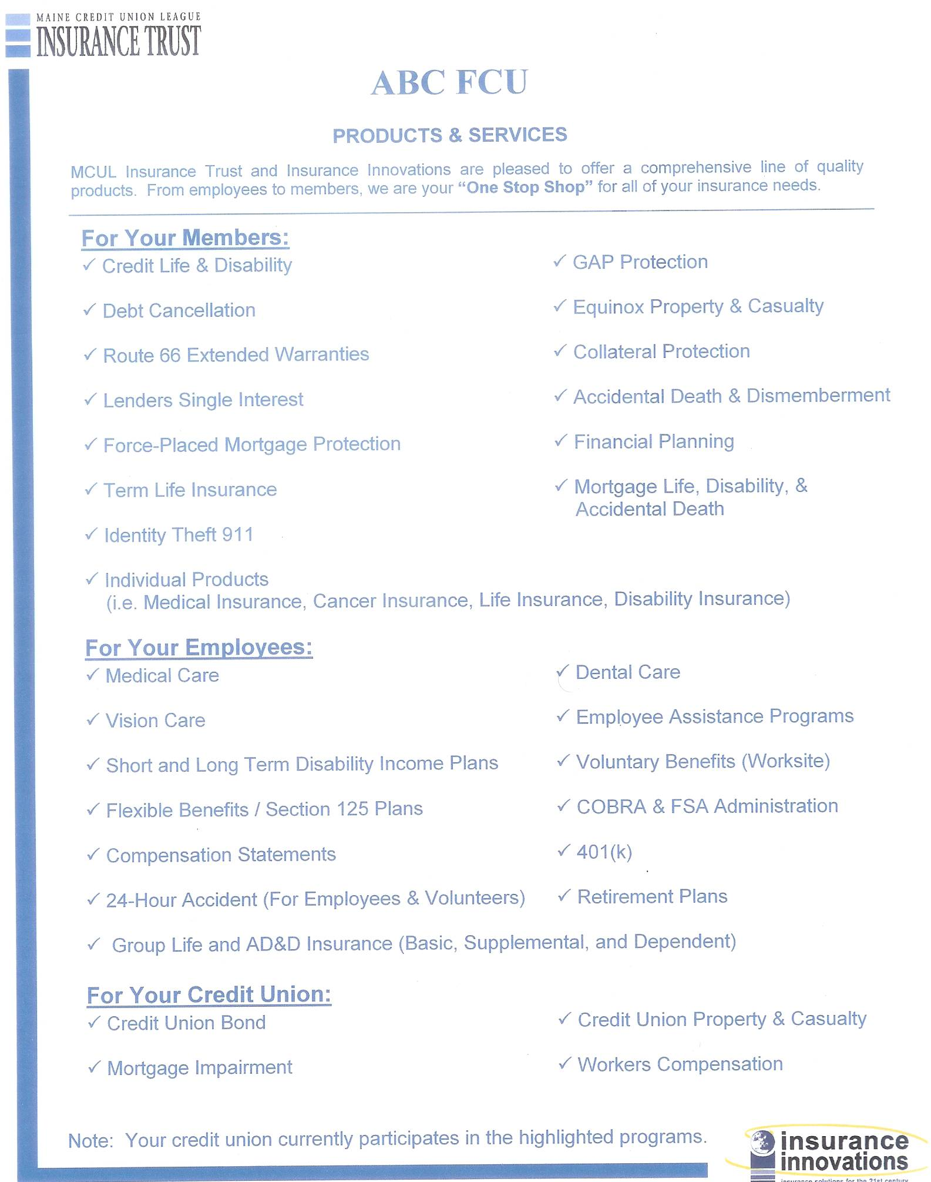
Marketing Materials Were Neither Compelling Nor Customer Focused

Slide 5


Now They’re Visually Impactful and Organized By Customer Needs

Slide 6
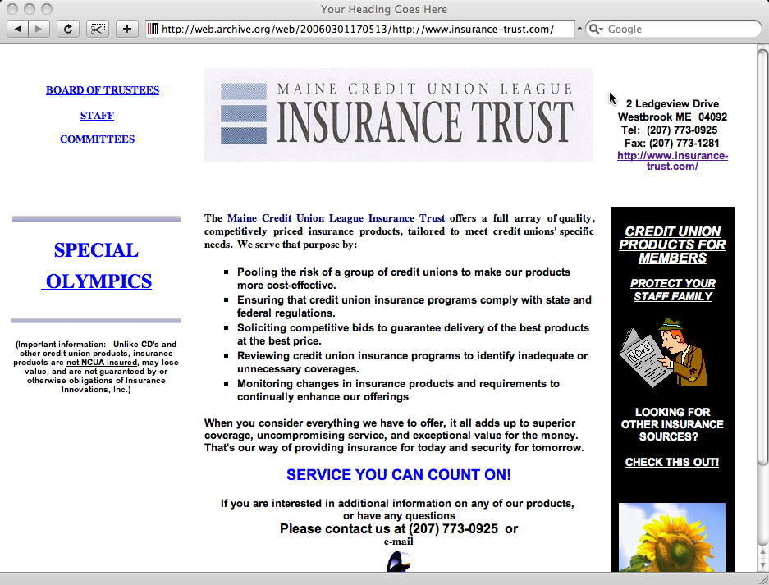
Web Sites Were Outdated and Not Delivering Business Value

Slide 7
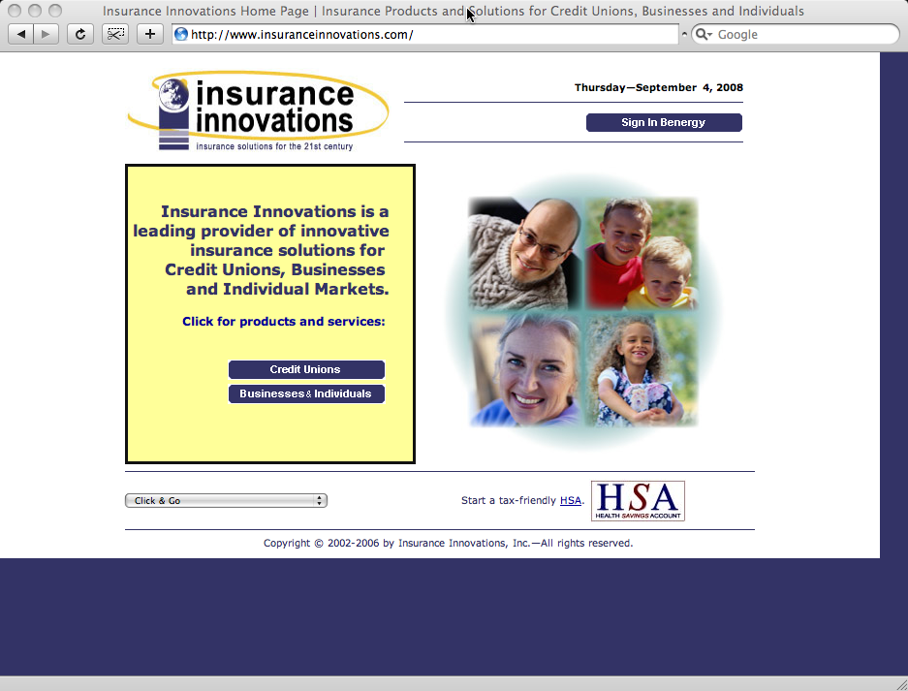
Web Sites Were Outdated and Not Delivering Business Value

Slide 8
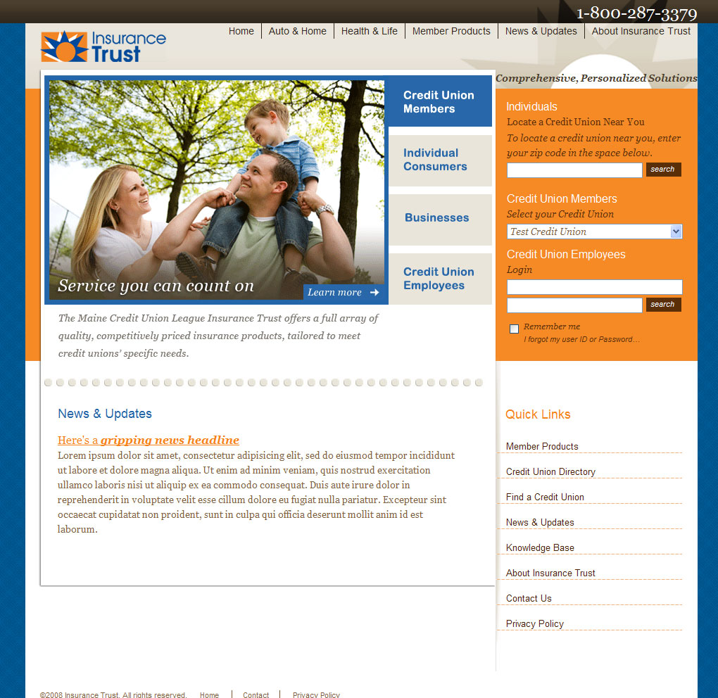
While the New Web Site Will Supplement the Sales & Support Team’s

Slide 9
