Slide 1
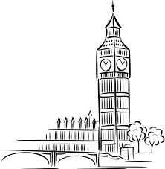
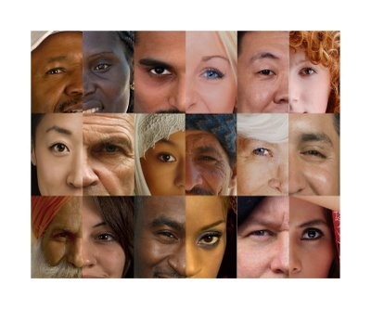
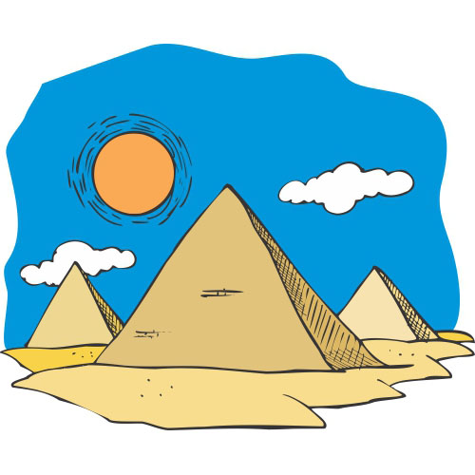
Unit 7
Describing People, Places, and Things

Slide 2
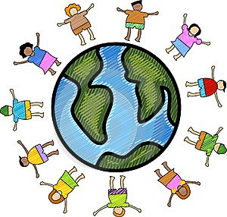
After this chapter, students are expected to be able to:
Notice other people’s physical appearance,
Describe their physical details (facial details and body posture),
Describe the country they were coming from.

Slide 3
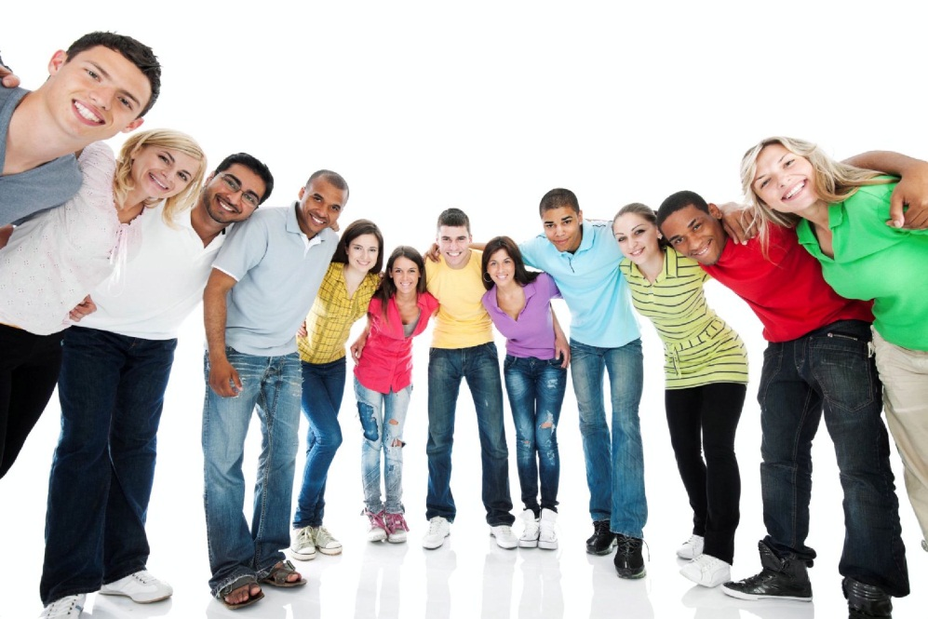
- Is it important?
- Extremely.
Skill needed to distinguish, respect, and acknowledge other people from other country, race, and belief is a very important one to possess. Such skill will make you a nice, friendly, and tolerant person with an attitude liked by many.

Slide 4
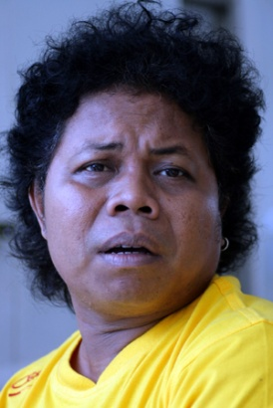
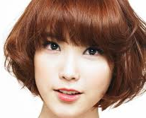
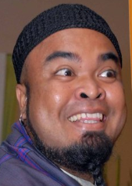
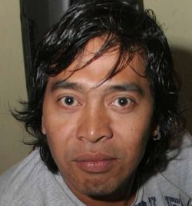
This world comprises from many different races of people, from many countries, from many geographical contours, conditions, and climates. Those diversities also affects the physical appearance of people, their habit, their custom, and their culture. In this chapter, you will learn to recognize them and, when you are capable of doing so, also to describe them back.

Slide 5
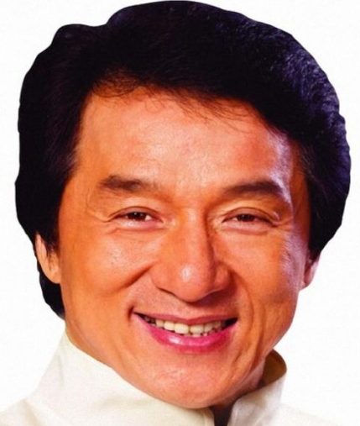
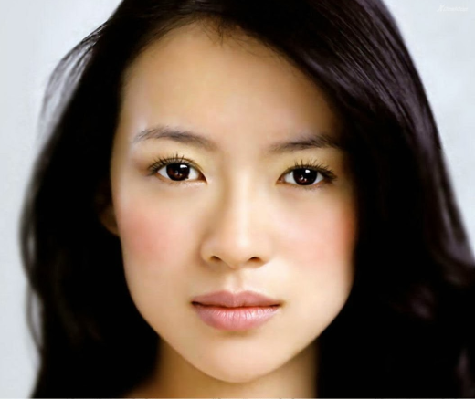
Although not all, but the following are general physical appearance characteristics of some races throughout the world.
Asian
Slanted eyes
White skin
Small and thin lips
Shorter nose
Small cheek bones
Small and round jaw

Slide 6
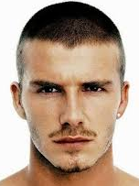
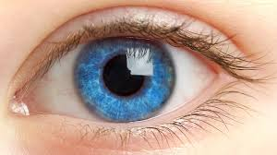
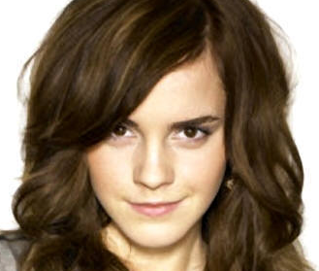
European/Caucasian
White skin
Sharp eyes pattern
Blue/brown pupil color
Firm cheek bones
Longer nose
Small and thin lips
Rather square jaw

Slide 7
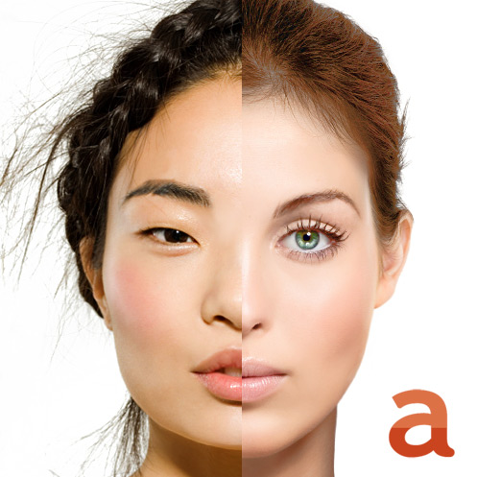
…And many more other races. Here is the comparison picture between those two races.
Source: asianplasticsurgeryguide.com

Slide 8
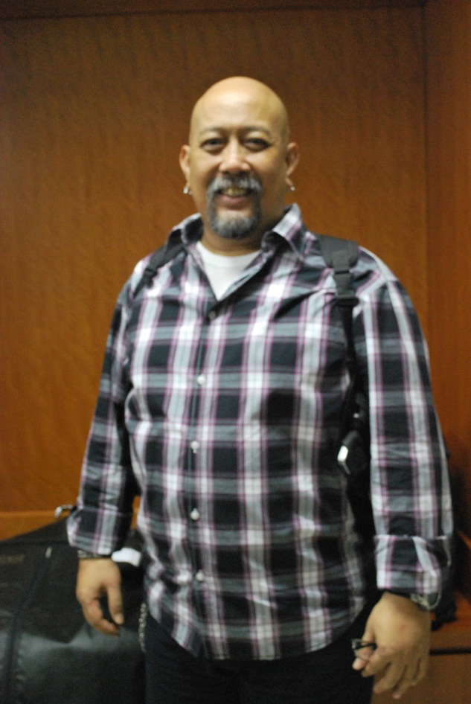
Now let us practice. Not only with the face, but with the body as well. Example
His head is bald.
He has a goatee
mustache
His body is quiet big and
sturdy
He is a legend
in Indonesian
comedy
He is Indro Warkop

Slide 9
Hair
………
Eyes
………
Nose
………
Lips
………
Skin
………
Overall physical figure
………

