Slide 1
Employee Released MMI – Now What?
Suzie Paulson, OMAG General Counsel and Human Resources Director

Slide 2
Workers’ Compensation
Provides injured employees with medical and financial assistance following a work related injury.

Slide 3
Medical Maximum Improvement (MMI)
Notes:
If Temporary Restrictions then check with WC adjuster to be sure that this is truly MMI

Slide 4
Now What?
Are they on FMLA for a “serious health condition”?
Do they have a “disability” under the ADA?

Slide 5
FMLA
50 employees to be eligible
Notice requirement
Runs concurrently with WC
1,250 hours in 12 month period
12 weeks unpaid leave

Slide 6
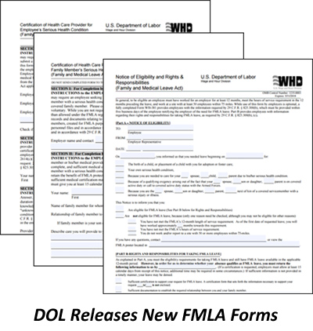
USE THE DOL FORMS!
WH-381: Notice of Eligibility & Rights & Responsibilities (50 employee box)
WH-380-E: Certification of Healthcare Provider (employee)
WH-382: Designation Notice (fitness for duty box and leave exhausted)

Slide 7
ADA
Protects individuals from discrimination associated with their disability and to provide reasonable accommodation.
*must have 15 or more employees

Slide 8
Oklahoma Anti- Discrimination Act (OADA)
The OADA prohibits discrimination in the areas of employment, housing, and public accommodation.
This statute covers disability discrimination for employers with less than 15 employees.

Slide 9
ADA: Are they disabled?
A physical or mental impairment that substantially limits one or more major life activities.

Slide 10
Major Life Activities
Caring for oneself
Walking
Seeing
Speaking
Learning
Breathing
Working
Thinking
Eating
Sleeping
Standing
Lifting
Bending
Concentrating

Slide 11
Major Bodily Functions
Functions of the immune system
Normal cell growth
Digestive functions
Bowel functions
Bladder functions
Neurological functions
Brain functions
Respiratory functions
Circulatory functions
Reproductive functions
Endocrine functions

Slide 12
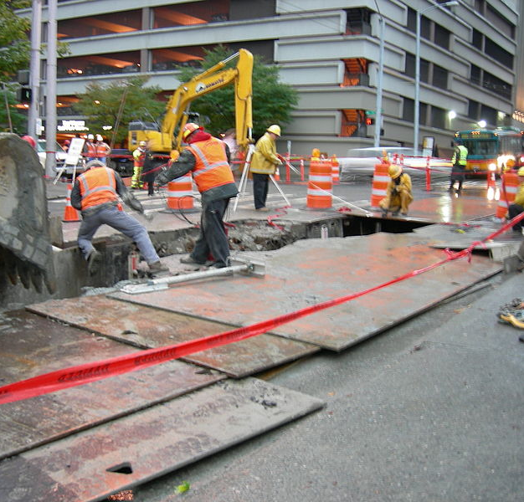
If disabled, can employee perform the essential functions of the position?

Slide 13
ADA
Before terminating a worker due to a disability, you must have “objective evidence” that the person’s unable to perform the duties or would pose a significant safety risk, even with an accommodation.
Notes:
This came out of EEOC “new guidance” on addressing employees with HIV.
3/2016 ADA Guidelines

Slide 14
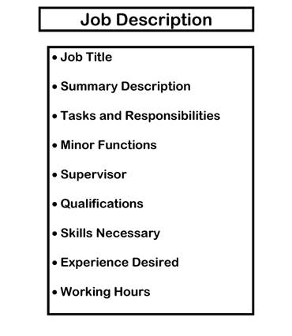
Essential Functions: Best Evidence
THE
JOB
DESCRIPTION
Notes:
(prepared before advertising or interviewing will be considered are evidence of essential functions.)
Provide the job description to the medical provider and have the medical provider indicate what major life activity(ies) is limited.

Slide 15
Essential Functions: Evidence
What have you done for others?
How often is that function performed?
What are the consequences of not requiring that an employee perform a function?
What does the collective bargaining agreement or contract say?
Notes:
For example, fire chief who’s contract or job description does not require him to respond to a fire in gear ready to fight fire.

Slide 16
ADA: Interactive Process
If the employee cannot meet the essential functions – is there an accommodation that can be made so that the employee can remain employed?

Slide 17
ADA: Interactive Process
Consult with employee on job-related medical limitations.
Identify potential accommodations.
Assess the effectiveness of each potential accommodation.
Consider the preference of the employee.
Select the best accommodation for both the employee and the employer.
Notes:
Ask the employee if there is any way that the employer can assist the employee in the performance of the job tasks. No Americans with Disabilities Act (ADA) acknowledgment is necessary at this point.

Slide 18
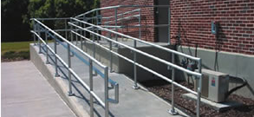
ADA: Accommodation
Make facilities accessible
Part-time or modified schedule
Acquiring or modifying equipment
Interpreters
Reassignment to a vacant position
Additional time off

Slide 19
ADA: Reassignment
An equivalent vacant position with the City.
A vacant position at a lower level within the City.
Employee must be qualified for the
position.

Slide 20
ADA: Additional Time Off
Things to consider:
The specific reason for the leave (i.e. surgery and recuperation, adjustment to a new medication regimen, doctor visits or physical therapy).
Whether the leave will be a block of time (weeks or months) or intermittent.
When the need for leave will end.

Slide 21
ADA: Undue Hardship
The nature and cost of the accommodation.
The employer’s overall financial resources.
The number of persons employed.
The number, type, and location of its facilities.

Slide 22
Undue Hardship: Additional Considerations
Lower quality
Lost sales
Increased customer dissatisfaction
Deferred projects
Increased burden on management staff
Increased stress on overburdened coworkers

Slide 23
ADA
You can ask an employee to submit medical documentation from a doctor explaining why an accommodation is needed.
You can ask an employee’s doctor if certain accommodations would be effective or would meet the employee’s needs.
You can ask an employee’s doctor if the employee would be a safety risk.
Notes:
This came out of EEOC “new guidance” on addressing employees with HIV.
3/2016 ADA Guidelines

Slide 24
ADA
You cannot require a doctor to provide you with a specific diagnosis. General terms like “immune disorder” are sufficient.
You cannot ask a doctor to disclose a patient’s detailed medical unless you have a release (and even then it’s not a good idea).
You cannot charge employees for the cost of any accommodations you provide.
Notes:
This came out of EEOC “new guidance” on addressing employees with HIV.
3/2016 ADA Guidelines

Slide 25
OMAG
www.omag.org
www.twitter.com/omag1977
www.facebook.com/oklahomamunicipalassurancegroup
www.linkedin.com/oklahomamunicipalassurancegroup

Slide 26
OMAG
3650 S. Boulevard
Edmond, Oklahoma 73013-5581
800-234-9461 ∙ 405-657-1400 ∙ Fax: 405-657-1401

