Slide 1
Dreams N MOTION
TIME MANAGEMENT WORKSHOP
3-26-2017

Slide 2
Agenda
Purpose/Bottom Line Up Front (BLUF)
What is Time Management?
Why is Time Management Important?
Time Management
Techniques
Tools
Conclusion
Participant Discussion
Individual Experiences
How do we apply what we learned?

Slide 3
Purpose (Bottom Line Up Front-BLUF)
Provide workshop attendees with a high level overview on Time Management principles, techniques and tools. Attendees will be able to use these techniques and tools to more effectively manage their time in routine daily life.

Slide 4
What is Time Management
Time management is the process of planning and exercising conscious control over the amount of time spent on specific activities, especially to increase effectiveness, efficiency or productivity
Career
Education
Home Life

Slide 5
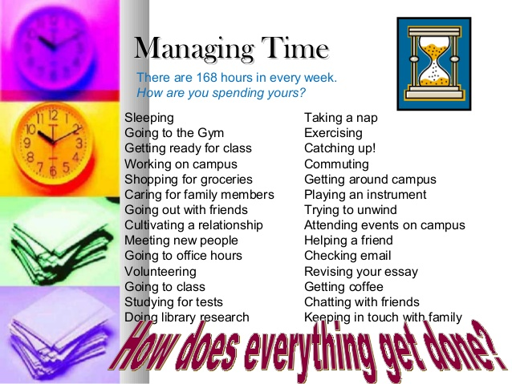
Why is Time Management important?
Life is complicated
People are multi-tasking
The workplace environment has become more competitive
More parents are trying to balance home and career
Single Parent households
Dual Parent households (more women have joined the workforce)
More working people are going back to school

Slide 6
Why is Time Management important? (cont.)
There are only 24 hours in a day
Some things are important, some things are not
Competing task can leave us feeling overwhelmed and stressed out

Slide 7
DARAR Techniques
Document
Achieve
Review
Assess
Revise
Write down or record/prioritize your activities/task
Achieve/Complete your activities or task
Review your plan at the end of the day or week
Assess to determine what was accomplished and if priorities have changed
Revise your daily, weekly etc. plan to reflect new task or re-prioritization of existing activities/task

Slide 8
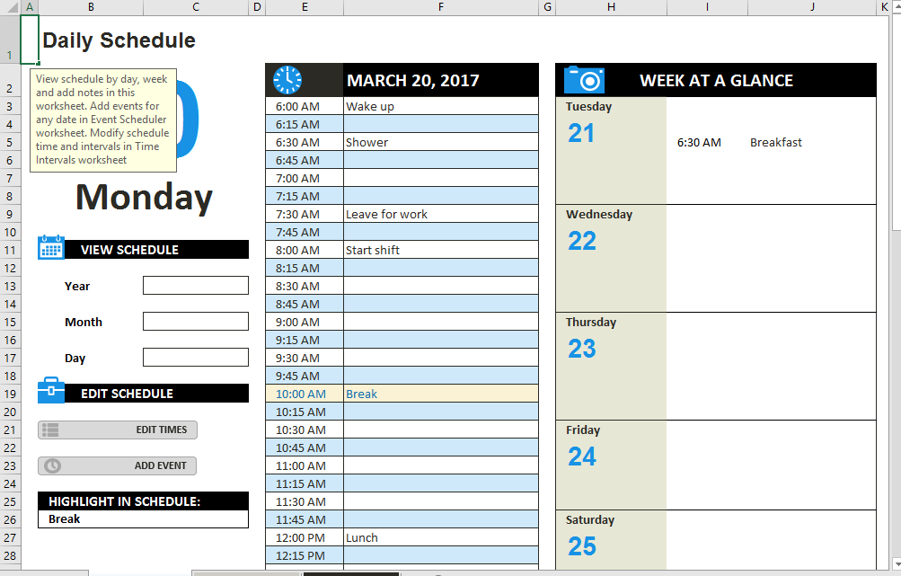
Tools
Daily/Weekly Planner
Use DARAR technique
Set priorities
Set start/stop times
Remove Distractions

Slide 9
Tools
Managing Priorities
 | URGENT | NOT URGENT
IMPORTANT | Quadrant I Urgent & Important Final Exam Tomorrow Emergency Business Trip Medical Emergency | Quadrant II Not Urgent but Important Birthday next week Paying bills Final Exam next month
NOT IMPORTANT | Quadrant III Urgent but not important Ringing phone Someone walk into your office to talk about football | Quadrant IV Not urgent or important Junk Mail from solicitors Routine lunch with co-workers

Slide 10
Conclusion
Life can be complicated with competing demands
Exercising time management can make you more productive and effective, at home, work or school
Use the DARAR techniques and available tools
Make Time Management a daily Habit
Time is a resource you will never get back, so use it wisely

Slide 11
Participant Discussion

