Slide 1
a, an
the indefinite articles

Slide 2
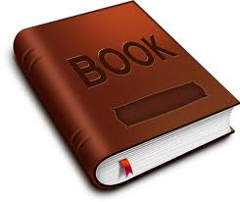
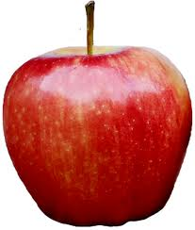
a, an
a
indefinite article (not a specific object, one of a number of the same objects)
with consonants.
the indefinite article
One (1) item
Begins with a consonant (BOOK)
Countable
a book
an
indefinite article (not a specific object, one of a number of the same objects) with vowels (a,e,i,o,u)
One (1) item
Begins with a vowel (APPLE)
Countable
an apple

Slide 3
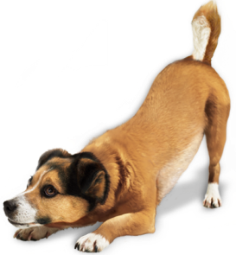
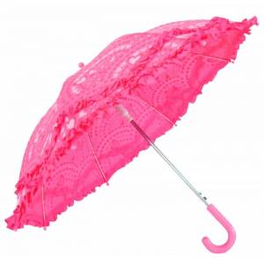
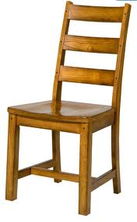
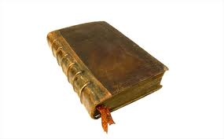
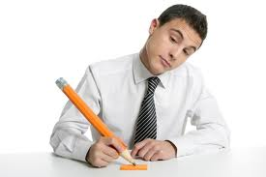
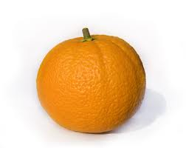
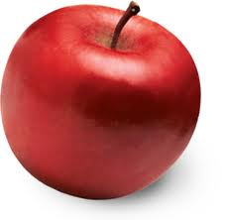
a, an
the indefinite article
a dog
an umbrella
a chair
a box
a flower
a book
a student
an orange
an apple

Slide 4
a, an
Don’t use an article with:
the indefinite article
countries, states,
countries or provinces,
lakes and mountains except when the country is a collection of states such as "The United States“
He lives in Washington near Mount Rainier.

Slide 5
a, an
the indefinite article
Don’t use an article when you are speaking about things in general.
I like Russian tea. She likes reading books.

Slide 6
a, an
the indefinite article
Don’t use an article when you are speaking meals, places, and transport.
He has breakfast at home. I go to university. He comes to work by taxi.

Slide 7
a, an
Exercises:
the indefinite article
a
There is ______ pencil on the desk.
I have got _______ new laptop.
She is _______ teacher.
There is _______ egg in the fridge.
Tom Hanks is _____American actor.
My father is ______ engineer.
There is ____ student in the class.
We haven’t got ____ ball.
a
a
an
an
an
a
a

Slide 8
THANKS
please visit
www.nihatkasim.org
To download this lesson.

