Slide 1
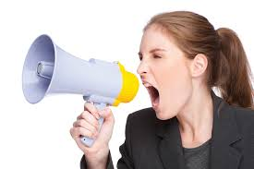
Unit 8
Attention, please!

Slide 2
After this chapter, students are expected to be able to:
Speak up if they have an announcement to make,
Respect other people’s will to make announcement,
Respond to an announcement properly.

Slide 3
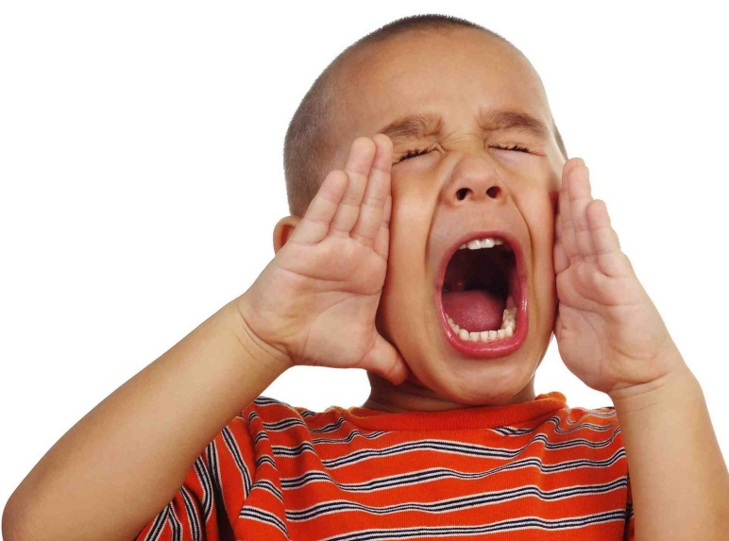
- Is it important?
- Very much.
The ability to make an announcement is as important as the ability to listen for it. One must know the appropriate condition whether to shout, announce, declare, or to be silent, quiet, and listen.

Slide 4
Types of announcement:
- Information of missing person,
- Information of property sale,
- Information of availability,
- Information of fugitives,
- Information of death,
- Information of promotion,
- Information of approval,
- etc.
Definition:
- a written or spoken statement that tells people about something : public or formal words that announce something
- the act of officially telling people about something
- the act of announcing something
Source: merriam-webster.com

Slide 5
Examples
A wanted poster
A missing person
For sale poster

Slide 6
Practice!
Identify these posters below, name their category in the box provided.
Poster of………
Poster of………
Poster of………
Poster of………

