Slide 1
BEGINNER CLASS LESSON: 23
Very + Adjective
Too+ Adjective
Adjective + Enough
Enough + Noun

Slide 2
We use very to strengthen an adjective. Very have positive or negative meaning. "It was very hot" -- means the temperature was high.
1. The exam is very difficult, but Jim can complete it.
2. She is very smart, I know she will pass the exam.
We use very to strengthen an adjective. Very has positive or negative meaning.
"It was very hot" -- means the temperature was high.

Slide 3
We use "too" to show that something is over (or under) a certain limit or that it is more (or less) than it should be.
. “too” has a generally negative implication.
"It was too hot" -- means the heat was excessive for some purpose, such as, "It was too hot to play tennis today."

Slide 4
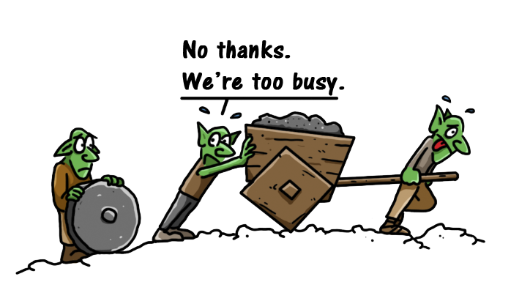
Te coffee is too hot

Slide 5
Exercise 1. use very / too in the blanks 1) Jim failed his math class because it was ________ difficult for him. 2) It’s ________ warm today, but I’m still going to play outside. 3) The old horse is ________ old to run. His legs don’t work like they used to. 4) She was feeling ________ ill. Nevertheless, he still went to school. 5) It’s ________ dark to see in here. Please turn on the lights. 6) Rick was ________ tired to come to the movie with us. He went to sleep instead. 7) Learning a second language is ________ difficult, but most students can do it with practice and determination. 8) The man is ________ old. He will be 92 next week.

Slide 6
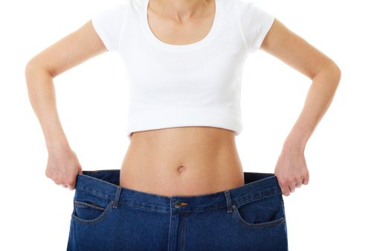
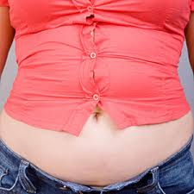
Too baggy or too tight is not alright. Your clothes should not squeeze you like a python or swallow you like a whale. Wear the clothes that fit.

Slide 7
Adjective + Enough Enough means sufficient. Enough is one of those words that can be used as an adjective and an adverb. The adverb enough is used to modify an adjective. In this case, it goes after the adjective it modifies.
She is pretty enough for everybody to notice her. (Everybody notices her because she is very pretty.) My friend lives close enough to my house to walk. Last summer it was hot enough to go swimming every day

Slide 8
When enough is used as an adjective, it modifies a noun. The adjective enough goes before the noun it modifies.
“There is not enough food for everybody, go and buy some more.”
“ we have enough money to buy this car.”

Slide 9
Exercise 2. fill in the blanks using Too/Very/Enough
1. Is she tall …………. to reach the bookshelf?
2. She is ………….fat to fit in these clothes.
3. Everybody says he is a ……… smart man.
4. I have had more than ……….. to eat, thank you.

Slide 10
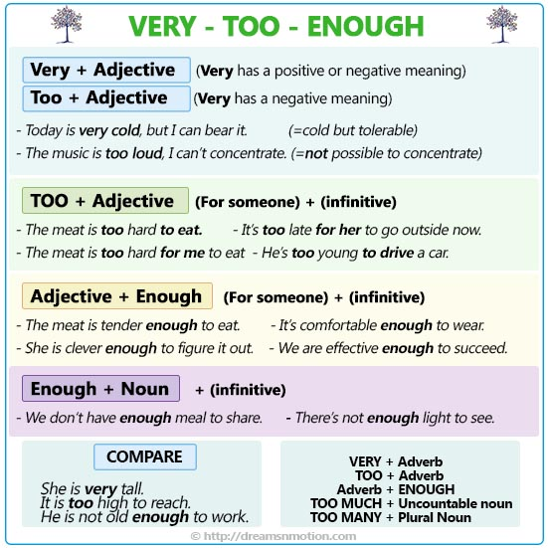
Summary:

