Slide 1
‘The roadmap to Zimbabwe’s desired future. Defining the possibilities that deliver value’ Zimbabwe National Chamber of Commerce Agrippa G.R Mugwagwa 14 June 2013
‘Transforming the economy with the power of ICTs’

Slide 2
Presentation Outline
1. Introduction
2. What are ICTs
3. Historical Perspective
4. The DotCom Bubble
5. The Consumerisation of IT
6. Global Trends
7. Impact of Technology
8. Digital Trends
9. Contributions of ICT
10. Mobile & Africa
11.MPesa in Kenya
12. Why Mobile will Rule
13. Harnessing ICTs
14. Conclusion

Slide 3
Introduction
‘Change is the only constant’
This saying could not be more applicable to ICTs and their impact on our lives and business in general
Innovation is the currency of ICTs and it has created and destroyed business models and businesses alike
Kodak as we know it is now extinct

Slide 4
What are ICTs?
Information and Communication Technologies
‘..is a more specific term that stresses the role of unified communications(telephone lines and wireless signals) computers as well as necessary enterprise software, middleware, storage and audio-visual systems which enable users to access, store, transmit and manipulate information’
- Wikipedia

Slide 5
ICT
Also refers to the convergence of audio-visual and telephone networks with computer networks through one cable or link
TV broadcasts are now enabled via the computer even mobile phone
The smart TV is integrated to seamlessly deliver media from TV and the internet

Slide 6
A Historical Perspective of ICTs
The history of ICTs has largely been punctuated by the development of powerful, smaller computers and more efficient and cheaper forms of communication
Mainframe computers that fitted into an entire room – all that is today matched by a quad-core processor that fits in your i-Phone 5 or S4
We now have the Silicon Valley which is entirely devoted to innovation and technology
Coming closer home we only had TelOne in telecoms – now we have Telecel, Econet, NetOne, Africom and various

Slide 7
The DotCom Bubble
We always over-estimate the power of IT in the short-run and under-estimate its impact in the long run’
e-Commerce was over-hyped as the big thing in the 90s on the rise of the internet
New companies based on the online business model were formed and capitalised by investors but never delivered pet.com/frys.com as there was no clear revenue model
The NASDAQ fell by some 84 points or 1.6% in one day 10 March 2000.
The same business model has built some of the dominant online businesses we know today..Amazon, e-Bay

Slide 8
The Consumerisation of ITs
This is the trend where ordinary consumers easily access IT for their day to day use
This trend has changed the way people consumer products and media, the way they work and relate
As we build the economy we need to align our business models to optimise the vastly changed consumer behaviour
Mobile telephony penetration is upwards of 70% and is expected to be in excess of 100% within the next 18 or so months
The smartphone is exponentially growing creating a powerful channel that will continue to change how people work and consume products and services
Technology is becoming more powerful, cheaper and accessible

Slide 9
Global Internet Access

Slide 10
Global SMS

Slide 11
Impact of Technology
Albert Einstein: "I fear the day when the technology overlaps with our humanity. The world will only have a generation of idiots”

Slide 12
Pervasive Impact of Digital.

Slide 13
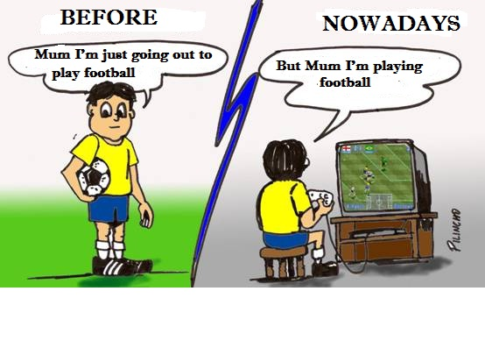
Change

Slide 14
Modern Birthdays

Slide 15
Coffee with friends

Slide 16
Get together in a restaurant

Slide 17
Enjoying the beauty in a museum

Slide 18
Pleasantly chatting in a cafe

Slide 19
Enjoying the day at the beach

Slide 20
At the stadium supporting the team

Slide 21
Having fun with the girlfriend

Slide 22
Appreciating the town in a convertible...

Slide 23
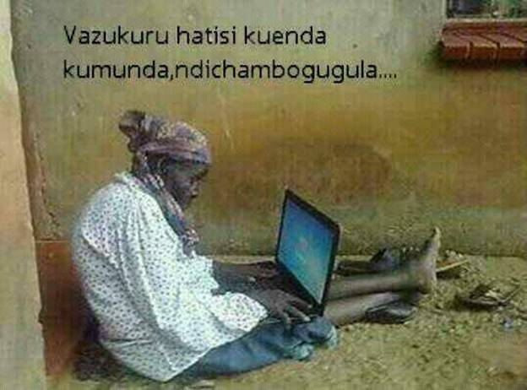

Slide 24
The Customer Remains King
“Technology is changing your customer, and your customer will change your business”

Slide 28
We love Google?

Slide 30
2 Billion Videos Are Streamed Each Day On YouTube
Source: Techcrunch

Slide 31
Digital Decision-making

Slide 32
Viral Power of Digital
Traditional Media is relatively static
Digital media is shareable and discoverable
Has a global reach
High velocity
Allows engagement
Digital is accessible – consumer-generated media which is unregulated
Digital is also local

Slide 36
“If I had to guess, social commerce is the next area to really blow up”

Slide 37
Contributions of ICTs
ICTs are some of the world’s leading companies – Apple, AT&T, T-Mobile, Samsung, Nokia, Econet
New industries have been spawned out of ICTs – call centres(India and the Philipines and lately South Africa), satellite television
Major employer – directly and indirectly – air time distributors and resellers
Lowered operating costs and improved efficiency
Contribution to the fiscus – sales tax

Slide 38
The Pervasive Impact of ICTs
The way we communicate
The way we think
The way we access information
The way we work
The way we pay and get paid

Slide 39
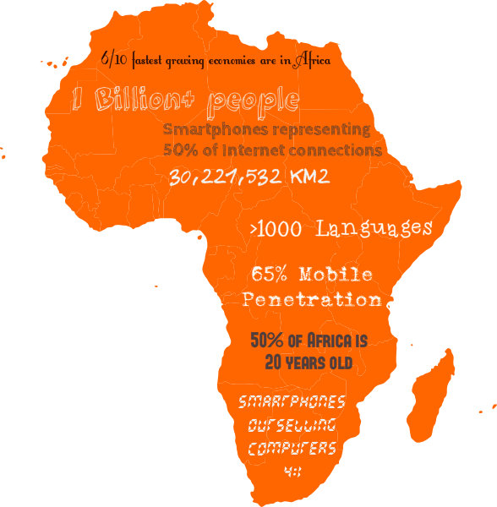
Mobile & Africa Key Facts
stats
Notes:
Africa: 30,221,532 km²
1 Billion+ people
>1000 Languages
Most Multilingual Continent
65% Mobile Penetration
2nd Biggest Mobile Market in the World
Fastest Growing Mobile Market
Smartphones are Outselling computers 4:1
What used to cost $2000 in 1994 now costs less than $80
Smartphones representing 50% of Internet connections
6/10 fastest growing economies are in Africa
50% of Africa is < 20 years old
Worldwide: there more android phone activations than babies born. 1.3M vs 300K

Slide 40
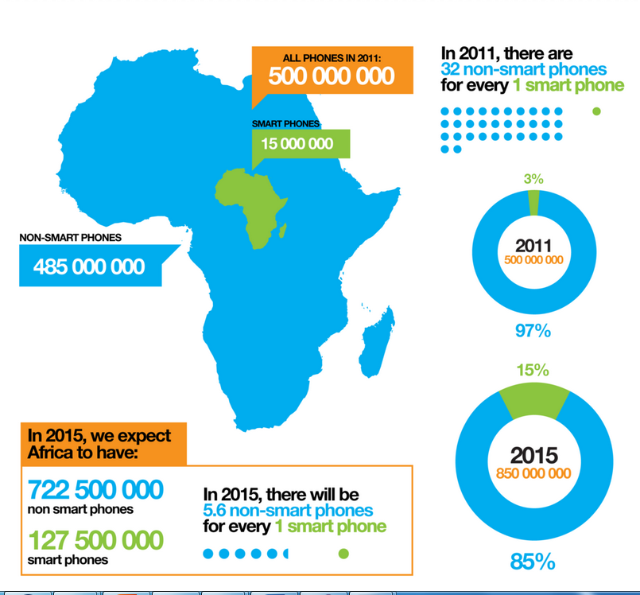
Smartphone Penetration
Data Source: Informa
Graphic: Afrographique

Slide 41
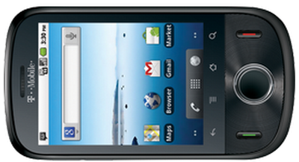
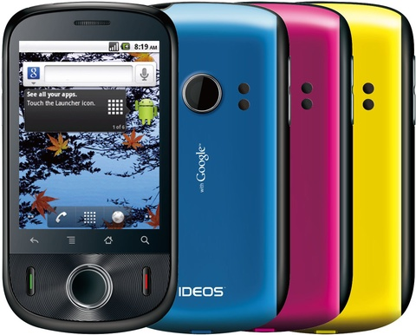
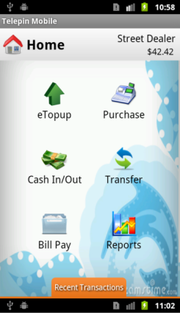
Sub $100 Android

Slide 42
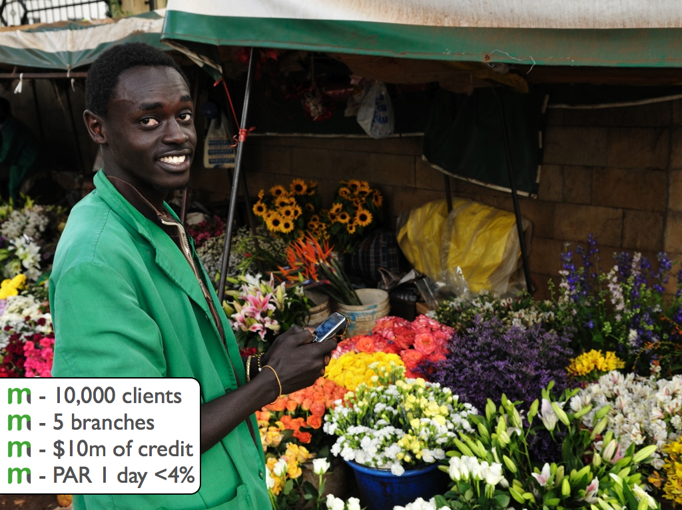

Slide 43
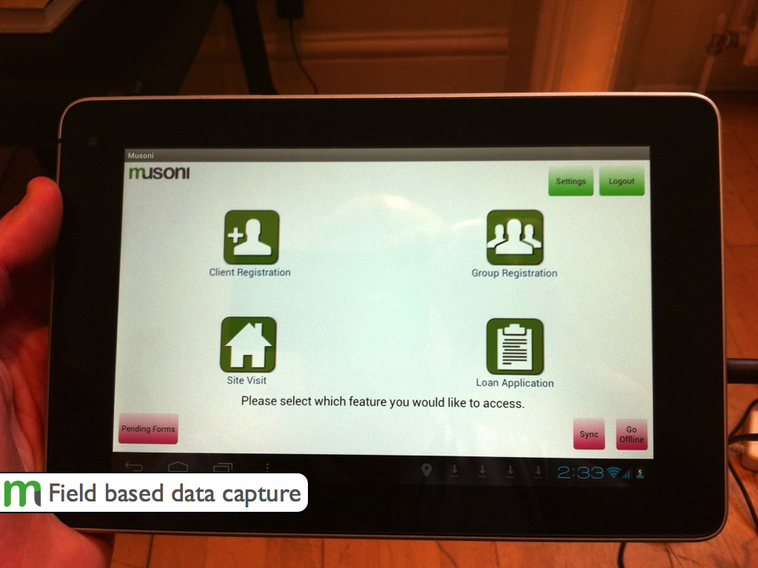

Slide 44
M-Pesa in Kenya
ICTs have successfully enabled financial inclusion in the country as well as created employment for Kenyans locally and internationally
In Zimbabwe Ecocash has gone some way in enhancing financial inclusion

Slide 45
Why Mobile Will Rule
It is personal
Is always carried on
Is always on
Relatively cheap hardware
Has a built-in payment system
Is available and ready at the moment of creative inspiration
Can provide accurate audience measurement
Captures the social context of media consumption i.e it is social
SoLoMo

Slide 46
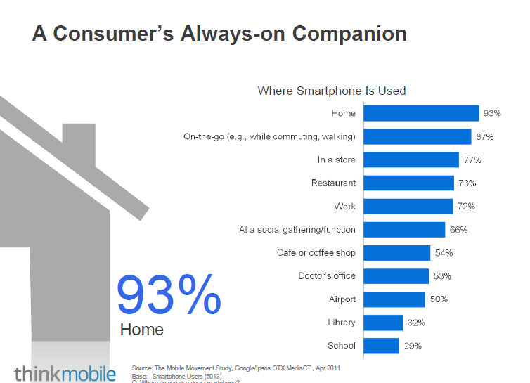

Slide 47
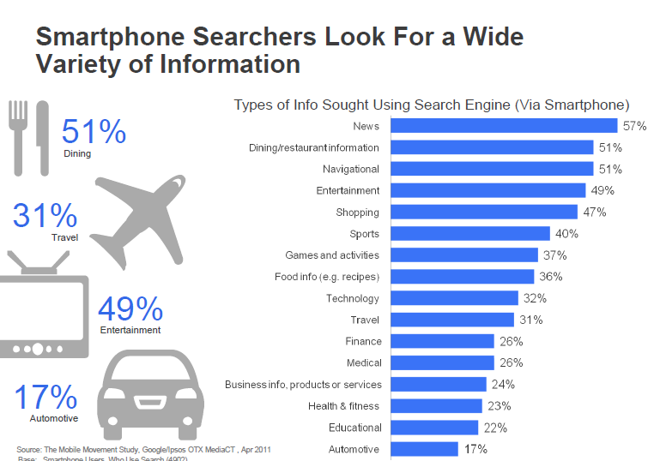

Slide 48
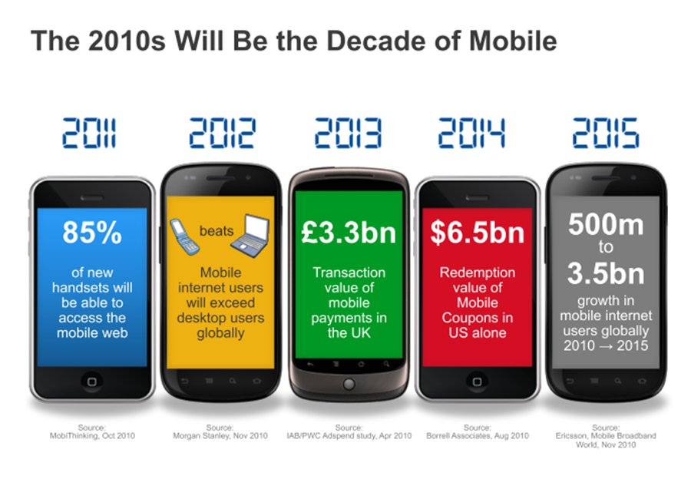

Slide 49
Formal Payment Statistics Sept 2012

Slide 50
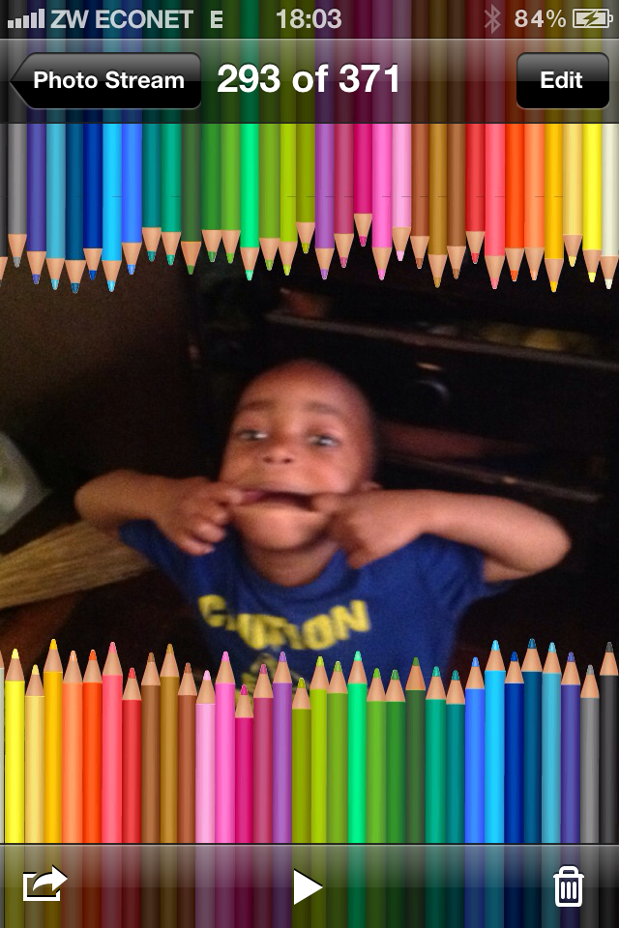
Digital Native

Slide 51
e-Commerce in Zimbabwe
Take off has been slow
There is huge scope to create more efficient retailing and marketing through this channel

Slide 52
How do we harness ICTs to grow the Economy?
Share infrastructure
Create inter-operable ecosystems and platforms that business and stakeholders can connect to
Think globally act locally – global village. We can’t create a globally competitive Zimbabwe when we do not leverage ICTs
Think differently – from the new customer’s perspective
Lets be adaptive
Take a long-term view

Slide 53
Conclusion
Technology will continue to change us and the world we live in
Technology will continue to be disruptive – destroy some industries and create new ones
ICTs will make us work smarter and be more efficient
The power of ICTs is in software
Nothing is permanent
The challenge to entrepreneurs is to embrace these innovations to provide solutions that change lives and make money
Stay paranoid

