Slide 1
Foundations
Come
"Come to me, all you who are weary and burdened, and I will give you rest.”
Matthew 11:28

Slide 2
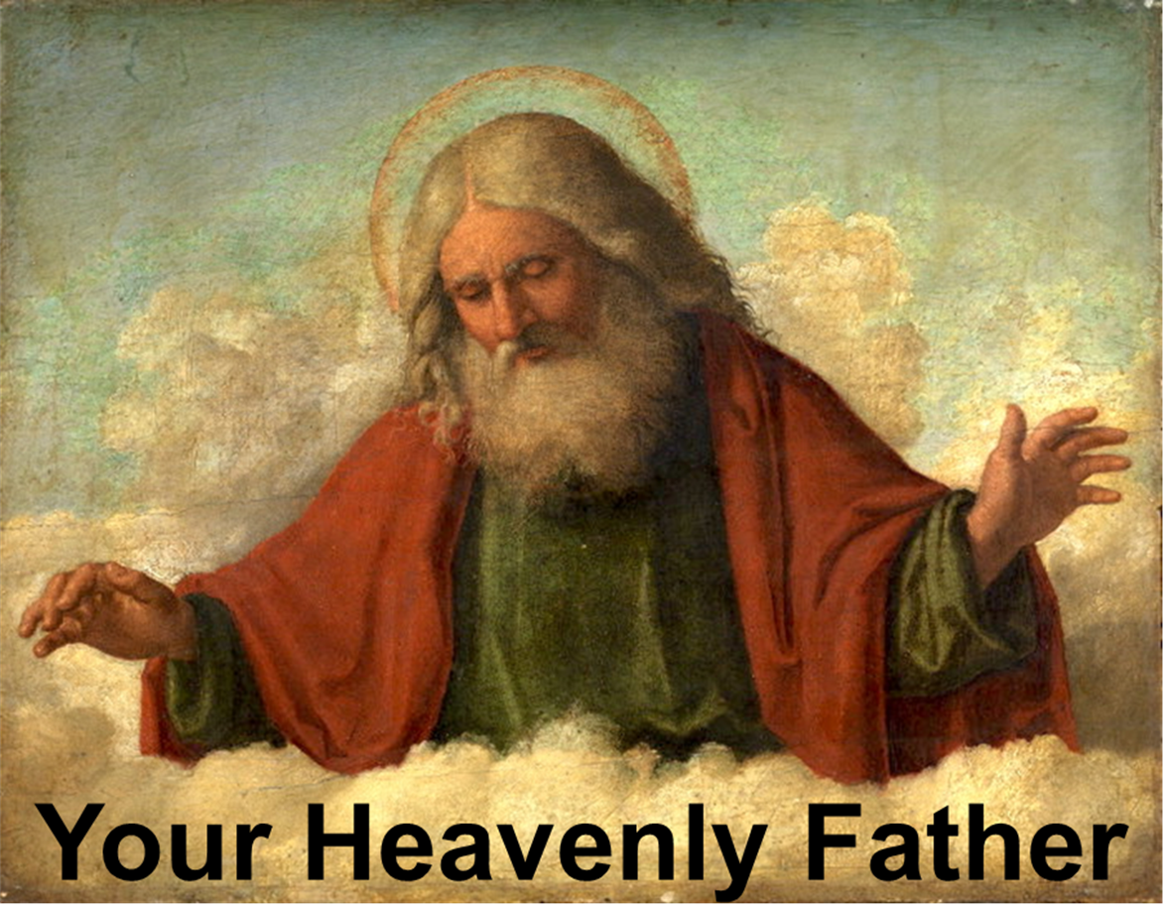
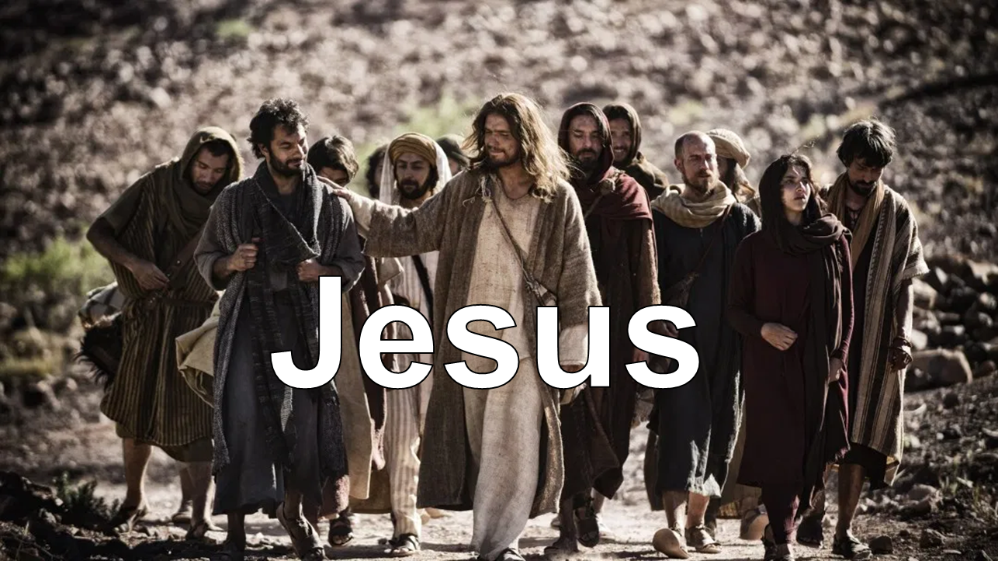
Subjects

Slide 3
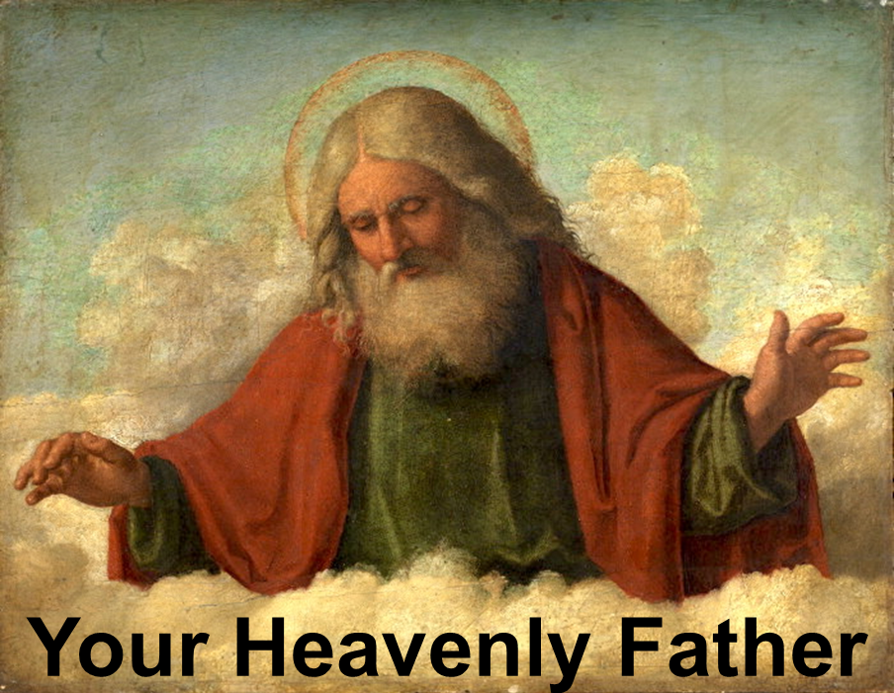

Slide 4
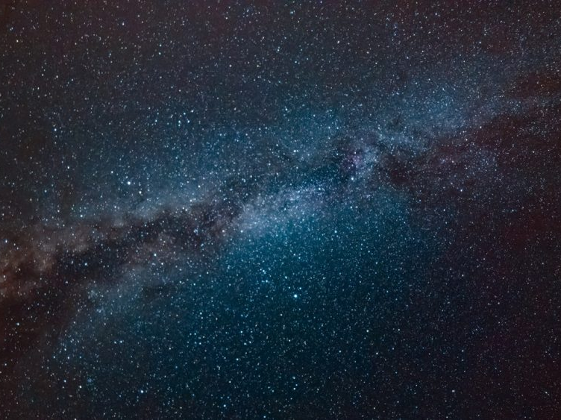
God
All of God is every place, all of the time
Past, present, and future
All of God is in the infinitesimal & the infinite
Smallest and largest places
God is not limited by space and time

Slide 5
God
God knows everything
about the past, present, and future
Present
Past
Future

Slide 6
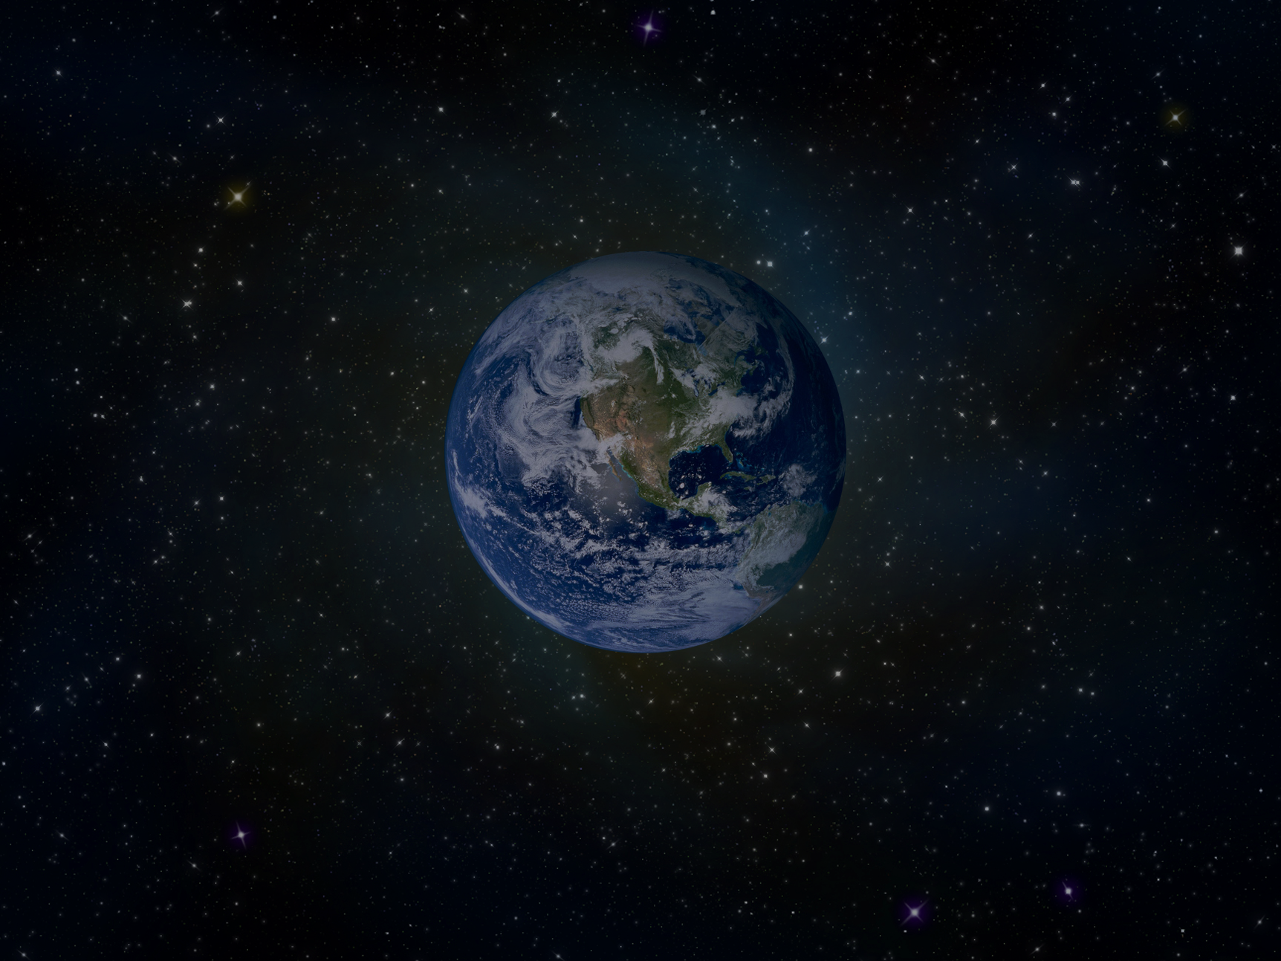
God
God created everything
The universe
The earth
Plants, animals, and people
Space and time

Slide 7
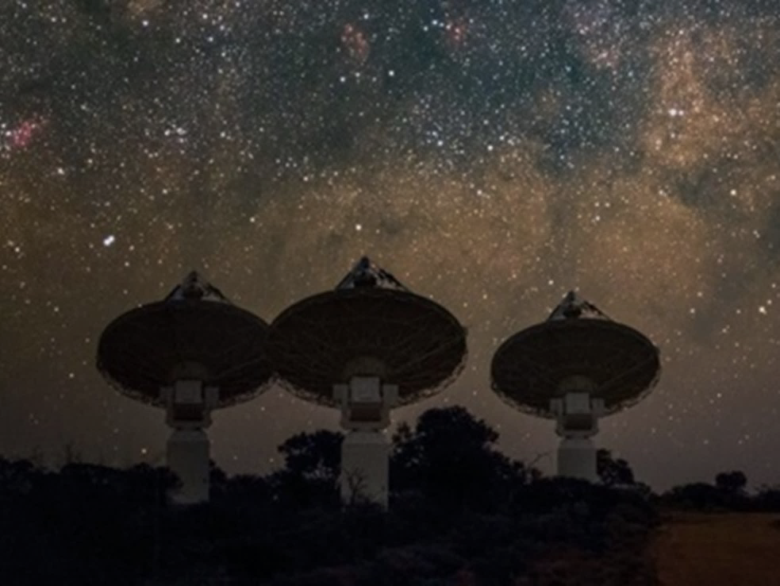
The observable universe is about 93 billion light years in diameter.
558 billion trillion miles
Astronomers think space outside of the observable universe might be an infinite expanse of what we see in the cosmos around us
The universe is big
God is bigger

Slide 8
God exists in 3 parts
Father, Son, and Holy Spirit
This is called the Trinity
The 3 in 1
They are different and the same

Slide 9
At a precise temperature and pressure,
matter can exist at the same time
as a solid, liquid, and gas.
For example, water can exist at the same time as ice, water, and water vapor.

Slide 10
Trinity
Triple Point
Father
Solid
Matter
Holy
Spirit
Son
Gas
Liquid
If created matter can exist at the same time as 3 different things,
the Creator can exist at the same time
as 3 different things

Slide 11
Characteristics of God
God is good; his love lasts forever.
In all things God works for the good
of those who love him
In what things does God work for your good?
Does this include the bad experiences in your life?
Psalm 107:1
Romans 8:28

Slide 12
Characteristics of God
I the LORD do not change.
Why is it important that God doesn’t change?
Malachi 3:6

Slide 13
Characteristics of God
God is good.
God works for my good.
God never changes.
I can trust that a good God
who never changes
and who works for the good of His children
will work for my good.
How do you feel about these facts about God?

Slide 14
God Created You
Genesis 1:26
Now we will make human beings
They will be like us and resemble us
How are we special?
They will be responsible for the Earth itself,
and every animal
What position of responsibility did God give us?

Slide 15
1 John 4:7-10
God created us to love us
Love comes from God
God loved us and sent his Son to be the way by which our sins are forgiven
Sins are bad thoughts, words, and actions

Slide 16
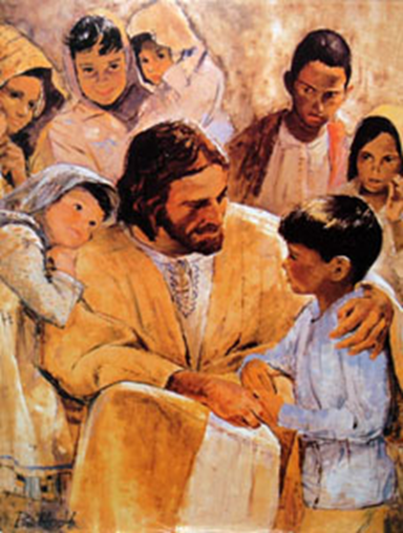
1 John 3:1
See how much the Father has loved us!
His love is so great that we are called God's children
How much does God love you?
Who are you to God?

Slide 17
Psalm 139:1-4
God has examined me and knows me
God knows everything I do
God understands all my thoughts
God sees me
God knows all my actions
Even before I speak, God knows what I will say

Slide 18
How does it make you feel to know
that God knows everything about you
including your thoughts?
Why can you trust God
to know everything about you?

Slide 19
Ephesians 1:3
Through Christ, God has blessed us with
every spiritual blessing

Slide 20
Ephesians 1:3
Examples of Spiritual Blessings
God’s love
Forgiveness
Eternal life
Peace
Prayer
God’s Word (The Bible)
God’s Spirit in us
Help in temptation

Slide 21
Ephesians 1:7
Our sins are forgiven through the sacrifice of Jesus
God forgives our sins because of His great kindness

Slide 22
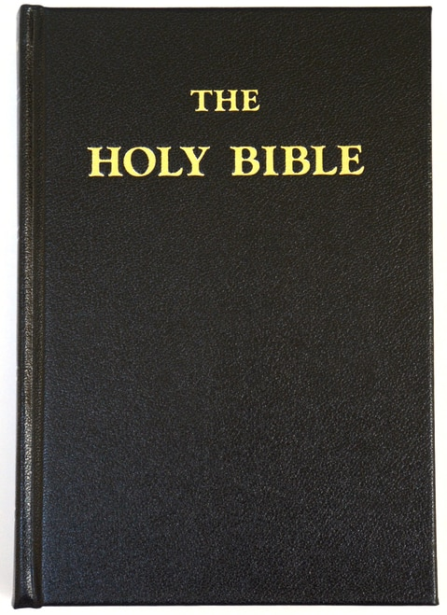
Ephesians 1:9
God revealed the mystery of his will to us
God reveals the mystery of His will to us in the Bible

Slide 23
1 Corinthians 3:16
Don't you know that you are God's temple
and that God's Spirit lives in you?
God lives in people
not in church buildings

Slide 24
2 Peter 1:3
God has given us everything we need
to live our life on the earth
and to have eternal life with God

Slide 25
Lamentations 3:22,23
The constant love of God never ceases
His kindness lasts forever
These are new every morning
Great is His faithfulness

Slide 26
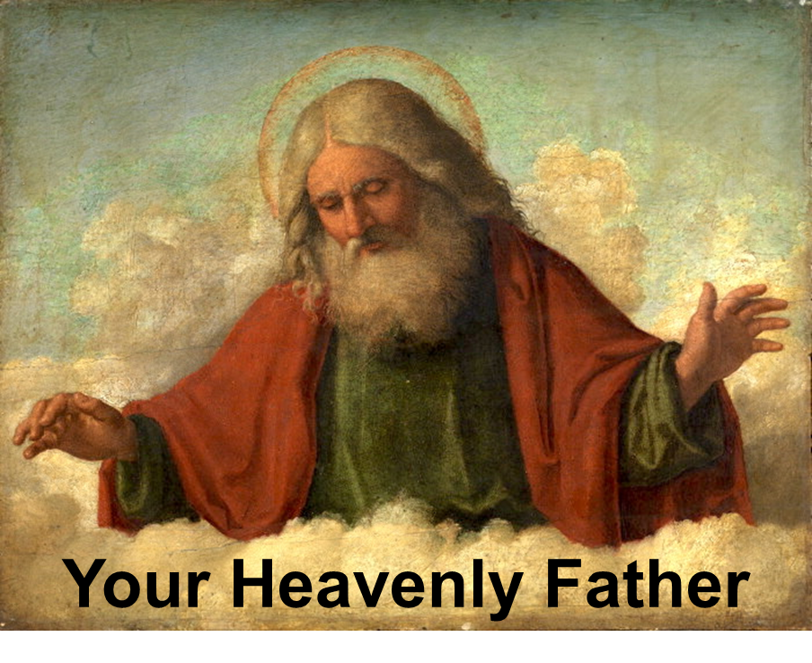
Summary
Characteristics of God
God is good
God works for your good
God never changes

Slide 27
“Your Heavenly Father” Summary
God created you to love you
You were created to be like God
You were created to care for the earth

Slide 28
“Your Heavenly Father” Summary
God loves you
God sacrificed His Son for you
God knows you
God loves you as His child

Slide 29
“Your Heavenly Father” Summary
God’s blessings to you
Every spiritual blessing
Forgiveness
Knowledge of His will
The Holy Spirit

Slide 30
“Your Heavenly Father” Summary
God’s blessings to you
Everything you need for living on earth and to have eternal life with God
God’s love, kindness, and faithfulness
His blessings are new every morning and they never cease

Slide 31
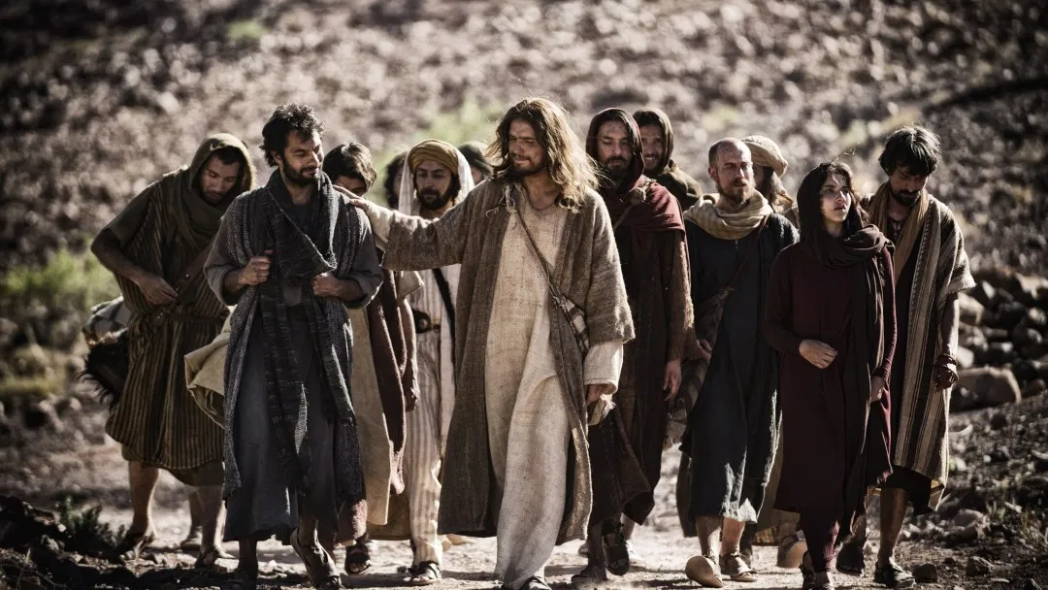
Jesus

Slide 32
Some say Jesus was just a great man.
Others say He was just a prophet.
But Jesus claimed that He is God
If Jesus is not God, then He is a liar

Slide 33
Jesus is entirely God and entirely man
As God He had the power to pay the penalty
for our sin by His death on the cross
for all who will believe
As a man He was able to communicate with us
and show us that He understands us

Slide 34
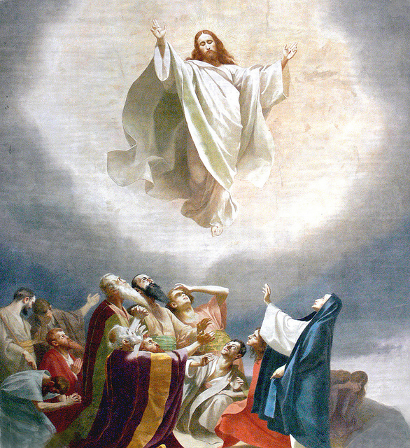
John 10:30
Jesus is God
What did Jesus say about Himself?
“I and the Father are one.”
Jesus said that He is God

Slide 35
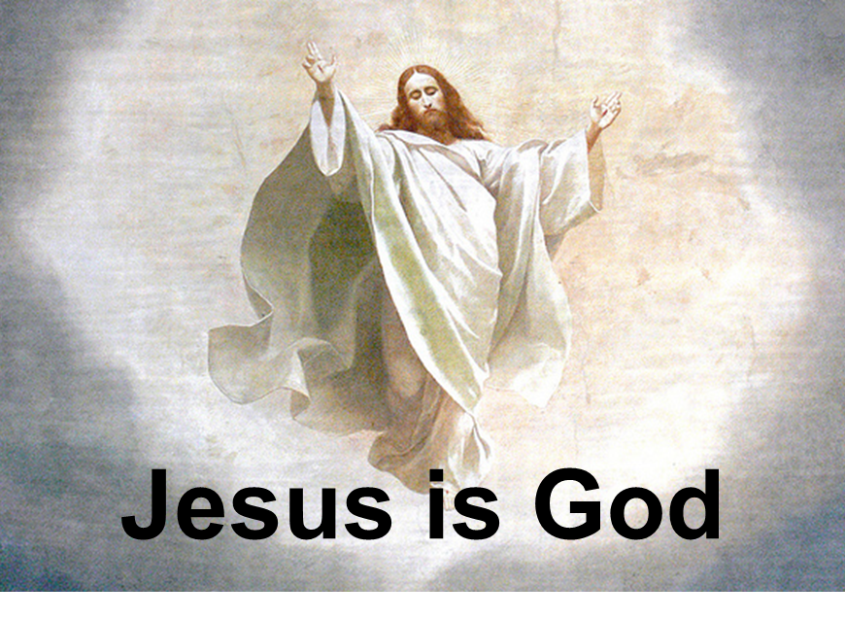
Hebrews 1:2
Jesus owns all things
Jesus made the universe

Slide 36
Hebrews 1:3
Jesus revealed the nature of God
Jesus is the exact likeness of God
Jesus holds the universe together

Slide 37
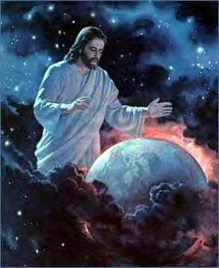
Hebrews 1:8, 10
God the Father says about Jesus
Your rule, O God, will last for ever and ever
In the beginning, O Lord,
you created the heavens and the earth
What does God the Father call Jesus?
What did Jesus do?

Slide 38
Hebrews 1:12
Jesus never changes
Jesus lives forever
Jesus has the characteristics of God

Slide 39
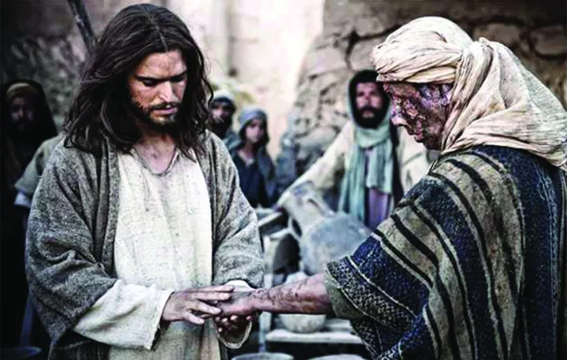
Matthew 8:3
Jesus cured a man of his leprosy

Slide 40
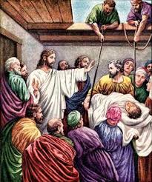
Mark 2:3-12
Jesus healed paralyzed people

Slide 41
Matthew 8:16-17
Jesus healed many sick people
Jesus shows He is God
by His supernatural power to heal people

Slide 42
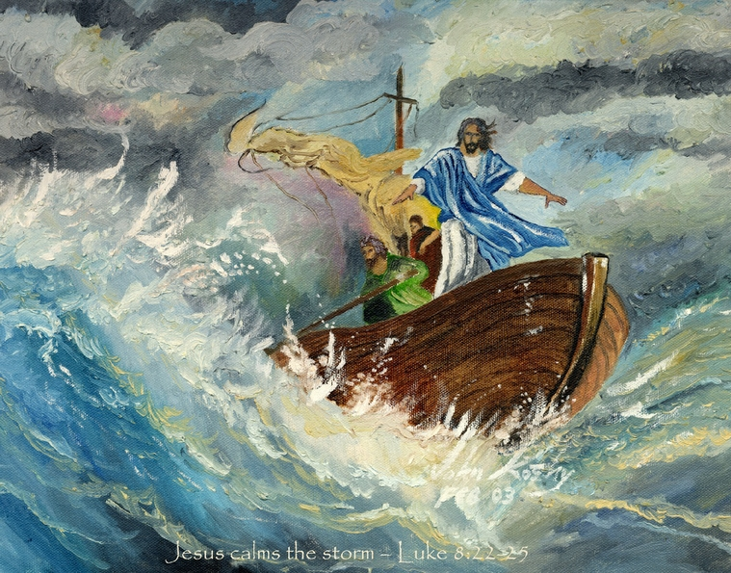
Matthew 8:23-27
Jesus calmed a storm
Jesus shows He is God
by His supernatural power over nature

Slide 43
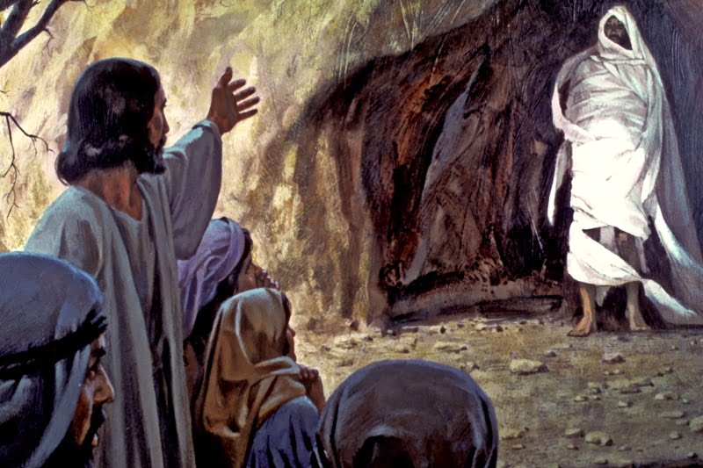
Matthew 8:23-27
Jesus brings a dead man back to life
Jesus shows He is God
by His supernatural power over death

Slide 44
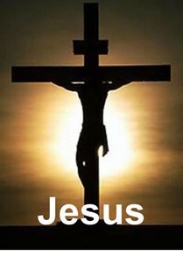
Romans 4:25
Jesus died
to pay the penalty
for our sins

Slide 45
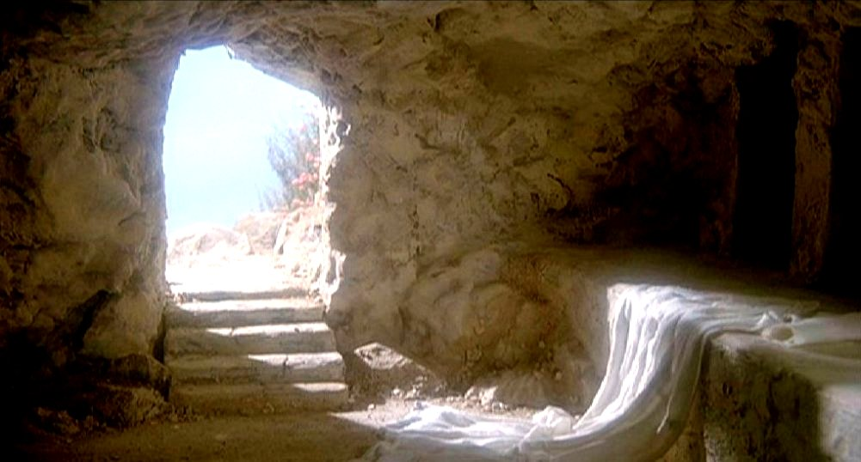
Matthew 28:5-7
Jesus rose from the dead to prove that He is God
Easter is the celebration of Jesus rising from the dead

Slide 46
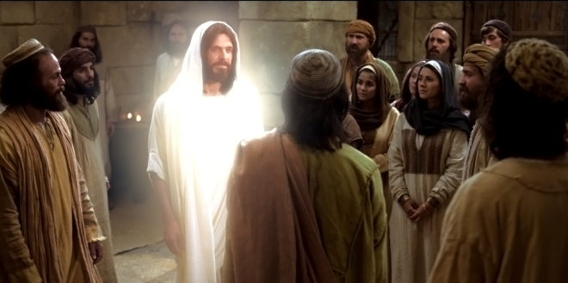
Matthew 28:16-20
Mark 16:14-15
Luke 24:33-37
John 20:19-20
1 Corinthians 15:3-7
Jesus revealed Himself to people after His death

Slide 47
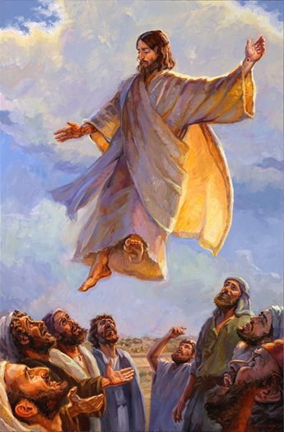
Acts 1:8-9
Jesus rose into heaven
40 days after He came alive

Slide 48
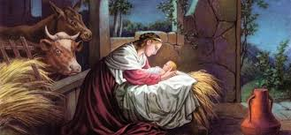
Luke 2:1-7
Jesus Was a Man
Jesus experienced birth
Christmas is the celebration of the birth of Jesus

Slide 49
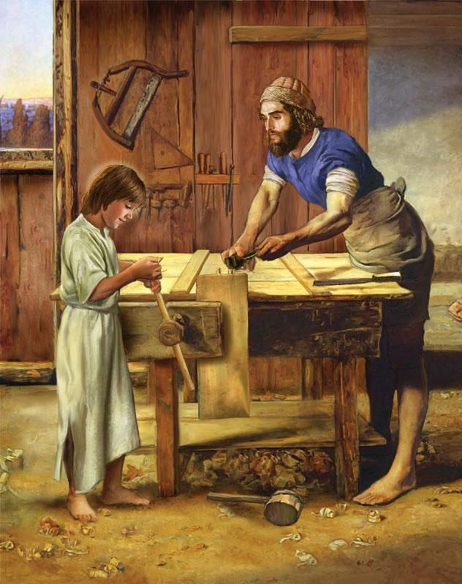
Luke 2:52
Jesus Was a Man
Jesus grew mentally, physically, spiritually, and socially
just as we do
Jesus developed as a boy

Slide 50
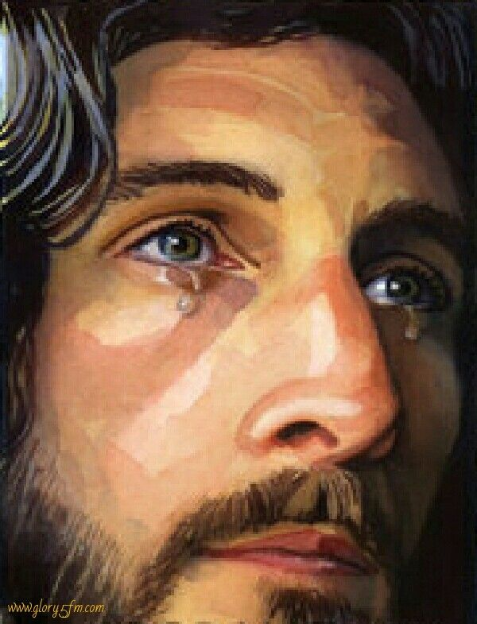
John 4:6, 7, 35
Jesus Was a Man
Jesus became tired and thirsty
Jesus became sad and wept
Jesus experienced human
physical and emotional
characteristics

Slide 51
Hebrews 2:10
Jesus Was a Man
Jesus suffered
Jesus experienced suffering
just as we do

Slide 52
Hebrews 2:11
Jesus Was a Man
Jesus calls us brothers and sisters
We are part of Jesus’ family

Slide 53
Hebrews 2:18
Jesus Was a Man
Jesus was tempted to sin
Jesus was tempted to sin just as we are,
but he didn’t sin
Temptation is the opportunity to do a bad thing
Sin is actually doing the bad thing

Slide 54
Romans 4:25
Jesus Was a Man
Jesus experienced death

Slide 55
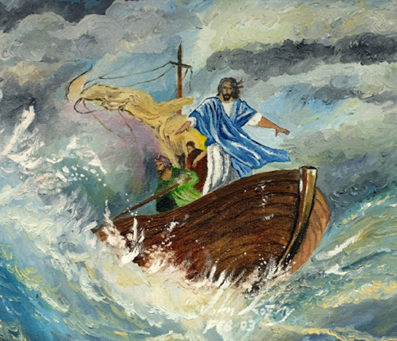
“Jesus” Summary
Jesus is God
Jesus said He was God
God the Father said He is God
Jesus created the universe
He healed and performed miracles
He lived a sinless life (Totally good)
He came alive from the dead
He rose into heaven

Slide 56
Jesus was a man
Jesus experienced birth
Jesus developed as a normal boy
He grew weary, was thirsty, and wept
He calls us brothers and sisters
He suffered and was tempted as we are
He experienced death
We know that God understands us because He became one of us

Slide 57
In this section you will see that God loved you even when you were going your own way and were not interested in Him.
God loves you so much that He sent His Son to die in your place to pay the penalty for your sin.
All you have to do is to receive Jesus into your life for the forgiveness of sins in order to receive eternal life.
You will learn that you have eternal life based on the trustworthiness of God and His Word and not because you deserve it or have earned it.

Slide 58
God’s Plan
In the beginning there was God.
God created mankind.
What kind of life did God create for us to live?
For God so loved the world that he gave his only Son, that whoever believes in him should not perish but have eternal life. John 3:16.
I came that they may have life, and have it abundantly. John 10:10.
In a love relationship with Him
Eternal life
Abundant life

Slide 59
Our Problem
What is life in the world really like today?
Instead of love there is hate.
Instead of eternal life there is death.
Instead of abundance there is poverty.
Real life is different
from the way God created it to be lived
Real Life
- Hate
- Death
- Poverty
God’s Plan
- Love
- Eternal life
- Abundance

Slide 60
Why is real life different
from the way God created it to be lived?
The first man and woman God created chose to sin
All people since then sin
Since all have sinned and fall short of the glory of God. Romans 3:23.
Sin separates us from God and causes all the bad things in life (Sin is to think, say and do bad things)
Real Life
- Hate
- Death
- Poverty
God’s Plan
- Love
- Eternal life
- Abundance
Sin

Slide 61
We try many ways to get back to God
But we cannot overcome our sin
For by grace you have been saved through faith; and this is not your own doing, it is the gift of God— not because of works, lest any man should boast. Ephesians 2:8-9.
No works will save us from the results of our sin.
Real Life
- Hate
- Death
- Poverty
God’s Plan
- Love
- Eternal life
- Abundance
Religion
Being Good
Sin

Slide 62
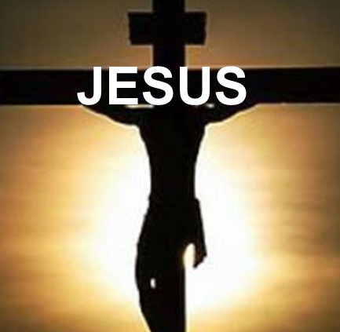
III. God’s Solution
What we can’t do for ourselves God has done for us.
God is on one side and all the people on the other side, and Christ Jesus, himself man, is between them to bring them together. 1 Timothy 2:5.
Real Life
- Hate
- Death
- Poverty
God
- Love
- Eternal life
- Abundance
Religion
Being Good
Sin

Slide 63
But God shows his love for us in that while we were yet sinners Christ died for us. Romans 5:8.
Christ paid the penalty for our sins to bring us to God.

Slide 64
God became a human who never sinned (Jesus).
Jesus took on the sin of every person for all time.
His death on a cross gives forgiveness from sin to those who believe that Jesus did this for them.

Slide 65
IV. Your Response
8. What must you do to have your sins forgiven, to receive eternal life, and be united with God?
But to all who received him, who believed in his name, he gave power to become children of God. John 1:12.

Slide 66
Believe Jesus died on the cross for your sins
to receive forgiveness and to live forever with God
Real Life
- Hate
- Death
- Poverty
God
- Love
- Eternal life
- Abundance
Religion
Being Good
Sin

Slide 67
To receive Christ and eternal life and be on God’s side, you simply ask Jesus to come into your life in prayer
Dear Jesus,
I am sorry for my sins.
I believe that you died on the cross for my sins.
Please come into my life, forgive me, and give me life forever with you.
Amen

Slide 68
You can know that you have eternal life with God
And this is the testimony: God has given us eternal life, and this life is in his Son.
He who has the Son has life; he who does not have the Son of God does not have life.
I write these things to you who believe in the name of the Son of God so that you may know that you have eternal life. 1 John 5:11-13.

Slide 69
You can know that you have eternal life with God
1. Who gives eternal life? God
2. Where is eternal life found? In Jesus
3. Who has eternal live? He who has Jesus
4. Can you know that you have eternal life?
Yes, you can know

Slide 70
You can know that you have eternal life with God
If you were to die and go to heaven and God asked you,
“Why should I allow you into heaven?”
What would you say to Him?

Slide 71
The Holy Spirit
The Holy Spirit is represented by a dove

Slide 72
Who has the
Holy Spirit?
John 14:16
Jesus promised that God
would give us the Holy Spirit
The Holy Spirit is called Counselor and Comforter
It means “Helper”
The Holy Spirit is God

Slide 73
Who has the
Holy Spirit?
1 Corinthians 2:12
1 Corinthians 3:16
Those who believe in Jesus
have the Holy Spirit in them

Slide 74
The Role of the
Holy Spirit
John 14:26
The Spirit teaches us
and reminds us of what Jesus said
What Jesus said
is in the Bible

Slide 75
The Role of the
Holy Spirit
1 Corinthians 2:12
The Spirit helps us understand what God has given us
What are some things God has given us

Slide 76
The Role of the
Holy Spirit
John 16:8-11
The Spirit lets people know that they sin
Sin is to think, say, and do bad things
Doing bad things makes us have a guilty conscience

Slide 77
The Role of the
Holy Spirit
John 16:13
The Spirit guides us into the truth
The truth is in the Bible

Slide 78
The Role of the
Holy Spirit
John 16:14
The Spirit helps us praise Jesus
by recognizing that Jesus is God

Slide 79
The Role of the
Holy Spirit
Romans 8:6
When we give control of our lives
to the Holy Spirit,
He gives us a life of joy and peace

Slide 80
The Role of the
Holy Spirit
Romans 8:16
Sometimes we feel unworthy
because we don’t act like God’s children,
so the Holy Spirit reminds us
that we are God’s children

Slide 81
The Role of the
Holy Spirit
Romans 8:26-27
The Spirit helps us in our weakness

Slide 82
The Role of the
Holy Spirit
Romans 8:26-27
Sometimes we don’t know what to pray for
Prayer is just talking with God
The Spirit prays for us according to what is best for us

Slide 83
The Role of the Holy Spirit
Romans 8:26-27
Examples of things we don’t know what to pray for:
Feeling bad
Things about ourselves and others we don’t understand

Slide 84
Your Response to the Holy Spirit
Galatians 5:16-17
All people are born with a sin nature
We all think, say, and do bad things sometimes

Slide 85
Your Response to the Holy Spirit
Galatians 5:16-17
Christians believe that Jesus died for them for the forgiveness of their sins
Christians still have their sin nature, but they also have the Holy Spirit in them

Slide 86
Galatians 5:16-17
There are two conflicting powers
in every Christian’s life

Slide 87
Galatians 5:16-17
We must choose which one is in control

Slide 88
Galatians 5:19-23
Choose to put God in control
Experience
Love, joy, peace
Patience, kindness, goodness
Faithfulness, gentleness, self-control

Slide 89
Galatians 5:19-23
When God is not in control
Experience
Hate, sadness, anger
Impatience, meanness, jealousy
Selfishness, lack of self-control

Slide 90
1 Corinthians 3:1-3
There are 2 types of Christians
Mature Christians and Immature Christians

Slide 91
1 Corinthians 3:1-3
Mature Christians
Don’t act like non-Christians
Are growing spiritually through God’s Word
Give God control of their lives

Slide 92
1 Corinthians 3:1-3
Immature Christians
Act like non-Christians
Are not growing spiritually through God’s Word
Don’t give God control of their lives

Slide 93
When we give the Holy Spirit Control of our life, we experience good things
1 Corinthians 3:1-3

Slide 94
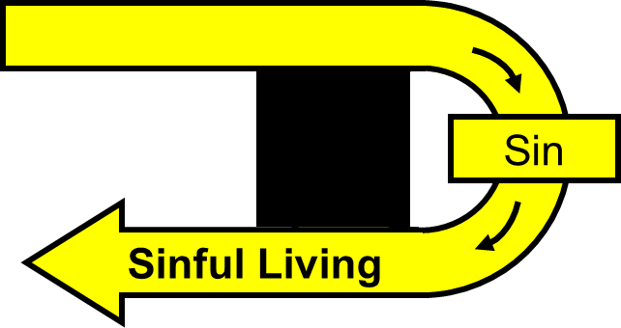
When we sin, we take control of our life away from God,
Our sin nature is in control and we experience bad things
1 Corinthians 3:1-3

Slide 95
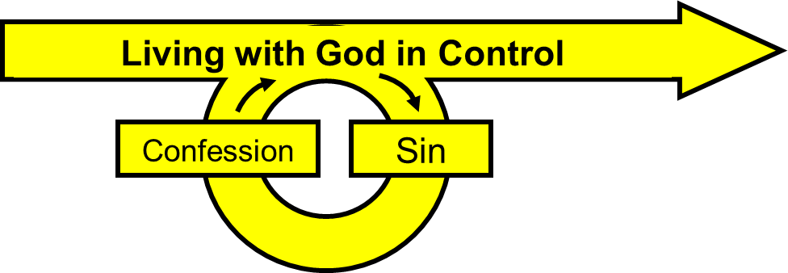
When we confess, we are giving control of our life back to God
To confess is to tell God you are sorry
God forgives you
1 Corinthians 3:1-3

Slide 96
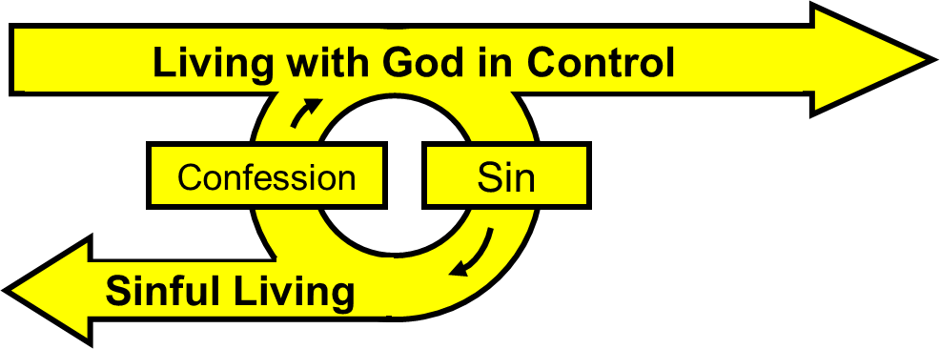
1 Corinthians 3:1-3

Slide 97
Ephesians 4:30-32
God is sad when we sin because it hurts us
Get rid of all bitterness, temper, anger, quarreling, cursing, and hatred
Be kind and sympathetic
Forgive others as God forgives you

Slide 98
Jesus promised that God would give us the Holy Spirit
Those who believe in Jesus have the Holy Spirit in them

Slide 99
Trinity
Triple Point
Father
Solid
Matter
Holy
Spirit
Son
Gas
Liquid
If created matter can coexist in 3 states,
the Creator can coexist in 3 states

Slide 100
The Holy Spirit:
Teaches us and reminds us of what Jesus said
Helps us understand what God has given us
Lets people know that they sin
Guides us into the truth

Slide 101
The Holy Spirit:
Helps us praise Jesus
Gives us a life of joy and peace
Reminds us that we are God’s children
Helps us in our weakness
Prays for us

Slide 102
The Holy Spirit and our sinful nature are in conflict
We must choose to allow God to control us

Slide 103
With God in control we experience good things
When God is not in control, we experience bad things

Slide 104
Mature Christians give God control of their lives
Immature Christians don’t give God control of their lives

Slide 105
When you sin, tell God you’re sorry
and He will forgive you
God is sad when we sin because it hurts us
Forgive others as God forgives you

Slide 106
Foundations
Come
"Come to me, all you who are weary and burdened,
and I will give you rest.”
Matthew 11:28
The End

