Slide 1
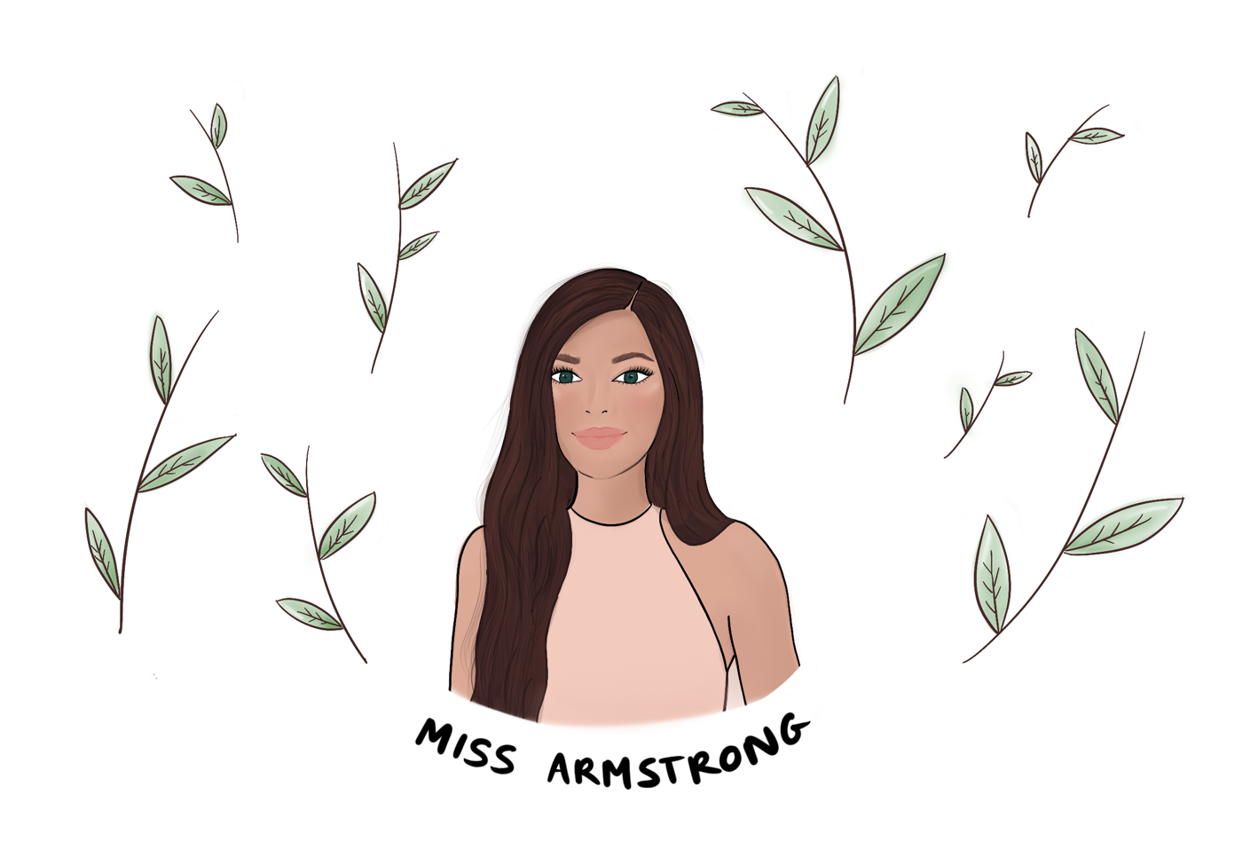
Thank you for downloading my resource. I would love to hear how you use it in your classroom. Tag me @teachpal on Instagram.
This resource is strictly for personal use, and educational use in school and at home. You can use my resources as many times as you want; however, resources may not be used commercially, sold or shared. If you would like to share my resources with someone, please link them to my website https://www.teachpal.co.uk/resources/
My resources are my own creative works and as such, are covered by copyright; please do not copy them, or claim them as your own, whether altered or unaltered. Click on the link below to read my full terms of use. https://www.teachpal.co.uk/terms-of-use/
Buy My Class a Book
If my free resources have helped you in some small way, it would be lovely if you could buy a book for the children in my class so that they can benefit too. I’ve popped a few books onto an Amazon Wishlist, but please don’t feel like you have to!

Slide 2
Wednesday 18th August 2021
Vast
Definition: a great amount of something.
Put it in a sentence.
Name a person you are grateful for in your life and explain why.
Wash hands.
Find your seat.
Take out whiteboards.
Complete tasks.
Give a classmate a compliment today.
I am proud of myself for all that I have achieved.

Slide 3
Thursday 19th August 2021
Immense
Definition: extremely large.
Write a synonym.
Write down something you are proud of and explain why.
Wash hands.
Take out whiteboards.
Complete tasks.
Write date and learning intention in your jotter.
Smile or wave at someone you pass in the corridor today.
I am capable of anything I put my mind to.

Slide 4
Friday 20th August 2021
Colossal
Definition: extremely large.
Put it in a sentence.
Describe a place that makes you happy. This can be a room at home or somewhere you have visited.
Wash hands.
Take out whiteboards.
Complete tasks.
Recycle everything you can today.
I am brave enough to try.

Slide 5
Monday 23rd August 2021
Dense
Definition: Tightly packed together.
Put it in a sentence.
Write down the name of a book you have enjoyed reading.
Wash hands.
Take out whiteboards.
Complete tasks.
Write date and learning intention in your jotter.
Say thank you to a teacher or classmate.
I am never too young to make a difference.

Slide 6
Tuesday 24th August 2021
Menacing
Definition: to appear threatening or scary.
Put it in a sentence.
Describe a memory that makes you smile.
Wash hands.
Take out whiteboards.
Complete tasks.
Write date and learning intention in your jotter.
Hold the door open for someone.
I am kind to others.

Slide 7
Wednesday 25th August 2021
Intriguing
Definition: interesting or fascinating.
Put it in a sentence.
Write down something you are excited for.
Wash hands.
Take out whiteboards.
Complete tasks.
Write date and learning intention in your jotter.
Invite someone to join in a game.
I am a great friend and can always be relied on.

Slide 8
Thursday 26th August 2021
Sinister
Definition: making you feel like something bad or evil might happen.
Put it in a sentence.
Write down something that has made you laugh.
Wash hands.
Take out whiteboards.
Complete tasks.
Write date and learning intention in your jotter.
Offer to help someone today.
I enjoy learning new things.

Slide 9
Friday 27th August 2021
Jubilantly
Definition: in a joyous or happy manner.
Put it in a sentence.
Write down something you like about yourself.
Wash hands.
Take out whiteboards.
Complete tasks.
Write date and learning intention in your jotter.
Clean out your tray and remember to recycle anything you can.
Today is a fresh start.

Slide 10
Monday 30th August 2021
Bewildered
Definition: really confused.
Put it in a sentence.
Describe the best gift you have ever received.
Wash hands.
Take out whiteboards.
Complete tasks.
Write date and learning intention in your jotter.
Write a note to a member of staff in the school to say thank you.
I have great ideas.

Slide 11
Tuesday 31st August 2021
Quaint
Definition: unusual in an interesting way/charming.
Put it in a sentence.
Describe your favourite part of nature.
Wash hands.
Take out whiteboards.
Complete tasks.
Write date and learning intention in your jotter.
Take 10 minutes at the end of today to do something you enjoy.
I am strong.

Slide 12
Wednesday 1st September 2021
Verdant
Definition: the bright green colour of grass.
Put it in a sentence.
Write down a compliment that made you feel good.
Wash hands.
Take out whiteboards.
Complete tasks.
Write date and learning intention in your jotter.
Ask somebody how they are or how their day has been.
I am creative.

Slide 13
Thursday 2nd September 2021
Ominous
Definition: the feeling that something bad is going to happen.
Put it in a sentence.
Write down your favourite part of the day.
Wash hands.
Take out whiteboards.
Complete tasks.
Write date and learning intention in your jotter.
Help someone at home and tell us about it tomorrow.
I am allowed to feel all of the feelings.

Slide 14
Friday 3rd September 2021
Pungent
Definition: having a sharply strong taste or smell.
Put it in a sentence.
Describe something beautiful you have seen this week.
Wash hands.
Take out whiteboards.
Complete tasks.
Write date and learning intention in your jotter.
Talk to someone you don’t usually talk to.
I am still learning and it’s ok to make mistakes.

Slide 15
Monday 6th September 2021
Meandered
Definition: to wander aimlessly or winding in and out.
Put it in a sentence.
Write down three things that make you happy.
Wash hands.
Take out whiteboards.
Complete tasks.
Write date and learning intention in your jotter.
Tell someone how well they are doing.
I treat everyone equally and with respect.

Slide 16
Tuesday 7th September 2021
Wailed
Definition: to make a high-pitched sound.
Put it in a sentence.
Write down some of your favourite foods.
Wash hands.
Take out whiteboards.
Complete tasks.
Write date and learning intention in your jotter.
Give someone a compliment using the compliment cup.
I care about others and our environment.

Slide 17
Wednesday 8th September 2021
Cacophony
Definition: a mixture of harsh sounds.
Put it in a sentence.
Where is your favourite place in the world?
Wash hands.
Take out whiteboards.
Complete tasks.
Write date and learning intention in your jotter.
Tell someone how well they are doing.
I am making progress every day.

Slide 18
Thursday 9th September 2021
illuminated
Definition: to light up.
Put it in a sentence.
Write down some of your favourite smells or sounds.
Wash hands.
Take out whiteboards.
Complete tasks.
Write date and learning intention in your jotter.
Help out at home or at school without being asked and tell us about it tomorrow.
I always include others in any games or conversations.

Slide 19
Friday 10th September 2021
Adorned
Definition: to decorate or make more beautiful.
Put it in a sentence.
Write down something you have learned to do recently.
Wash hands.
Take out whiteboards.
Complete tasks.
Write date and learning intention in your jotter.
Remember to say thank you to everyone today.
I am willing to try new things.

Slide 20
Monday 13th September 2021
Beckoned
Definition: make a gesture with the hand or head to call someone over.
Put it in a sentence.
Write down your favourite hobby and why you like it.
Wash hands.
Take out whiteboards.
Complete tasks.
Write date and learning intention in your jotter.
Pick up some rubbish today in school or on the way home.
I am important.

Slide 21
Tuesday 14th September 2021
Murmured
Definition: to say something in a low voice.
Think of three synonyms.
Choose someone at home and write down your favourite three things about them.
Wash hands.
Take out whiteboards.
Complete tasks.
Write date and learning intention in your jotter.
Share the three things you have written with the person you have chosen.
Today I will do my best.

Slide 22
Wednesday 15th September 2021
Corralled
Definition: to gather together a group of people or things.
Put it in a sentence.
Write down a strength of yours which you are grateful for.
Wash hands.
Take out whiteboards.
Complete tasks.
Write date and learning intention in your jotter.
Spend 10 minutes at the end of the day doing something you enjoy.
I ask for help.

Slide 23
Thursday 16th September 2021
Ceased
Definition: to come to an end.
Write down a synonym and antonym.
Write down the name of someone who is kind to you and explain how.
Wash hands.
Take out whiteboards.
Complete tasks.
Write date and learning intention in your jotter.
Let someone go ahead of you in the line.
I enjoy being challenged.

Slide 24
Friday 17th September 2021
Jolted
Definition: to push someone abruptly or to move with sudden lurches.
Put it in a sentence.
Write a list of things that cheer you up if you’re feeling sad.
Wash hands.
Take out whiteboards.
Complete tasks.
Write date and learning intention in your jotter.
Smile or wave at five people today.
I have people in my life who love me and respect me.

Slide 25
Tuesday 21st September 2021
Buffeted
Definition: to knock or hit against something.
Put it in a sentence.
Write down some of the things you are grateful for that people sometimes take for granted.
Wash hands.
Take out whiteboards.
Complete tasks.
Write date and learning intention in your jotter.
Tidy your tray or an area of the classroom.
I have a positive attitude to my learning and my life.

Slide 26
Wednesday 22nd September 2021
Permeated
Definition: to spread through.
Put it in a sentence.
Name something that you are grateful for that money can’t buy.
Wash hands.
Take out whiteboards.
Complete tasks.
Write date and learning intention in your jotter.
Teach someone something that you know how to do.
Mistakes help me to learn and grow.

Slide 27
Thursday 23rd September 2021
Hurtled
Definition: to move at high speed in an uncontrolled manner.
Put it in a sentence.
Write down something you are looking forward to.
Wash hands.
Take out whiteboards.
Complete tasks.
Write date and learning intention in your jotter.
Make a handmade gift for someone.
I am a great listener.

Slide 28
Friday 24th September 2021
Ricocheted
Definition: to bounce off a surface.
Put it in a sentence.
Write down the best thing that has happened to you this week.
Wash hands.
Take out whiteboards.
Complete tasks.
Write date and learning intention in your jotter.
Make a kind comment on someone's work.
I don’t compare myself to others.

Slide 29
Monday 27th September 2021
Abrupt
Definition: sudden and unexpected.
Put it in a sentence.
Write down something you have achieved. This could be something you participated in or have learned to do.
Wash hands.
Take out whiteboards.
Complete tasks.
Write date and learning intention in your jotter.
Tell a joke and make someone laugh.
I will start today with a smile and a positive thought.

Slide 30
Tuesday 28th September 2021
Weary
Definition: feeling or showing extreme tiredness.
Put it in a sentence.
Write down some of the people in the community who support you.
Wash hands.
Take out whiteboards.
Complete tasks.
Write date and learning intention in your jotter.
Write down something you are proud of yourself for.
I am perfect just the way I am.

Slide 31
Wednesday 29th September 2021
Sanctuary
Definition: a safe place.
Put it in a sentence.
Describe a place that makes you feel calm or happy.
Wash hands.
Take out whiteboards.
Complete tasks.
Write date and learning intention in your jotter.
Ask someone how their day has been.
I am trustworthy and can always be relied on by others.

Slide 32
Thursday 30th September 2021
Sanctuary
Definition: a safe place.
Put it in a sentence.
Write down three things in your life that you’re grateful for.
Wash hands.
Take out whiteboards.
Complete tasks.
Write date and learning intention in your jotter.
Hold the door for someone today.
I am a problem solver.

Slide 33
Friday 1st October 2021
Horizon
Definition: the line at which the earth's surface and the sky appear to meet.
Put it in a sentence.
Which of your five senses are you most grateful for?
Wash hands.
Take out whiteboards.
Complete tasks.
Write date and learning intention in your jotter.
Say something positive to the person on your left.
I work well as part of a team.

