Slide 1

Foundations
For no one can lay any foundation
other than the one already laid, which is Jesus Christ.
1 Corinthians 3:11
Grow
Instead, speaking the truth in love, we will in all things grow up into him who is the Head, that is, Christ.
Ephesians 4:15
God’s Word, Prayer, Fellowship
developingworkers.com
foundationsglobal.com

Slide 2
Introduction
The purpose of this series of topical Bible studies is to help you lay a foundation for life change that will last for the rest of your life.
Life change is about becoming more and more like Jesus.
Foundations follows the same process Jesus used to train His disciples: Come → Grow → Serve → Go
In the Grow section you will learn
how to grow spiritually through God’s Word, prayer, and fellowship with other Christians

Slide 3
Pray and ask the Lord for understanding
and to change your life to be more like Jesus
as you study each of the chapters

Slide 4
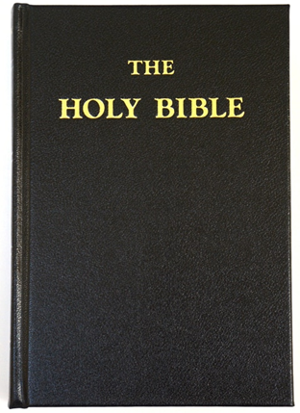
God’s Word
Chapter 1
The Bible is the most amazing book ever written.
The Bible was written by 40 different authors in 3 languages
  Greek in the New Testament
  Hebrew in the Old Testament
  Aramaic in a few verses
It was written over 1800 years
The whole book fits together perfectly

Slide 5
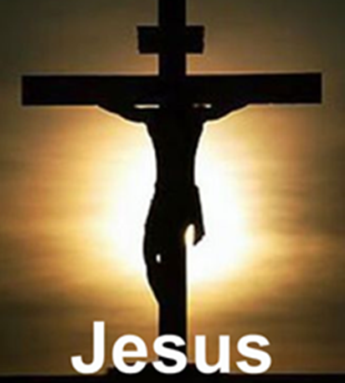
Jesus is the Central Figure of the Bible
The Bible has two parts
Old Testament
New Testament
Before Jesus came
After Jesus came
2,000 years
2,020 years
The word “Testament” means agreement, covenant, or contract.
The Old Testament is about the agreement God made with people before Christ came
The New Testament is about the agreement God made with people after Christ came

Slide 6
God’s Word
The Bible contains 66 books:
  39 books in the Old Testament
  27 books in the New Testament

Slide 7

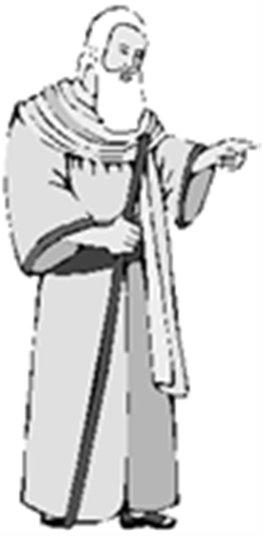
The Bible Is God’s Word
The Bible is a supernatural book
  God’s Words
  Written through people
  in the Bible

Slide 8
God’s Word is referred to in many ways in the Bible:
  Scriptures, commandments, testimonies, precepts, judgments, law, regulations, decrees, etc.

Slide 9
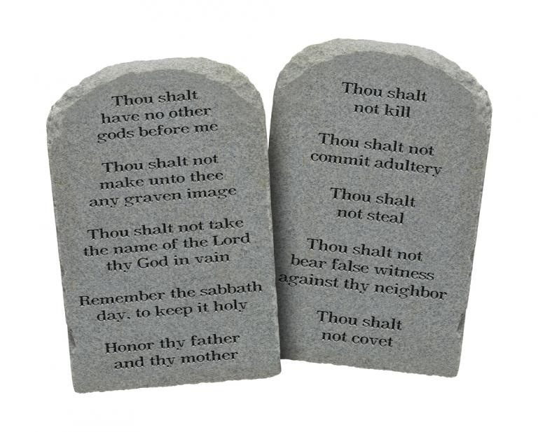
Contents of the Bible
Old Testament
Books of the Law
Will of God for human conduct.
Creation and Nation of Israel.
Written by Moses.
Pentateuch (5)
Genesis
Exodus
Leviticus
Numbers
Deuteronomy

Slide 10
Books of History
History of the nation of Israel up to 400 years before the coming of Christ.
Various writers.
Joshua
Judges
Ruth
I Samuel
II Samuel
I Kings
II Kings
I Chronicles
II Chronicles
Ezra
Nehemiah
Esther

Slide 11
Books of Poetry
Job written by Moses
Psalms written by King David
Ecclesiastes and Song of Solomon
  written by King Solomon

Slide 12
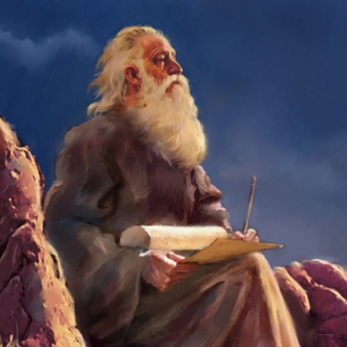
Prophets
Books of warning to the Nation of Israel & foretelling of future things.
Major Prophets
Isaiah
Jeremiah
Lamentations
Ezekiel
Daniel
Minor Prophets
Hosea
Joel
Amos
Obadiah
Jonah
Micah
Nahum
Habakkuk
Zephaniah
Haggai
Zechariah
Malachi

Slide 13
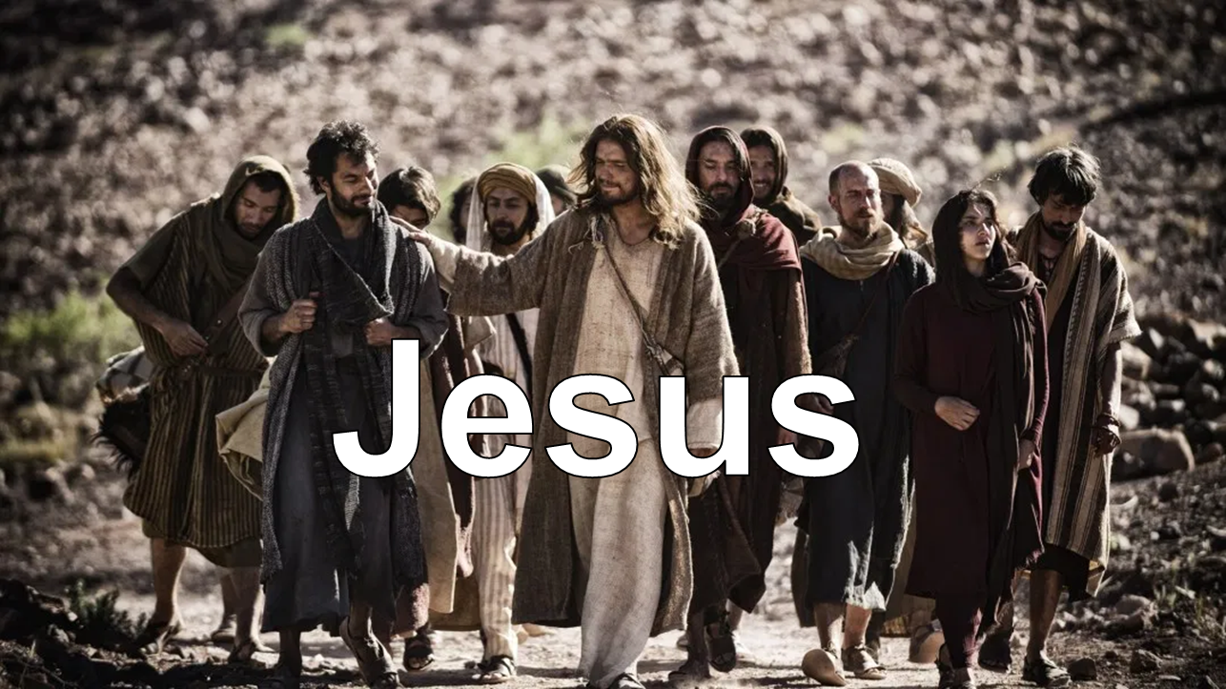
Contents of the Bible
New Testament
Gospels (Biographies)
Life, Death, & Resurrection of Jesus
        Matthew (With emphasis of Jesus as King)
Mark (With emphasis of Jesus as Servant)
Luke (With emphasis of Jesus as Man)
John (With emphasis of Jesus as God)

Slide 14
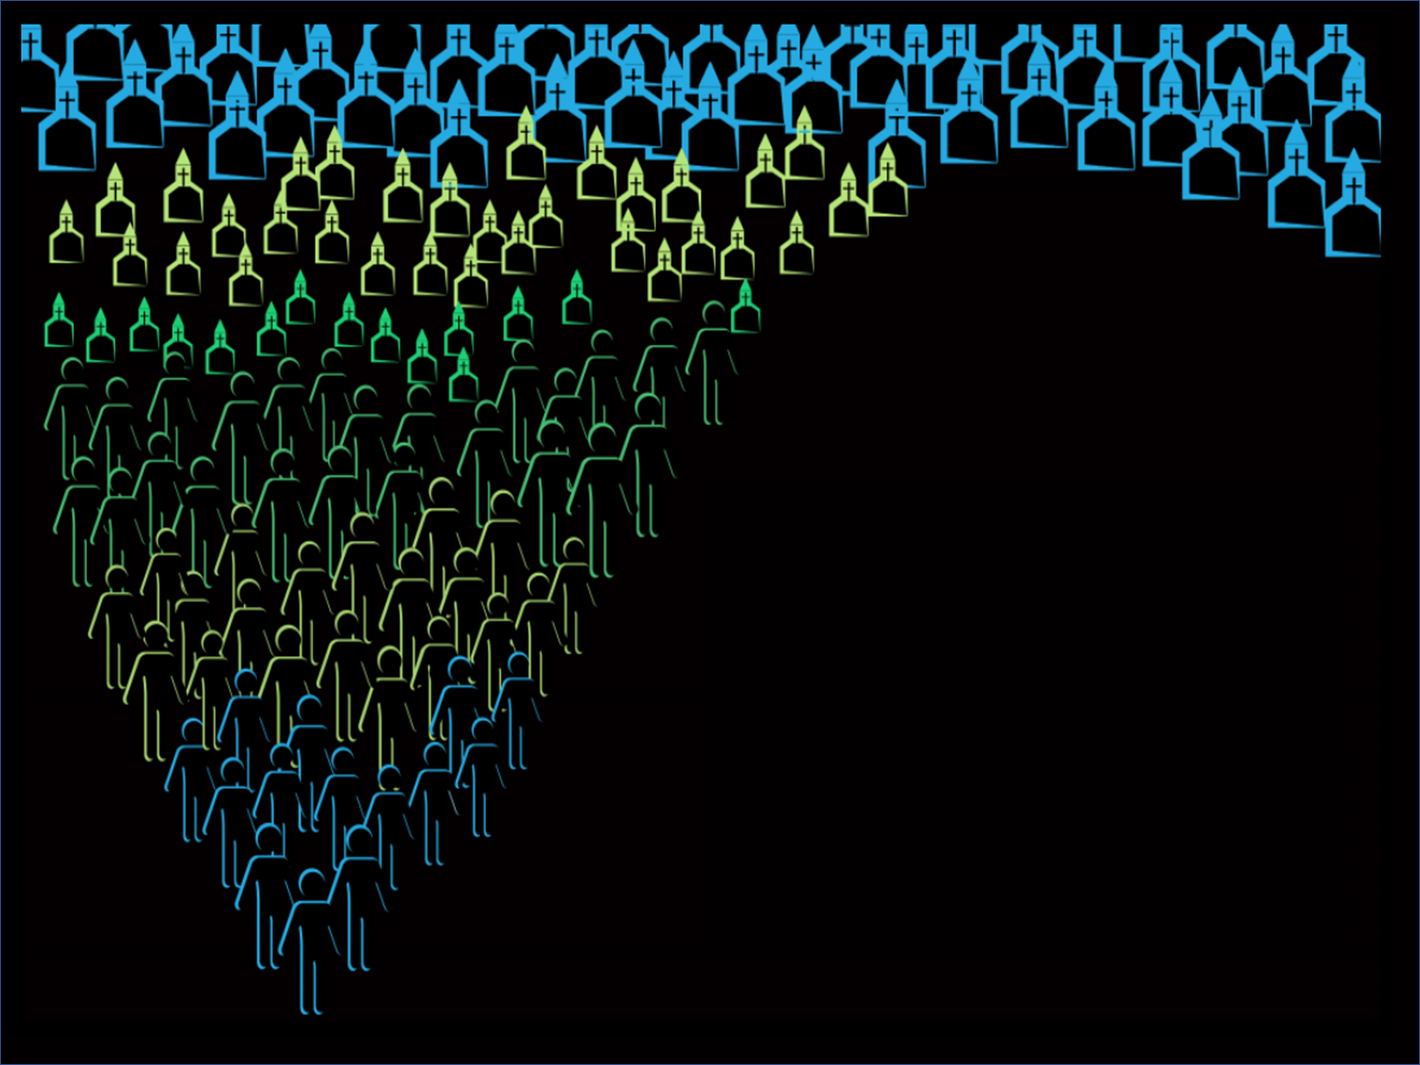
Growth of the Christian Faith
Acts
(Acts of the Apostles)

Slide 15

Letters (Epistles) of the Apostle Paul
Letters to Christians to help them grow to be like Jesus
To Churches:
To Individuals:
I Timothy
II Timothy
Titus
Philemon
Romans
I Corinthians
II Corinthians
Galatians
Ephesians
Philippians
Colossians
I Thessalonians
II Thessalonians

Slide 16

Miscellaneous Letters (Epistles)
Letters of instruction written by various writers to churches or individuals
Hebrews
James
I Peter
II Peter
I John
II John
III John
Jude

Slide 17
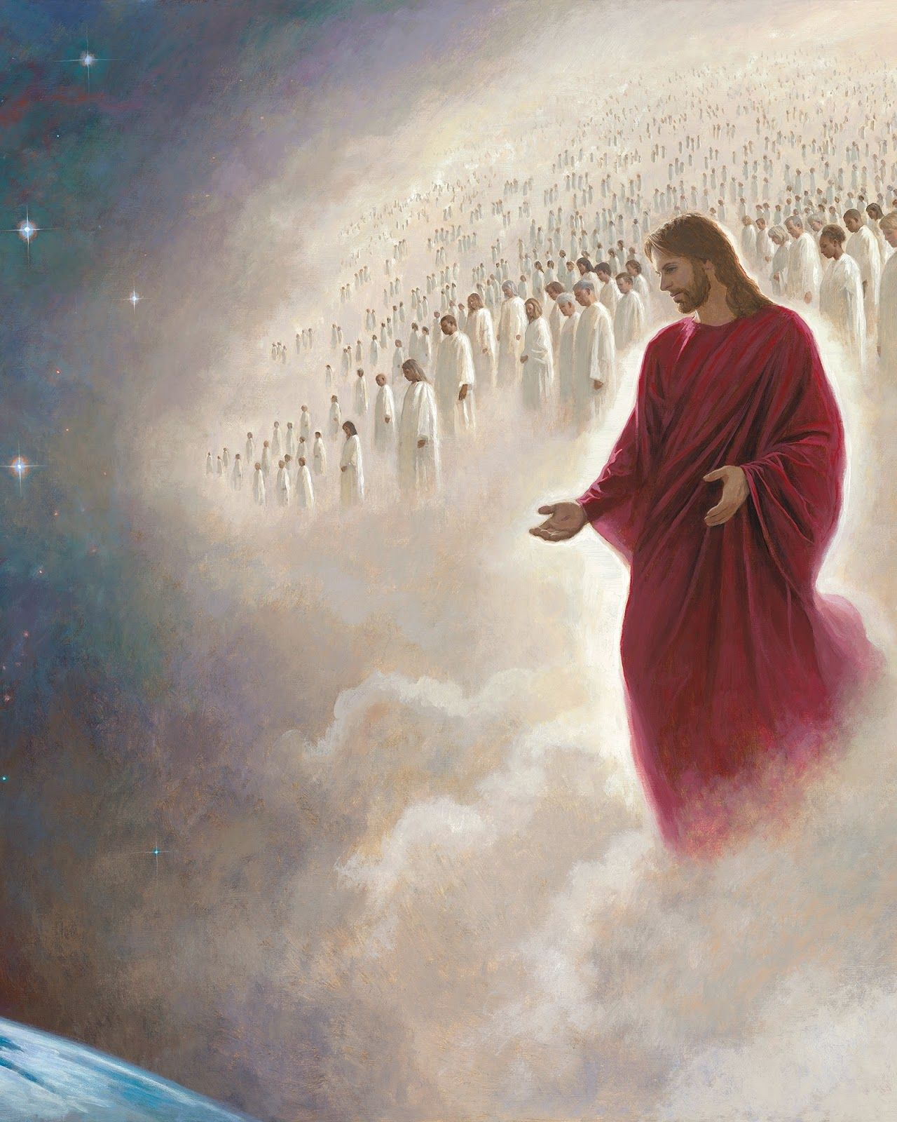
Future of Believers and the Nation of Israel
Revelation

Slide 18

The Bible tells us:
Who God is
What God desires
What God offers
The Bible is God’s Communication to us
The Bible is our operator’s Manual
It explains:
  How to have a relationship with God
  How to live
  How to love others

Slide 19
How the Old Testament and New Testament Fit Together
Old Testament
New Testament
How They Apply to Jesus
Looks to the coming of Jesus
Looks at the life, death,
& resurrection of Jesus
Central People
People of the Nation of Israel
Believers in Jesus
God’s Purpose
To reveal Himself to the world through the Nation of Israel
& look forward to the coming of the Messiah, Jesus
To reveal Himself to the world through His life, death, & resurrection & through the believers in Jesus

Slide 20
Chronological Summary of the Old Testament
History of the human race
Genesis 1-11
History of the Hebrew people
Genesis 12-50
Exodus Wanderings
Conquest
History of the Nation of Israel
Abraham
Isaac
Jacob
Joseph
Samuel
Saul
David
Solomon
Moses
Joshua
Judges
Creation
Fall
2000 BC
1500 BC
1000 BC
400 BC

Slide 21
Timeline of Jesus’ Life
Resurrection
Ascension
Birth
Crucifixion
12
30
33
3 Days
40 Days
Jesus’ Ministry
(3 Years)
Baptized by John the Baptist
Lived a sinless life
Preached to the crowds
Performed miracles
Healed many
Called 12 Disciples to follow Him
Trained the disciples
Talked with the religious leaders
at the Temple

Slide 22

Israel
Israel

Slide 23
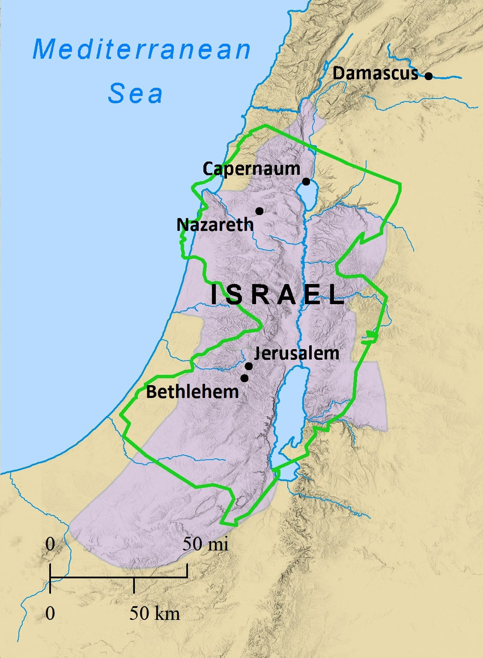

Slide 24
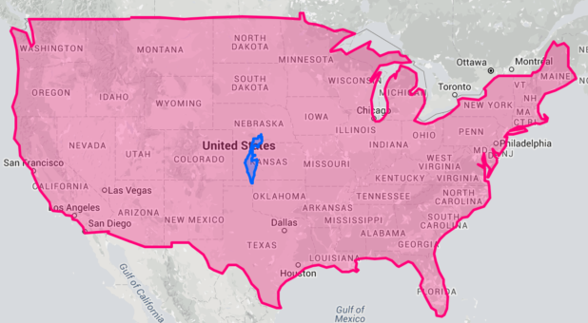
Size of Israel Compared to the USA
Israel

Slide 25
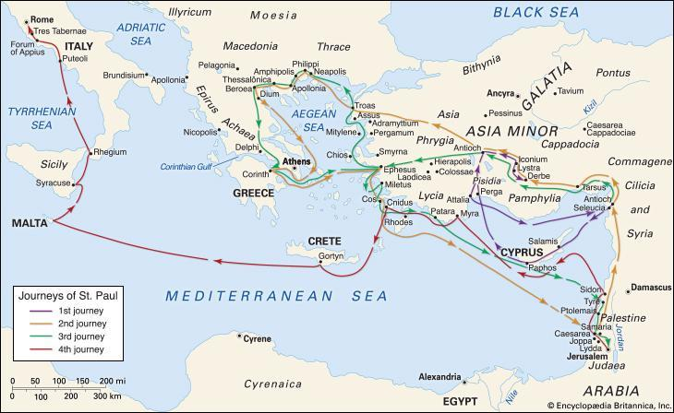
The Spread of Christianity in the Book of Acts

Slide 26
Jesus’ Summary of the Whole Bible
Great Commandment
Jesus replied: "'Love the Lord your God with all your heart and with all your soul and with all your mind.’
This is the first and greatest commandment.
And the second is like it: 'Love your neighbor as yourself.’
All the Law and the Prophets hang on these two commandments." (Matthew 22:37-40)
Love God
Love All People

Slide 27
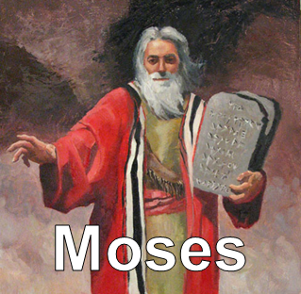
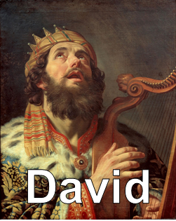

The Bible is God’s Communication to You
God spoke through Moses, King David & others
The Bible is the Word of God not the words of men

Slide 28
You came down on Mount Sinai; you spoke to them from heaven. You gave them regulations and laws that are just and right, and decrees and commands that are good. You made known to them your holy Sabbath and gave them commands, decrees and laws through your servant Moses.
Nehemiah 9:13-14
The Spirit of the LORD spoke through me; his word was on my tongue. 2 Samuel 23:2
And we also thank God continually because, when you received the word of God, which you heard from us, you accepted it not as the word of men, but as it actually is, the word of God, which is at work in you who believe.
1 Thessalonians 2:13

Slide 29
I will bow down toward your holy temple and will praise your name for your love and your faithfulness,
for you have exalted above all things your name and your word. Psalms 138:2
  God made who He is and His Word
  greater than everything
What God Says about His Word

Slide 30
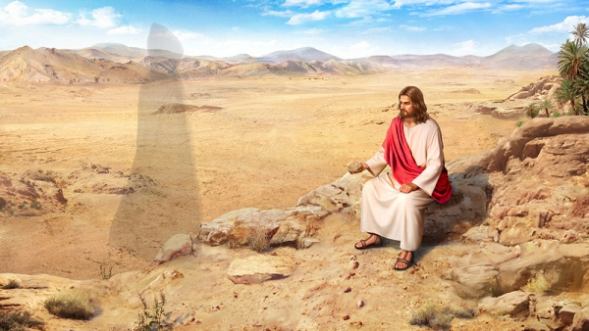
Jesus and the Bible
Jesus was in the desert for 40 days without eating
and then the devil tempted Jesus 3 times
1. The devil tempted Jesus to turn stones into bread
  Jesus answered, “It is written: Man does not live on bread alone, but on every word that comes from the mouth of God.” Matthew 4:4

Slide 31
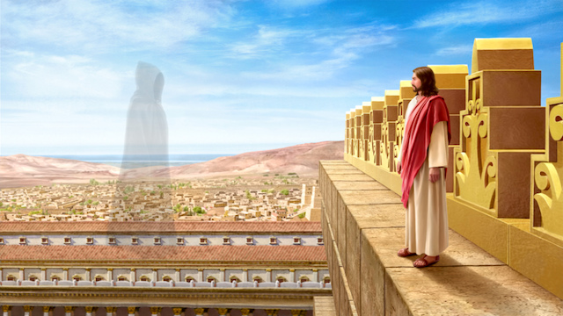
2. The devil took Jesus to the top of the temple and tempted Jesus to jump and allow angels to catch Him.
  Jesus answered him, “It is also written: ‘Do not put the Lord your God to the test.’” Matthew 4:7

Slide 32
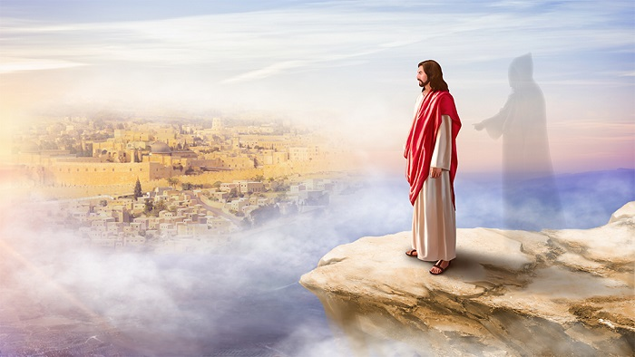
  3. The devil took Jesus to a mountain and showed him all the kingdoms of the world and said, "All this I will give you, if you will bow down and worship me."
  Jesus said, "Away from me, Satan! For it is written: Worship the Lord your, God and serve him only. Matthew 4:10
Jesus quoted the Bible against Satan’s temptations

Slide 33
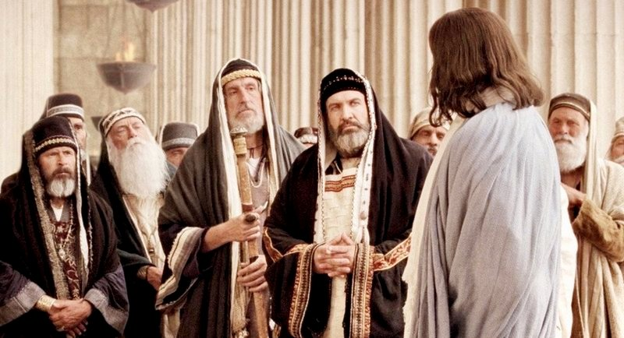
  Jesus speaking to religious leaders
  “Jesus replied, Isaiah was right when he prophesied about you hypocrites;
  as it is written: “‘These people honor me with their lips, but their hearts are far from me.
  They worship me in vain; their teachings are but rules taught by men.’
  You have let go of the commands of God and are holding on to the traditions of men.” Mark 7:6 -8
Some churches
teach rules taught by men and traditions rather than what God says

Slide 34
  Jesus speaking to Jewish religious leaders
  Jesus replied, “Are you not in error because you do not know the Scriptures or the power of God?” Mark 12:24
It’s important to know the Bible to avoid error
What have you learned about the power of God?

Slide 35
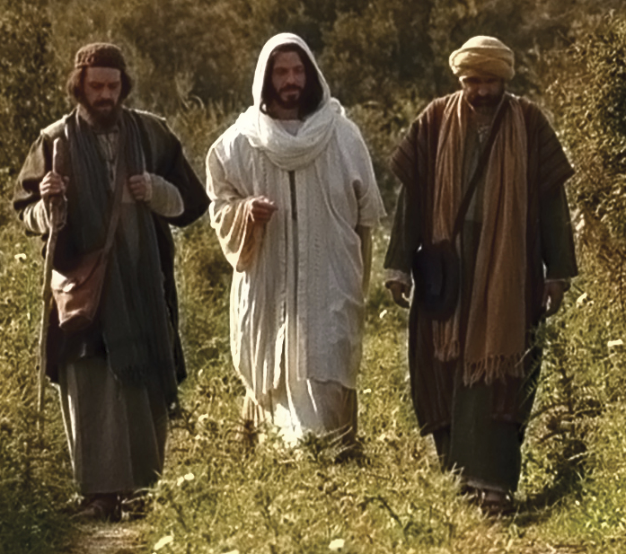
  Jesus speaking to 2 of His disciples
  after His death and resurrection
  He said to them, “How foolish you are, and how slow of heart to believe all that the prophets have spoken!
  Did not the Christ have to suffer these things and then enter his glory?”
  And beginning with Moses and all the Prophets, he explained to them what was said in all the Scriptures concerning himself. Luke 24:25 -27
What have you learned about Jesus in the Bible?

Slide 36
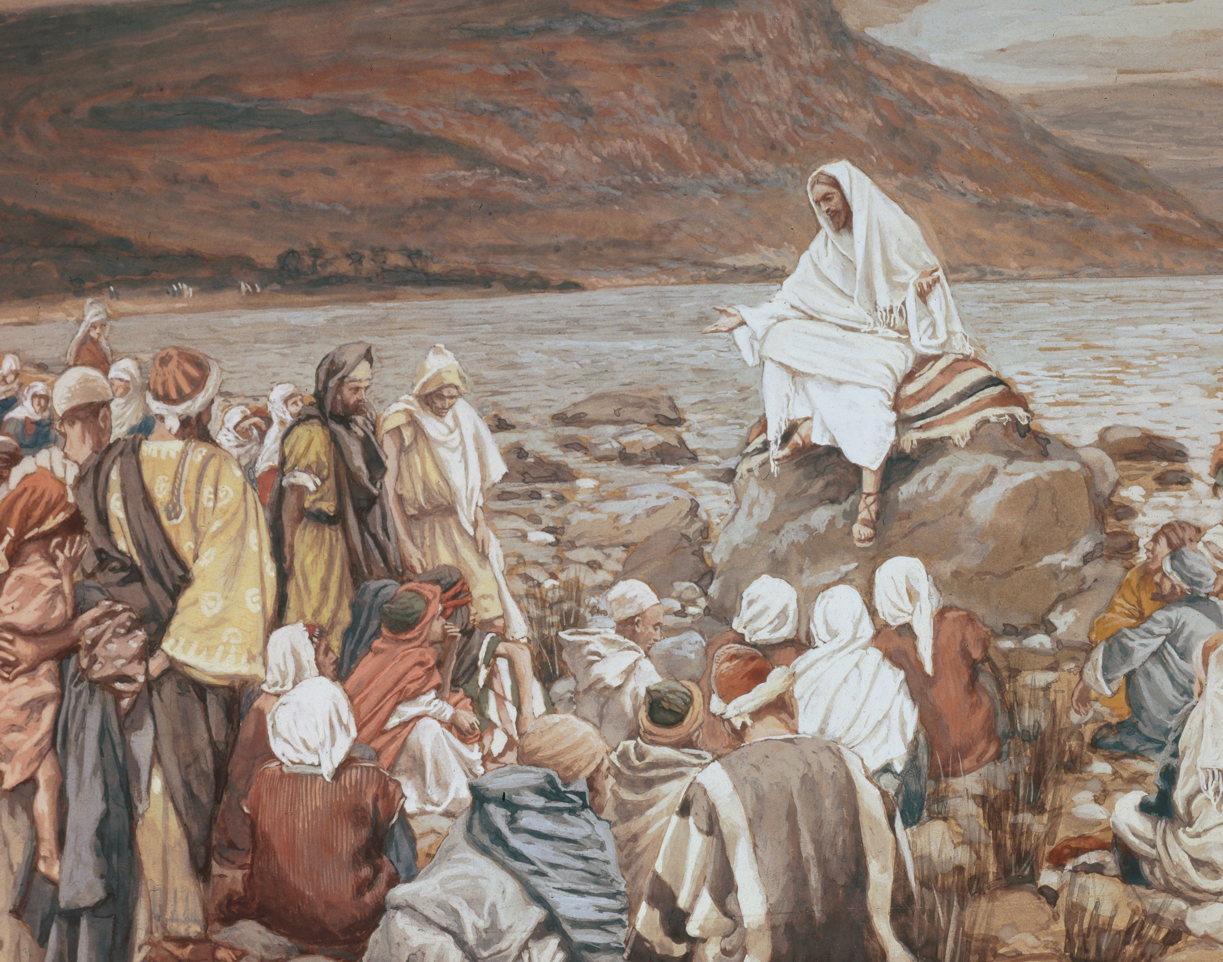
  Words of Jesus
  from the Sermon on the Mount
  “Do not think that I have come to abolish the Law or the Prophets; I have not come to abolish them but to fulfill them.”
  “I tell you the truth, until heaven and earth disappear, not the smallest letter, not the least stroke of a pen, will by any means disappear from the Law until everything is accomplished.” Matthew 5:17-18
What did Jesus say about God’s Word?

Slide 37
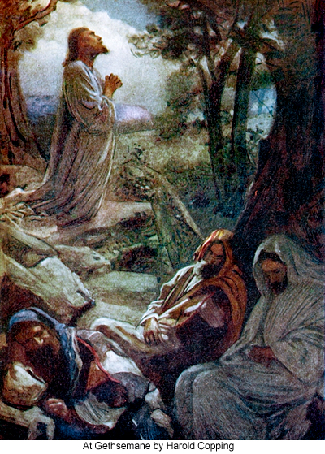
Jesus praying to God for His disciples
before He was arrested, tried, and crucified
  “Use the truth to make them holy.
  Your words are truth.” John 17:17
God’s words are truth
God’s words are in the Bible

Slide 38
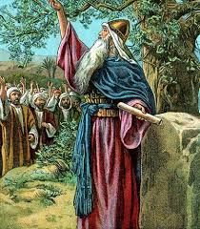
We Can Rely on God’s Word
Joshua speaking to the leaders of Israel
Joshua was the main leader after Moses
  Now I am about to go the way of all the earth.
  You know with all your heart and soul that not one of all the good promises the LORD your God gave you has failed.
  Every promise has been fulfilled; not one has failed. Joshua 23:14
Why can we rely on God’s Word
according to this verse?

Slide 39
  For the word of the LORD is right and true; he is faithful in all he does. Psalms 33:4
  Every word of God is flawless; he is a shield to those who take refuge in him. Proverbs 30:5
Why can we rely on God’s Word
according to these verses?

Slide 40
How God’s Word Helps You
The law of his God is in his heart; his feet do not slip. Psalms 37.31
  Memorize God’s Word to keep from
  falling into sin and suffering bad things
How can God’s Word
keep you from falling into sin?

Slide 41
  The unfolding of your words gives light; it gives understanding to those seeking it. Psalm 119:130
  God’s Word gives understanding and wisdom
How can understanding and wisdom help you?

Slide 42

How the Bible Helps You
All Scripture is inspired by God and is useful for teaching the truth, rebuking error, correcting faults, and giving instruction for right living, so that the person who serves God may be fully qualified and equipped to do every kind of good deed. 2 Timothy 3:16-17
1. Teaches
Shows the path to walk on

Slide 43
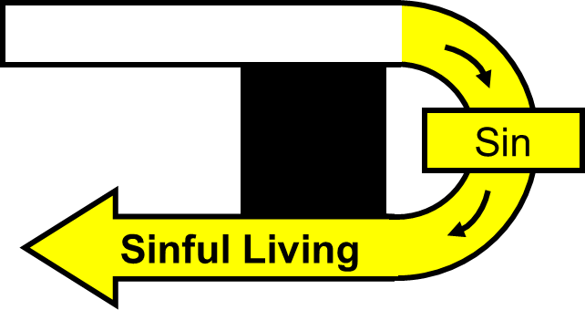
2. Rebukes
Shows where you’ve gotten off the path

Slide 44
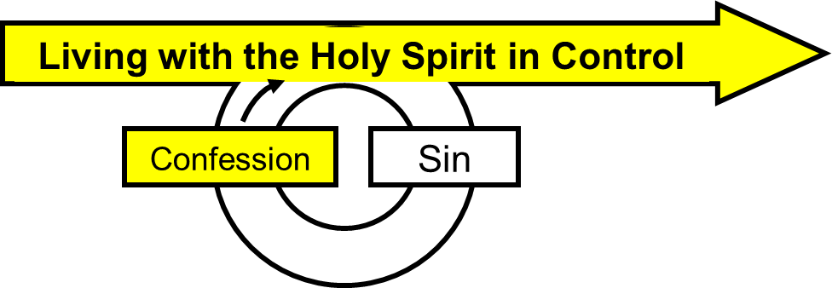
3. Corrects
Shows how to get back on the path

Slide 45
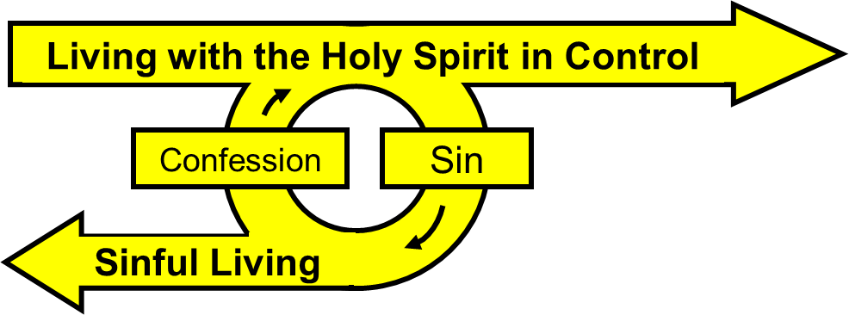
4. Instructs
Shows how to stay on the path

Slide 46
The Bible helps us grow spiritually
and equips us to help others grow spiritually
1. Teaches
Shows the path to walk on
4. Instructs
Shows how to stay on the path
3. Corrects
Shows how to get back on the path
2. Convicts
Shows where you’ve gotten off the path

Slide 47
As the rain and the snow come down from heaven, and do not return to it without watering the earth and making it bud and flourish, so that it yields seed for the sower and bread for the eater,
so is my word that goes out from my mouth: It will not return to me empty, but will accomplish what I desire and achieve the purpose for which I sent it. Isaiah 55:10, 11
God’s Word will accomplish what God desires and achieve the purpose for which He gave it

Slide 48
For the word of God is living and active.
Sharper than any double-edged sword, it penetrates even to dividing soul and spirit, joints and marrow;
it judges the thoughts and attitudes of the heart. Hebrews 4:12
How is God’s Word living and active?
How can you tell that God’s Word knows
the thoughts and intentions of your heart?
How is the Bible helping you?

Slide 49
“God’s Word” Summary
The Bible Is God’s Word
  God’s Words
The Bible is a supernatural book of God’s words written through people in the Bible
Jesus is the central figure of the Bible in
  the Old Testament written before His birth
  and the New Testament written after His birth

Slide 50
The Bible tells us who God is, what He desires, and what He offers
The Bible is God’s communication to us and explains:
  How to have a relationship with God
  How to live
  How to love others

Slide 51
Jesus’ Summary of the Whole Bible
Great Commandment
Love God
Love All People
Matthew 22:37-39

Slide 52


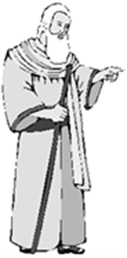
God’s Communication to You
The Bible comes from people who spoke from God by the Holy Spirit
God exalts who He is and His Word above everything

Slide 53
Jesus and the Bible
Jesus quoted scripture when tempted by Satan
Jesus demonstrated the importance and power of God’s Word

Slide 54
Jesus encouraged others to understand and obey the scriptures
Jesus explained to His disciples what was said in all the Scriptures concerning Himself

Slide 55
You Can Rely on the Bible
Every promise in the Bible has been fulfilled, not one has failed
God’s Word is right and true, every word is flawless

Slide 56
How the Bible Helps You
  It keeps us from falling into sin and suffering bad things
It gives us understanding and wisdom
It teaches, convicts, corrects, and trains us
It helps us grow spiritually and equips us to help others grow spiritually

Slide 57
Experience Life Change
Chapter 2
Life Change is a Process
Instead, speaking the truth in love, we will in all things grow up into him who is the Head, that is, Christ. Ephesians 4:15
Life change is becoming like Jesus
How have you experienced life change?
What kind of life change do you want to experience?

Slide 58
How spiritual growth is like physical growth
Anyone who lives on milk, being still an infant, is not acquainted with the teaching about righteousness.
Hebrews 5:13.
Babies feed on milk
Baby Christians keep feeding on the elementary truths of the Bible and don’t grow
How does a spiritual baby behave?
Why do some people stay spiritual babies regardless of how many years they have been a Christian?

Slide 59
How spiritual growth is like physical growth
But solid food is for the mature, who by constant use have trained themselves to distinguish good from evil. Hebrews 5:14
Mature people feed on solid food and grow physically
Mature Christians apply what they learn from the Bible and grow spiritually
How does a mature Christian behave?

Slide 60
Process of Life Change
1. Come | 2. Grow | 3. Serve | 4. Go
Know God | God’s Word Prayer Fellowship | Service | Outreach
Ingredients
Notes:
Ingredients of a disciple of Jesus:
Worship, Fellowship, God’s Word, Prayer, Service, and Outreach
These ingredients provide a summary of all of Jesus’ commands
The Bible is not a menu that we use to choose what areas we want to obey.
A disciple needs to grow spiritually in all these areas
Foundations Discipleship Process
Jesus used four distinct training phases to make His disciples and we do the same thing.
We follow a process of Come-Grow-Serve-Go.
This figure shows how all of the ingredients of a disciple are included in the discipleship process.
Unless we use the same ingredients and the same process Jesus used,
we won’t make the kind of disciples Jesus wants us to make.
Foundations Group members stay with the same group
and the same leader through the Foundations study
This way they maintain the relationships they started with.
This is the same way Jesus trained His disciples.

Slide 61
Process of Life Change
Come and get to know God
Starting point of life change
Grow in your relationship with God
Through God’s Word, prayer, and fellowship
Serve by giving and caring for others
Go and help other people know God
and grow spiritually
Notes:
Foundations Material
The Foundations material can be used for one-on-one discipleship
or with 2-10 other people
Foundations is a series of topical Bible studies:
Come and get to know God and His people. This is where we learn who God is and the importance of fellowship with other Christians.
Grow in your relationship with God. Learn how to grow spiritually through God’s Word and prayer.
Serve by giving and caring for others. Learn about your spiritual gifts and abilities and how to give to and serve God and others.
Go and make disciples. Invest in the lives of others and invite them to know the Lord when they are ready. Then we make disciples by helping them go through this process of Come-Grow-Serve-Go.

Slide 62
Three Aspects of Life Change
Past
  I have received Jesus into my life for forgiveness of my sins
  God sees me as pure because of Jesus in me
Present
  I am becoming like Jesus through the power of the Holy Spirit
  Come–Grow–Serve–Go
Future
  When I die, I will go to heaven and be like Jesus
Notes:
Foundations Material
The Foundations material can be used for one-on-one discipleship
or with 2-10 other people
Foundations is a series of topical Bible studies:
Come and get to know God and His people. This is where we learn who God is and the importance of fellowship with other Christians.
Grow in your relationship with God. Learn how to grow spiritually through God’s Word and prayer.
Serve by giving and caring for others. Learn about your spiritual gifts and abilities and how to give to and serve God and others.
Go and make disciples. Invest in the lives of others and invite them to know the Lord when they are ready. Then we make disciples by helping them go through this process of Come-Grow-Serve-Go.

Slide 63
Experience Life Change through God’s Word
Jesus answered, "It is written: 'Man does not live on bread alone, but on every word that comes from the mouth of God.’” Matthew 4:4
We can’t live on just food
We need the spiritual food of the Bible
What happens if you don’t eat enough food?
What happens if you don’t get enough spiritual food?
Notes:
Foundations Material
The Foundations material can be used for one-on-one discipleship
or with 2-10 other people
Foundations is a series of topical Bible studies:
Come and get to know God and His people. This is where we learn who God is and the importance of fellowship with other Christians.
Grow in your relationship with God. Learn how to grow spiritually through God’s Word and prayer.
Serve by giving and caring for others. Learn about your spiritual gifts and abilities and how to give to and serve God and others.
Go and make disciples. Invest in the lives of others and invite them to know the Lord when they are ready. Then we make disciples by helping them go through this process of Come-Grow-Serve-Go.

Slide 64
Have nothing to do with godless myths and old wives’ tales; rather, train yourself to be godly.
For physical training is of some value, but godliness has value for all things, holding promise for both the present life and the life to come. 1 Timothy 4:7-8
Train yourself to be like Jesus
Physical training has some value
Spiritual training has value now and forever
The Bible is our spiritual training manual
What are the benefits of physical training?
What are the benefits of spiritual training?
Notes:
Foundations Material
The Foundations material can be used for one-on-one discipleship
or with 2-10 other people
Foundations is a series of topical Bible studies:
Come and get to know God and His people. This is where we learn who God is and the importance of fellowship with other Christians.
Grow in your relationship with God. Learn how to grow spiritually through God’s Word and prayer.
Serve by giving and caring for others. Learn about your spiritual gifts and abilities and how to give to and serve God and others.
Go and make disciples. Invest in the lives of others and invite them to know the Lord when they are ready. Then we make disciples by helping them go through this process of Come-Grow-Serve-Go.

Slide 65
His divine power has given us everything we need for life and godliness through our knowledge of him who called us by his own glory and goodness.
Through these he has given us his very great and precious promises, so that through them you may participate in the divine nature and escape the corruption in the world caused by evil desires. 2 Peter 1:3-4
God has given us everything we need through His Word
to become like Jesus and escape our sin nature
Notes:
Foundations Material
The Foundations material can be used for one-on-one discipleship
or with 2-10 other people
Foundations is a series of topical Bible studies:
Come and get to know God and His people. This is where we learn who God is and the importance of fellowship with other Christians.
Grow in your relationship with God. Learn how to grow spiritually through God’s Word and prayer.
Serve by giving and caring for others. Learn about your spiritual gifts and abilities and how to give to and serve God and others.
Go and make disciples. Invest in the lives of others and invite them to know the Lord when they are ready. Then we make disciples by helping them go through this process of Come-Grow-Serve-Go.

Slide 66
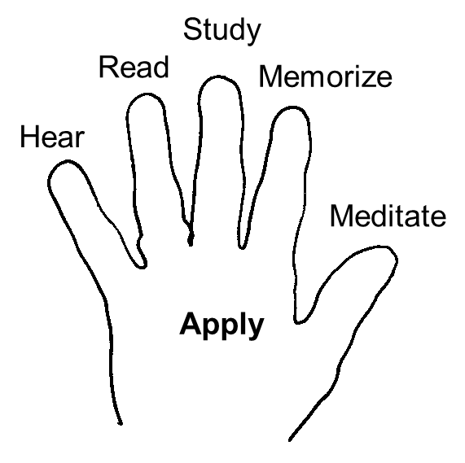
How to Get a Grasp on Your Bible
Notes:
Foundations Material
The Foundations material can be used for one-on-one discipleship
or with 2-10 other people
Foundations is a series of topical Bible studies:
Come and get to know God and His people. This is where we learn who God is and the importance of fellowship with other Christians.
Grow in your relationship with God. Learn how to grow spiritually through God’s Word and prayer.
Serve by giving and caring for others. Learn about your spiritual gifts and abilities and how to give to and serve God and others.
Go and make disciples. Invest in the lives of others and invite them to know the Lord when they are ready. Then we make disciples by helping them go through this process of Come-Grow-Serve-Go.

Slide 67
Hear God’s Word
Faith comes from hearing the message,
and the message is heard through the word of Christ.
Romans 10:17
  What are some ways you can hear God’s Word?
  Church services, small groups, radio, TV, internet
Problem: We forget 95% of what we hear after 72 hours
  What can you do to become a better listener to God’s Word?
    Take notes
Notes:
Foundations Material
The Foundations material can be used for one-on-one discipleship
or with 2-10 other people
Foundations is a series of topical Bible studies:
Come and get to know God and His people. This is where we learn who God is and the importance of fellowship with other Christians.
Grow in your relationship with God. Learn how to grow spiritually through God’s Word and prayer.
Serve by giving and caring for others. Learn about your spiritual gifts and abilities and how to give to and serve God and others.
Go and make disciples. Invest in the lives of others and invite them to know the Lord when they are ready. Then we make disciples by helping them go through this process of Come-Grow-Serve-Go.

Slide 68
Read God’s Word
If you read 15 minutes a day,
you can read through the Bible in a year.
BIBLE READING SUGGESTIONS
• Choose a reading plan
• Read in different versions: New International Version, The Message, etc
• For variety read it aloud sometimes.
• Underline or color-code key verses.
• Respond back to God in prayer about what you read
Notes:
Foundations Material
The Foundations material can be used for one-on-one discipleship
or with 2-10 other people
Foundations is a series of topical Bible studies:
Come and get to know God and His people. This is where we learn who God is and the importance of fellowship with other Christians.
Grow in your relationship with God. Learn how to grow spiritually through God’s Word and prayer.
Serve by giving and caring for others. Learn about your spiritual gifts and abilities and how to give to and serve God and others.
Go and make disciples. Invest in the lives of others and invite them to know the Lord when they are ready. Then we make disciples by helping them go through this process of Come-Grow-Serve-Go.

Slide 69
Study God’s Word
Bible reading gives us an OVERVIEW of God’s Word
Bible study gives us DETAILED knowledge of specific truths and helps us develop deeper convictions.
Bible study is feeding on the MEAT of God’s Word.
We can read through a chapter in the Bible in two to five minutes, but it may take an hour or more to study the same chapter.
Notes:
Foundations Material
The Foundations material can be used for one-on-one discipleship
or with 2-10 other people
Foundations is a series of topical Bible studies:
Come and get to know God and His people. This is where we learn who God is and the importance of fellowship with other Christians.
Grow in your relationship with God. Learn how to grow spiritually through God’s Word and prayer.
Serve by giving and caring for others. Learn about your spiritual gifts and abilities and how to give to and serve God and others.
Go and make disciples. Invest in the lives of others and invite them to know the Lord when they are ready. Then we make disciples by helping them go through this process of Come-Grow-Serve-Go.

Slide 70
Bible study is how we let God be our TEACHER rather than some other person.
God wants to teach us DIRECTLY from His Word.
We are responsible to study God’s word for ourselves instead of just relying on others if we want to GROW spiritually.
Bible study involves several aspects that help us INTERPRET it correctly so we can APPLY it to our lives correctly.
Foundations is a topical Bible study. We study what God says about different topics and we apply it to our lives in order to experience life change and become more like Jesus.
Notes:
Foundations Material
The Foundations material can be used for one-on-one discipleship
or with 2-10 other people
Foundations is a series of topical Bible studies:
Come and get to know God and His people. This is where we learn who God is and the importance of fellowship with other Christians.
Grow in your relationship with God. Learn how to grow spiritually through God’s Word and prayer.
Serve by giving and caring for others. Learn about your spiritual gifts and abilities and how to give to and serve God and others.
Go and make disciples. Invest in the lives of others and invite them to know the Lord when they are ready. Then we make disciples by helping them go through this process of Come-Grow-Serve-Go.

Slide 71
Memorize God’s Word
Keep my commands and you will live; guard my teachings as the apple of your eye. Bind them on your fingers; write them on the tablet of your heart. Proverbs 7:2-3
BENEFITS OF SCRIPTURE MEMORY
It helps me RESIST temptation.
I have hidden your word in my heart that I might not sin against you. Psalm 119:11.
How can scripture memory help you resist temptation?
Notes:
Foundations Material
The Foundations material can be used for one-on-one discipleship
or with 2-10 other people
Foundations is a series of topical Bible studies:
Come and get to know God and His people. This is where we learn who God is and the importance of fellowship with other Christians.
Grow in your relationship with God. Learn how to grow spiritually through God’s Word and prayer.
Serve by giving and caring for others. Learn about your spiritual gifts and abilities and how to give to and serve God and others.
Go and make disciples. Invest in the lives of others and invite them to know the Lord when they are ready. Then we make disciples by helping them go through this process of Come-Grow-Serve-Go.

Slide 72
It helps me make WISE DECISIONS.
“Your word is a lamp to my feet and a light for my path.” Psalm 119:105
  How?
It STRENGTHENS me when I’m under stress.
My soul is weary with sorrow; strengthen me according to your word. Psalm 119:28
  How?
Notes:
Foundations Material
The Foundations material can be used for one-on-one discipleship
or with 2-10 other people
Foundations is a series of topical Bible studies:
Come and get to know God and His people. This is where we learn who God is and the importance of fellowship with other Christians.
Grow in your relationship with God. Learn how to grow spiritually through God’s Word and prayer.
Serve by giving and caring for others. Learn about your spiritual gifts and abilities and how to give to and serve God and others.
Go and make disciples. Invest in the lives of others and invite them to know the Lord when they are ready. Then we make disciples by helping them go through this process of Come-Grow-Serve-Go.

Slide 73
It COMFORTS me when I’m sad.
“My comfort in my suffering is this: Your promise preserves my life.” Psalm 119:50
  How?
It helps me SHARE with unbelievers.
Always be prepared to give an answer to everyone who asks you to give the reason for the hope that you have. 1 Peter 3:15.
  How?
Notes:
Foundations Material
The Foundations material can be used for one-on-one discipleship
or with 2-10 other people
Foundations is a series of topical Bible studies:
Come and get to know God and His people. This is where we learn who God is and the importance of fellowship with other Christians.
Grow in your relationship with God. Learn how to grow spiritually through God’s Word and prayer.
Serve by giving and caring for others. Learn about your spiritual gifts and abilities and how to give to and serve God and others.
Go and make disciples. Invest in the lives of others and invite them to know the Lord when they are ready. Then we make disciples by helping them go through this process of Come-Grow-Serve-Go.

Slide 74
WHEN TO MEMORIZE A VERSE
During your Quiet Time
While Exercising
While waiting (spare moments)
When is the best time for you to memorize and review verses?
Notes:
Foundations Material
The Foundations material can be used for one-on-one discipleship
or with 2-10 other people
Foundations is a series of topical Bible studies:
Come and get to know God and His people. This is where we learn who God is and the importance of fellowship with other Christians.
Grow in your relationship with God. Learn how to grow spiritually through God’s Word and prayer.
Serve by giving and caring for others. Learn about your spiritual gifts and abilities and how to give to and serve God and others.
Go and make disciples. Invest in the lives of others and invite them to know the Lord when they are ready. Then we make disciples by helping them go through this process of Come-Grow-Serve-Go.

Slide 75
HOW TO MEMORIZE A VERSE
Start by saying the topic of the verse.
  Life Change
Say the reference before and after the verse.
  Galatians 2:20
Memorize one phrase at a time.
Notes:
Foundations Material
The Foundations material can be used for one-on-one discipleship
or with 2-10 other people
Foundations is a series of topical Bible studies:
Come and get to know God and His people. This is where we learn who God is and the importance of fellowship with other Christians.
Grow in your relationship with God. Learn how to grow spiritually through God’s Word and prayer.
Serve by giving and caring for others. Learn about your spiritual gifts and abilities and how to give to and serve God and others.
Go and make disciples. Invest in the lives of others and invite them to know the Lord when they are ready. Then we make disciples by helping them go through this process of Come-Grow-Serve-Go.

Slide 76
Use verse cards.
Always carry some verse cards with you for review.
Review the verse daily for a month and then once a month for life.
Always memorize the verse word perfect.
Notes:
Foundations Material
The Foundations material can be used for one-on-one discipleship
or with 2-10 other people
Foundations is a series of topical Bible studies:
Come and get to know God and His people. This is where we learn who God is and the importance of fellowship with other Christians.
Grow in your relationship with God. Learn how to grow spiritually through God’s Word and prayer.
Serve by giving and caring for others. Learn about your spiritual gifts and abilities and how to give to and serve God and others.
Go and make disciples. Invest in the lives of others and invite them to know the Lord when they are ready. Then we make disciples by helping them go through this process of Come-Grow-Serve-Go.

Slide 77
OTHER HELP FOR MEMORIZING
Read the verse aloud many times.
Write it down.
Emphasize key words when quoting the verse.
Display your verse cards in prominent places.
Get a partner so you can check each other.
Notes:
Foundations Material
The Foundations material can be used for one-on-one discipleship
or with 2-10 other people
Foundations is a series of topical Bible studies:
Come and get to know God and His people. This is where we learn who God is and the importance of fellowship with other Christians.
Grow in your relationship with God. Learn how to grow spiritually through God’s Word and prayer.
Serve by giving and caring for others. Learn about your spiritual gifts and abilities and how to give to and serve God and others.
Go and make disciples. Invest in the lives of others and invite them to know the Lord when they are ready. Then we make disciples by helping them go through this process of Come-Grow-Serve-Go.

Slide 78
THREE KEYS TO MEMORIZING:
1. REVIEW
2. REVIEW
3. REVIEW
If you review a verse once a day for 30 days and then review it once a month for the rest of your life, then it’s yours for life.
Notes:
Foundations Material
The Foundations material can be used for one-on-one discipleship
or with 2-10 other people
Foundations is a series of topical Bible studies:
Come and get to know God and His people. This is where we learn who God is and the importance of fellowship with other Christians.
Grow in your relationship with God. Learn how to grow spiritually through God’s Word and prayer.
Serve by giving and caring for others. Learn about your spiritual gifts and abilities and how to give to and serve God and others.
Go and make disciples. Invest in the lives of others and invite them to know the Lord when they are ready. Then we make disciples by helping them go through this process of Come-Grow-Serve-Go.

Slide 79
We remember what is IMPORTANT TO US.
The law from your mouth is more precious to me than thousands of pieces of silver and gold. Psalm 119:72
Why do you think you should memorize Bible verses?
How do you know that you can memorize Bible verses?
  You know your name, address, phone number, etc
You can memorize!
Memorize Galatians 2:20 this week.
Notes:
Foundations Material
The Foundations material can be used for one-on-one discipleship
or with 2-10 other people
Foundations is a series of topical Bible studies:
Come and get to know God and His people. This is where we learn who God is and the importance of fellowship with other Christians.
Grow in your relationship with God. Learn how to grow spiritually through God’s Word and prayer.
Serve by giving and caring for others. Learn about your spiritual gifts and abilities and how to give to and serve God and others.
Go and make disciples. Invest in the lives of others and invite them to know the Lord when they are ready. Then we make disciples by helping them go through this process of Come-Grow-Serve-Go.

Slide 80
Life Change Memory Verses
Life Change
  Galatians 2:20
  Romans 12:2
  Come and Worship
    Matthew 22:37-39
  Come and Fellowship
    1 Thessalonians 5:11
  Grow through God’s Word
    2 Timothy 3:16
Grow through Prayer
  Philippians 4:6-7
Serve Like Jesus
  Mark 10:45
Serve by Giving
  2 Corinthians 9:6-7
Go and Be Witnesses
  Acts 1:8
Go and Make Disciples
  Matthew 28:19-20

Slide 81
Meditate on God’s Word
But his delight is in the law of the LORD, and on his law he meditates day and night.
He is like a tree planted by streams of water, which yields its fruit in season and whose leaf does not wither. Whatever he does prospers. Psalm 1:2-3
Notes:
Foundations Material
The Foundations material can be used for one-on-one discipleship
or with 2-10 other people
Foundations is a series of topical Bible studies:
Come and get to know God and His people. This is where we learn who God is and the importance of fellowship with other Christians.
Grow in your relationship with God. Learn how to grow spiritually through God’s Word and prayer.
Serve by giving and caring for others. Learn about your spiritual gifts and abilities and how to give to and serve God and others.
Go and make disciples. Invest in the lives of others and invite them to know the Lord when they are ready. Then we make disciples by helping them go through this process of Come-Grow-Serve-Go.

Slide 82
Meditate on God’s Word
What is meditation?
Meditation is FOCUSED THINKING about a Bible passage in order to discover how you can apply its truth to your own life.
Meditation is not emptying your mind.
Meditate on God’s Word while hearing, reading, studying, and memorizing it.
Notes:
Foundations Material
The Foundations material can be used for one-on-one discipleship
or with 2-10 other people
Foundations is a series of topical Bible studies:
Come and get to know God and His people. This is where we learn who God is and the importance of fellowship with other Christians.
Grow in your relationship with God. Learn how to grow spiritually through God’s Word and prayer.
Serve by giving and caring for others. Learn about your spiritual gifts and abilities and how to give to and serve God and others.
Go and make disciples. Invest in the lives of others and invite them to know the Lord when they are ready. Then we make disciples by helping them go through this process of Come-Grow-Serve-Go.

Slide 83
Ways to meditate on God’s Word
Picture it. Visualize the scene in your mind.
Pronounce it. Say the verse aloud, each time emphasizing a different word.
Paraphrase it. Rewrite the verse in your own words.
Personalize it. Replace the pronouns or people with your own name.
I love the Lord my God with all my heart, and with all my soul, and with all my mind. And I love my neighbor as myself. Matthew 22:37-39
Pray it. Turn the verse into a prayer and say it back to God.
Notes:
Foundations Material
The Foundations material can be used for one-on-one discipleship
or with 2-10 other people
Foundations is a series of topical Bible studies:
Come and get to know God and His people. This is where we learn who God is and the importance of fellowship with other Christians.
Grow in your relationship with God. Learn how to grow spiritually through God’s Word and prayer.
Serve by giving and caring for others. Learn about your spiritual gifts and abilities and how to give to and serve God and others.
Go and make disciples. Invest in the lives of others and invite them to know the Lord when they are ready. Then we make disciples by helping them go through this process of Come-Grow-Serve-Go.

Slide 84
What are you going to do
to have a better intake of God’s Word
at this point in your spiritual growth?
Notes:
Foundations Material
The Foundations material can be used for one-on-one discipleship
or with 2-10 other people
Foundations is a series of topical Bible studies:
Come and get to know God and His people. This is where we learn who God is and the importance of fellowship with other Christians.
Grow in your relationship with God. Learn how to grow spiritually through God’s Word and prayer.
Serve by giving and caring for others. Learn about your spiritual gifts and abilities and how to give to and serve God and others.
Go and make disciples. Invest in the lives of others and invite them to know the Lord when they are ready. Then we make disciples by helping them go through this process of Come-Grow-Serve-Go.

Slide 85
Apply God’s Word
The purpose of hearing, reading, studying, memorizing, and meditating on God’s Word is to put it into practice in your lives.
Applying God’s Word to your life is how to experience Life Change.
As you do your part and develop the habit of feeding on God’s Word, which is necessary for spiritual growth, you must never forget God’s part and live by the Spirit and His power every day.
Notes:
Foundations Material
The Foundations material can be used for one-on-one discipleship
or with 2-10 other people
Foundations is a series of topical Bible studies:
Come and get to know God and His people. This is where we learn who God is and the importance of fellowship with other Christians.
Grow in your relationship with God. Learn how to grow spiritually through God’s Word and prayer.
Serve by giving and caring for others. Learn about your spiritual gifts and abilities and how to give to and serve God and others.
Go and make disciples. Invest in the lives of others and invite them to know the Lord when they are ready. Then we make disciples by helping them go through this process of Come-Grow-Serve-Go.

Slide 86
Steps for Applying God’s Word to Your Life
The one thing I am going to apply to my life:
1. What should my life be like from God’s Word? (Application verse)
2. What is my life like that is different from God’s Word?
3. What am I going to do to put God’s Word into practice?
4. How will I check up to make sure I have accomplished what God wants me to?
Notes:
Foundations Material
The Foundations material can be used for one-on-one discipleship
or with 2-10 other people
Foundations is a series of topical Bible studies:
Come and get to know God and His people. This is where we learn who God is and the importance of fellowship with other Christians.
Grow in your relationship with God. Learn how to grow spiritually through God’s Word and prayer.
Serve by giving and caring for others. Learn about your spiritual gifts and abilities and how to give to and serve God and others.
Go and make disciples. Invest in the lives of others and invite them to know the Lord when they are ready. Then we make disciples by helping them go through this process of Come-Grow-Serve-Go.

Slide 87
Example of Applying God’s Word to Your Life
Do not be anxious about anything, but in everything, by prayer and petition, with thanksgiving, present your requests to God. And the peace of God, which transcends all understanding, will guard your hearts and your minds in Christ Jesus. Philippians 4:6 - 7
The one thing I am going to apply to my life:
What should my life be like from God’s Word?
Do not be anxious about anything
Notes:
Foundations Material
The Foundations material can be used for one-on-one discipleship
or with 2-10 other people
Foundations is a series of topical Bible studies:
Come and get to know God and His people. This is where we learn who God is and the importance of fellowship with other Christians.
Grow in your relationship with God. Learn how to grow spiritually through God’s Word and prayer.
Serve by giving and caring for others. Learn about your spiritual gifts and abilities and how to give to and serve God and others.
Go and make disciples. Invest in the lives of others and invite them to know the Lord when they are ready. Then we make disciples by helping them go through this process of Come-Grow-Serve-Go.

Slide 88
Do not be anxious about anything, but in everything, by prayer and petition, with thanksgiving, present your requests to God. And the peace of God, which transcends all understanding, will guard your hearts and your minds in Christ Jesus. Philippians 4:6 - 7
2. What is my life like that is different from God’s Word?
I worry and am anxious
Notes:
Foundations Material
The Foundations material can be used for one-on-one discipleship
or with 2-10 other people
Foundations is a series of topical Bible studies:
Come and get to know God and His people. This is where we learn who God is and the importance of fellowship with other Christians.
Grow in your relationship with God. Learn how to grow spiritually through God’s Word and prayer.
Serve by giving and caring for others. Learn about your spiritual gifts and abilities and how to give to and serve God and others.
Go and make disciples. Invest in the lives of others and invite them to know the Lord when they are ready. Then we make disciples by helping them go through this process of Come-Grow-Serve-Go.

Slide 89
Do not be anxious about anything, but in everything, by prayer and petition, with thanksgiving, present your requests to God. And the peace of God, which transcends all understanding, will guard your hearts and your minds in Christ Jesus. Philippians 4:6 - 7
3. What am I going to do to put God’s Word into practice?
I will memorize these verses
Notes:
Foundations Material
The Foundations material can be used for one-on-one discipleship
or with 2-10 other people
Foundations is a series of topical Bible studies:
Come and get to know God and His people. This is where we learn who God is and the importance of fellowship with other Christians.
Grow in your relationship with God. Learn how to grow spiritually through God’s Word and prayer.
Serve by giving and caring for others. Learn about your spiritual gifts and abilities and how to give to and serve God and others.
Go and make disciples. Invest in the lives of others and invite them to know the Lord when they are ready. Then we make disciples by helping them go through this process of Come-Grow-Serve-Go.

Slide 90
Do not be anxious about anything, but in everything, by prayer and petition, with thanksgiving, present your requests to God. And the peace of God, which transcends all understanding, will guard your hearts and your minds in Christ Jesus. Philippians 4:6 - 7
4. How will I check up to make sure I have accomplished what God wants me to?
  Share my progress in our Bible study
Notes:
Foundations Material
The Foundations material can be used for one-on-one discipleship
or with 2-10 other people
Foundations is a series of topical Bible studies:
Come and get to know God and His people. This is where we learn who God is and the importance of fellowship with other Christians.
Grow in your relationship with God. Learn how to grow spiritually through God’s Word and prayer.
Serve by giving and caring for others. Learn about your spiritual gifts and abilities and how to give to and serve God and others.
Go and make disciples. Invest in the lives of others and invite them to know the Lord when they are ready. Then we make disciples by helping them go through this process of Come-Grow-Serve-Go.

Slide 91
“Experience Life Change” Summary
Life Change is a Process
Life Change is the process of becoming like Jesus
Spiritual growth is a process of maturing just like physical growth
Our process of Life Change is to
  Come-Grow-Serve-Go
Notes:
Foundations Material
The Foundations material can be used for one-on-one discipleship
or with 2-10 other people
Foundations is a series of topical Bible studies:
Come and get to know God and His people. This is where we learn who God is and the importance of fellowship with other Christians.
Grow in your relationship with God. Learn how to grow spiritually through God’s Word and prayer.
Serve by giving and caring for others. Learn about your spiritual gifts and abilities and how to give to and serve God and others.
Go and make disciples. Invest in the lives of others and invite them to know the Lord when they are ready. Then we make disciples by helping them go through this process of Come-Grow-Serve-Go.

Slide 92
The three aspects of salvation
  Past
  I have received Jesus into my life for forgiveness of my sins
  God sees me as pure because of Jesus in me
  Present
  I am becoming like Jesus through the power of the Holy Spirit
  Future
  When I die, I will go to heaven and be like Jesus
Notes:
Foundations Material
The Foundations material can be used for one-on-one discipleship
or with 2-10 other people
Foundations is a series of topical Bible studies:
Come and get to know God and His people. This is where we learn who God is and the importance of fellowship with other Christians.
Grow in your relationship with God. Learn how to grow spiritually through God’s Word and prayer.
Serve by giving and caring for others. Learn about your spiritual gifts and abilities and how to give to and serve God and others.
Go and make disciples. Invest in the lives of others and invite them to know the Lord when they are ready. Then we make disciples by helping them go through this process of Come-Grow-Serve-Go.

Slide 93
Experience Life Change Through God’s Word
God’s Word is your spiritual food that makes you grow
God provides everything you need for spiritual growth
  His Word to guide you
  His Spirit to help you understand His Word
Notes:
Foundations Material
The Foundations material can be used for one-on-one discipleship
or with 2-10 other people
Foundations is a series of topical Bible studies:
Come and get to know God and His people. This is where we learn who God is and the importance of fellowship with other Christians.
Grow in your relationship with God. Learn how to grow spiritually through God’s Word and prayer.
Serve by giving and caring for others. Learn about your spiritual gifts and abilities and how to give to and serve God and others.
Go and make disciples. Invest in the lives of others and invite them to know the Lord when they are ready. Then we make disciples by helping them go through this process of Come-Grow-Serve-Go.

Slide 94
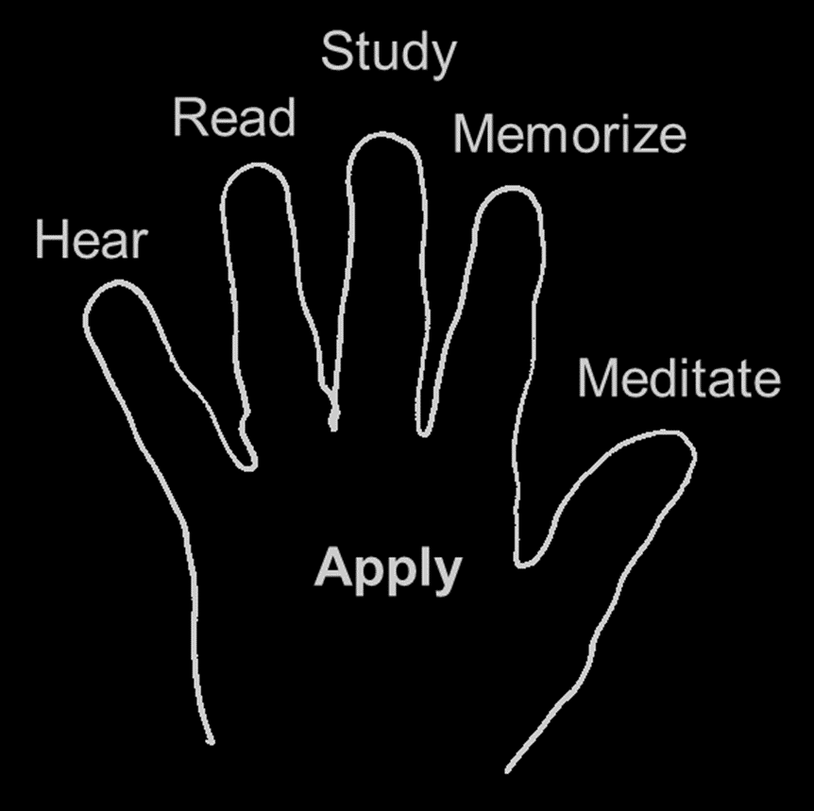
How to Get a Grasp on Your Bible
Hear God’s Word
  We forget 95% of what we hear after 72 hours
Read God’s Word
  Bible reading gives you an overview of God’s Word
Study God’s Word
  Bible study is how you feed on the meat of God’s Word
Notes:
Foundations Material
The Foundations material can be used for one-on-one discipleship
or with 2-10 other people
Foundations is a series of topical Bible studies:
Come and get to know God and His people. This is where we learn who God is and the importance of fellowship with other Christians.
Grow in your relationship with God. Learn how to grow spiritually through God’s Word and prayer.
Serve by giving and caring for others. Learn about your spiritual gifts and abilities and how to give to and serve God and others.
Go and make disciples. Invest in the lives of others and invite them to know the Lord when they are ready. Then we make disciples by helping them go through this process of Come-Grow-Serve-Go.

Slide 95
Memorize God’s Word
  There are many benefits to scripture memory
  You can memorize if you make it a priority
Meditate on God’s Word
  Meditation is focused thinking about a passage of God’s Word
Apply God’s Word
  Have a balanced intake of God’s Word
  Experience Life Change by putting God’s Word into practice in thought, word, and deed
Notes:
Foundations Material
The Foundations material can be used for one-on-one discipleship
or with 2-10 other people
Foundations is a series of topical Bible studies:
Come and get to know God and His people. This is where we learn who God is and the importance of fellowship with other Christians.
Grow in your relationship with God. Learn how to grow spiritually through God’s Word and prayer.
Serve by giving and caring for others. Learn about your spiritual gifts and abilities and how to give to and serve God and others.
Go and make disciples. Invest in the lives of others and invite them to know the Lord when they are ready. Then we make disciples by helping them go through this process of Come-Grow-Serve-Go.

Slide 96
Obey God
Chapter 3
The reason we hear, read, study, memorize, and meditate on God’s Word
is to obey it and experience Life Change:
to become more like Jesus.
Notes:
Foundations Material
The Foundations material can be used for one-on-one discipleship
or with 2-10 other people
Foundations is a series of topical Bible studies:
Come and get to know God and His people. This is where we learn who God is and the importance of fellowship with other Christians.
Grow in your relationship with God. Learn how to grow spiritually through God’s Word and prayer.
Serve by giving and caring for others. Learn about your spiritual gifts and abilities and how to give to and serve God and others.
Go and make disciples. Invest in the lives of others and invite them to know the Lord when they are ready. Then we make disciples by helping them go through this process of Come-Grow-Serve-Go.

Slide 97
Why You Should Obey God
Now, people of Israel, listen to what the LORD your God demands of you: Worship the LORD and do all that he commands.
Love him, serve him with all your heart, and obey all his laws.
I am giving them to you today for your benefit. Deuteronomy 10:12-13
Why does God want us to obey Him?
How do you know that obeying God
is for your own good?
Notes:
Foundations Material
The Foundations material can be used for one-on-one discipleship
or with 2-10 other people
Foundations is a series of topical Bible studies:
Come and get to know God and His people. This is where we learn who God is and the importance of fellowship with other Christians.
Grow in your relationship with God. Learn how to grow spiritually through God’s Word and prayer.
Serve by giving and caring for others. Learn about your spiritual gifts and abilities and how to give to and serve God and others.
Go and make disciples. Invest in the lives of others and invite them to know the Lord when they are ready. Then we make disciples by helping them go through this process of Come-Grow-Serve-Go.

Slide 98
If you love me, you will obey what I command.
Whoever has my commands and obeys them, he is the one who loves me.
He who loves me will be loved by my Father, and I too will love him and show myself to him. John 14:15, 21
What is the relationship between loving God
and obeying Him?
Who knows what is best for a young child, the parent or the child?
How is this like you and God?
Notes:
Foundations Material
The Foundations material can be used for one-on-one discipleship
or with 2-10 other people
Foundations is a series of topical Bible studies:
Come and get to know God and His people. This is where we learn who God is and the importance of fellowship with other Christians.
Grow in your relationship with God. Learn how to grow spiritually through God’s Word and prayer.
Serve by giving and caring for others. Learn about your spiritual gifts and abilities and how to give to and serve God and others.
Go and make disciples. Invest in the lives of others and invite them to know the Lord when they are ready. Then we make disciples by helping them go through this process of Come-Grow-Serve-Go.

Slide 99
Therefore everyone who hears these words of mine and puts them into practice is like a wise man who built his house on the rock.
The rain came down, the streams rose, and the winds blew and beat against that house; yet it did not fall, because it had its foundation on the rock.
But everyone who hears these words of mine and does not put them into practice is like a foolish man who built his house on sand.
The rain came down, the streams rose, and the winds blew and beat against that house, and it fell with a great crash. Matthew 7:24-27
Both men in this parable hear God’s Word.
How was the wise man different from the foolish man?
Notes:
Foundations Material
The Foundations material can be used for one-on-one discipleship
or with 2-10 other people
Foundations is a series of topical Bible studies:
Come and get to know God and His people. This is where we learn who God is and the importance of fellowship with other Christians.
Grow in your relationship with God. Learn how to grow spiritually through God’s Word and prayer.
Serve by giving and caring for others. Learn about your spiritual gifts and abilities and how to give to and serve God and others.
Go and make disciples. Invest in the lives of others and invite them to know the Lord when they are ready. Then we make disciples by helping them go through this process of Come-Grow-Serve-Go.

Slide 100
What was your life like when you faced hardship without the solid foundation of God’s Word to guide you?
How has the solid foundation of God’s Word helped you through some rough times in your life?
Why is it wise to obey God?
Notes:
Foundations Material
The Foundations material can be used for one-on-one discipleship
or with 2-10 other people
Foundations is a series of topical Bible studies:
Come and get to know God and His people. This is where we learn who God is and the importance of fellowship with other Christians.
Grow in your relationship with God. Learn how to grow spiritually through God’s Word and prayer.
Serve by giving and caring for others. Learn about your spiritual gifts and abilities and how to give to and serve God and others.
Go and make disciples. Invest in the lives of others and invite them to know the Lord when they are ready. Then we make disciples by helping them go through this process of Come-Grow-Serve-Go.

Slide 101
Practical Help in Obeying God
Remember from the previous chapters all of the resources God has given you to help you obey Him and experience Life Change.
God has also given you everything you need to resist temptation and avoid sin and its destructive consequences.
Notes:
Foundations Material
The Foundations material can be used for one-on-one discipleship
or with 2-10 other people
Foundations is a series of topical Bible studies:
Come and get to know God and His people. This is where we learn who God is and the importance of fellowship with other Christians.
Grow in your relationship with God. Learn how to grow spiritually through God’s Word and prayer.
Serve by giving and caring for others. Learn about your spiritual gifts and abilities and how to give to and serve God and others.
Go and make disciples. Invest in the lives of others and invite them to know the Lord when they are ready. Then we make disciples by helping them go through this process of Come-Grow-Serve-Go.

Slide 102
What should your attitude be in obeying God?
The LORD your God commands you this day to follow these decrees and laws; carefully observe them with all your heart and with all your soul. Deuteronomy 26:16
I desire to do your will, O my God; your law is within my heart. Psalms 40:8
The seeds that fell in good soil stand for those who hear the message and retain it in a good and obedient heart, and they persist until they bear fruit. Luke 8:15
Notes:
Foundations Material
The Foundations material can be used for one-on-one discipleship
or with 2-10 other people
Foundations is a series of topical Bible studies:
Come and get to know God and His people. This is where we learn who God is and the importance of fellowship with other Christians.
Grow in your relationship with God. Learn how to grow spiritually through God’s Word and prayer.
Serve by giving and caring for others. Learn about your spiritual gifts and abilities and how to give to and serve God and others.
Go and make disciples. Invest in the lives of others and invite them to know the Lord when they are ready. Then we make disciples by helping them go through this process of Come-Grow-Serve-Go.

Slide 103
What are some reasons we sometimes
don’t have a good attitude about obeying God?
I want what I want when I want it.
Why are you motivated to obey God?
We should have an attitude of gratitude.
Notes:
Foundations Material
The Foundations material can be used for one-on-one discipleship
or with 2-10 other people
Foundations is a series of topical Bible studies:
Come and get to know God and His people. This is where we learn who God is and the importance of fellowship with other Christians.
Grow in your relationship with God. Learn how to grow spiritually through God’s Word and prayer.
Serve by giving and caring for others. Learn about your spiritual gifts and abilities and how to give to and serve God and others.
Go and make disciples. Invest in the lives of others and invite them to know the Lord when they are ready. Then we make disciples by helping them go through this process of Come-Grow-Serve-Go.

Slide 104
A lesson on Temptation
Who tempts you?
Then Jesus was led by the Spirit into the desert to be tempted by the devil. After fasting forty days and forty nights, he was hungry. The tempter came to him and said, “If you are the Son of God, tell these stones to become bread.” Matthew 4:1-3
Who never tempts you?
When tempted, no one should say, “God is tempting me.” For God cannot be tempted by evil, nor does he tempt anyone. James 1:13
Notes:
Foundations Material
The Foundations material can be used for one-on-one discipleship
or with 2-10 other people
Foundations is a series of topical Bible studies:
Come and get to know God and His people. This is where we learn who God is and the importance of fellowship with other Christians.
Grow in your relationship with God. Learn how to grow spiritually through God’s Word and prayer.
Serve by giving and caring for others. Learn about your spiritual gifts and abilities and how to give to and serve God and others.
Go and make disciples. Invest in the lives of others and invite them to know the Lord when they are ready. Then we make disciples by helping them go through this process of Come-Grow-Serve-Go.

Slide 105
Where does temptation come from?
But each one is tempted when, by his own evil desire, he is dragged away and enticed. James 1:14
What are some of our temptations?
Notes:
Foundations Material
The Foundations material can be used for one-on-one discipleship
or with 2-10 other people
Foundations is a series of topical Bible studies:
Come and get to know God and His people. This is where we learn who God is and the importance of fellowship with other Christians.
Grow in your relationship with God. Learn how to grow spiritually through God’s Word and prayer.
Serve by giving and caring for others. Learn about your spiritual gifts and abilities and how to give to and serve God and others.
Go and make disciples. Invest in the lives of others and invite them to know the Lord when they are ready. Then we make disciples by helping them go through this process of Come-Grow-Serve-Go.

Slide 106
See what you can learn from Achan’s disobedience.
Achan replied, “It is true! I have sinned against the LORD, the God of Israel.
This is what I have done: When I saw in the plunder a beautiful robe from Babylonia, two hundred shekels of silver and a wedge of gold weighing fifty shekels, I coveted them and took them.
They are hidden in the ground inside my tent, with the silver underneath.” Joshua 7:20-21
What led to Achan’s disobedience?
What could he have done to avoid sin?
Obey God
Notes:
Foundations Material
The Foundations material can be used for one-on-one discipleship
or with 2-10 other people
Foundations is a series of topical Bible studies:
Come and get to know God and His people. This is where we learn who God is and the importance of fellowship with other Christians.
Grow in your relationship with God. Learn how to grow spiritually through God’s Word and prayer.
Serve by giving and caring for others. Learn about your spiritual gifts and abilities and how to give to and serve God and others.
Go and make disciples. Invest in the lives of others and invite them to know the Lord when they are ready. Then we make disciples by helping them go through this process of Come-Grow-Serve-Go.

Slide 107
Use the following verses as a guide and define sin.
We all, like sheep, have gone astray, each of us has turned to his own way; and the LORD has laid on him the iniquity of us all. Isaiah 53:6
Anyone, then, who knows the good he ought to do and doesn’t do it, sins. James 4:17
How do temptation and sin differ?
Temptation is the opportunity to sin and sin is the act.
Notes:
Foundations Material
The Foundations material can be used for one-on-one discipleship
or with 2-10 other people
Foundations is a series of topical Bible studies:
Come and get to know God and His people. This is where we learn who God is and the importance of fellowship with other Christians.
Grow in your relationship with God. Learn how to grow spiritually through God’s Word and prayer.
Serve by giving and caring for others. Learn about your spiritual gifts and abilities and how to give to and serve God and others.
Go and make disciples. Invest in the lives of others and invite them to know the Lord when they are ready. Then we make disciples by helping them go through this process of Come-Grow-Serve-Go.

Slide 108
No temptation has overtaken you except what is common to us all.
And God is faithful; he will not let you be tempted beyond what you can bear.
But when you are tempted, he will also provide a way out so that you can endure it. 1 Corinthians 10:13
Are your temptations different or more difficult than anyone else’s?
No temptation has overtaken you except what is common to us all.
Notes:
Foundations Material
The Foundations material can be used for one-on-one discipleship
or with 2-10 other people
Foundations is a series of topical Bible studies:
Come and get to know God and His people. This is where we learn who God is and the importance of fellowship with other Christians.
Grow in your relationship with God. Learn how to grow spiritually through God’s Word and prayer.
Serve by giving and caring for others. Learn about your spiritual gifts and abilities and how to give to and serve God and others.
Go and make disciples. Invest in the lives of others and invite them to know the Lord when they are ready. Then we make disciples by helping them go through this process of Come-Grow-Serve-Go.

Slide 109
No temptation has overtaken you except what is common to us all.
And God is faithful; he will not let you be tempted beyond what you can bear.
But when you are tempted, he will also provide a way out so that you can endure it. 1 Corinthians 10:13
What limit does God place on any temptation you will face?
He will not let you be tempted beyond what you can bear.
Notes:
Foundations Material
The Foundations material can be used for one-on-one discipleship
or with 2-10 other people
Foundations is a series of topical Bible studies:
Come and get to know God and His people. This is where we learn who God is and the importance of fellowship with other Christians.
Grow in your relationship with God. Learn how to grow spiritually through God’s Word and prayer.
Serve by giving and caring for others. Learn about your spiritual gifts and abilities and how to give to and serve God and others.
Go and make disciples. Invest in the lives of others and invite them to know the Lord when they are ready. Then we make disciples by helping them go through this process of Come-Grow-Serve-Go.

Slide 110
No temptation has overtaken you except what is common to us all.
And God is faithful; he will not let you be tempted beyond what you can bear.
But when you are tempted, he will also provide a way out so that you can endure it. 1 Corinthians 10:13
What does God provide with every temptation that allows you to avoid sin?
He will also provide a way out
What is a temptation you are facing now?
What way out has God provided for you to avoid sinning?
Notes:
Foundations Material
The Foundations material can be used for one-on-one discipleship
or with 2-10 other people
Foundations is a series of topical Bible studies:
Come and get to know God and His people. This is where we learn who God is and the importance of fellowship with other Christians.
Grow in your relationship with God. Learn how to grow spiritually through God’s Word and prayer.
Serve by giving and caring for others. Learn about your spiritual gifts and abilities and how to give to and serve God and others.
Go and make disciples. Invest in the lives of others and invite them to know the Lord when they are ready. Then we make disciples by helping them go through this process of Come-Grow-Serve-Go.

Slide 111
Sometimes we don’t take advantage of God’s way to avoid sin.
Our sin doesn’t cause us to lose our salvation
  but it does damage our relationship with God
  just as sin damages any relationship.
God has provided a way to repair our damaged relationship with Him.
Notes:
Foundations Material
The Foundations material can be used for one-on-one discipleship
or with 2-10 other people
Foundations is a series of topical Bible studies:
Come and get to know God and His people. This is where we learn who God is and the importance of fellowship with other Christians.
Grow in your relationship with God. Learn how to grow spiritually through God’s Word and prayer.
Serve by giving and caring for others. Learn about your spiritual gifts and abilities and how to give to and serve God and others.
Go and make disciples. Invest in the lives of others and invite them to know the Lord when they are ready. Then we make disciples by helping them go through this process of Come-Grow-Serve-Go.

Slide 112
If we confess our sins, he is faithful and just
and will forgive us our sins
and purify us from all unrighteousness. 1 John 1:9
What can we do
to repair our damaged relationship with God?
Why is it so important that we do this?
Notes:
Foundations Material
The Foundations material can be used for one-on-one discipleship
or with 2-10 other people
Foundations is a series of topical Bible studies:
Come and get to know God and His people. This is where we learn who God is and the importance of fellowship with other Christians.
Grow in your relationship with God. Learn how to grow spiritually through God’s Word and prayer.
Serve by giving and caring for others. Learn about your spiritual gifts and abilities and how to give to and serve God and others.
Go and make disciples. Invest in the lives of others and invite them to know the Lord when they are ready. Then we make disciples by helping them go through this process of Come-Grow-Serve-Go.

Slide 113
Facing Temptation
Temptation
Choice
LIVING BY THE SPIRIT
Way of Escape
Confession
Sin
WORLDLY LIVING

Slide 114
Hold on to instruction, do not let it go; guard it well, for it is your life.
Do not set foot on the path of the wicked or walk in the way of evil men. Avoid it, do not travel on it; turn from it and go on your way. Proverbs 4:13-15
What can you do to resist temptation?
What can you do to better hold on to God’s Word?
Are there any relationships
that are getting you off the path?
What can you do about it?
Notes:
Foundations Material
The Foundations material can be used for one-on-one discipleship
or with 2-10 other people
Foundations is a series of topical Bible studies:
Come and get to know God and His people. This is where we learn who God is and the importance of fellowship with other Christians.
Grow in your relationship with God. Learn how to grow spiritually through God’s Word and prayer.
Serve by giving and caring for others. Learn about your spiritual gifts and abilities and how to give to and serve God and others.
Go and make disciples. Invest in the lives of others and invite them to know the Lord when they are ready. Then we make disciples by helping them go through this process of Come-Grow-Serve-Go.

Slide 115
Submit yourselves, then, to God.
Resist the devil, and he will flee from you.
James 4:7
What can you do to resist temptation?
What practical things can you do to submit yourself to God?
What practical things
can you do to resist the devil?
Notes:
Foundations Material
The Foundations material can be used for one-on-one discipleship
or with 2-10 other people
Foundations is a series of topical Bible studies:
Come and get to know God and His people. This is where we learn who God is and the importance of fellowship with other Christians.
Grow in your relationship with God. Learn how to grow spiritually through God’s Word and prayer.
Serve by giving and caring for others. Learn about your spiritual gifts and abilities and how to give to and serve God and others.
Go and make disciples. Invest in the lives of others and invite them to know the Lord when they are ready. Then we make disciples by helping them go through this process of Come-Grow-Serve-Go.

Slide 116
“Obey God” Summary
Why You Should Obey God
It is for your own good
It is how we love God
It is the wise thing to do and will keep us from destructive behavior
Notes:
Foundations Material
The Foundations material can be used for one-on-one discipleship
or with 2-10 other people
Foundations is a series of topical Bible studies:
Come and get to know God and His people. This is where we learn who God is and the importance of fellowship with other Christians.
Grow in your relationship with God. Learn how to grow spiritually through God’s Word and prayer.
Serve by giving and caring for others. Learn about your spiritual gifts and abilities and how to give to and serve God and others.
Go and make disciples. Invest in the lives of others and invite them to know the Lord when they are ready. Then we make disciples by helping them go through this process of Come-Grow-Serve-Go.

Slide 117
Practical Help in Obeying God
You should have a positive attitude about obeying God
  Obey with all of your heart and all of your soul
  Desire to obey God
  Have an honest and good heart and persevere
Understanding temptation
  The devil tempts us
  God never tempts us
  T emptation comes from your own evil desire
Notes:
Foundations Material
The Foundations material can be used for one-on-one discipleship
or with 2-10 other people
Foundations is a series of topical Bible studies:
Come and get to know God and His people. This is where we learn who God is and the importance of fellowship with other Christians.
Grow in your relationship with God. Learn how to grow spiritually through God’s Word and prayer.
Serve by giving and caring for others. Learn about your spiritual gifts and abilities and how to give to and serve God and others.
Go and make disciples. Invest in the lives of others and invite them to know the Lord when they are ready. Then we make disciples by helping them go through this process of Come-Grow-Serve-Go.

Slide 118
A lesson from Achan
  He looked at, dwelled on, and coveted riches
  He should have looked away and not dwelt on this temptation
Sins are acts of disobedience to God
  Sin may be acts of omission or commission
  Sin may consist of thought, word, or deed
  Sin damages your relationship with God
Temptation is the opportunity to sin and sin is the act of disobedience
Notes:
Foundations Material
The Foundations material can be used for one-on-one discipleship
or with 2-10 other people
Foundations is a series of topical Bible studies:
Come and get to know God and His people. This is where we learn who God is and the importance of fellowship with other Christians.
Grow in your relationship with God. Learn how to grow spiritually through God’s Word and prayer.
Serve by giving and caring for others. Learn about your spiritual gifts and abilities and how to give to and serve God and others.
Go and make disciples. Invest in the lives of others and invite them to know the Lord when they are ready. Then we make disciples by helping them go through this process of Come-Grow-Serve-Go.

Slide 119
God helps you resist temptation
  Everyone faces temptation just like you do
  God will not allow you to be tempted beyond what you can bear
  God always provides a way of escape
If you confess your sin, God will forgive you
  When you sin, you don’t lose your salvation
  Confession repairs your damaged relationship with God
Notes:
Foundations Material
The Foundations material can be used for one-on-one discipleship
or with 2-10 other people
Foundations is a series of topical Bible studies:
Come and get to know God and His people. This is where we learn who God is and the importance of fellowship with other Christians.
Grow in your relationship with God. Learn how to grow spiritually through God’s Word and prayer.
Serve by giving and caring for others. Learn about your spiritual gifts and abilities and how to give to and serve God and others.
Go and make disciples. Invest in the lives of others and invite them to know the Lord when they are ready. Then we make disciples by helping them go through this process of Come-Grow-Serve-Go.

Slide 120
  What you can do to resist temptation
    Remember God’s Word
    Choose to be around people who build you up
    Submit to God by yielding your will to His
    Resist the devil by relying on God’s supernatural provision
Notes:
Foundations Material
The Foundations material can be used for one-on-one discipleship
or with 2-10 other people
Foundations is a series of topical Bible studies:
Come and get to know God and His people. This is where we learn who God is and the importance of fellowship with other Christians.
Grow in your relationship with God. Learn how to grow spiritually through God’s Word and prayer.
Serve by giving and caring for others. Learn about your spiritual gifts and abilities and how to give to and serve God and others.
Go and make disciples. Invest in the lives of others and invite them to know the Lord when they are ready. Then we make disciples by helping them go through this process of Come-Grow-Serve-Go.

Slide 121
  Make Jesus Lord of Your Life
  Chapter 4
Jesus is Lord of All
You call me ‘Teacher’ and ‘Lord,’ and rightly so, for that is what I am. John 13:13
They will make war against the Lamb, but the Lamb will overcome them because he is Lord of lords and King of kings—and with him will be his called, chosen and faithful followers.” Revelation 17:14
What is Jesus called?
Notes:
Foundations Material
The Foundations material can be used for one-on-one discipleship
or with 2-10 other people
Foundations is a series of topical Bible studies:
Come and get to know God and His people. This is where we learn who God is and the importance of fellowship with other Christians.
Grow in your relationship with God. Learn how to grow spiritually through God’s Word and prayer.
Serve by giving and caring for others. Learn about your spiritual gifts and abilities and how to give to and serve God and others.
Go and make disciples. Invest in the lives of others and invite them to know the Lord when they are ready. Then we make disciples by helping them go through this process of Come-Grow-Serve-Go.

Slide 122
Therefore God exalted him to the highest place and gave him the name that is above every name,
that at the name of Jesus every knee should bow, in heaven and on earth and under the earth,
and every tongue confess that Jesus Christ is Lord, to the glory of God the Father.
Philippians 2:9-11
How has God exalted Jesus?
How will every person acknowledge Jesus?
How should we honor Jesus’ authority over us?
What does the word “Lord” mean as it applies to Jesus?
Notes:
Foundations Material
The Foundations material can be used for one-on-one discipleship
or with 2-10 other people
Foundations is a series of topical Bible studies:
Come and get to know God and His people. This is where we learn who God is and the importance of fellowship with other Christians.
Grow in your relationship with God. Learn how to grow spiritually through God’s Word and prayer.
Serve by giving and caring for others. Learn about your spiritual gifts and abilities and how to give to and serve God and others.
Go and make disciples. Invest in the lives of others and invite them to know the Lord when they are ready. Then we make disciples by helping them go through this process of Come-Grow-Serve-Go.

Slide 123
Make Jesus Your Lord
Just as God did not force you to accept Jesus as Savior, He will not force you to make Jesus Lord of your life.
Jesus is Lord of the universe and He wants to be Lord of your life.
It is your choice
Notes:
Foundations Material
The Foundations material can be used for one-on-one discipleship
or with 2-10 other people
Foundations is a series of topical Bible studies:
Come and get to know God and His people. This is where we learn who God is and the importance of fellowship with other Christians.
Grow in your relationship with God. Learn how to grow spiritually through God’s Word and prayer.
Serve by giving and caring for others. Learn about your spiritual gifts and abilities and how to give to and serve God and others.
Go and make disciples. Invest in the lives of others and invite them to know the Lord when they are ready. Then we make disciples by helping them go through this process of Come-Grow-Serve-Go.

Slide 124
Therefore, I urge you, brothers, in view of God’s mercy, to offer your bodies as living sacrifices, holy and pleasing to God—this is your spiritual act of worship. Romans 12:1
  What does God want you to do?
  Why should you do this?
  It is holy and pleasing to God and is your spiritual act of worship.
  According to this verse what is the definition of worship?
  How is this an act of worship?
  How does this change your understanding of what worship is?
Notes:
Foundations Material
The Foundations material can be used for one-on-one discipleship
or with 2-10 other people
Foundations is a series of topical Bible studies:
Come and get to know God and His people. This is where we learn who God is and the importance of fellowship with other Christians.
Grow in your relationship with God. Learn how to grow spiritually through God’s Word and prayer.
Serve by giving and caring for others. Learn about your spiritual gifts and abilities and how to give to and serve God and others.
Go and make disciples. Invest in the lives of others and invite them to know the Lord when they are ready. Then we make disciples by helping them go through this process of Come-Grow-Serve-Go.

Slide 125
What keeps you from giving Jesus control in every area of your life?
For I know the plans I have for you, declares the LORD, plans to prosper you and not to harm you, plans to give you hope and a future. Jeremiah 29:11
How does this verse make you more willing to give Jesus control of every area of your life?
What kind of prosperity does God want to give you?
How has God given you hope?
What kind of future does God want for you?
Notes:
Foundations Material
The Foundations material can be used for one-on-one discipleship
or with 2-10 other people
Foundations is a series of topical Bible studies:
Come and get to know God and His people. This is where we learn who God is and the importance of fellowship with other Christians.
Grow in your relationship with God. Learn how to grow spiritually through God’s Word and prayer.
Serve by giving and caring for others. Learn about your spiritual gifts and abilities and how to give to and serve God and others.
Go and make disciples. Invest in the lives of others and invite them to know the Lord when they are ready. Then we make disciples by helping them go through this process of Come-Grow-Serve-Go.

Slide 126
Why is it best to give control of your life over to Jesus rather than keeping control of it yourself?
Pray right now
and give control of your life to Jesus
and make Him Lord of your life
just as He is Lord of the universe
Once you have decided to make Jesus Lord of your life as well as your Savior, you must give Him control of every area of your life every day.
Notes:
Foundations Material
The Foundations material can be used for one-on-one discipleship
or with 2-10 other people
Foundations is a series of topical Bible studies:
Come and get to know God and His people. This is where we learn who God is and the importance of fellowship with other Christians.
Grow in your relationship with God. Learn how to grow spiritually through God’s Word and prayer.
Serve by giving and caring for others. Learn about your spiritual gifts and abilities and how to give to and serve God and others.
Go and make disciples. Invest in the lives of others and invite them to know the Lord when they are ready. Then we make disciples by helping them go through this process of Come-Grow-Serve-Go.

Slide 127
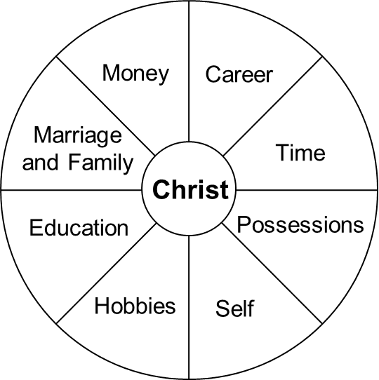
This illustration shows some of the areas of your life that you must give control over to Jesus.
If you don’t choose to give Jesus control of your life daily, then these things will control you.
Notes:
Foundations Material
The Foundations material can be used for one-on-one discipleship
or with 2-10 other people
Foundations is a series of topical Bible studies:
Come and get to know God and His people. This is where we learn who God is and the importance of fellowship with other Christians.
Grow in your relationship with God. Learn how to grow spiritually through God’s Word and prayer.
Serve by giving and caring for others. Learn about your spiritual gifts and abilities and how to give to and serve God and others.
Go and make disciples. Invest in the lives of others and invite them to know the Lord when they are ready. Then we make disciples by helping them go through this process of Come-Grow-Serve-Go.

Slide 128
What areas of your life are you not allowing Jesus to control?
What can you do to give Jesus control in these areas?
Notes:
Foundations Material
The Foundations material can be used for one-on-one discipleship
or with 2-10 other people
Foundations is a series of topical Bible studies:
Come and get to know God and His people. This is where we learn who God is and the importance of fellowship with other Christians.
Grow in your relationship with God. Learn how to grow spiritually through God’s Word and prayer.
Serve by giving and caring for others. Learn about your spiritual gifts and abilities and how to give to and serve God and others.
Go and make disciples. Invest in the lives of others and invite them to know the Lord when they are ready. Then we make disciples by helping them go through this process of Come-Grow-Serve-Go.

Slide 129
Humble yourselves, therefore, under God’s mighty hand, that he may lift you up in due time. Cast all your anxiety on him because he cares for you. 1 Peter 5:6-7
What can you do when you take control back in an area of your life?
Why is it necessary to humble yourself in order to put Jesus in charge of your life?
How does anxiety keep you from putting Jesus in charge of your life?
How do you cast all your anxiety on Jesus?
Notes:
Foundations Material
The Foundations material can be used for one-on-one discipleship
or with 2-10 other people
Foundations is a series of topical Bible studies:
Come and get to know God and His people. This is where we learn who God is and the importance of fellowship with other Christians.
Grow in your relationship with God. Learn how to grow spiritually through God’s Word and prayer.
Serve by giving and caring for others. Learn about your spiritual gifts and abilities and how to give to and serve God and others.
Go and make disciples. Invest in the lives of others and invite them to know the Lord when they are ready. Then we make disciples by helping them go through this process of Come-Grow-Serve-Go.

Slide 130
Still others, like seed sown among thorns, hear the word; but the worries of this life, the deceitfulness of wealth and the desires for other things come in and choke the word, making it unfruitful. Mark 4:18-19
What happens when cares, worries, and desires are not committed to Christ?
How do the worries of life, deceitfulness of wealth, and the desires for other things choke out the Word and make it unfruitful?
Notes:
Foundations Material
The Foundations material can be used for one-on-one discipleship
or with 2-10 other people
Foundations is a series of topical Bible studies:
Come and get to know God and His people. This is where we learn who God is and the importance of fellowship with other Christians.
Grow in your relationship with God. Learn how to grow spiritually through God’s Word and prayer.
Serve by giving and caring for others. Learn about your spiritual gifts and abilities and how to give to and serve God and others.
Go and make disciples. Invest in the lives of others and invite them to know the Lord when they are ready. Then we make disciples by helping them go through this process of Come-Grow-Serve-Go.

Slide 131
Why do you call me, ‘Lord, Lord,’ and do not do what I say? Luke 6:46
How can you tell if Jesus is in control of your life?
Then he said to them all: “If anyone would come after me, he must deny himself and take up his cross daily and follow me.” Luke 9:23
What three things has your Lord asked you to do?
Notes:
Foundations Material
The Foundations material can be used for one-on-one discipleship
or with 2-10 other people
Foundations is a series of topical Bible studies:
Come and get to know God and His people. This is where we learn who God is and the importance of fellowship with other Christians.
Grow in your relationship with God. Learn how to grow spiritually through God’s Word and prayer.
Serve by giving and caring for others. Learn about your spiritual gifts and abilities and how to give to and serve God and others.
Go and make disciples. Invest in the lives of others and invite them to know the Lord when they are ready. Then we make disciples by helping them go through this process of Come-Grow-Serve-Go.

Slide 132
What does it mean to deny yourself? What are your denying?
To choose to put Jesus in charge instead of yourself
What does it mean to take up your cross daily?
To die to yourself and come alive to Jesus every day
I have been crucified with Christ and I no longer live, but Christ lives in me. The life I live in the body, I live by faith in the Son of God, who loved me and gave himself for me. Galatians 2:20
Baptism is a symbol of dying to self
and living for Jesus
Notes:
Foundations Material
The Foundations material can be used for one-on-one discipleship
or with 2-10 other people
Foundations is a series of topical Bible studies:
Come and get to know God and His people. This is where we learn who God is and the importance of fellowship with other Christians.
Grow in your relationship with God. Learn how to grow spiritually through God’s Word and prayer.
Serve by giving and caring for others. Learn about your spiritual gifts and abilities and how to give to and serve God and others.
Go and make disciples. Invest in the lives of others and invite them to know the Lord when they are ready. Then we make disciples by helping them go through this process of Come-Grow-Serve-Go.

Slide 133
What does it mean to follow Jesus?
Think, say, and do what Jesus would.
Why does Jesus want us to do these things?
Notes:
Foundations Material
The Foundations material can be used for one-on-one discipleship
or with 2-10 other people
Foundations is a series of topical Bible studies:
Come and get to know God and His people. This is where we learn who God is and the importance of fellowship with other Christians.
Grow in your relationship with God. Learn how to grow spiritually through God’s Word and prayer.
Serve by giving and caring for others. Learn about your spiritual gifts and abilities and how to give to and serve God and others.
Go and make disciples. Invest in the lives of others and invite them to know the Lord when they are ready. Then we make disciples by helping them go through this process of Come-Grow-Serve-Go.

Slide 134
Life Change Occurs by Faith
Now faith is being sure of what we hope for and certain of what we do not see. Hebrews 11:1
Yet he did not waver through unbelief regarding the promise of God, but was strengthened in his faith and gave glory to God being fully persuaded that God had power to do what he had promised. Romans 4:20 – 21
What is faith?
Notes:
Foundations Material
The Foundations material can be used for one-on-one discipleship
or with 2-10 other people
Foundations is a series of topical Bible studies:
Come and get to know God and His people. This is where we learn who God is and the importance of fellowship with other Christians.
Grow in your relationship with God. Learn how to grow spiritually through God’s Word and prayer.
Serve by giving and caring for others. Learn about your spiritual gifts and abilities and how to give to and serve God and others.
Go and make disciples. Invest in the lives of others and invite them to know the Lord when they are ready. Then we make disciples by helping them go through this process of Come-Grow-Serve-Go.

Slide 135
We live by faith, not by sight. 2 Corinthians 5:7
  What does this mean?
Notes:
Foundations Material
The Foundations material can be used for one-on-one discipleship
or with 2-10 other people
Foundations is a series of topical Bible studies:
Come and get to know God and His people. This is where we learn who God is and the importance of fellowship with other Christians.
Grow in your relationship with God. Learn how to grow spiritually through God’s Word and prayer.
Serve by giving and caring for others. Learn about your spiritual gifts and abilities and how to give to and serve God and others.
Go and make disciples. Invest in the lives of others and invite them to know the Lord when they are ready. Then we make disciples by helping them go through this process of Come-Grow-Serve-Go.

Slide 136
What are some wrong things to put your faith in?
Do not put your trust in princes, in mortal men, who cannot save. Psalms 146:3
  What does it mean to not put your faith or trust in a prince?
  What are some examples of people we could put our faith in?
Trust in the LORD with all your heart and lean not on your own understanding. Proverbs 3:5
  How does trusting in our own understanding let us down?
Notes:
Foundations Material
The Foundations material can be used for one-on-one discipleship
or with 2-10 other people
Foundations is a series of topical Bible studies:
Come and get to know God and His people. This is where we learn who God is and the importance of fellowship with other Christians.
Grow in your relationship with God. Learn how to grow spiritually through God’s Word and prayer.
Serve by giving and caring for others. Learn about your spiritual gifts and abilities and how to give to and serve God and others.
Go and make disciples. Invest in the lives of others and invite them to know the Lord when they are ready. Then we make disciples by helping them go through this process of Come-Grow-Serve-Go.

Slide 137
He who trusts in himself is a fool, but he who walks in wisdom is kept safe. Proverbs 28:26
  How does trusting in yourself make you a fool?
  Where does wisdom come from?
This is what the LORD says: “Let not the wise man boast of his wisdom or the strong man boast of his strength or the rich man boast of his riches. Jeremiah 9:23
  What kind of wisdom should you not trust in?
  What are some problems with trusting in riches?
Notes:
Foundations Material
The Foundations material can be used for one-on-one discipleship
or with 2-10 other people
Foundations is a series of topical Bible studies:
Come and get to know God and His people. This is where we learn who God is and the importance of fellowship with other Christians.
Grow in your relationship with God. Learn how to grow spiritually through God’s Word and prayer.
Serve by giving and caring for others. Learn about your spiritual gifts and abilities and how to give to and serve God and others.
Go and make disciples. Invest in the lives of others and invite them to know the Lord when they are ready. Then we make disciples by helping them go through this process of Come-Grow-Serve-Go.

Slide 138
Wrong things to put your faith in
Leaders, people, your own understanding, yourself,
human wisdom, strength, riches
    Which of these things do you put your faith in?
    What are the results of placing your faith in these things?
Notes:
Foundations Material
The Foundations material can be used for one-on-one discipleship
or with 2-10 other people
Foundations is a series of topical Bible studies:
Come and get to know God and His people. This is where we learn who God is and the importance of fellowship with other Christians.
Grow in your relationship with God. Learn how to grow spiritually through God’s Word and prayer.
Serve by giving and caring for others. Learn about your spiritual gifts and abilities and how to give to and serve God and others.
Go and make disciples. Invest in the lives of others and invite them to know the Lord when they are ready. Then we make disciples by helping them go through this process of Come-Grow-Serve-Go.

Slide 139
Have faith in God,” Jesus answered. Mark 11:22
  Who should be the object of your faith?
He replied, If you have faith as small as a mustard seed, you can say to this mulberry tree, ‘Be uprooted and planted in the sea,’ and it will obey you. Luke 17:6
  How much faith do you need?
  Which is more important, how much faith you have or what your faith is in?
  Why do you think this is so?
Notes:
Foundations Material
The Foundations material can be used for one-on-one discipleship
or with 2-10 other people
Foundations is a series of topical Bible studies:
Come and get to know God and His people. This is where we learn who God is and the importance of fellowship with other Christians.
Grow in your relationship with God. Learn how to grow spiritually through God’s Word and prayer.
Serve by giving and caring for others. Learn about your spiritual gifts and abilities and how to give to and serve God and others.
Go and make disciples. Invest in the lives of others and invite them to know the Lord when they are ready. Then we make disciples by helping them go through this process of Come-Grow-Serve-Go.

Slide 140
“Make Jesus Lord of Your Life” Summary
• Jesus is Lord of all
  Jesus is Lord of lords and King of kings
  God has exalted Jesus to the highest place and given Him the name that is above every name
  Every person in heaven and earth shall confess that Jesus is Lord
Notes:
Foundations Material
The Foundations material can be used for one-on-one discipleship
or with 2-10 other people
Foundations is a series of topical Bible studies:
Come and get to know God and His people. This is where we learn who God is and the importance of fellowship with other Christians.
Grow in your relationship with God. Learn how to grow spiritually through God’s Word and prayer.
Serve by giving and caring for others. Learn about your spiritual gifts and abilities and how to give to and serve God and others.
Go and make disciples. Invest in the lives of others and invite them to know the Lord when they are ready. Then we make disciples by helping them go through this process of Come-Grow-Serve-Go.

Slide 141
Make Jesus Your Lord
Choose to make Jesus Lord of your life just as you chose to make Him Savior
Give your body as a living sacrifice to God
Jesus plans are to prosper you and not harm you, plans to give you hope and a future
Give Jesus control of every area of your life every day
Notes:
Foundations Material
The Foundations material can be used for one-on-one discipleship
or with 2-10 other people
Foundations is a series of topical Bible studies:
Come and get to know God and His people. This is where we learn who God is and the importance of fellowship with other Christians.
Grow in your relationship with God. Learn how to grow spiritually through God’s Word and prayer.
Serve by giving and caring for others. Learn about your spiritual gifts and abilities and how to give to and serve God and others.
Go and make disciples. Invest in the lives of others and invite them to know the Lord when they are ready. Then we make disciples by helping them go through this process of Come-Grow-Serve-Go.

Slide 142
When you take control of your life back, humble yourself and cast all your anxiety on Him
Cares, worries, and desires choke the Word in your life and make you unfruitful
You can tell if Jesus is Lord of your life if you do what He says
Notes:
Foundations Material
The Foundations material can be used for one-on-one discipleship
or with 2-10 other people
Foundations is a series of topical Bible studies:
Come and get to know God and His people. This is where we learn who God is and the importance of fellowship with other Christians.
Grow in your relationship with God. Learn how to grow spiritually through God’s Word and prayer.
Serve by giving and caring for others. Learn about your spiritual gifts and abilities and how to give to and serve God and others.
Go and make disciples. Invest in the lives of others and invite them to know the Lord when they are ready. Then we make disciples by helping them go through this process of Come-Grow-Serve-Go.

Slide 143
Three things your Lord has asked you to do
  Deny yourself
  Take up your cross daily (die to self)
  Follow Him
Notes:
Foundations Material
The Foundations material can be used for one-on-one discipleship
or with 2-10 other people
Foundations is a series of topical Bible studies:
Come and get to know God and His people. This is where we learn who God is and the importance of fellowship with other Christians.
Grow in your relationship with God. Learn how to grow spiritually through God’s Word and prayer.
Serve by giving and caring for others. Learn about your spiritual gifts and abilities and how to give to and serve God and others.
Go and make disciples. Invest in the lives of others and invite them to know the Lord when they are ready. Then we make disciples by helping them go through this process of Come-Grow-Serve-Go.

Slide 144
Life Change Occurs by Faith
Faith is
  Being sure of what you hope for and certain of what you do not see
  Being fully persuaded that God can do what He says
  You live by faith not by sight
Notes:
Foundations Material
The Foundations material can be used for one-on-one discipleship
or with 2-10 other people
Foundations is a series of topical Bible studies:
Come and get to know God and His people. This is where we learn who God is and the importance of fellowship with other Christians.
Grow in your relationship with God. Learn how to grow spiritually through God’s Word and prayer.
Serve by giving and caring for others. Learn about your spiritual gifts and abilities and how to give to and serve God and others.
Go and make disciples. Invest in the lives of others and invite them to know the Lord when they are ready. Then we make disciples by helping them go through this process of Come-Grow-Serve-Go.

Slide 145
Things you should not put your faith in
  People
  Leaders
  Your own understanding
  Yourself
  Wisdom, strength, or riches
  Your faith should be in God alone
  A small amount of faith is enough as long as your faith is in God alone
Notes:
Foundations Material
The Foundations material can be used for one-on-one discipleship
or with 2-10 other people
Foundations is a series of topical Bible studies:
Come and get to know God and His people. This is where we learn who God is and the importance of fellowship with other Christians.
Grow in your relationship with God. Learn how to grow spiritually through God’s Word and prayer.
Serve by giving and caring for others. Learn about your spiritual gifts and abilities and how to give to and serve God and others.
Go and make disciples. Invest in the lives of others and invite them to know the Lord when they are ready. Then we make disciples by helping them go through this process of Come-Grow-Serve-Go.

Slide 146
Know God’s Will
Chapter 5
God promises to guide you and let you know His will.
All you have to do is to trust Him and seek His will.
God is good, He loves you, and as your perfect Heavenly Father, He knows what is best for you.
Trust in the LORD with all your heart and lean not on your own understanding; in all your ways acknowledge him, and he will make your paths straight. Proverbs 3:5 - 6
Notes:
Foundations Material
The Foundations material can be used for one-on-one discipleship
or with 2-10 other people
Foundations is a series of topical Bible studies:
Come and get to know God and His people. This is where we learn who God is and the importance of fellowship with other Christians.
Grow in your relationship with God. Learn how to grow spiritually through God’s Word and prayer.
Serve by giving and caring for others. Learn about your spiritual gifts and abilities and how to give to and serve God and others.
Go and make disciples. Invest in the lives of others and invite them to know the Lord when they are ready. Then we make disciples by helping them go through this process of Come-Grow-Serve-Go.

Slide 147
God’s Will
Therefore do not be foolish, but understand what the Lord’s will is. Ephesians 5:17
What does God want you to do?
Why is it foolish to not know God’s will?
Why do parents want their children to know and obey their will?
Why does God want you to know and obey His will?
What happens when we don’t follow God’s will?
Notes:
Foundations Material
The Foundations material can be used for one-on-one discipleship
or with 2-10 other people
Foundations is a series of topical Bible studies:
Come and get to know God and His people. This is where we learn who God is and the importance of fellowship with other Christians.
Grow in your relationship with God. Learn how to grow spiritually through God’s Word and prayer.
Serve by giving and caring for others. Learn about your spiritual gifts and abilities and how to give to and serve God and others.
Go and make disciples. Invest in the lives of others and invite them to know the Lord when they are ready. Then we make disciples by helping them go through this process of Come-Grow-Serve-Go.

Slide 148
I will instruct you and teach you in the way you should go; I will counsel you and watch over you. Psalms 32:8
What will God do to help you know His will for your life?
Notes:
Foundations Material
The Foundations material can be used for one-on-one discipleship
or with 2-10 other people
Foundations is a series of topical Bible studies:
Come and get to know God and His people. This is where we learn who God is and the importance of fellowship with other Christians.
Grow in your relationship with God. Learn how to grow spiritually through God’s Word and prayer.
Serve by giving and caring for others. Learn about your spiritual gifts and abilities and how to give to and serve God and others.
Go and make disciples. Invest in the lives of others and invite them to know the Lord when they are ready. Then we make disciples by helping them go through this process of Come-Grow-Serve-Go.

Slide 149
It is God’s will that you should be sanctified: that you should avoid sexual immorality. 1 Thessalonians 4:3
(Being sanctified is the process of becoming like Jesus)
Give thanks in all circumstances, for this is God’s will for you in Christ Jesus. 1 Thessalonians 5:18
Why does God want you to do this?
How can you give thanks in bad circumstances?
What are we like if we don’t develop the habit of thankfulness?
Notes:
Foundations Material
The Foundations material can be used for one-on-one discipleship
or with 2-10 other people
Foundations is a series of topical Bible studies:
Come and get to know God and His people. This is where we learn who God is and the importance of fellowship with other Christians.
Grow in your relationship with God. Learn how to grow spiritually through God’s Word and prayer.
Serve by giving and caring for others. Learn about your spiritual gifts and abilities and how to give to and serve God and others.
Go and make disciples. Invest in the lives of others and invite them to know the Lord when they are ready. Then we make disciples by helping them go through this process of Come-Grow-Serve-Go.

Slide 150
What do you learn about God’s will for your life?
For it is God’s will that by doing good you should silence the ignorant talk of foolish men. 1 Peter 2:15
What kind of good does God want you to do?
  To whom?
How does this silence the ignorant talk of foolish men?
Notes:
Foundations Material
The Foundations material can be used for one-on-one discipleship
or with 2-10 other people
Foundations is a series of topical Bible studies:
Come and get to know God and His people. This is where we learn who God is and the importance of fellowship with other Christians.
Grow in your relationship with God. Learn how to grow spiritually through God’s Word and prayer.
Serve by giving and caring for others. Learn about your spiritual gifts and abilities and how to give to and serve God and others.
Go and make disciples. Invest in the lives of others and invite them to know the Lord when they are ready. Then we make disciples by helping them go through this process of Come-Grow-Serve-Go.

Slide 151
What should your attitude be toward God’s will?
I desire to do your will, O my God; your law is within my heart. Psalms 40:8.
What helps produce this attitude?
  Having God’s Word in your heart.
How does God’s Word get into your heart?
  Scripture memory
How does scripture memory help you know and do God’s will?
Notes:
Foundations Material
The Foundations material can be used for one-on-one discipleship
or with 2-10 other people
Foundations is a series of topical Bible studies:
Come and get to know God and His people. This is where we learn who God is and the importance of fellowship with other Christians.
Grow in your relationship with God. Learn how to grow spiritually through God’s Word and prayer.
Serve by giving and caring for others. Learn about your spiritual gifts and abilities and how to give to and serve God and others.
Go and make disciples. Invest in the lives of others and invite them to know the Lord when they are ready. Then we make disciples by helping them go through this process of Come-Grow-Serve-Go.

Slide 152
How does God help you accomplish His will?
It is God who works in you to will and to act according to his good purpose. Philippians 2:13
How does God work in you to have the will and the ability to do his will?
Notes:
Foundations Material
The Foundations material can be used for one-on-one discipleship
or with 2-10 other people
Foundations is a series of topical Bible studies:
Come and get to know God and His people. This is where we learn who God is and the importance of fellowship with other Christians.
Grow in your relationship with God. Learn how to grow spiritually through God’s Word and prayer.
Serve by giving and caring for others. Learn about your spiritual gifts and abilities and how to give to and serve God and others.
Go and make disciples. Invest in the lives of others and invite them to know the Lord when they are ready. Then we make disciples by helping them go through this process of Come-Grow-Serve-Go.

Slide 153
Biblical Principles in Determining God’s Will
But seek first his kingdom and his righteousness, and all these things will be given to you as well. Matthew 6:33
What priority should God’s kingdom and His righteousness have in your life?
What happens in your life when you keep God’s priorities?
What are “all these things” that God will give you?
Notes:
Foundations Material
The Foundations material can be used for one-on-one discipleship
or with 2-10 other people
Foundations is a series of topical Bible studies:
Come and get to know God and His people. This is where we learn who God is and the importance of fellowship with other Christians.
Grow in your relationship with God. Learn how to grow spiritually through God’s Word and prayer.
Serve by giving and caring for others. Learn about your spiritual gifts and abilities and how to give to and serve God and others.
Go and make disciples. Invest in the lives of others and invite them to know the Lord when they are ready. Then we make disciples by helping them go through this process of Come-Grow-Serve-Go.

Slide 154
‘Love the Lord your God with all your heart and with all your soul and with all your mind.’ This is the first and greatest commandment. And the second is like it: ‘Love your neighbor as yourself. (Great Commandment)
Matthew 22:37-39
  Is loving God the driving force in your life?
  How can you love God more?
  Who is your neighbor?
  Who do you need to love more?
Notes:
Foundations Material
The Foundations material can be used for one-on-one discipleship
or with 2-10 other people
Foundations is a series of topical Bible studies:
Come and get to know God and His people. This is where we learn who God is and the importance of fellowship with other Christians.
Grow in your relationship with God. Learn how to grow spiritually through God’s Word and prayer.
Serve by giving and caring for others. Learn about your spiritual gifts and abilities and how to give to and serve God and others.
Go and make disciples. Invest in the lives of others and invite them to know the Lord when they are ready. Then we make disciples by helping them go through this process of Come-Grow-Serve-Go.

Slide 155
Therefore go and make disciples of all nations, baptizing them in the name of the Father and of the Son and of the Holy Spirit, and teaching them to obey everything I have commanded you. And surely I am with you always, to the very end of the age.” (Great Commission) Matthew 28:19-20
Who are you praying for to come to the Lord?
  Family members, friends, neighbors, other people
Notes:
Foundations Material
The Foundations material can be used for one-on-one discipleship
or with 2-10 other people
Foundations is a series of topical Bible studies:
Come and get to know God and His people. This is where we learn who God is and the importance of fellowship with other Christians.
Grow in your relationship with God. Learn how to grow spiritually through God’s Word and prayer.
Serve by giving and caring for others. Learn about your spiritual gifts and abilities and how to give to and serve God and others.
Go and make disciples. Invest in the lives of others and invite them to know the Lord when they are ready. Then we make disciples by helping them go through this process of Come-Grow-Serve-Go.

Slide 156
But just as he who called you is holy, so be holy in all you do. 1 Peter 1:15
What does it mean to be holy?
What are some areas in which you need to be holy?
What is the difference between being holy and being moral?
  Who we are vs what we do.
Notes:
Foundations Material
The Foundations material can be used for one-on-one discipleship
or with 2-10 other people
Foundations is a series of topical Bible studies:
Come and get to know God and His people. This is where we learn who God is and the importance of fellowship with other Christians.
Grow in your relationship with God. Learn how to grow spiritually through God’s Word and prayer.
Serve by giving and caring for others. Learn about your spiritual gifts and abilities and how to give to and serve God and others.
Go and make disciples. Invest in the lives of others and invite them to know the Lord when they are ready. Then we make disciples by helping them go through this process of Come-Grow-Serve-Go.

Slide 157
But grow in the grace and knowledge of our Lord and Savior Jesus Christ. To him be glory both now and forever! Amen. 2 Peter 3:18
  What is grace?
  How can you grow in it?
Notes:
Foundations Material
The Foundations material can be used for one-on-one discipleship
or with 2-10 other people
Foundations is a series of topical Bible studies:
Come and get to know God and His people. This is where we learn who God is and the importance of fellowship with other Christians.
Grow in your relationship with God. Learn how to grow spiritually through God’s Word and prayer.
Serve by giving and caring for others. Learn about your spiritual gifts and abilities and how to give to and serve God and others.
Go and make disciples. Invest in the lives of others and invite them to know the Lord when they are ready. Then we make disciples by helping them go through this process of Come-Grow-Serve-Go.

Slide 158
You can determine God’s will by asking yourself questions based on God’s Word.
The following questions are based on the previous verses.
• Am I putting what God wants for me ahead of what I want?
• Will it help me love God and others more?
• Will it help or hinder me from helping others find the Lord?
• Is it something Jesus would do?
• Will it help me be more like Jesus?
Notes:
Foundations Material
The Foundations material can be used for one-on-one discipleship
or with 2-10 other people
Foundations is a series of topical Bible studies:
Come and get to know God and His people. This is where we learn who God is and the importance of fellowship with other Christians.
Grow in your relationship with God. Learn how to grow spiritually through God’s Word and prayer.
Serve by giving and caring for others. Learn about your spiritual gifts and abilities and how to give to and serve God and others.
Go and make disciples. Invest in the lives of others and invite them to know the Lord when they are ready. Then we make disciples by helping them go through this process of Come-Grow-Serve-Go.

Slide 159
Develop a question from the following verse to help you know God’s will
Everything is permissible for me”—
  but not everything is beneficial.
“Everything is permissible for me”—
  but I will not be mastered by anything. 1 Corinthians 6:12
Will this help me?
  What are examples of things that are permissible but are not helpful?
Notes:
Foundations Material
The Foundations material can be used for one-on-one discipleship
or with 2-10 other people
Foundations is a series of topical Bible studies:
Come and get to know God and His people. This is where we learn who God is and the importance of fellowship with other Christians.
Grow in your relationship with God. Learn how to grow spiritually through God’s Word and prayer.
Serve by giving and caring for others. Learn about your spiritual gifts and abilities and how to give to and serve God and others.
Go and make disciples. Invest in the lives of others and invite them to know the Lord when they are ready. Then we make disciples by helping them go through this process of Come-Grow-Serve-Go.

Slide 160
Develop a question from the following verse to help you know God’s will
Do you not know that your body is a temple of the Holy Spirit, who is in you, whom you have received from God?
You are not your own; you were bought at a price.
Therefore, honor God with your body. 1 Corinthians 6:19 – 20
Will this honor God in my body?
  Examples?
Notes:
Foundations Material
The Foundations material can be used for one-on-one discipleship
or with 2-10 other people
Foundations is a series of topical Bible studies:
Come and get to know God and His people. This is where we learn who God is and the importance of fellowship with other Christians.
Grow in your relationship with God. Learn how to grow spiritually through God’s Word and prayer.
Serve by giving and caring for others. Learn about your spiritual gifts and abilities and how to give to and serve God and others.
Go and make disciples. Invest in the lives of others and invite them to know the Lord when they are ready. Then we make disciples by helping them go through this process of Come-Grow-Serve-Go.

Slide 161
Develop a question from the following verse to help you know God’s will
Be careful, however, that the exercise of your freedom does not become a stumbling block to the weak. 1 Corinthians 8:9
Will this cause a weaker brother or sister to stumble?
  Examples?
Notes:
Foundations Material
The Foundations material can be used for one-on-one discipleship
or with 2-10 other people
Foundations is a series of topical Bible studies:
Come and get to know God and His people. This is where we learn who God is and the importance of fellowship with other Christians.
Grow in your relationship with God. Learn how to grow spiritually through God’s Word and prayer.
Serve by giving and caring for others. Learn about your spiritual gifts and abilities and how to give to and serve God and others.
Go and make disciples. Invest in the lives of others and invite them to know the Lord when they are ready. Then we make disciples by helping them go through this process of Come-Grow-Serve-Go.

Slide 162
Develop a question from the following verse to help you know God’s will
So whether you eat or drink or whatever you do, do it all for the glory of God. 1 Corinthians 10:31
  Will this bring glory to God?
Examples of things that might not bring glory to God?
Notes:
Foundations Material
The Foundations material can be used for one-on-one discipleship
or with 2-10 other people
Foundations is a series of topical Bible studies:
Come and get to know God and His people. This is where we learn who God is and the importance of fellowship with other Christians.
Grow in your relationship with God. Learn how to grow spiritually through God’s Word and prayer.
Serve by giving and caring for others. Learn about your spiritual gifts and abilities and how to give to and serve God and others.
Go and make disciples. Invest in the lives of others and invite them to know the Lord when they are ready. Then we make disciples by helping them go through this process of Come-Grow-Serve-Go.

Slide 163
What can you do to know God’s will?
The law of his God is in his heart; his feet do not slip. Psalms 37:31.
  Memorize God’s Word.
Notes:
Foundations Material
The Foundations material can be used for one-on-one discipleship
or with 2-10 other people
Foundations is a series of topical Bible studies:
Come and get to know God and His people. This is where we learn who God is and the importance of fellowship with other Christians.
Grow in your relationship with God. Learn how to grow spiritually through God’s Word and prayer.
Serve by giving and caring for others. Learn about your spiritual gifts and abilities and how to give to and serve God and others.
Go and make disciples. Invest in the lives of others and invite them to know the Lord when they are ready. Then we make disciples by helping them go through this process of Come-Grow-Serve-Go.

Slide 164
What can you do to know God’s will?
Let the morning bring me word of your unfailing love, for I have put my trust in you.
Show me the way I should go, for to you I lift up my soul. Psalms 143:8
  Look into God’s Word every morning.
  Put your trust in God.
How can you put your trust in God?
    Ask God to show you His will in prayer.
    Lift your soul to God.
What does it mean to lift your soul to God?
Notes:
Foundations Material
The Foundations material can be used for one-on-one discipleship
or with 2-10 other people
Foundations is a series of topical Bible studies:
Come and get to know God and His people. This is where we learn who God is and the importance of fellowship with other Christians.
Grow in your relationship with God. Learn how to grow spiritually through God’s Word and prayer.
Serve by giving and caring for others. Learn about your spiritual gifts and abilities and how to give to and serve God and others.
Go and make disciples. Invest in the lives of others and invite them to know the Lord when they are ready. Then we make disciples by helping them go through this process of Come-Grow-Serve-Go.

Slide 165
What can you do to know God’s will?
If any of you lacks wisdom, he should ask God, who gives generously to all without finding fault, and it will be given to him. James 1:5.
  Ask God for wisdom.
Notes:
Foundations Material
The Foundations material can be used for one-on-one discipleship
or with 2-10 other people
Foundations is a series of topical Bible studies:
Come and get to know God and His people. This is where we learn who God is and the importance of fellowship with other Christians.
Grow in your relationship with God. Learn how to grow spiritually through God’s Word and prayer.
Serve by giving and caring for others. Learn about your spiritual gifts and abilities and how to give to and serve God and others.
Go and make disciples. Invest in the lives of others and invite them to know the Lord when they are ready. Then we make disciples by helping them go through this process of Come-Grow-Serve-Go.

Slide 166
Humbly ask God to reveal His will to you.
Read the following prayer and make it your own prayer.
Show me your ways, O LORD, teach me your paths; guide me in your truth and teach me, for you are God my Savior, and my hope is in you all day long. Psalms 25:4-5
Notes:
Foundations Material
The Foundations material can be used for one-on-one discipleship
or with 2-10 other people
Foundations is a series of topical Bible studies:
Come and get to know God and His people. This is where we learn who God is and the importance of fellowship with other Christians.
Grow in your relationship with God. Learn how to grow spiritually through God’s Word and prayer.
Serve by giving and caring for others. Learn about your spiritual gifts and abilities and how to give to and serve God and others.
Go and make disciples. Invest in the lives of others and invite them to know the Lord when they are ready. Then we make disciples by helping them go through this process of Come-Grow-Serve-Go.

Slide 167
Therefore, I urge you, brothers, in view of God’s mercy, to offer your bodies as living sacrifices, holy and pleasing to God—this is your spiritual act of worship.
Do not conform any longer to the pattern of this world, but be transformed by the renewing of your mind.
Then you will be able to test and approve what God’s will is—his good, pleasing and perfect will. Romans 12:1-2
What are some conditions to finding God’s will for your life?
In order to know God’s will, we must choose between the way of the world and the way of God.
  How do you renew your mind?
  How does this transform you?
Notes:
Foundations Material
The Foundations material can be used for one-on-one discipleship
or with 2-10 other people
Foundations is a series of topical Bible studies:
Come and get to know God and His people. This is where we learn who God is and the importance of fellowship with other Christians.
Grow in your relationship with God. Learn how to grow spiritually through God’s Word and prayer.
Serve by giving and caring for others. Learn about your spiritual gifts and abilities and how to give to and serve God and others.
Go and make disciples. Invest in the lives of others and invite them to know the Lord when they are ready. Then we make disciples by helping them go through this process of Come-Grow-Serve-Go.

Slide 168
But when he, the Spirit of truth, comes, he will guide you into all truth.
He will not speak on his own; he will speak only what he hears, and he will tell you what is yet to come. John 16:13
Who will guide you as you seek God’s will for your life?
Notes:
Foundations Material
The Foundations material can be used for one-on-one discipleship
or with 2-10 other people
Foundations is a series of topical Bible studies:
Come and get to know God and His people. This is where we learn who God is and the importance of fellowship with other Christians.
Grow in your relationship with God. Learn how to grow spiritually through God’s Word and prayer.
Serve by giving and caring for others. Learn about your spiritual gifts and abilities and how to give to and serve God and others.
Go and make disciples. Invest in the lives of others and invite them to know the Lord when they are ready. Then we make disciples by helping them go through this process of Come-Grow-Serve-Go.

Slide 169
Yet the LORD longs to be gracious to you; he rises to show you compassion.
For the LORD is a God of justice. Blessed are all who wait for him! Isaiah 30:18
What does waiting on God have to do with knowing God’s will?
Notes:
Foundations Material
The Foundations material can be used for one-on-one discipleship
or with 2-10 other people
Foundations is a series of topical Bible studies:
Come and get to know God and His people. This is where we learn who God is and the importance of fellowship with other Christians.
Grow in your relationship with God. Learn how to grow spiritually through God’s Word and prayer.
Serve by giving and caring for others. Learn about your spiritual gifts and abilities and how to give to and serve God and others.
Go and make disciples. Invest in the lives of others and invite them to know the Lord when they are ready. Then we make disciples by helping them go through this process of Come-Grow-Serve-Go.

Slide 170
Plans fail for lack of counsel, but with many advisers they succeed. Proverbs 15:22
What is another important thing you can do to help you know God’s will?
What are some qualifications you should look for in someone to give you advice?
  Mature Christian. Know you well.
  Experience in the area.
What should you do with the advice you are given?
  You take it before God and you and God make the decision.
  Only follow the advice if you and God agree with it.
Notes:
Foundations Material
The Foundations material can be used for one-on-one discipleship
or with 2-10 other people
Foundations is a series of topical Bible studies:
Come and get to know God and His people. This is where we learn who God is and the importance of fellowship with other Christians.
Grow in your relationship with God. Learn how to grow spiritually through God’s Word and prayer.
Serve by giving and caring for others. Learn about your spiritual gifts and abilities and how to give to and serve God and others.
Go and make disciples. Invest in the lives of others and invite them to know the Lord when they are ready. Then we make disciples by helping them go through this process of Come-Grow-Serve-Go.

Slide 171
Obey them not only to win their favor when their eye is on you, but like slaves of Christ, doing the will of God from your heart. Ephesians 6:6.
What should your attitude be when you do the will of God?
  Not as a man pleaser but from the heart.
Notes:
Foundations Material
The Foundations material can be used for one-on-one discipleship
or with 2-10 other people
Foundations is a series of topical Bible studies:
Come and get to know God and His people. This is where we learn who God is and the importance of fellowship with other Christians.
Grow in your relationship with God. Learn how to grow spiritually through God’s Word and prayer.
Serve by giving and caring for others. Learn about your spiritual gifts and abilities and how to give to and serve God and others.
Go and make disciples. Invest in the lives of others and invite them to know the Lord when they are ready. Then we make disciples by helping them go through this process of Come-Grow-Serve-Go.

Slide 172
What other factors can help you know God’s will for your life?
Everyone must submit himself to the governing authorities, for there is no authority except that which God has established. The authorities that exist have been established by God. Romans 13:1
  Legal obligations.
Notes:
Foundations Material
The Foundations material can be used for one-on-one discipleship
or with 2-10 other people
Foundations is a series of topical Bible studies:
Come and get to know God and His people. This is where we learn who God is and the importance of fellowship with other Christians.
Grow in your relationship with God. Learn how to grow spiritually through God’s Word and prayer.
Serve by giving and caring for others. Learn about your spiritual gifts and abilities and how to give to and serve God and others.
Go and make disciples. Invest in the lives of others and invite them to know the Lord when they are ready. Then we make disciples by helping them go through this process of Come-Grow-Serve-Go.

Slide 173
What other factors can help you know God’s will for your life?
Be very careful, then, how you live—not as unwise but as wise, making the most of every opportunity, because the days are evil. Therefore do not be foolish, but understand what the Lord’s will is. Ephesians 5:15 – 17.
  Careful and wise thinking.
Notes:
Foundations Material
The Foundations material can be used for one-on-one discipleship
or with 2-10 other people
Foundations is a series of topical Bible studies:
Come and get to know God and His people. This is where we learn who God is and the importance of fellowship with other Christians.
Grow in your relationship with God. Learn how to grow spiritually through God’s Word and prayer.
Serve by giving and caring for others. Learn about your spiritual gifts and abilities and how to give to and serve God and others.
Go and make disciples. Invest in the lives of others and invite them to know the Lord when they are ready. Then we make disciples by helping them go through this process of Come-Grow-Serve-Go.

Slide 174
What other factors can help you know God’s will for your life?
Let the peace of Christ rule in your hearts, since as members of one body you were called to peace. And be thankful. Colossians 3:15.
  Inner spiritual peace.
Notes:
Foundations Material
The Foundations material can be used for one-on-one discipleship
or with 2-10 other people
Foundations is a series of topical Bible studies:
Come and get to know God and His people. This is where we learn who God is and the importance of fellowship with other Christians.
Grow in your relationship with God. Learn how to grow spiritually through God’s Word and prayer.
Serve by giving and caring for others. Learn about your spiritual gifts and abilities and how to give to and serve God and others.
Go and make disciples. Invest in the lives of others and invite them to know the Lord when they are ready. Then we make disciples by helping them go through this process of Come-Grow-Serve-Go.

Slide 175
“Know God’s Will” Summary
God’s Will
God wants you to know His will
God instructs, teaches, counsels, and watches over you
Specific areas of God’s will for your life
  Become more like Jesus
  Avoid sexual immorality
  Give thanks in all circumstances
  Do good
Notes:
Foundations Material
The Foundations material can be used for one-on-one discipleship
or with 2-10 other people
Foundations is a series of topical Bible studies:
Come and get to know God and His people. This is where we learn who God is and the importance of fellowship with other Christians.
Grow in your relationship with God. Learn how to grow spiritually through God’s Word and prayer.
Serve by giving and caring for others. Learn about your spiritual gifts and abilities and how to give to and serve God and others.
Go and make disciples. Invest in the lives of others and invite them to know the Lord when they are ready. Then we make disciples by helping them go through this process of Come-Grow-Serve-Go.

Slide 176
You should desire to do God’s will
  Memorizing God’s Word helps you do God’s will
God works in you to want to do His will and to actually do it
Notes:
Foundations Material
The Foundations material can be used for one-on-one discipleship
or with 2-10 other people
Foundations is a series of topical Bible studies:
Come and get to know God and His people. This is where we learn who God is and the importance of fellowship with other Christians.
Grow in your relationship with God. Learn how to grow spiritually through God’s Word and prayer.
Serve by giving and caring for others. Learn about your spiritual gifts and abilities and how to give to and serve God and others.
Go and make disciples. Invest in the lives of others and invite them to know the Lord when they are ready. Then we make disciples by helping them go through this process of Come-Grow-Serve-Go.

Slide 177
Biblical Principles in Determining God’s Will
Questions to know God’s will based on Biblical principles
  Am I putting what God wants for me ahead of what I want?
  Will it help me love God and others more?
  Will it help or hinder me from helping others find the Lord?
  Is it something Jesus would do?
  Will it help me be more like Jesus?
Notes:
Foundations Material
The Foundations material can be used for one-on-one discipleship
or with 2-10 other people
Foundations is a series of topical Bible studies:
Come and get to know God and His people. This is where we learn who God is and the importance of fellowship with other Christians.
Grow in your relationship with God. Learn how to grow spiritually through God’s Word and prayer.
Serve by giving and caring for others. Learn about your spiritual gifts and abilities and how to give to and serve God and others.
Go and make disciples. Invest in the lives of others and invite them to know the Lord when they are ready. Then we make disciples by helping them go through this process of Come-Grow-Serve-Go.

Slide 178
Additional questions to help you know God’s will
  Is it beneficial? Will it control me?
  Does it honor God with my body?
  Is it a stumbling block to weaker Christians?
  Does it glorify God?
Notes:
Foundations Material
The Foundations material can be used for one-on-one discipleship
or with 2-10 other people
Foundations is a series of topical Bible studies:
Come and get to know God and His people. This is where we learn who God is and the importance of fellowship with other Christians.
Grow in your relationship with God. Learn how to grow spiritually through God’s Word and prayer.
Serve by giving and caring for others. Learn about your spiritual gifts and abilities and how to give to and serve God and others.
Go and make disciples. Invest in the lives of others and invite them to know the Lord when they are ready. Then we make disciples by helping them go through this process of Come-Grow-Serve-Go.

Slide 179
Things you can do to know God’s will
  Memorize God’s Word
  Put your trust in God daily
  Ask God for wisdom to know His will
Conditions to knowing God’s will for your life
  Wholly commit yourself to God
  Do not conform to the world, be transformed by renewing your mind with God’s Word
Notes:
Foundations Material
The Foundations material can be used for one-on-one discipleship
or with 2-10 other people
Foundations is a series of topical Bible studies:
Come and get to know God and His people. This is where we learn who God is and the importance of fellowship with other Christians.
Grow in your relationship with God. Learn how to grow spiritually through God’s Word and prayer.
Serve by giving and caring for others. Learn about your spiritual gifts and abilities and how to give to and serve God and others.
Go and make disciples. Invest in the lives of others and invite them to know the Lord when they are ready. Then we make disciples by helping them go through this process of Come-Grow-Serve-Go.

Slide 180
Be patient and wait on God’s timing to reveal His will
Get godly advice
Do God’s will from your heart
Other factors to help you know God’s will
  Obey the authorities
  Careful and wise thinking
  God’s will gives you inner peace
Notes:
Foundations Material
The Foundations material can be used for one-on-one discipleship
or with 2-10 other people
Foundations is a series of topical Bible studies:
Come and get to know God and His people. This is where we learn who God is and the importance of fellowship with other Christians.
Grow in your relationship with God. Learn how to grow spiritually through God’s Word and prayer.
Serve by giving and caring for others. Learn about your spiritual gifts and abilities and how to give to and serve God and others.
Go and make disciples. Invest in the lives of others and invite them to know the Lord when they are ready. Then we make disciples by helping them go through this process of Come-Grow-Serve-Go.

Slide 181
How to Determine if a Decision is God’ Will
Decision:
Questions to Help Determine God’s Will
(Yes, No, or Not Applicable)
Am I putting what God wants for me ahead of what I want?
Will it help me love God and others more?
Will it help or hinder me from helping others find the Lord?
Is it something Jesus would do?
Will it help me be more like Jesus?
Notes:
Foundations Material
The Foundations material can be used for one-on-one discipleship
or with 2-10 other people
Foundations is a series of topical Bible studies:
Come and get to know God and His people. This is where we learn who God is and the importance of fellowship with other Christians.
Grow in your relationship with God. Learn how to grow spiritually through God’s Word and prayer.
Serve by giving and caring for others. Learn about your spiritual gifts and abilities and how to give to and serve God and others.
Go and make disciples. Invest in the lives of others and invite them to know the Lord when they are ready. Then we make disciples by helping them go through this process of Come-Grow-Serve-Go.

Slide 182
Additional Questions:
Are there other areas in which I need to obey God?
What Bible verses or Biblical principles relate to this decision?
Have I prayed about this decision?
What are the pros and cons in making this decision?
  Pros:
  Cons:
Notes:
Foundations Material
The Foundations material can be used for one-on-one discipleship
or with 2-10 other people
Foundations is a series of topical Bible studies:
Come and get to know God and His people. This is where we learn who God is and the importance of fellowship with other Christians.
Grow in your relationship with God. Learn how to grow spiritually through God’s Word and prayer.
Serve by giving and caring for others. Learn about your spiritual gifts and abilities and how to give to and serve God and others.
Go and make disciples. Invest in the lives of others and invite them to know the Lord when they are ready. Then we make disciples by helping them go through this process of Come-Grow-Serve-Go.

Slide 183
Additional Questions:
Am I willing to do whatever God wants me to do?
What advice have I received?
What decision gives me peace?
How do circumstances guide my decision?
My decision is:
Notes:
Foundations Material
The Foundations material can be used for one-on-one discipleship
or with 2-10 other people
Foundations is a series of topical Bible studies:
Come and get to know God and His people. This is where we learn who God is and the importance of fellowship with other Christians.
Grow in your relationship with God. Learn how to grow spiritually through God’s Word and prayer.
Serve by giving and caring for others. Learn about your spiritual gifts and abilities and how to give to and serve God and others.
Go and make disciples. Invest in the lives of others and invite them to know the Lord when they are ready. Then we make disciples by helping them go through this process of Come-Grow-Serve-Go.

Slide 184
Talking with God
Chapter 6
Be joyful in hope, patient in affliction, faithful in prayer. Romans 12:12
Prayer is simply talking with God.
Communication is essential for any relationship including your relationship with God.
You were created to have a relationship with God, so your communication with Him is very important.
Notes:
Foundations Material
The Foundations material can be used for one-on-one discipleship
or with 2-10 other people
Foundations is a series of topical Bible studies:
Come and get to know God and His people. This is where we learn who God is and the importance of fellowship with other Christians.
Grow in your relationship with God. Learn how to grow spiritually through God’s Word and prayer.
Serve by giving and caring for others. Learn about your spiritual gifts and abilities and how to give to and serve God and others.
Go and make disciples. Invest in the lives of others and invite them to know the Lord when they are ready. Then we make disciples by helping them go through this process of Come-Grow-Serve-Go.

Slide 185
Prayer is not about saying the right words the right way to get God to do what you want Him to do.
God is not a cosmic genie and prayer is not a way of “rubbing the lamp” to get God to come forth and give us what we want.
Notes:
Foundations Material
The Foundations material can be used for one-on-one discipleship
or with 2-10 other people
Foundations is a series of topical Bible studies:
Come and get to know God and His people. This is where we learn who God is and the importance of fellowship with other Christians.
Grow in your relationship with God. Learn how to grow spiritually through God’s Word and prayer.
Serve by giving and caring for others. Learn about your spiritual gifts and abilities and how to give to and serve God and others.
Go and make disciples. Invest in the lives of others and invite them to know the Lord when they are ready. Then we make disciples by helping them go through this process of Come-Grow-Serve-Go.

Slide 186
Prayer is Your Communication with God
Let us then approach the throne of grace with confidence, so that we may receive mercy and find grace to help us in our time of need. Hebrews 4:16
Since you are a child of God forgiven by grace, how can you approach God?
Why can you approach God with confidence?
  You are a child of God forgiven by grace.
What do you receive when you approach God?
  Mercy and grace.
Notes:
Foundations Material
The Foundations material can be used for one-on-one discipleship
or with 2-10 other people
Foundations is a series of topical Bible studies:
Come and get to know God and His people. This is where we learn who God is and the importance of fellowship with other Christians.
Grow in your relationship with God. Learn how to grow spiritually through God’s Word and prayer.
Serve by giving and caring for others. Learn about your spiritual gifts and abilities and how to give to and serve God and others.
Go and make disciples. Invest in the lives of others and invite them to know the Lord when they are ready. Then we make disciples by helping them go through this process of Come-Grow-Serve-Go.

Slide 187
Trust in him at all times, O people; pour out your hearts to him, for God is our refuge. Psalms 62:8
What does God want you to do when you come to Him?
What does it mean to pour out your heart to God?
Why would you pour out your heart to God?
What does it mean that God is our refuge?
Notes:
Foundations Material
The Foundations material can be used for one-on-one discipleship
or with 2-10 other people
Foundations is a series of topical Bible studies:
Come and get to know God and His people. This is where we learn who God is and the importance of fellowship with other Christians.
Grow in your relationship with God. Learn how to grow spiritually through God’s Word and prayer.
Serve by giving and caring for others. Learn about your spiritual gifts and abilities and how to give to and serve God and others.
Go and make disciples. Invest in the lives of others and invite them to know the Lord when they are ready. Then we make disciples by helping them go through this process of Come-Grow-Serve-Go.

Slide 188
Benefits of Prayer
How does God respond to your prayers?
‘Call to me and I will answer you and tell you great and unsearchable things you do not know.’ Jeremiah 33:3.
  What are unsearchable things?
Now to him who is able to do immeasurably more than all we ask or imagine, according to his power that is at work within us, Ephesians 3:20.
Notes:
Foundations Material
The Foundations material can be used for one-on-one discipleship
or with 2-10 other people
Foundations is a series of topical Bible studies:
Come and get to know God and His people. This is where we learn who God is and the importance of fellowship with other Christians.
Grow in your relationship with God. Learn how to grow spiritually through God’s Word and prayer.
Serve by giving and caring for others. Learn about your spiritual gifts and abilities and how to give to and serve God and others.
Go and make disciples. Invest in the lives of others and invite them to know the Lord when they are ready. Then we make disciples by helping them go through this process of Come-Grow-Serve-Go.

Slide 189
I sought the LORD, and he answered me; he delivered me from all my fears. Psalms 34:4
How did God answer prayer in this verse?
  He doesn’t deliver us from our circumstances.
  What are some fears you can discuss with God?
  How has God delivered you from your fears?
Notes:
Foundations Material
The Foundations material can be used for one-on-one discipleship
or with 2-10 other people
Foundations is a series of topical Bible studies:
Come and get to know God and His people. This is where we learn who God is and the importance of fellowship with other Christians.
Grow in your relationship with God. Learn how to grow spiritually through God’s Word and prayer.
Serve by giving and caring for others. Learn about your spiritual gifts and abilities and how to give to and serve God and others.
Go and make disciples. Invest in the lives of others and invite them to know the Lord when they are ready. Then we make disciples by helping them go through this process of Come-Grow-Serve-Go.

Slide 190
God teaches us how to be free from anxiety and experience His peace in Philippians 4:6-9.
Do not be anxious about anything, but in everything, by prayer and petition, with thanksgiving, present your requests to God. Philippians 4:6
  What are you to do?
Notes:
Foundations Material
The Foundations material can be used for one-on-one discipleship
or with 2-10 other people
Foundations is a series of topical Bible studies:
Come and get to know God and His people. This is where we learn who God is and the importance of fellowship with other Christians.
Grow in your relationship with God. Learn how to grow spiritually through God’s Word and prayer.
Serve by giving and caring for others. Learn about your spiritual gifts and abilities and how to give to and serve God and others.
Go and make disciples. Invest in the lives of others and invite them to know the Lord when they are ready. Then we make disciples by helping them go through this process of Come-Grow-Serve-Go.

Slide 191
And the peace of God, which transcends all understanding, will guard your hearts and your minds in Christ Jesus. Philippians 4:7
What will God do in response to your prayer?
  Give peace.
How does prayer give peace?
What is the connection between thanksgiving and peace?
What are some things you are thankful for?
How does being thankful for these things give you peace?
Notes:
Foundations Material
The Foundations material can be used for one-on-one discipleship
or with 2-10 other people
Foundations is a series of topical Bible studies:
Come and get to know God and His people. This is where we learn who God is and the importance of fellowship with other Christians.
Grow in your relationship with God. Learn how to grow spiritually through God’s Word and prayer.
Serve by giving and caring for others. Learn about your spiritual gifts and abilities and how to give to and serve God and others.
Go and make disciples. Invest in the lives of others and invite them to know the Lord when they are ready. Then we make disciples by helping them go through this process of Come-Grow-Serve-Go.

Slide 192
Finally, brothers, whatever is true, whatever is noble, whatever is right, whatever is pure, whatever is lovely, whatever is admirable—if anything is excellent or praiseworthy—think about such things. Philippians 4:8
What are some things we should think about in order to be thankful and experience the peace of God?
What are some specific examples of things we should think about that give us peace?
What are some examples of things we think about that make us anxious and steal our peace?
What is the connection between what we think and our peace?
Notes:
Foundations Material
The Foundations material can be used for one-on-one discipleship
or with 2-10 other people
Foundations is a series of topical Bible studies:
Come and get to know God and His people. This is where we learn who God is and the importance of fellowship with other Christians.
Grow in your relationship with God. Learn how to grow spiritually through God’s Word and prayer.
Serve by giving and caring for others. Learn about your spiritual gifts and abilities and how to give to and serve God and others.
Go and make disciples. Invest in the lives of others and invite them to know the Lord when they are ready. Then we make disciples by helping them go through this process of Come-Grow-Serve-Go.

Slide 193
Whatever you have learned or received or heard from me, or seen in me—put it into practice. And the God of peace will be with you. Philippians 4:9
What can you do to experience the peace of God?
What are some things you have learned from God’s Word and the example of mature believers and put into practice that gave you peace?
What are some things you are doing that you need to stop that are stealing your peace?
Notes:
Foundations Material
The Foundations material can be used for one-on-one discipleship
or with 2-10 other people
Foundations is a series of topical Bible studies:
Come and get to know God and His people. This is where we learn who God is and the importance of fellowship with other Christians.
Grow in your relationship with God. Learn how to grow spiritually through God’s Word and prayer.
Serve by giving and caring for others. Learn about your spiritual gifts and abilities and how to give to and serve God and others.
Go and make disciples. Invest in the lives of others and invite them to know the Lord when they are ready. Then we make disciples by helping them go through this process of Come-Grow-Serve-Go.

Slide 194
Conditions to Answered Prayer
If I had cherished sin in my heart, the Lord would not have listened. Psalms 66:18.
What are some conditions to answered prayer?
Why does sin hinder your communication with God?
  Sin in a relationship hinders your relationship with anyone.
Notes:
Foundations Material
The Foundations material can be used for one-on-one discipleship
or with 2-10 other people
Foundations is a series of topical Bible studies:
Come and get to know God and His people. This is where we learn who God is and the importance of fellowship with other Christians.
Grow in your relationship with God. Learn how to grow spiritually through God’s Word and prayer.
Serve by giving and caring for others. Learn about your spiritual gifts and abilities and how to give to and serve God and others.
Go and make disciples. Invest in the lives of others and invite them to know the Lord when they are ready. Then we make disciples by helping them go through this process of Come-Grow-Serve-Go.

Slide 195
If you believe, you will receive whatever you ask for in prayer. Matthew 21:22
Why is faith or belief an important aspect of prayer?
If you remain in me and my words remain in you, ask whatever you wish, and it will be given you. John 15:7
What does it mean to remain in Jesus?
What does it mean for God’s Word to remain in you?
  Scripture memory.
  Application.
Notes:
Foundations Material
The Foundations material can be used for one-on-one discipleship
or with 2-10 other people
Foundations is a series of topical Bible studies:
Come and get to know God and His people. This is where we learn who God is and the importance of fellowship with other Christians.
Grow in your relationship with God. Learn how to grow spiritually through God’s Word and prayer.
Serve by giving and caring for others. Learn about your spiritual gifts and abilities and how to give to and serve God and others.
Go and make disciples. Invest in the lives of others and invite them to know the Lord when they are ready. Then we make disciples by helping them go through this process of Come-Grow-Serve-Go.

Slide 196
Until now you have not asked for anything in my name. Ask and you will receive, and your joy will be complete. John 16:24
  What does it mean to ask in the name of Jesus?
  Pray by the power and authority of Jesus.
This is the confidence we have in approaching God: that if we ask anything according to his will, he hears us. And if we know that he hears us—whatever we ask— we know that we have what we asked of him. 1 John 5:14 – 15.
  How do you know God’s will?
Notes:
Foundations Material
The Foundations material can be used for one-on-one discipleship
or with 2-10 other people
Foundations is a series of topical Bible studies:
Come and get to know God and His people. This is where we learn who God is and the importance of fellowship with other Christians.
Grow in your relationship with God. Learn how to grow spiritually through God’s Word and prayer.
Serve by giving and caring for others. Learn about your spiritual gifts and abilities and how to give to and serve God and others.
Go and make disciples. Invest in the lives of others and invite them to know the Lord when they are ready. Then we make disciples by helping them go through this process of Come-Grow-Serve-Go.

Slide 197
God’s answer to your prayer may be yes, no, or wait.
You can trust God’s answer to your prayer because
  He is your perfect heavenly Father
  He is good
  He loves you
  He knows what is best for you
Notes:
Foundations Material
The Foundations material can be used for one-on-one discipleship
or with 2-10 other people
Foundations is a series of topical Bible studies:
Come and get to know God and His people. This is where we learn who God is and the importance of fellowship with other Christians.
Grow in your relationship with God. Learn how to grow spiritually through God’s Word and prayer.
Serve by giving and caring for others. Learn about your spiritual gifts and abilities and how to give to and serve God and others.
Go and make disciples. Invest in the lives of others and invite them to know the Lord when they are ready. Then we make disciples by helping them go through this process of Come-Grow-Serve-Go.

Slide 198
How to Pray
Jesus: This, then, is HOW you should pray.
Matthew 6:9-15
There are no set formulas for how to pray, but a good way of praying includes the four elements of prayer Jesus gave us in the Lord’s Prayer, Matthew 6:9-15.
Adoration
Confession
Thanksgiving
Supplication
A C T S
Notes:
Foundations Material
The Foundations material can be used for one-on-one discipleship
or with 2-10 other people
Foundations is a series of topical Bible studies:
Come and get to know God and His people. This is where we learn who God is and the importance of fellowship with other Christians.
Grow in your relationship with God. Learn how to grow spiritually through God’s Word and prayer.
Serve by giving and caring for others. Learn about your spiritual gifts and abilities and how to give to and serve God and others.
Go and make disciples. Invest in the lives of others and invite them to know the Lord when they are ready. Then we make disciples by helping them go through this process of Come-Grow-Serve-Go.

Slide 199
ADORATION (Praise for who God is)
Our Father in heaven, hallowed be your name. Matthew 6:9
What does “hallowed mean’?
Through Jesus, therefore, let us continually offer to God a sacrifice of praise—the fruit of lips that confess his name. Hebrews 13:15
  As you read your Bible, make a list of God's character qualities (attributes) that you discover and then review them when you pray.
Notes:
Foundations Material
The Foundations material can be used for one-on-one discipleship
or with 2-10 other people
Foundations is a series of topical Bible studies:
Come and get to know God and His people. This is where we learn who God is and the importance of fellowship with other Christians.
Grow in your relationship with God. Learn how to grow spiritually through God’s Word and prayer.
Serve by giving and caring for others. Learn about your spiritual gifts and abilities and how to give to and serve God and others.
Go and make disciples. Invest in the lives of others and invite them to know the Lord when they are ready. Then we make disciples by helping them go through this process of Come-Grow-Serve-Go.

Slide 200
Praise God right now. Which of the following attributes of God are the most meaningful to you?
      • PATIENT
      • MERCIFUL
      • FORGIVING
      • LOVING
      • ETERNAL
      • UNCHANGING
      • KNOWS EVERYTHING
      • IS EVERYPLACE
You have just prayed a prayer of praise.
Notes:
Foundations Material
The Foundations material can be used for one-on-one discipleship
or with 2-10 other people
Foundations is a series of topical Bible studies:
Come and get to know God and His people. This is where we learn who God is and the importance of fellowship with other Christians.
Grow in your relationship with God. Learn how to grow spiritually through God’s Word and prayer.
Serve by giving and caring for others. Learn about your spiritual gifts and abilities and how to give to and serve God and others.
Go and make disciples. Invest in the lives of others and invite them to know the Lord when they are ready. Then we make disciples by helping them go through this process of Come-Grow-Serve-Go.

Slide 201
Why should you praise God?
• It reminds you who God is (Creator)
• It reminds you who you are (Creation)
• It gives you proper perspective
Notes:
Foundations Material
The Foundations material can be used for one-on-one discipleship
or with 2-10 other people
Foundations is a series of topical Bible studies:
Come and get to know God and His people. This is where we learn who God is and the importance of fellowship with other Christians.
Grow in your relationship with God. Learn how to grow spiritually through God’s Word and prayer.
Serve by giving and caring for others. Learn about your spiritual gifts and abilities and how to give to and serve God and others.
Go and make disciples. Invest in the lives of others and invite them to know the Lord when they are ready. Then we make disciples by helping them go through this process of Come-Grow-Serve-Go.

Slide 202
CONFESSION
Forgive us our debts (sins). Matthew 6:12
I confess my iniquity; I am troubled by my sin. Psalm 38:18
What does it mean to confess?
  Agree with God that it is wrong.
Notes:
Foundations Material
The Foundations material can be used for one-on-one discipleship
or with 2-10 other people
Foundations is a series of topical Bible studies:
Come and get to know God and His people. This is where we learn who God is and the importance of fellowship with other Christians.
Grow in your relationship with God. Learn how to grow spiritually through God’s Word and prayer.
Serve by giving and caring for others. Learn about your spiritual gifts and abilities and how to give to and serve God and others.
Go and make disciples. Invest in the lives of others and invite them to know the Lord when they are ready. Then we make disciples by helping them go through this process of Come-Grow-Serve-Go.

Slide 203
All of your sins (past, present, and future) as a Christian were forgiven when you received Jesus for forgiveness of sins and eternal life.
Sin causes damage to any relationship.
Your sins as a Christian do not make you lose your position as God’s child but your sins do damage your relationship with God.
Confession repairs your damaged relationship with God and allows you to put Him back in control of your life where He belongs.
Notes:
Foundations Material
The Foundations material can be used for one-on-one discipleship
or with 2-10 other people
Foundations is a series of topical Bible studies:
Come and get to know God and His people. This is where we learn who God is and the importance of fellowship with other Christians.
Grow in your relationship with God. Learn how to grow spiritually through God’s Word and prayer.
Serve by giving and caring for others. Learn about your spiritual gifts and abilities and how to give to and serve God and others.
Go and make disciples. Invest in the lives of others and invite them to know the Lord when they are ready. Then we make disciples by helping them go through this process of Come-Grow-Serve-Go.

Slide 204
THANKSGIVING (For what God has done)
Always giving thanks to God the Father for everything, in the name of our Lord Jesus Christ. Ephesians 5:20
Look for the good in life, thank God for it, and you will be a more positive person.
Make a list of all that you are thankful for and review them when you pray.
Share something they are thankful for.
You have just prayed a prayer of thanksgiving.
Notes:
Foundations Material
The Foundations material can be used for one-on-one discipleship
or with 2-10 other people
Foundations is a series of topical Bible studies:
Come and get to know God and His people. This is where we learn who God is and the importance of fellowship with other Christians.
Grow in your relationship with God. Learn how to grow spiritually through God’s Word and prayer.
Serve by giving and caring for others. Learn about your spiritual gifts and abilities and how to give to and serve God and others.
Go and make disciples. Invest in the lives of others and invite them to know the Lord when they are ready. Then we make disciples by helping them go through this process of Come-Grow-Serve-Go.

Slide 205
SUPPLICATION
(Talking to God about the needs of others and yourself)
• Pray for other people
I urge, then, first of all, that requests, prayers, intercession and thanksgiving be made for everyone. 1 Timothy 2:1
Make a prayer list of people you want to pray for. You might pray for different people on different days of the week.
Look at the prayers of Paul to help you pray for others:
  Ephesians 1:15-19, Colossians 1:3-12,
  1 Thessalonians 1:2-3, 2 Thessalonians 1:11-12
Notes:
Foundations Material
The Foundations material can be used for one-on-one discipleship
or with 2-10 other people
Foundations is a series of topical Bible studies:
Come and get to know God and His people. This is where we learn who God is and the importance of fellowship with other Christians.
Grow in your relationship with God. Learn how to grow spiritually through God’s Word and prayer.
Serve by giving and caring for others. Learn about your spiritual gifts and abilities and how to give to and serve God and others.
Go and make disciples. Invest in the lives of others and invite them to know the Lord when they are ready. Then we make disciples by helping them go through this process of Come-Grow-Serve-Go.

Slide 206
Pray for God's purpose and will to be done
in your life…in your words…in your attitudes
in your family ... your church ... your ministry
your job ... your future ... your city
the nation ... the world
"Your kingdom come, your will be done,
on earth as it is in heaven” Matthew 6:10
Notes:
Foundations Material
The Foundations material can be used for one-on-one discipleship
or with 2-10 other people
Foundations is a series of topical Bible studies:
Come and get to know God and His people. This is where we learn who God is and the importance of fellowship with other Christians.
Grow in your relationship with God. Learn how to grow spiritually through God’s Word and prayer.
Serve by giving and caring for others. Learn about your spiritual gifts and abilities and how to give to and serve God and others.
Go and make disciples. Invest in the lives of others and invite them to know the Lord when they are ready. Then we make disciples by helping them go through this process of Come-Grow-Serve-Go.

Slide 207
Pray for yourself
  Pray for your daily needs to be met
Give us today our daily bread. Matthew 6:11
  Pray victory over temptation
"And lead us not into temptation but deliver us from the evil one.” Matthew 6:13
  Write down your requests and expect an answer!
And my God will meet all your needs according to his glorious riches in Christ Jesus. Philippians 4:19
You do not have because you do not ask God. James 4:2.
Notes:
Foundations Material
The Foundations material can be used for one-on-one discipleship
or with 2-10 other people
Foundations is a series of topical Bible studies:
Come and get to know God and His people. This is where we learn who God is and the importance of fellowship with other Christians.
Grow in your relationship with God. Learn how to grow spiritually through God’s Word and prayer.
Serve by giving and caring for others. Learn about your spiritual gifts and abilities and how to give to and serve God and others.
Go and make disciples. Invest in the lives of others and invite them to know the Lord when they are ready. Then we make disciples by helping them go through this process of Come-Grow-Serve-Go.

Slide 208
Believers face a spiritual battle every day
Satan wants to defeat you through temptation and fear
By praying for protection, you will have the confidence to face every situation during the day.
The one who is in you is greater
than the one who is in the world 1 John 4:4
Notes:
Foundations Material
The Foundations material can be used for one-on-one discipleship
or with 2-10 other people
Foundations is a series of topical Bible studies:
Come and get to know God and His people. This is where we learn who God is and the importance of fellowship with other Christians.
Grow in your relationship with God. Learn how to grow spiritually through God’s Word and prayer.
Serve by giving and caring for others. Learn about your spiritual gifts and abilities and how to give to and serve God and others.
Go and make disciples. Invest in the lives of others and invite them to know the Lord when they are ready. Then we make disciples by helping them go through this process of Come-Grow-Serve-Go.

Slide 209
Praying for yourself and others is a way to give up control of things that you cannot control and giving control to God.
Share a prayer request for someone else or themselves.
Everyone has just prayed because God heard their request.
Notes:
Foundations Material
The Foundations material can be used for one-on-one discipleship
or with 2-10 other people
Foundations is a series of topical Bible studies:
Come and get to know God and His people. This is where we learn who God is and the importance of fellowship with other Christians.
Grow in your relationship with God. Learn how to grow spiritually through God’s Word and prayer.
Serve by giving and caring for others. Learn about your spiritual gifts and abilities and how to give to and serve God and others.
Go and make disciples. Invest in the lives of others and invite them to know the Lord when they are ready. Then we make disciples by helping them go through this process of Come-Grow-Serve-Go.

Slide 210
QUIET TIME
In order for your love relationship with God to grow, you should have a regular quiet time to be alone with God to get to know and experience Him through Bible reading and prayer.
A quiet time is not just Bible reading to gain an overview of the Bible or a Bible study to gain in-depth knowledge of the Bible.
Also, a quiet time is not just prayer to communicate your thoughts and feelings to God.
Notes:
Foundations Material
The Foundations material can be used for one-on-one discipleship
or with 2-10 other people
Foundations is a series of topical Bible studies:
Come and get to know God and His people. This is where we learn who God is and the importance of fellowship with other Christians.
Grow in your relationship with God. Learn how to grow spiritually through God’s Word and prayer.
Serve by giving and caring for others. Learn about your spiritual gifts and abilities and how to give to and serve God and others.
Go and make disciples. Invest in the lives of others and invite them to know the Lord when they are ready. Then we make disciples by helping them go through this process of Come-Grow-Serve-Go.

Slide 211
A QUIET TIME IS A DIALOG
GOD
God speaks to us from the BIBLE
We respond to God in PRAYER
MAN

Slide 212
THE IMPORTANCE OF A DAILY QUIET TIME
Your time alone with God should be the top priority in your schedule for five reasons:
We were created to have fellowship with God.
So God created man in his own image. Genesis 1:27
"Look! I've been standing at the door and constantly knocking.
If anyone opens the door, I will come in and fellowship with him and he with me. Revelation 3:20
Notes:
Foundations Material
The Foundations material can be used for one-on-one discipleship
or with 2-10 other people
Foundations is a series of topical Bible studies:
Come and get to know God and His people. This is where we learn who God is and the importance of fellowship with other Christians.
Grow in your relationship with God. Learn how to grow spiritually through God’s Word and prayer.
Serve by giving and caring for others. Learn about your spiritual gifts and abilities and how to give to and serve God and others.
Go and make disciples. Invest in the lives of others and invite them to know the Lord when they are ready. Then we make disciples by helping them go through this process of Come-Grow-Serve-Go.

Slide 213
2. Jesus died to make a relationship with God possible.
  God has invited you into this wonderful friendship with his Son, Christ our Lord. 1 Corinthians 1:9
3. Personal time alone with God was Jesus’ habit.
  Jesus often withdrew to lonely places and prayed.
    Mark 1:35, Luke 22:39, Luke 5:16.
Notes:
Foundations Material
The Foundations material can be used for one-on-one discipleship
or with 2-10 other people
Foundations is a series of topical Bible studies:
Come and get to know God and His people. This is where we learn who God is and the importance of fellowship with other Christians.
Grow in your relationship with God. Learn how to grow spiritually through God’s Word and prayer.
Serve by giving and caring for others. Learn about your spiritual gifts and abilities and how to give to and serve God and others.
Go and make disciples. Invest in the lives of others and invite them to know the Lord when they are ready. Then we make disciples by helping them go through this process of Come-Grow-Serve-Go.

Slide 214
4. Every person who has been effective in ministry developed this habit.
  Abraham, Moses, David, Daniel, Paul, etc.
5. You cannot be a growing Christian without it!
  Jesus answered, “It is written: ‘Man does not live on bread alone, but on every word that comes from the mouth of God.’ Matthew 4:4.
Notes:
Foundations Material
The Foundations material can be used for one-on-one discipleship
or with 2-10 other people
Foundations is a series of topical Bible studies:
Come and get to know God and His people. This is where we learn who God is and the importance of fellowship with other Christians.
Grow in your relationship with God. Learn how to grow spiritually through God’s Word and prayer.
Serve by giving and caring for others. Learn about your spiritual gifts and abilities and how to give to and serve God and others.
Go and make disciples. Invest in the lives of others and invite them to know the Lord when they are ready. Then we make disciples by helping them go through this process of Come-Grow-Serve-Go.

Slide 215
THE PURPOSE OF A DAILY QUIET TIME
1. TO GIVE DEVOTION TO GOD.
Give to the Lord the glory due to his name.
Worship the Lord in the splendor of his holiness. Psalm 29:2.
Notes:
Foundations Material
The Foundations material can be used for one-on-one discipleship
or with 2-10 other people
Foundations is a series of topical Bible studies:
Come and get to know God and His people. This is where we learn who God is and the importance of fellowship with other Christians.
Grow in your relationship with God. Learn how to grow spiritually through God’s Word and prayer.
Serve by giving and caring for others. Learn about your spiritual gifts and abilities and how to give to and serve God and others.
Go and make disciples. Invest in the lives of others and invite them to know the Lord when they are ready. Then we make disciples by helping them go through this process of Come-Grow-Serve-Go.

Slide 216
2. TO GET DIRECTION FROM GOD.
Show me the path where I should go, O Lord; point out the right road for me to walk.
Lead me. Psalm 25:4.
Consider your way:
In all your ways acknowledge him, and He will make your paths straight. Proverbs 3:6.
Commit your day:
Commit everything you do to the Lord.
Trust him to help you do it and he will. Psalm 37:5.
Notes:
Foundations Material
The Foundations material can be used for one-on-one discipleship
or with 2-10 other people
Foundations is a series of topical Bible studies:
Come and get to know God and His people. This is where we learn who God is and the importance of fellowship with other Christians.
Grow in your relationship with God. Learn how to grow spiritually through God’s Word and prayer.
Serve by giving and caring for others. Learn about your spiritual gifts and abilities and how to give to and serve God and others.
Go and make disciples. Invest in the lives of others and invite them to know the Lord when they are ready. Then we make disciples by helping them go through this process of Come-Grow-Serve-Go.

Slide 217
3. TO GAIN DELIGHT IN GOD.
Delight yourself in the Lord; and he will give you the desires of your heart. Psalm 37:4.
God's presence fills me with joy and brings me pleasure. Psalm 16:11.
The objective of your Quiet Time is not to study about Christ, but to actually spend time with him and get to know Him!
Notes:
Foundations Material
The Foundations material can be used for one-on-one discipleship
or with 2-10 other people
Foundations is a series of topical Bible studies:
Come and get to know God and His people. This is where we learn who God is and the importance of fellowship with other Christians.
Grow in your relationship with God. Learn how to grow spiritually through God’s Word and prayer.
Serve by giving and caring for others. Learn about your spiritual gifts and abilities and how to give to and serve God and others.
Go and make disciples. Invest in the lives of others and invite them to know the Lord when they are ready. Then we make disciples by helping them go through this process of Come-Grow-Serve-Go.

Slide 218
4. TO GROW DAILY LIKE GOD.
When the council saw the boldness of Peter and John they were amazed and realized what being with Jesus had done for them! Acts 4:13.
It takes 3 weeks for you to become familiar with a new task.
Then it takes another 3 weeks before it becomes a comfortable habit.
Let us not get tired of doing what is right, for after a while we will reap a harvest of blessing if we don't get discouraged and give up. Galatians 6:9.
Notes:
Foundations Material
The Foundations material can be used for one-on-one discipleship
or with 2-10 other people
Foundations is a series of topical Bible studies:
Come and get to know God and His people. This is where we learn who God is and the importance of fellowship with other Christians.
Grow in your relationship with God. Learn how to grow spiritually through God’s Word and prayer.
Serve by giving and caring for others. Learn about your spiritual gifts and abilities and how to give to and serve God and others.
Go and make disciples. Invest in the lives of others and invite them to know the Lord when they are ready. Then we make disciples by helping them go through this process of Come-Grow-Serve-Go.

Slide 219
HOW TO BEGIN A QUIET TIME
1. SELECT A SPECIFIC TIME.
  The best time to have a quiet time is when you are at your best.
  Whatever time you set, be consistent.
• HOW LONG SHOULD A QUIET TIME BE?
  Start with a few minutes and let it grow.
  Emphasize quality, not quantity!
Notes:
Foundations Material
The Foundations material can be used for one-on-one discipleship
or with 2-10 other people
Foundations is a series of topical Bible studies:
Come and get to know God and His people. This is where we learn who God is and the importance of fellowship with other Christians.
Grow in your relationship with God. Learn how to grow spiritually through God’s Word and prayer.
Serve by giving and caring for others. Learn about your spiritual gifts and abilities and how to give to and serve God and others.
Go and make disciples. Invest in the lives of others and invite them to know the Lord when they are ready. Then we make disciples by helping them go through this process of Come-Grow-Serve-Go.

Slide 220
2. CHOOSE A SPECIAL PLACE.
Jesus went out as usual to the Mount of Olives and prayed. Luke 22:39 & 41.
3. GATHER THE RESOURCES YOU'LL NEED.
  A Bible.
  A Notebook and pen or pencil to write down what the Lord speaks to you about and to keep your prayer lists.
Notes:
Foundations Material
The Foundations material can be used for one-on-one discipleship
or with 2-10 other people
Foundations is a series of topical Bible studies:
Come and get to know God and His people. This is where we learn who God is and the importance of fellowship with other Christians.
Grow in your relationship with God. Learn how to grow spiritually through God’s Word and prayer.
Serve by giving and caring for others. Learn about your spiritual gifts and abilities and how to give to and serve God and others.
Go and make disciples. Invest in the lives of others and invite them to know the Lord when they are ready. Then we make disciples by helping them go through this process of Come-Grow-Serve-Go.

Slide 221
4. BEGIN WITH THE RIGHT ATTITUDES
• REVERENCE
Be still, and know that I am God. Psalm 46:10.
• EXPECTANCY
Open my eyes that I may see wonderful things in your law. Psalm 119:18.
Notes:
Foundations Material
The Foundations material can be used for one-on-one discipleship
or with 2-10 other people
Foundations is a series of topical Bible studies:
Come and get to know God and His people. This is where we learn who God is and the importance of fellowship with other Christians.
Grow in your relationship with God. Learn how to grow spiritually through God’s Word and prayer.
Serve by giving and caring for others. Learn about your spiritual gifts and abilities and how to give to and serve God and others.
Go and make disciples. Invest in the lives of others and invite them to know the Lord when they are ready. Then we make disciples by helping them go through this process of Come-Grow-Serve-Go.

Slide 222
5. FOLLOW A SIMPLE PLAN
a. READ A PASSAGE: One chapter is enough to read.
b. MARK the thoughts that impress you the most as you read.
c. RECORD what God said.
• Pick out the one thought you marked that impressed you the most.
• Write down the reference and thought from the verse
d. RESPOND back to God.
• Pray to God in response to what He has spoken to you in what you have written.
• Your response in prayer may be adoration, confession, thanksgiving, or supplication.
Notes:
Foundations Material
The Foundations material can be used for one-on-one discipleship
or with 2-10 other people
Foundations is a series of topical Bible studies:
Come and get to know God and His people. This is where we learn who God is and the importance of fellowship with other Christians.
Grow in your relationship with God. Learn how to grow spiritually through God’s Word and prayer.
Serve by giving and caring for others. Learn about your spiritual gifts and abilities and how to give to and serve God and others.
Go and make disciples. Invest in the lives of others and invite them to know the Lord when they are ready. Then we make disciples by helping them go through this process of Come-Grow-Serve-Go.

Slide 223
Have a quiet time using the following passage of scripture. John 15:4-10.
Mark the thoughts that impress you the most as you read.
Best thing you marked (Reference):
Thought from God
Prayer response to God
  Praise, confession, thanksgiving, requests
Notes:
Foundations Material
The Foundations material can be used for one-on-one discipleship
or with 2-10 other people
Foundations is a series of topical Bible studies:
Come and get to know God and His people. This is where we learn who God is and the importance of fellowship with other Christians.
Grow in your relationship with God. Learn how to grow spiritually through God’s Word and prayer.
Serve by giving and caring for others. Learn about your spiritual gifts and abilities and how to give to and serve God and others.
Go and make disciples. Invest in the lives of others and invite them to know the Lord when they are ready. Then we make disciples by helping them go through this process of Come-Grow-Serve-Go.

Slide 224
“Talking with God” Summary
• Prayer is Your Communication with God
  As a child of God you can approach Him with confidence
  God wants you to trust Him, pour out your heart to Him, and find your refuge in Him
• Benefits of Prayer
  God will tell you great and unsearchable things
  God will do immeasurably more than you ask
  God will deliver you from fear
  God will replace your anxiety with His peace as you pray
Notes:
Foundations Material
The Foundations material can be used for one-on-one discipleship
or with 2-10 other people
Foundations is a series of topical Bible studies:
Come and get to know God and His people. This is where we learn who God is and the importance of fellowship with other Christians.
Grow in your relationship with God. Learn how to grow spiritually through God’s Word and prayer.
Serve by giving and caring for others. Learn about your spiritual gifts and abilities and how to give to and serve God and others.
Go and make disciples. Invest in the lives of others and invite them to know the Lord when they are ready. Then we make disciples by helping them go through this process of Come-Grow-Serve-Go.

Slide 225
• Conditions of Answered Prayer
  Unconfessed sin hinders your prayers
  Belief is needed for answered prayer
  Remain in Jesus and have his Word remain in you
  Ask in Jesus’ name
  Ask according to God’s will
Notes:
Foundations Material
The Foundations material can be used for one-on-one discipleship
or with 2-10 other people
Foundations is a series of topical Bible studies:
Come and get to know God and His people. This is where we learn who God is and the importance of fellowship with other Christians.
Grow in your relationship with God. Learn how to grow spiritually through God’s Word and prayer.
Serve by giving and caring for others. Learn about your spiritual gifts and abilities and how to give to and serve God and others.
Go and make disciples. Invest in the lives of others and invite them to know the Lord when they are ready. Then we make disciples by helping them go through this process of Come-Grow-Serve-Go.

Slide 226
• How to Pray
  Use the Lord’s Prayer as a model
    Adoration (Praise for who God is)
    Confession
    Thanksgiving (For what God has done)
    Supplication (Requests for other people and yourself)
Notes:
Foundations Material
The Foundations material can be used for one-on-one discipleship
or with 2-10 other people
Foundations is a series of topical Bible studies:
Come and get to know God and His people. This is where we learn who God is and the importance of fellowship with other Christians.
Grow in your relationship with God. Learn how to grow spiritually through God’s Word and prayer.
Serve by giving and caring for others. Learn about your spiritual gifts and abilities and how to give to and serve God and others.
Go and make disciples. Invest in the lives of others and invite them to know the Lord when they are ready. Then we make disciples by helping them go through this process of Come-Grow-Serve-Go.

Slide 227
• Quiet Time
  A Quiet Time is a dialog between you and God
  Jesus showed us the importance of a regular Quiet Time
  Have a regular Quiet Time
Notes:
Foundations Material
The Foundations material can be used for one-on-one discipleship
or with 2-10 other people
Foundations is a series of topical Bible studies:
Come and get to know God and His people. This is where we learn who God is and the importance of fellowship with other Christians.
Grow in your relationship with God. Learn how to grow spiritually through God’s Word and prayer.
Serve by giving and caring for others. Learn about your spiritual gifts and abilities and how to give to and serve God and others.
Go and make disciples. Invest in the lives of others and invite them to know the Lord when they are ready. Then we make disciples by helping them go through this process of Come-Grow-Serve-Go.

Slide 228
Use a Quiet Time Diary and develop the habit of having a daily Quiet Time.
  Date:
  Best thing I marked (Reference):
  Thought from God:
  Prayer response to God
    Praise, confession, thanksgiving, requests
Notes:
Foundations Material
The Foundations material can be used for one-on-one discipleship
or with 2-10 other people
Foundations is a series of topical Bible studies:
Come and get to know God and His people. This is where we learn who God is and the importance of fellowship with other Christians.
Grow in your relationship with God. Learn how to grow spiritually through God’s Word and prayer.
Serve by giving and caring for others. Learn about your spiritual gifts and abilities and how to give to and serve God and others.
Go and make disciples. Invest in the lives of others and invite them to know the Lord when they are ready. Then we make disciples by helping them go through this process of Come-Grow-Serve-Go.

Slide 229
Biblical Fellowship
Chapter 7
What is Biblical Fellowship?
How great is the love the Father has lavished on us, that we should be called children of God! And that is what we are! 1 John 3:1
Since God is our heavenly Father and all believers are His children, what is your relationship to other believers?
  Christians are brothers and sisters.
How should brothers and sisters act toward one another?
Notes:
Foundations Material
The Foundations material can be used for one-on-one discipleship
or with 2-10 other people
Foundations is a series of topical Bible studies:
Come and get to know God and His people. This is where we learn who God is and the importance of fellowship with other Christians.
Grow in your relationship with God. Learn how to grow spiritually through God’s Word and prayer.
Serve by giving and caring for others. Learn about your spiritual gifts and abilities and how to give to and serve God and others.
Go and make disciples. Invest in the lives of others and invite them to know the Lord when they are ready. Then we make disciples by helping them go through this process of Come-Grow-Serve-Go.

Slide 230
For where two or three come together in my name, there am I with them. Matthew 18:20
  Who is the central focus of Biblical fellowship?
    Jesus
Notes:
Foundations Material
The Foundations material can be used for one-on-one discipleship
or with 2-10 other people
Foundations is a series of topical Bible studies:
Come and get to know God and His people. This is where we learn who God is and the importance of fellowship with other Christians.
Grow in your relationship with God. Learn how to grow spiritually through God’s Word and prayer.
Serve by giving and caring for others. Learn about your spiritual gifts and abilities and how to give to and serve God and others.
Go and make disciples. Invest in the lives of others and invite them to know the Lord when they are ready. Then we make disciples by helping them go through this process of Come-Grow-Serve-Go.

Slide 231
What are some things we can do for each other
as brothers and sisters?
Dear friends, since God so loved us, we also ought to love one another. 1 John 4:11
  How can we love one another?
Carry each other’s burdens, and in this way you will fulfill the law of Christ. Galatians 6:2
  How can we carry each other’s burdens?
Pray for each other so that you may be healed. The prayer of a righteous man is powerful and effective. James 5:16
  How can we pray for each other?
Notes:
Foundations Material
The Foundations material can be used for one-on-one discipleship
or with 2-10 other people
Foundations is a series of topical Bible studies:
Come and get to know God and His people. This is where we learn who God is and the importance of fellowship with other Christians.
Grow in your relationship with God. Learn how to grow spiritually through God’s Word and prayer.
Serve by giving and caring for others. Learn about your spiritual gifts and abilities and how to give to and serve God and others.
Go and make disciples. Invest in the lives of others and invite them to know the Lord when they are ready. Then we make disciples by helping them go through this process of Come-Grow-Serve-Go.

Slide 232
All believers are forgiven sinners yet we still sin.
None of us is perfect.
“Therefore, if you are offering your gift at the altar and there remember that your brother has something against you, leave your gift there in front of the altar. First go and be reconciled to your brother; then come and offer your gift.” Matthew 5:23-24
What is your responsibility to your brother or sister when you have offended him or her?
What can you do to be reconciled?
Is there someone you have sinned against? Who?
What are you going to do?
Notes:
Foundations Material
The Foundations material can be used for one-on-one discipleship
or with 2-10 other people
Foundations is a series of topical Bible studies:
Come and get to know God and His people. This is where we learn who God is and the importance of fellowship with other Christians.
Grow in your relationship with God. Learn how to grow spiritually through God’s Word and prayer.
Serve by giving and caring for others. Learn about your spiritual gifts and abilities and how to give to and serve God and others.
Go and make disciples. Invest in the lives of others and invite them to know the Lord when they are ready. Then we make disciples by helping them go through this process of Come-Grow-Serve-Go.

Slide 233
“If your brother sins against you, go and show him his fault, just between the two of you. If he listens to you, you have won your brother over. Matthew 18:15
  What should you do when a brother or sister has offended you?
Instead, speaking the truth in love, we will in all things grow up into him who is the Head, that is, Christ. Ephesians 4:15
  How should you show someone what they have done to you?
  How do you speak the truth in love?
Notes:
Foundations Material
The Foundations material can be used for one-on-one discipleship
or with 2-10 other people
Foundations is a series of topical Bible studies:
Come and get to know God and His people. This is where we learn who God is and the importance of fellowship with other Christians.
Grow in your relationship with God. Learn how to grow spiritually through God’s Word and prayer.
Serve by giving and caring for others. Learn about your spiritual gifts and abilities and how to give to and serve God and others.
Go and make disciples. Invest in the lives of others and invite them to know the Lord when they are ready. Then we make disciples by helping them go through this process of Come-Grow-Serve-Go.

Slide 234
Is there someone who has sinned against you?
What are you going to do?
  Forgive.
Why does God want you to forgive?
  Not forgiving others hurts us.
Notes:
Foundations Material
The Foundations material can be used for one-on-one discipleship
or with 2-10 other people
Foundations is a series of topical Bible studies:
Come and get to know God and His people. This is where we learn who God is and the importance of fellowship with other Christians.
Grow in your relationship with God. Learn how to grow spiritually through God’s Word and prayer.
Serve by giving and caring for others. Learn about your spiritual gifts and abilities and how to give to and serve God and others.
Go and make disciples. Invest in the lives of others and invite them to know the Lord when they are ready. Then we make disciples by helping them go through this process of Come-Grow-Serve-Go.

Slide 235
If you ever have a problem with a relationship, you don’t have to wonder who should make the first move.
It is always you.
However, you must rely on wisdom, timing, and love from the Holy Spirit.
This cannot be done in the flesh.
What did God do to be reconciled with you?
Notes:
Foundations Material
The Foundations material can be used for one-on-one discipleship
or with 2-10 other people
Foundations is a series of topical Bible studies:
Come and get to know God and His people. This is where we learn who God is and the importance of fellowship with other Christians.
Grow in your relationship with God. Learn how to grow spiritually through God’s Word and prayer.
Serve by giving and caring for others. Learn about your spiritual gifts and abilities and how to give to and serve God and others.
Go and make disciples. Invest in the lives of others and invite them to know the Lord when they are ready. Then we make disciples by helping them go through this process of Come-Grow-Serve-Go.

Slide 236
How is Biblical fellowship different from other fellowship groups you have been associated with?
Biblical fellowship is a Christ centered gathering of spiritual brothers and sisters
  who love each other
  and are seeking to love God more
  and to become more like Jesus.
Notes:
Foundations Material
The Foundations material can be used for one-on-one discipleship
or with 2-10 other people
Foundations is a series of topical Bible studies:
Come and get to know God and His people. This is where we learn who God is and the importance of fellowship with other Christians.
Grow in your relationship with God. Learn how to grow spiritually through God’s Word and prayer.
Serve by giving and caring for others. Learn about your spiritual gifts and abilities and how to give to and serve God and others.
Go and make disciples. Invest in the lives of others and invite them to know the Lord when they are ready. Then we make disciples by helping them go through this process of Come-Grow-Serve-Go.

Slide 237
The Purpose of Biblical Fellowship
As iron sharpens iron, so one man sharpens another. Proverbs 27:17
What are some of the aspects of Biblical fellowship?
How can we sharpen one another?
Notes:
Foundations Material
The Foundations material can be used for one-on-one discipleship
or with 2-10 other people
Foundations is a series of topical Bible studies:
Come and get to know God and His people. This is where we learn who God is and the importance of fellowship with other Christians.
Grow in your relationship with God. Learn how to grow spiritually through God’s Word and prayer.
Serve by giving and caring for others. Learn about your spiritual gifts and abilities and how to give to and serve God and others.
Go and make disciples. Invest in the lives of others and invite them to know the Lord when they are ready. Then we make disciples by helping them go through this process of Come-Grow-Serve-Go.

Slide 238
And let us consider how we may spur one another on toward love and good deeds.
Let us not give up meeting together, as some are in the habit of doing, but let us encourage one another and all the more as you see the Day approaching. Hebrews 10:24-25
  How do we/can we spur one another on?
  How do we/can we encourage one another?
Notes:
Foundations Material
The Foundations material can be used for one-on-one discipleship
or with 2-10 other people
Foundations is a series of topical Bible studies:
Come and get to know God and His people. This is where we learn who God is and the importance of fellowship with other Christians.
Grow in your relationship with God. Learn how to grow spiritually through God’s Word and prayer.
Serve by giving and caring for others. Learn about your spiritual gifts and abilities and how to give to and serve God and others.
Go and make disciples. Invest in the lives of others and invite them to know the Lord when they are ready. Then we make disciples by helping them go through this process of Come-Grow-Serve-Go.

Slide 239
Let us do good to all people, especially to those who belong to the family of believers. Galatians 6:10
  How do we/can we do good to one another?
Notes:
Foundations Material
The Foundations material can be used for one-on-one discipleship
or with 2-10 other people
Foundations is a series of topical Bible studies:
Come and get to know God and His people. This is where we learn who God is and the importance of fellowship with other Christians.
Grow in your relationship with God. Learn how to grow spiritually through God’s Word and prayer.
Serve by giving and caring for others. Learn about your spiritual gifts and abilities and how to give to and serve God and others.
Go and make disciples. Invest in the lives of others and invite them to know the Lord when they are ready. Then we make disciples by helping them go through this process of Come-Grow-Serve-Go.

Slide 240
Submit to one another out of reverence for Christ. Ephesians 5:21
What are some of the responsibilities we have to one another in Biblical fellowship?
How do we/can we submit to one another?
Notes:
Foundations Material
The Foundations material can be used for one-on-one discipleship
or with 2-10 other people
Foundations is a series of topical Bible studies:
Come and get to know God and His people. This is where we learn who God is and the importance of fellowship with other Christians.
Grow in your relationship with God. Learn how to grow spiritually through God’s Word and prayer.
Serve by giving and caring for others. Learn about your spiritual gifts and abilities and how to give to and serve God and others.
Go and make disciples. Invest in the lives of others and invite them to know the Lord when they are ready. Then we make disciples by helping them go through this process of Come-Grow-Serve-Go.

Slide 241
Let the word of Christ dwell in you richly as you teach and admonish one another with all wisdom, and as you sing psalms, hymns and spiritual songs with gratitude in your hearts to God. Colossians 3:16
  How can we teach one another?
  How can we admonish one another?
  How do we do this in all wisdom?
Notes:
Foundations Material
The Foundations material can be used for one-on-one discipleship
or with 2-10 other people
Foundations is a series of topical Bible studies:
Come and get to know God and His people. This is where we learn who God is and the importance of fellowship with other Christians.
Grow in your relationship with God. Learn how to grow spiritually through God’s Word and prayer.
Serve by giving and caring for others. Learn about your spiritual gifts and abilities and how to give to and serve God and others.
Go and make disciples. Invest in the lives of others and invite them to know the Lord when they are ready. Then we make disciples by helping them go through this process of Come-Grow-Serve-Go.

Slide 242
Therefore encourage one another and build each other up, just as in fact you are doing. 1 Thessalonians 5:11.
  How can we encourage one another?
  How can we build each other up?
Notes:
Foundations Material
The Foundations material can be used for one-on-one discipleship
or with 2-10 other people
Foundations is a series of topical Bible studies:
Come and get to know God and His people. This is where we learn who God is and the importance of fellowship with other Christians.
Grow in your relationship with God. Learn how to grow spiritually through God’s Word and prayer.
Serve by giving and caring for others. Learn about your spiritual gifts and abilities and how to give to and serve God and others.
Go and make disciples. Invest in the lives of others and invite them to know the Lord when they are ready. Then we make disciples by helping them go through this process of Come-Grow-Serve-Go.

Slide 243
Our Fellowship Functions as the Body of Christ
Now you are the body of Christ, and each one of you is a part of it. 1 Corinthians 12:27
  How is our fellowship of believers described?
  How is the fellowship of believers described?
  How is the fellowship of believers like a body?
Notes:
Foundations Material
The Foundations material can be used for one-on-one discipleship
or with 2-10 other people
Foundations is a series of topical Bible studies:
Come and get to know God and His people. This is where we learn who God is and the importance of fellowship with other Christians.
Grow in your relationship with God. Learn how to grow spiritually through God’s Word and prayer.
Serve by giving and caring for others. Learn about your spiritual gifts and abilities and how to give to and serve God and others.
Go and make disciples. Invest in the lives of others and invite them to know the Lord when they are ready. Then we make disciples by helping them go through this process of Come-Grow-Serve-Go.

Slide 244
But in fact God has arranged the parts in the body, every one of them, just as he wanted them to be. 1 Corinthians 12:18
  Who gave the parts of the body their functions?
There should be no division in the body, but that its parts should have equal concern for each other. 1 Corinthians 12:25
  What does God want for our fellowship?
  What can we do to have unity?
Notes:
Foundations Material
The Foundations material can be used for one-on-one discipleship
or with 2-10 other people
Foundations is a series of topical Bible studies:
Come and get to know God and His people. This is where we learn who God is and the importance of fellowship with other Christians.
Grow in your relationship with God. Learn how to grow spiritually through God’s Word and prayer.
Serve by giving and caring for others. Learn about your spiritual gifts and abilities and how to give to and serve God and others.
Go and make disciples. Invest in the lives of others and invite them to know the Lord when they are ready. Then we make disciples by helping them go through this process of Come-Grow-Serve-Go.

Slide 245
If the foot should say, “Because I am not a hand, I do not belong to the body,” it would not for that reason cease to be part of the body.
And if the ear should say, “Because I am not an eye, I do not belong to the body,” it would not for that reason cease to be part of the body.
The eye cannot say to the hand, “I don’t need you!”
And the head cannot say to the feet, “I don’t need you!” 1 Corinthians 15, 16, 21
  What can lead to division in the body?
    Comparison, feeling of no need of another part
  What are some other things that can cause division?
Notes:
Foundations Material
The Foundations material can be used for one-on-one discipleship
or with 2-10 other people
Foundations is a series of topical Bible studies:
Come and get to know God and His people. This is where we learn who God is and the importance of fellowship with other Christians.
Grow in your relationship with God. Learn how to grow spiritually through God’s Word and prayer.
Serve by giving and caring for others. Learn about your spiritual gifts and abilities and how to give to and serve God and others.
Go and make disciples. Invest in the lives of others and invite them to know the Lord when they are ready. Then we make disciples by helping them go through this process of Come-Grow-Serve-Go.

Slide 246
As it is, there are many parts, but one body.
The eye cannot say to the hand, “I don’t need you!”
And the head cannot say to the feet, “I don’t need you!”
On the contrary, those parts of the body that seem to be weaker are indispensable, 1 Corinthians 12:20-22
  Why are there no unnecessary members in the body?
    Each depends on the other
Notes:
Foundations Material
The Foundations material can be used for one-on-one discipleship
or with 2-10 other people
Foundations is a series of topical Bible studies:
Come and get to know God and His people. This is where we learn who God is and the importance of fellowship with other Christians.
Grow in your relationship with God. Learn how to grow spiritually through God’s Word and prayer.
Serve by giving and caring for others. Learn about your spiritual gifts and abilities and how to give to and serve God and others.
Go and make disciples. Invest in the lives of others and invite them to know the Lord when they are ready. Then we make disciples by helping them go through this process of Come-Grow-Serve-Go.

Slide 247
If one part suffers, every part suffers with it; if one part is honored, every part rejoices with it. 1 Corinthians 12:26
How does stubbing your toe demonstrate the truth of this verse?
Notes:
Foundations Material
The Foundations material can be used for one-on-one discipleship
or with 2-10 other people
Foundations is a series of topical Bible studies:
Come and get to know God and His people. This is where we learn who God is and the importance of fellowship with other Christians.
Grow in your relationship with God. Learn how to grow spiritually through God’s Word and prayer.
Serve by giving and caring for others. Learn about your spiritual gifts and abilities and how to give to and serve God and others.
Go and make disciples. Invest in the lives of others and invite them to know the Lord when they are ready. Then we make disciples by helping them go through this process of Come-Grow-Serve-Go.

Slide 248
And he is the head of the body, the church; he is the beginning and the firstborn from among the dead, so that in everything he might have the supremacy. Colossians 1:18
Who is the head of our body of believers?
  Jesus.
Jesus won’t force His leadership on our fellowship just like He won’t force His Lordship on our life.
Why should we eagerly follow His leadership in our fellowship?
Notes:
Foundations Material
The Foundations material can be used for one-on-one discipleship
or with 2-10 other people
Foundations is a series of topical Bible studies:
Come and get to know God and His people. This is where we learn who God is and the importance of fellowship with other Christians.
Grow in your relationship with God. Learn how to grow spiritually through God’s Word and prayer.
Serve by giving and caring for others. Learn about your spiritual gifts and abilities and how to give to and serve God and others.
Go and make disciples. Invest in the lives of others and invite them to know the Lord when they are ready. Then we make disciples by helping them go through this process of Come-Grow-Serve-Go.

Slide 249
Be completely humble and gentle; be patient, bearing with one another in love. Make every effort to keep the unity of the Spirit through the bond of peace. Ephesians 4:2-3
What will preserve unity in the body?
Is there someone with whom we need to be humble?
  Gentle?
  Bear with them in love?
How can we bear with someone in love?
Why does it take effort on our part to keep unity in our fellowship?
What is our common bond that binds us together?
Notes:
Foundations Material
The Foundations material can be used for one-on-one discipleship
or with 2-10 other people
Foundations is a series of topical Bible studies:
Come and get to know God and His people. This is where we learn who God is and the importance of fellowship with other Christians.
Grow in your relationship with God. Learn how to grow spiritually through God’s Word and prayer.
Serve by giving and caring for others. Learn about your spiritual gifts and abilities and how to give to and serve God and others.
Go and make disciples. Invest in the lives of others and invite them to know the Lord when they are ready. Then we make disciples by helping them go through this process of Come-Grow-Serve-Go.

Slide 250
“Biblical Fellowship” Summary
What is Biblical Fellowship?
We are a fellowship of brothers and sisters
Jesus is the central focus of Biblical fellowship
We love one another, carry each other’s burdens, confess to each other, and pray for each other
It is always your responsibility to make the first move in restoring a relationship independent of whether you or the other person was to blame
Biblical fellowship is Christ centered and is about giving and receiving from one another
Notes:
Foundations Material
The Foundations material can be used for one-on-one discipleship
or with 2-10 other people
Foundations is a series of topical Bible studies:
Come and get to know God and His people. This is where we learn who God is and the importance of fellowship with other Christians.
Grow in your relationship with God. Learn how to grow spiritually through God’s Word and prayer.
Serve by giving and caring for others. Learn about your spiritual gifts and abilities and how to give to and serve God and others.
Go and make disciples. Invest in the lives of others and invite them to know the Lord when they are ready. Then we make disciples by helping them go through this process of Come-Grow-Serve-Go.

Slide 251
The Purpose of Biblical Fellowship
Our fellowship sharpens us, spurs us on to love and good deeds, and encourages us
We do good to everyone, especially to the family of believers
We submit to one another, teach and admonish one another, and build each other up
Notes:
Foundations Material
The Foundations material can be used for one-on-one discipleship
or with 2-10 other people
Foundations is a series of topical Bible studies:
Come and get to know God and His people. This is where we learn who God is and the importance of fellowship with other Christians.
Grow in your relationship with God. Learn how to grow spiritually through God’s Word and prayer.
Serve by giving and caring for others. Learn about your spiritual gifts and abilities and how to give to and serve God and others.
Go and make disciples. Invest in the lives of others and invite them to know the Lord when they are ready. Then we make disciples by helping them go through this process of Come-Grow-Serve-Go.

Slide 252
Our Fellowship Functions as the Body of Christ
Our fellowship functions as a body with Jesus as the head
God gave each member of the body an indispensable function
God wants no division in the body and that there should be equal concern for all parts of the body
God wants us to make every effort to maintain unity by being humble, gentle, patient, and bearing with one another in love
Notes:
Foundations Material
The Foundations material can be used for one-on-one discipleship
or with 2-10 other people
Foundations is a series of topical Bible studies:
Come and get to know God and His people. This is where we learn who God is and the importance of fellowship with other Christians.
Grow in your relationship with God. Learn how to grow spiritually through God’s Word and prayer.
Serve by giving and caring for others. Learn about your spiritual gifts and abilities and how to give to and serve God and others.
Go and make disciples. Invest in the lives of others and invite them to know the Lord when they are ready. Then we make disciples by helping them go through this process of Come-Grow-Serve-Go.

Slide 253
Foundations
For no one can lay any foundation
other than the one already laid, which is Jesus Christ.
1 Corinthians 3:11
Grow
Instead, speaking the truth in love, we will in all things grow up into him who is the Head, that is, Christ.
Ephesians 4:15
The End
developingworkers.com
foundationsglobal.com

