Slide 1
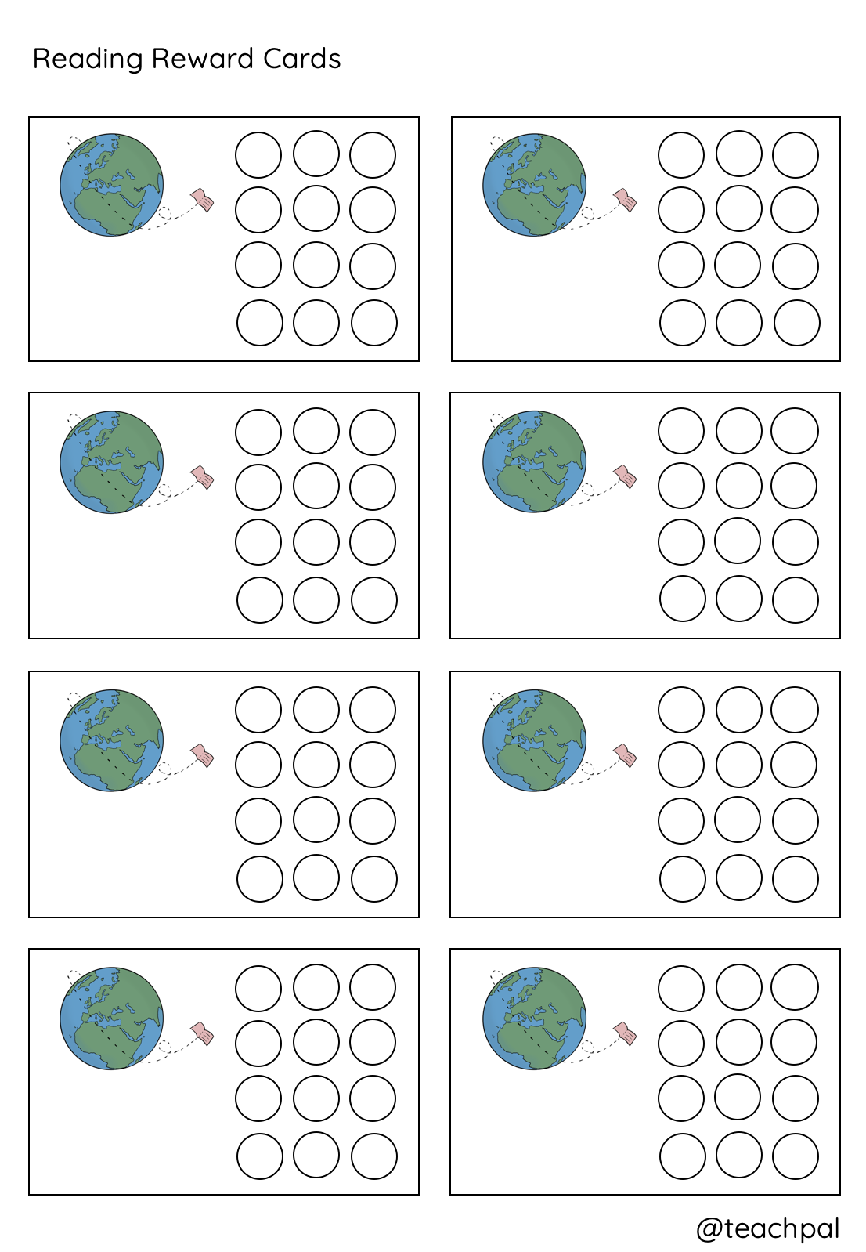
Earn a stamp each time you complete a new book. When you have filled a card, trade it in for a free hot chocolate.
Earn a stamp each time you complete a new book. When you have filled a card, trade it in for a free hot chocolate.
Earn a stamp each time you complete a new book. When you have filled a card, trade it in for a free hot chocolate.
Earn a stamp each time you complete a new book. When you have filled a card, trade it in for a free hot chocolate.
Earn a stamp each time you complete a new book. When you have filled a card, trade it in for a free hot chocolate.
Earn a stamp each time you complete a new book. When you have filled a card, trade it in for a free hot chocolate.
Earn a stamp each time you complete a new book. When you have filled a card, trade it in for a free hot chocolate.
Earn a stamp each time you complete a new book. When you have filled a card, trade it in for a free hot chocolate.

