Slide 1
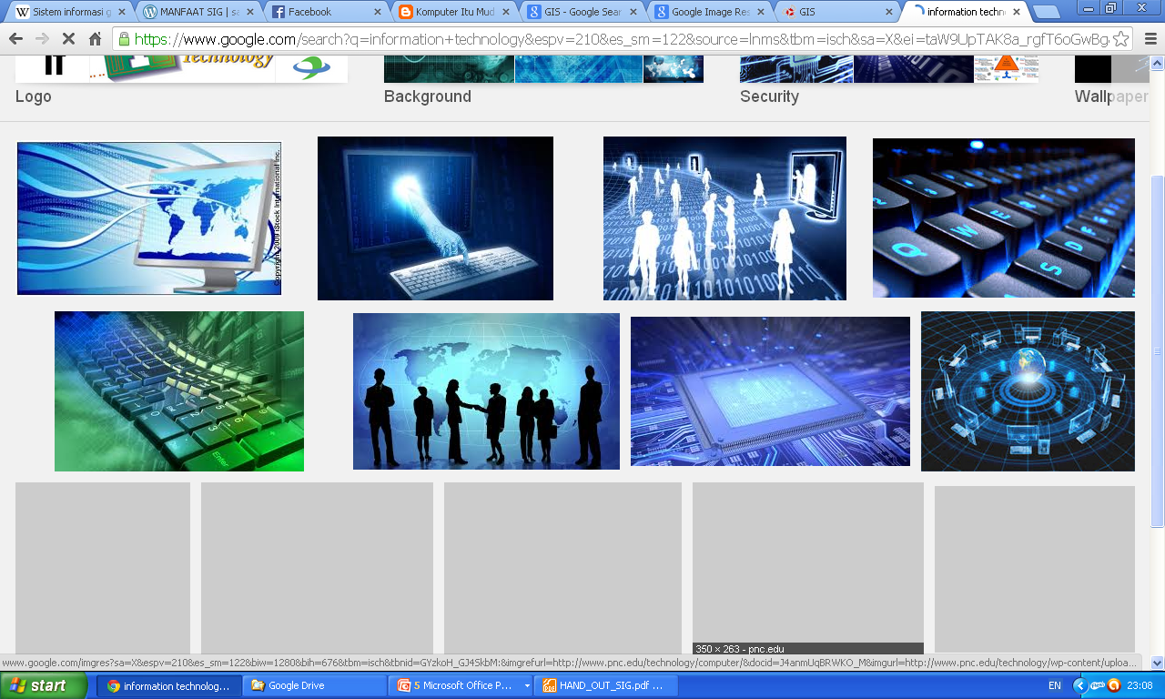
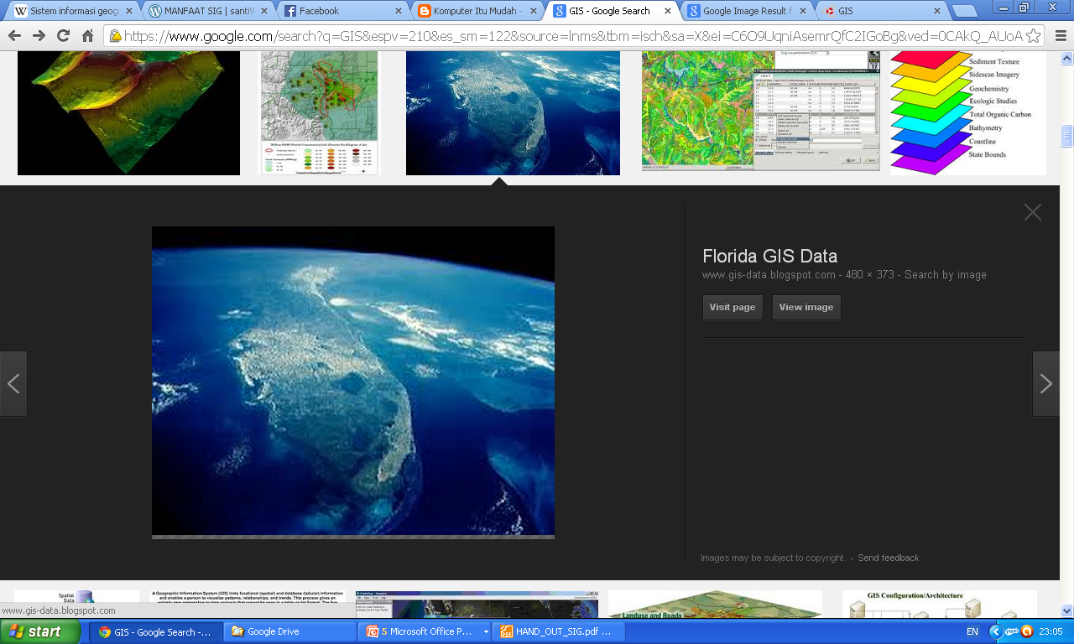
PERANAN TEKNOLOGI INFORMASI DALAM GEOGRAPHICAL INFORMATION SYSTEM (GIS)
EDWAR ALI, S.Kom, M.Kom
Dosen dan Peneliti

Slide 2
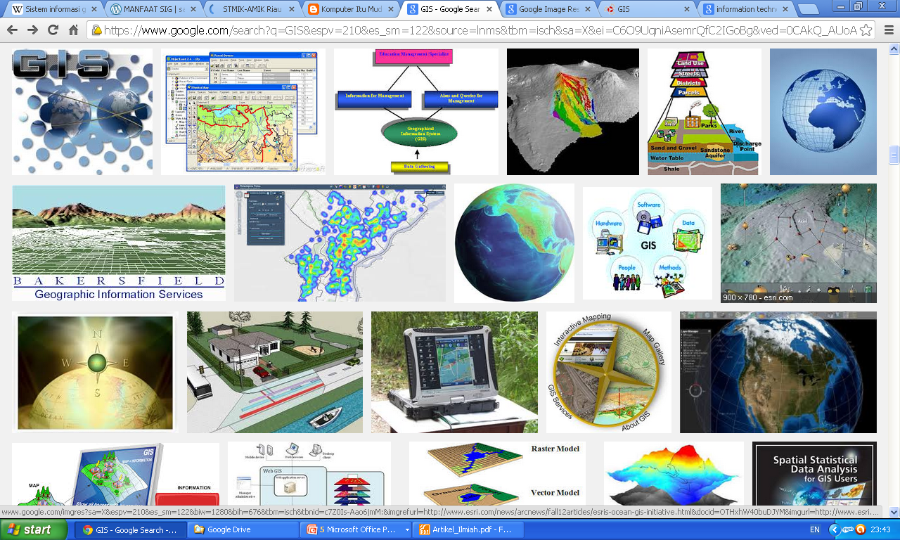
UmUM:
Ruang publik merupakan salah satu sarana yang selalu digunakan oleh masyarakat umum dalam beraktifitas.
Diperlukan ketersediaan akses yang tak terbatas terhadap informasi oleh masyarakat secara detil dan lengkap. Kriteria Informasi Berkualitas ?
Metode pengkomunikasian informasi yang tepat merupakan salah satu strategi guna menyediakan informasi yang mempunyai banyak atribut data

Slide 3
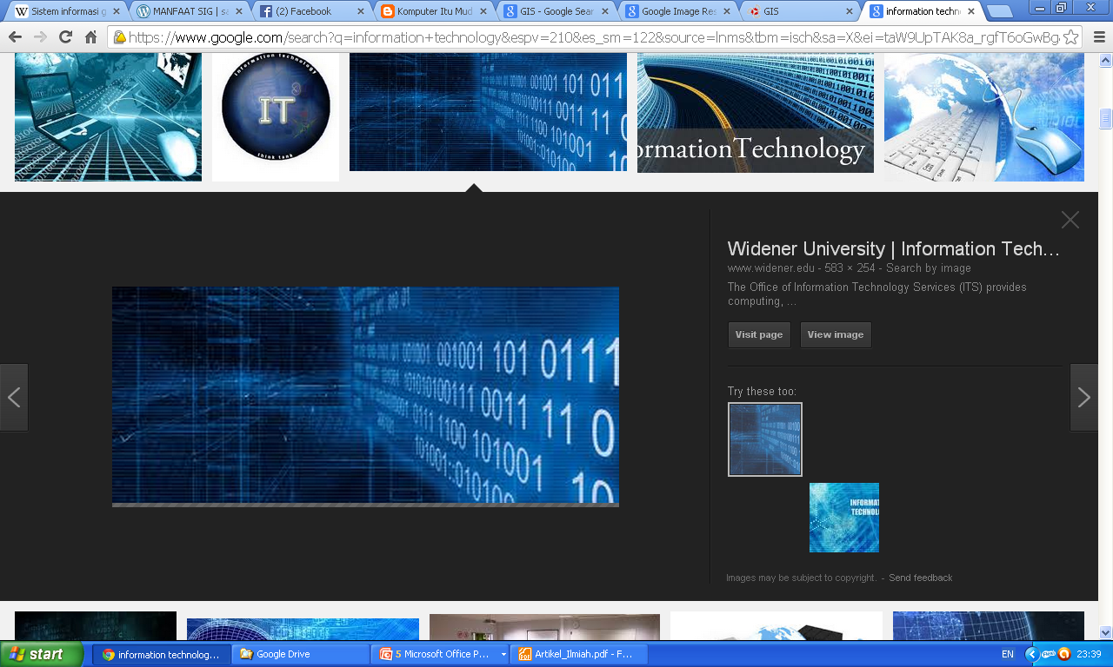
Informasi YANG BERKUALITAS ?
Memberikan manfaat/relevant
Tidak Usang/Aktual/Up to date
Bebas dari kesalahan/Akurat
Dapat dipercaya/reliable
Lengkap

Slide 4
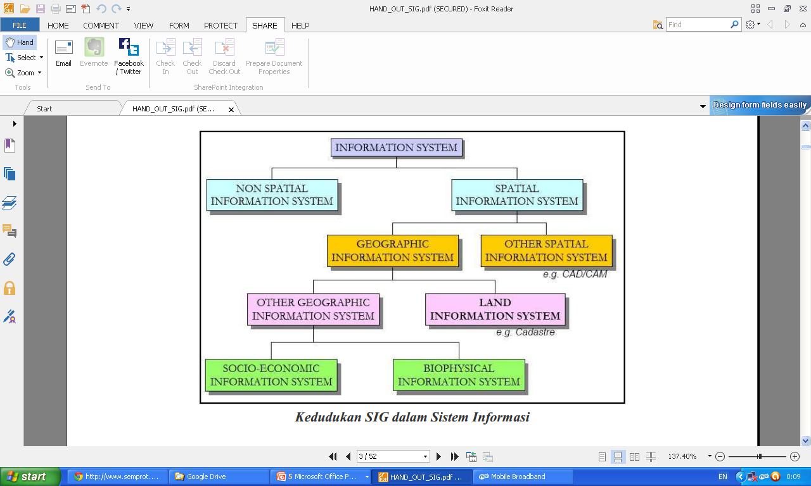
Sistem informasi terdiri atas non spasial dan spasial. Salah satu terapan sistem informasi spasial adalah sistem informasi geografiS (gis)

Slide 5
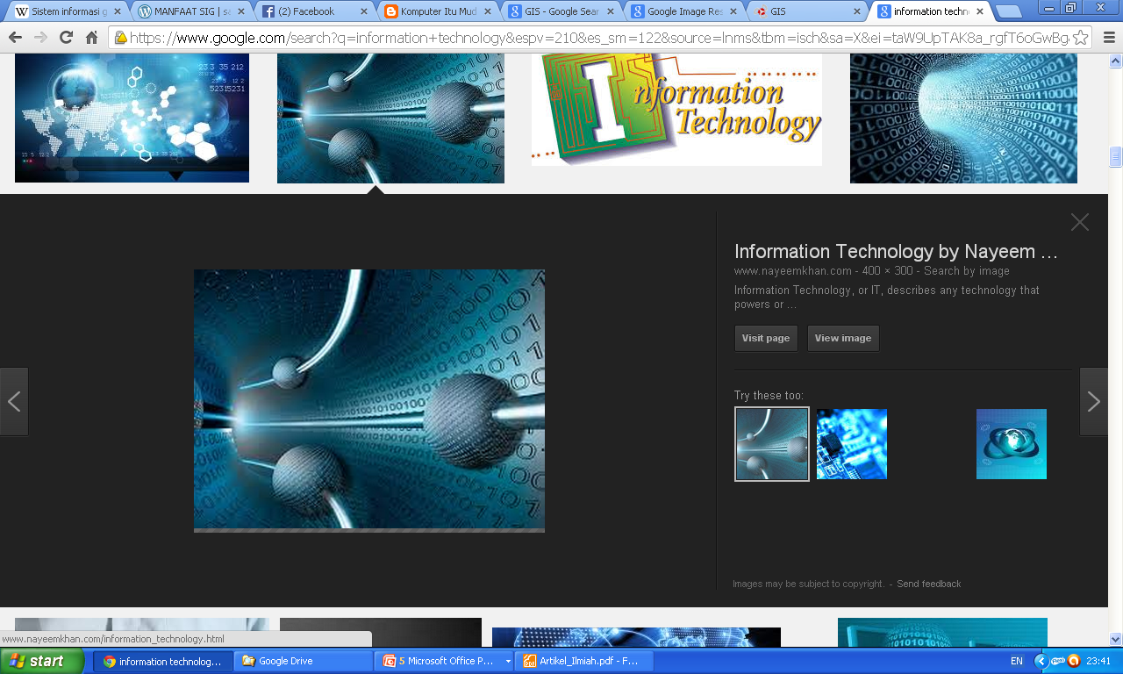
METODE PENGKOMUNIKASIAN
Salah satu bentuk pengkomunikasian itu adalah dalam bentuk visualisasi/pencitraan.
Visualisasi informasi merepresentasikan data yang telah diolah menggunakan berbagai macam perangkat pengolahan citra (hardware, software dan brainware) .
Selanjutnya disajikan dalam bentuk visual berupa teks, gambar, warna, bangun, diagram, dan kombinasinya.
Salah satu bentuk kombinasi ini adalah visualisasi georeferensi dalam bentuk peta

Slide 6
Dalam dunia IT, bentuk visualisasi georeferensi dapat diperoleh dengan adanya Geographic Information System (GIS) atau Sistem Informasi Geografis (SIG).
GIS merupakan sistem komputer dengan kemampuan mengolah, menganalisis, memanipulasi dan menyajikan data spasial yang bergeoreferensi beserta atribut-atributnya.
Data spasial adalah data yang merujuk terhadap lokasi yang mempunyai koordinat-koordinat geografis sedangkan atribut adalah detail informasi dari setiap lokasi yang tersedia.
Contoh jumlah penduduk suatu provinsi, ruang terbuka hijau pada suatu kota, dan lain-lain. Dengan kata lain, SIG mampu memberikan informasi yang aktual dan bersifat dinamis terhadap suatu lokasi.

Slide 7
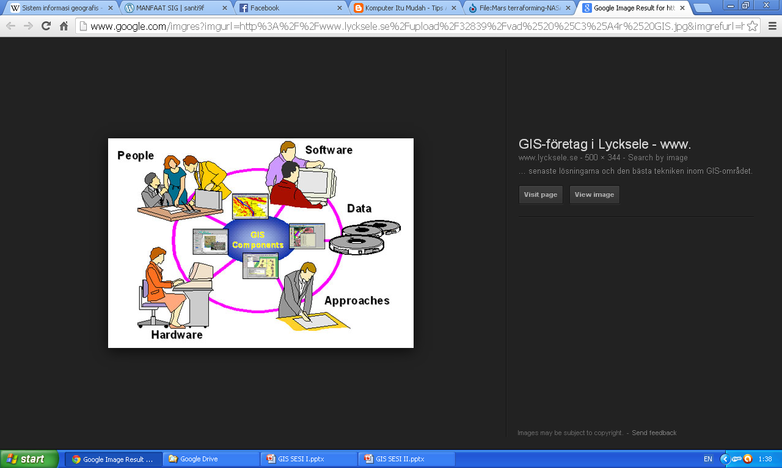
Komponen GIS
Data
Spasial
G I S
?
Computer hardware /
software tools
Aplikasi-aplikasi khusus/
Untuk berbagai keperluan
Notes:
GIS components
The key to establishing this type of technology within an information framework for the purposes of decision making is INTEGRATION: the linking together of technology, data and a decision making strategy.
What GIS is all about today is the bringing together of spatial analysis techniques and digital spatial data combined with computer technology.
But for many, GIS is much more than a computer database and a set of tools: it is also a philosophy for information management. Often GIS can form the core of the information management within an organisation.
There are of course other definitions too. GIS is sometimes referred to as the tool whilst the user may be the Spatial Information Scientist! In recent times the whole subject area has also been referred to as Geographic Information Management (GIM) or even Geomatics
Each of these components will now be examined in further details.
1. Data
2. Software & hardware tools
3. GIS data manipulation & analysis

Slide 8
4 Komponen Utama SIG
Ada empat komponen utama yang dibutuhkan untuk mengembangkan Sistem Informasi Geografis, antara lain:
  Perangkat keras (Hardware)
  Perangkat lunak (Software)
  Data dan informasi geografi
  Manajemen (manusia)

Slide 9
Komponen Perangkat keras (1)
Perangkat keras untuk SIG meliputi perangkat keras yang bekerja sebagai: pemasukan data, pemrosesan data, penyajian hasil, dan penyimpanan (storage)
Perangkat keras yang sering digunakan antara lain adalah Digitizer, scanner, Central Procesing Unit (CPU), hard-disk, mouse, printer, plotter.

Slide 10
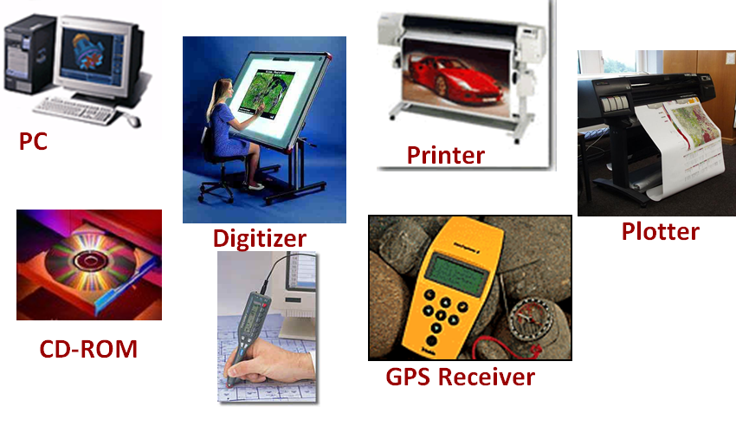
Komponen Perangkat keras (2)

Slide 11
Komponen Perangkat lunak (1)
Software SIG harus memiliki spesifikasi sebagai:
  merupakan Database Management System (DBMS), fasilitas untuk input dan manipulasi data geografis, fasilitas untuk query, analisis, dan visualisasi.
  Graphical User Interface (GUI) yang baik untuk mempermudah akses fasilitas yang ada. (Misal : Arc view, Idrisi, ARC/INFO, ILWIS, MapInfo, dan lain-lain)

Slide 12
Komponen Perangkat lunak (2)
Dari Universitas :
  SYMAP, Harvard
  CALFORM, Harvard
  SYMVU, Harvard
  Grid, Harvard
  Polyvrt, Harvard
  Odyssey,Harvard
  ILWIS, ITC, Belanda
  IDRISI, Univ. Clark USA

Slide 13
Komponen Perangkat lunak (3)
Dari Perusahaan :
  MapX, MapInfo Corp. (www.mapinfo.com)
  MapXtreme, MapInfo Corp.
  MapInfo, MapInfo Corp.
  Map Basic, MapInfo Corp.
  ER Mapper
  ERDAS Imagine
  Spans GIS
  MGE, Integraph
  ArcInfo, ESRI (www.esri.com)
  ArcView (Whats_new_in_ArcView8 basics.ppt), ESRI
  ArcGIS, ESRI
  MapObjects, ESRI
  dll.

Slide 14
Komponen Data (1)
Data SIG atau disebut data geospatial dibedakan menjadi data grafis (geometris) dan data attribute (tabel data).
Data terdiri dari 2 jenis yaitu data vektor dan data raster yang mewakili geometri topologi, ukuran, bentuk, posisi, dan arah
Data vektor mempunyai tiga elemen:
  titik (node/point),
  garis (arc/polyline),
  luasan/area(polygon)
Data raster berbentuk pixel

Slide 15
Komponen Data (2)
7 (tujuh) fenomena geografis yang dapat diwakili dalam bentuk titik, garis, dan polygon/area, yaitu:
  Data kenampakan
  Unit area
  Jaringan topologi
  Catatan sampel
  Data permukaan bumi
  Label/teks pada data
  Simbol data

Slide 16
Komponen Manusia (1)
Teknologi GIS tidaklah bermanfaat tanpa manusia yang mengelola sistem dan membangun perencanaan yang dapat diaplikasikan sesuai kondisi nyata.
Suatu proyek SIG akan berhasil jika di kelola dengan baik dan dikerjakan oleh orang-orang yang memiliki keakhlian yang tepat pada semua tingkatan.

Slide 17
Komponen Manusia (2)
High Application Skill
Low Application Skill
GIS Analysts : ‘Applications Specialists’
E.q. system manager, analyst, cartographer
Computer Technicians : ‘Computer Specialists’
E.q. programmers, data processor, database administrator, digitizing technicians
High
GIS
Skill
Managers :
‘Occasional Professionals’
E.q. end-users, decision makers
Customers :
‘ The Public ‘
E.q. Customers
Low
GIS
Skill
Adopted from Brown(1989), Grimshaw(1994), Eason(1994)

Slide 18
Komponen Manusia (3)
GIS Analysts : Applications Specialists
System Manager : maintain GIS every time. Have a good understanding of the applications’ context and GIS.
Analyst : able to translate the managers’ requirements into real GIS analysis. Have a good understanding of the applications’ context and GIS.
Cartographer : help to produce spatial information into GIS
They all also have a role in designing and maintaining the GIS, including the development of new application for the system.

Slide 19
Komponen Manusia (4)
Managers :Occasional Professionals
End Users Decision Makers : required strategic information from the GIS to make decision, but are unlikely ever to use the system in a ‘hands-on’ way.
They are more interested in hard-copy output, such as maps.
They have a good knowledge of the context of the application, but little GIS knowledge or experience.
E.q. : Company directors, managers.

Slide 20
Komponen Manusia (5)
Computer Technicians : Computer Specialists
Have other responsibility in addition to the GIS.
Responsible for the wages and personnel computer system, which has no GIS element.
Assist data formatting and input, hardware maintenance and system upgrading.
They are not GIS experts.
E.q. :
  Programmer
  Data Processor
  D/B Administrator
  Digitizing Technicians

Slide 21
Komponen Manusia (6)
Customers : Public user
Using GIS to get spatial information by searching, retrieving, etc.
Customers also receive any products or services as a result of the GIS analysts’ manipulations of the customer databases.
Do not need to know that it is a GIS they are interacting with. Unlikely to have any business, GIS or computer expertise.
They are end-users of the products and services offered by the company.

Slide 22
KARAKTERISTIK DATA SPASIAL
Lokasi:
    Description: Kingston University,PenrhynRoad Centre
    Post Code: KT1 2EE
    Grid Reference: 518106.72 168530.37
    Latitude/Longitude: 0° 21’ 55.38”W, 49° 36’ 17.62”N
Notes:
Characteristics of spatial data
This can be expressed in many ways. It may, however, differ in terms of:
Method e.g. co-ordinate, place name, Post Code
Precision e.g. <1.0m, City name, Post Code sector
Accuracy e.g. centre of building, front door position
Examine the spatial data descriptions in the slide, then attempt to answer the following question:
Question
Could you describe your current location in these terms?
Name of building:
Post Code:
Grid reference:
Latitude/Longitude:
Other spatial reference:

Slide 23
Karakteristik data spasial
Geometri
Pola Suatu bangunan atau wilayah
Jalur sungai, rute jalan
Pola dari tanah, relief
Notes:
Characteristics of spatial data: Geometry
It is also important to remember that geographical information often has shape associated with it. The forms might be: the shape of a building; the course of a river or even the relief of the landscape.
Using the example of Kingston University again, have a look at Figure above and examine the geometry or shape of the University buildings.

Slide 24
Contoh data spasial
Data Sosial-ekonomi
  Data kondisi kesehatan suatu wilayah
  Konsumen / Profil gaya hidup
  Geo-Demografi
Data Lingkungan
  Data topografi
  Tanah, bebatuan, mineral
Notes:
Spatial data examples
Socio-economic data is widely available, often from national and local government, and is usually the product of population surveys and censuses. This data is also used by a number of commercial vendors who combine census information with other datasets to produce neighbourhood profiles classifying particular areas for marketing purposes. This ability to recognise particular markets based on geographical datasets is known as Geodemographics and is one of the fastest growth areas within GIS.
Environmental Data
The collection and analysis of information about the environment was one of the driving forces behind the development of GIS and continues to be an important application area. Environmental data sets often tend to be large and require considerable management.
Environmental data often includes boundaries between vegetation types, for example, which are fuzzy i.e. they are not defined by a simple line. Conversely, socio-economic data is usually related to administrative boundaries, which are sharp if artificial.

Slide 25
Data Modelling - step 1
Features
  Bangunan
  Jalur jalan
  Jalur penerangan
  Pipa Gas, PDAM
  Permukaan jalan
Notes:
Data modelling - Step 1
It is important to identify the features that one can see. Look at the photograph of the marketplace in Kingston-upon-Thames and see if you can identify any of the features listed above.
Question
Perhaps you can identify other features? Jot them down here.

Slide 26
Data Modelling - step 2
Point
Line
Polygon
Notes:
Data modelling - Step 2
It is now important to identify these features into three categories: point, line or polygon
Question
Identify the following features using one of these categories for each
Feature Category
Buildings
Road centrelines
Lamp columns
Gas pipes
CTV Access covers
Road surfaces
Remember that as you continue to model the spatial data, you will move further away from the physical representation of the feature (Heywood et al 1998)

Slide 27
Data Modelling - step 3
Feature : Building
Object: Polygon
Entity: Tourist
Information
Bureau
Notes:
Data Modelling - Step 3
Finally you can identify your features in terms of geometry. Look at the large building in the centre of the photograph. Then examine the geometrical representation of the marketplace buildings in Kingston-upon-Thames.

Slide 28
Atribut
Name : Next
Address: 5 Market Place
Town: Kingston
Owner: Ms J Shore
Tel. No: 0181 547 1245
Floor space 1300 sq m
Notes:
Attributes
Finally consider the type of description or attributes of the chosen feature. What sort of information could be recorded about the feature? An example is given in the slide.
Question
See if you can complete a similar description for the building that you are currently located in at the moment.
Name
Address:
Town:
Post Code:
Owner:
Tel. No:
Floor space:

Slide 29
Spatial data storage
Vector model
Raster model
as geometric objects:
points, lines, polygons
as image files
composed of grid-cells
(pixels)
Notes:
Spatial data storage
It is easy for us to recognise by eye the shape and form of objects or features such as those you have just examined (Burrough 1998). Computers require much more information and precision and, in fact, instructions on how to store such information.
Spatial features or entities and their attributes are stored in computers using a number of spatial data models. It is important to understand the characteristics of them since the data model employed has considerable influence on the functionality of the GIS.
The basic approaches are :
• The Raster model
• The Vector model
The Raster data model is the simpler of the two and is based on the division of reality into a regular grid of identically shaped cells.
The Vector data model is similar in its operation to the ‘join the dot’ books we all used as children. An object’s shape is represented by dots which are located where the shape of the object changes. The dots are joined by straight lines. In the vector data model the dots are known as vertices

Slide 30
Modelling the real world
y
1 1 20 50
1 2 24 45
1 3 52 55
2 1 0 45 46 40
...
x
0 0 0 0 0 0 0 2 0 0 0 0 0 0 1 0 0 0 0 2 0 0 1 0 0 0 0 0 0 0 0 2 0 0 0 0 2 2 2 0 1 ...
Notes:
Modelling the real world
Thus all features can be coded in a digital form that the computer (and GIS) can understand. The slide shows the real world features as we see them, followed by a map representation. The map is then coded into two data models.
Firstly (above) the Vector representation.
Secondly (below) the Raster data model.
Finally these two models when applied will be translated into a series of numbers or codes that the computer can understand.
Further examples of these two data models can be found in both Burroughs & McDonnell and also Heywood et al.

Slide 31
Vector data
Land use parcels
Notes:
Vector data
This slide shows a typical example of some Vector data. It represents land use parcels from an American dataset. Notice how it is possible to colour code different types of land use.
Question
Can you think how this is possible? Jot down your ideas.

Slide 32
Raster data
Notes:
Raster Data
This slide shows a typical example of some raster data. It represents an aerial photo/satellite image? Of a river valley.
Question
What do you think the different colours represent here?

Slide 33
Manipulation and analysis
Apa yang akan terjadi bila. . .
Terjadi kebocoran kimia berbahaya ke sungai ?
Dimanakah. . .
Letak Kampus UIN Suska di Kota Pekanbaru ?
Adakah . . .
Terjadi perubahan populasi dalam 10 tahun terakhir ?
Apakah data spasial dapat menunjukkan. . .
Para Pemilik mobil di Pekanbaru ?
Notes:
Manipulation and analysis
To be of any value a GIS must perform a wide range of data manipulation and analysis functions. Thus all good GIS systems should be able to answer the types of questions listed above. The only limitations would be the availability of data and the functions of the specific software package.
In addition how each GIS is used to carry out such analysis will vary. In this course you will be using MapInfo - a Desk top GIS. You will carry out many of these type of questions in terms of MapInfo’s functionality. At the end of the day, however, it will be your interpretation of how the software functions which will determine the type of analysis that can be achieved.
Project planning will be an important issue to consider if you decide to carry out further analysis of your own data after completion of this course.

Slide 34
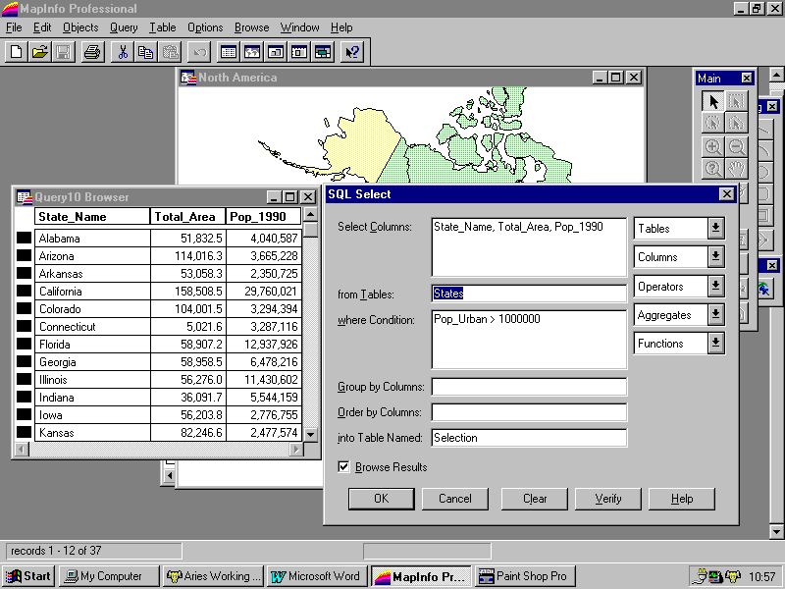
Databases & GIS
Spatial data
At a simple level a GIS may just form the graphical interface to a database
The majority of GIS applications follow this example
MapInfo
Linked database table
SQL Query Manager

Slide 35
Geo-relational Data Models
Linked tables based on the relational model, but storing geographical information such as:
  Geometry
  Topology
  Attributes

Slide 36
GIS & Analysis
In the context of GIS, analysis is...
“Deriving new information from existing data”
It is also the manipulation of data to solve a problem
e.g. identify all areas within 500m of a lake
Increasing use is made of the analytical capabilities of GIS, BUT
many GIS projects only use the software to store and manage
geographical data
Yet analysis often relies on many simple basic GIS techniques

Slide 37
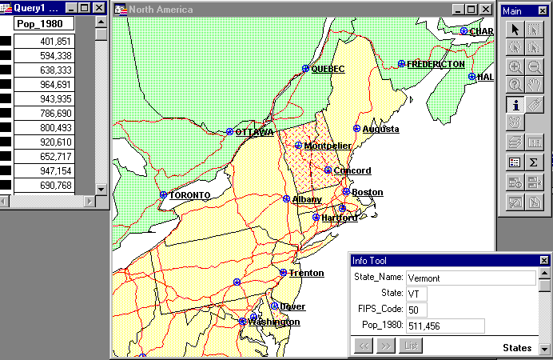
Simple Query
The identification of objects and their attributes either by location or attribute query.
MapInfo

Slide 38
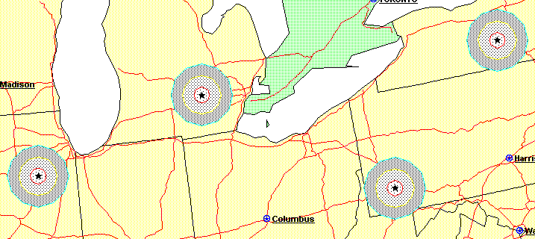
Buffering
Creation of an area of interest around an object
  proximity analysis and environmental impact assessment.
MapInfo

Slide 39
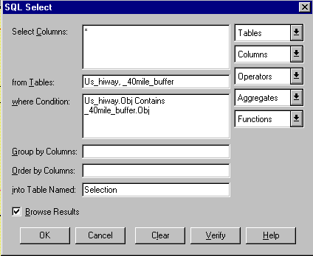
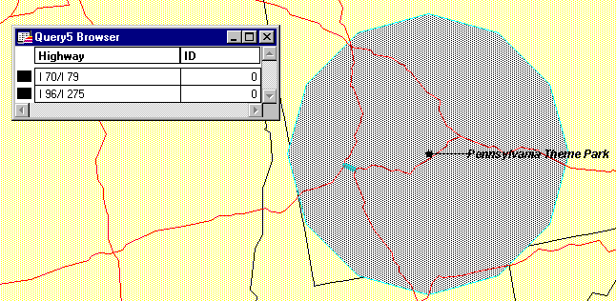
Cookie Cutting
Overlay of datasets using one dataset as a sieve or cookie cutter to select a subset of the other dataset.
MapInfo

Slide 40
Overlays
Layer: A thematic plane of GIS features containing geographically and logically related data
Overlaying involves superimposing two or more map layers to produce a new map layer.
Example: a new genetically engineered variety of wheat grows well in dry environments, with long growing seasons and alkaline soils. Given the availability of data on the length of the growing season, moisture regime and soil alkalinity, where is the best place to plant the wheat?
  overlaying (superimposing) several maps showing (separately) water-budget, growing season length, soil pH, sodium content, and so on. The GIS analysis can establish the locations where all the favorable soil conditions coincide, as the places where the wheat will grow best.

Slide 43
The benefits of GIS include:
Better information management
Higher quality analysis
Ability to carry out “what if?” scenarios
Improve project efficiency
Notes:
The benefits of GIS include:
Use of GIS software and spatial data should lead to better information management; higher quality analysis; the ability to carry out ‘what if . . ?’ scenarios and improve project efficiency.
Remember, however, that many of these achievements are dependent on:
data availability
the ease of use of the GIS software
the understanding of the problem to be solved
the time available
the amount of funding for the project in hand
A project may take longer than you first anticipate . . . .

Slide 44
Aplikasi GIS
Facilities management
Marketing and retailing
Environmental
Transport/vehicle routing
Health
Insurance
dan sebagainya. . .
Notes:
GIS Applications
Facilities management: Utilities such as electricity, gas, water and cable communication companies all use GIS systems to store, retrieve and analyse their plant and materials. Areas such as customer responses, demand forecasting, fault analysis, network assessment analysis, site planning, strategic planning and market analysis can be generated by the GIS.
Marketing and retailing: these applications tend towards targeting customers and identifying potential markets for customers. The extensive datasets generated from the use of loyalty cards can also be used in conjunction with GIS. Other applications may include: media planning, territory allocation and prospect analysis.
Environmental: Forestry management, impact analysis, resource management, coastal zone mapping, geophysical & geotechnical surveys.
Transport/vehicle routing: this is an example of ‘real-time’ GIS and is used particularly by vehicle routing companies and the emergency services who need to know where there vehicles are located at any given time. Vehicle routing can also be assessed in terms of least cost or efficiency. In addition GIS may also be used for; dispatch, scheduling, franchise planning as well as route planning.
Health: Disease mapping as well as epidemiology, facility planning, provider & purchaser planning, expenditure monitoring and patient analysis can all be carried out using GIS.
Insurance: risk distribution analysis, catastrophe planning, customer service analysis, hazard & prediction analysis and underwriting

Slide 45

SELESAI
ILMU tidak akan bermanfaat bila tidak diamalkan

