Slide 1



Animal models of MS
Stefanie A.G. Black, Ph.D.
Research Associate
Cumming School of Medicine
Department of Physiology and Pharmacology
and
Hotchkiss Brain Institute
University of Calgary

Slide 2
Outline
Background about multiple sclerosis (MS)
Experimental autoimmune encephalomyelitis (EAE)
Virus-induced demyelination
Toxin-induced demyelination
Targeted oligodendrocyte ablation
Studying behavioural aspects of MS using animal models
Summary

Slide 3
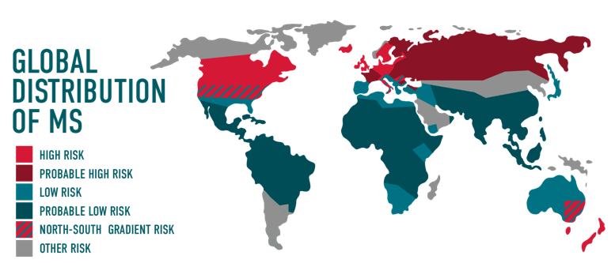
Multiple sclerosis (MS)
MS affects 2.3 million people worldwide
100 000 Canadians live with MS
Canada has highest rate of MS worldwide
Diagnosed most often from 15-40 years of age
Most common neurological disorder affecting young adults
https://multiplesclerosis.net/what-is-ms/statistics/

Slide 4
MS is a complex disease
  Central nervous system demyelination, inflammation, and neurodegeneration
  Large variety of symptoms and pathologies
  Different disease courses of MS

Slide 5
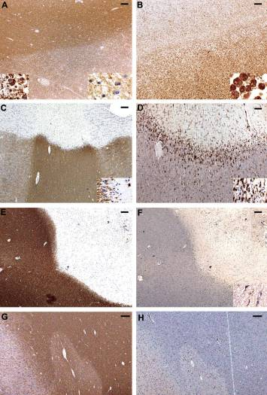
MS plaque types
myelin
(PLP)
Microglia/macrophages
(KiM1P)
Early active
Smoldering
(aka slowly expanding)
Inactive
Shadow
Ann Neurol. 2015 Nov; 78(5): 710–721.

Slide 6
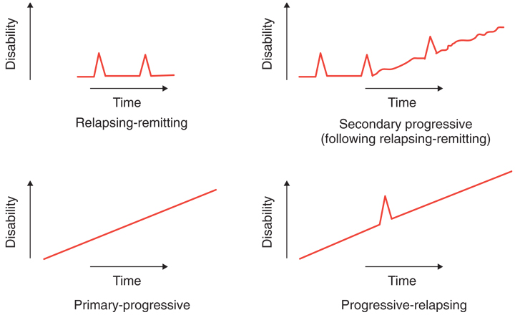
MS disease courses
Adapted from Lublin FD, et al. Defining the clinical course of multiple sclerosis: results of an international survey. Neurology 1996; 46:907–911.

Slide 7
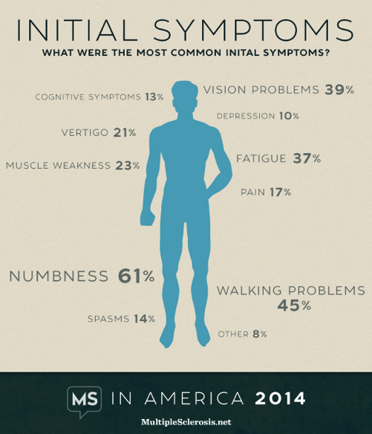
MS has a large variety of symptoms

Slide 8
Various models are used to study MS
No known cause for MS, and thus no cure
Models needed to study the different aspects of MS
  Disease mechanisms
  Remyelination
  Symptoms
  Treatments
No spontaneous disease in animals equivalent to MS
No one model recapitulates all aspects of MS
A variety of animal models are used to study different aspects of MS
  EAE: experimental autoimmune encephalomyelitis
  Virus-induced demyelination
  Toxin-induced demyelination
  Conditional oligodendrocyte ablation

Slide 9
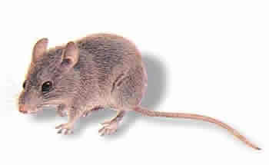
EAE – active induction
Score (daily) | Phenotype
5 | Moribund/ death
4 | forelimb weakness
3 | complete hindlimb paralysis
2 | weak hindlimb
1 | limp tail
0 | healthy
8-12 week
old mice
DAILY SCORING OF EAE CLINICAL SEVERITY
Day
0
2
~9-14
ascending
paralysis
begins
s.c. injection of myelin peptide in CFA
+
i.p. injection of pertussis toxin
i.p. injection of pertussis toxin
CFA, complete Freund’s adjuvant; i.p., intraperitoneal; s.c., subcutaneous

Slide 10
EAE – passive induction
inject cells i.v. into
naïve mice
+ pertussis toxin on days 0 and 2
ascending
paralysis
8-12 week
old mice
Day
0
2
~day 8-10
harvest immune cells:
Splenocytes,
lymph node cells,
CD4⁺/CD3⁺ T cells or
bone marrow cells
Before clinical
disease,
s.c. injection of myelin peptide in CFA
+
i.p. injection of pertussis toxin
i.p. injection of pertussis toxin
grow in vitro under conditions to expand Th1 cells
or
Th17 cells
CFA, complete Freund’s adjuvant; i.p., intraperitoneal; i.v., intravenous; s.c., subcutaneous

Slide 11
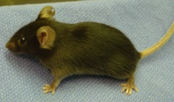
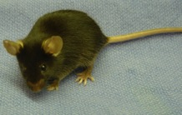
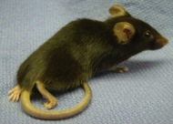
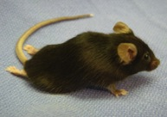
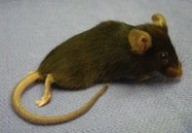
Clinical assessment of EAE
0
C57BL/6
myelin oligodendrocyte glycoprotein (MOG)-induced EAE
1
2
3
4
Data from Peggy Ho
Slide courtesy of Dr. Shalina Ousman

Slide 12
EAE clinical course depends on mouse strain
“chronic progressive”: C57BL/6
EAE score
“relapsing-remitting”: SJL/J
EAE score
Days following immunization
Slide courtesy of Dr. Shalina Ousman

Slide 13
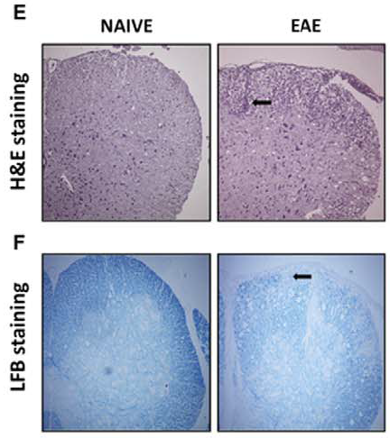
EAE histopathology
Lumbar spinal cord sections from MOG₃₅₋₅₅ EAE in female C56BL/6, 25 days post-induction
Inflammatory
cell infiltration
Demyelination
Dutra et al. (2011) PLoS ONE 6(11):e27875

Slide 14
Testing therapeutic interventions in EAE
EAE score
prevention
treatment
Days following immunization
Slide courtesy of Dr. Shalina Ousman

Slide 15
Examples of experiments in EAE
Clinical disease
WT vs KO/transgenic/conditional KO
control vs therapeutic compound (i.p., i.v., gavage, i.m.)
gender differences
Immunology
Splenocytes, lymph nodes cells, CD3+, Th1 CD4+, Th17 CD4+, CD8+
T cells, dendritic cells, B cells, macrophages from spleen, LN or CNS:
number or percentage of cells
proliferation rate
activation (cytokine and chemokine secretion)
cell death
antigen presentation capability
adhesion and migration
Slide courtesy of Dr. Shalina Ousman

Slide 16
Examples of experiments in EAE
Histology
number of immune cells in CNS
demyelination
glial and neuronal cell death
Neuroscience
Astrocytes, microglia, oligodendrocytes, neurons:
activation (cytokine, chemokine secretion, proliferation)
cell death
antigen presentation capability
differentiation potential
Slide courtesy of Dr. Shalina Ousman

Slide 17
Virus-induced demyelination
MHV: Mouse hepatitis virus
SFV: Semiliki forest virus
TMEV: Theiler’s murine encephalomyelitis virus

Slide 18
Virus-induced demyelination
MHV: Mouse hepatitis virus
SFV: Semiliki forest virus
TMEV: Theiler’s murine encephalomyelitis virus

Slide 19
Theiler’s murine encephalomyelitis virus (TMEV)
intracerebral inoculation with
low-neurovirulence strains of the picornavirus, TMEV
Score (every 3-4 days) | Phenotype
5 | moribund
4 | paralysis of 1 or more limbs, inability to walk
3 | extreme difficulty walking, impaired righting reflex
2 | moderate to severe waddling gait with extensor spasms
1 | mild to moderate waddling gait
0 | asymptomatic
4-6 week old SJL mice
SCORE EVERY 3-4 DAYS
gait difficulty
between 1-3 months post-infection

Slide 20
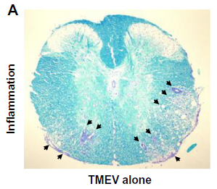
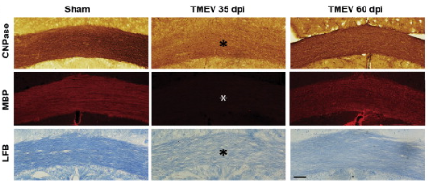
TMEV histopathology
Inflammation
Demyelination/remyelination
dpi, days post-injection
Martinez et al. (2014) Brain Pathol
Mecha et al. (2013) Exp Neurol 250:348-52

Slide 21
Examples of experiments in TMEV
Clinical disease
WT vs KO/transgenic/conditional KO
control vs drug (i.p., i.v., gavage, i.m.)
gender differences
Neuroscience
Astrocytes, microglia, oligodendrocytes,
neurons:
activation (cytokine, chemokine
secretion)
cell death
antigen presentation capability
differentiation potential
Immunology
Splenocytes, lymph nodes cells, CD3+, CD4, CD8 T cells, dendritic cells, B cells, macrophages from spleen, LN or CNS:
number or percentage of cells
proliferation rate
activation (cytokine and chemokine secretion)
cell death
antigen presentation capability
adhesion and migration
Histology
number of immune cells in CNS
demyelination
glial and neuronal cell death
Slide courtesy of Dr. Shalina Ousman

Slide 22
Toxin-induced demyelination
Precise location and timing of demyelination
Focal
  Lysophosphatidylcholine (lysolecithin)
  Ethidium bromide
Systemic
  Cuprizone

Slide 23
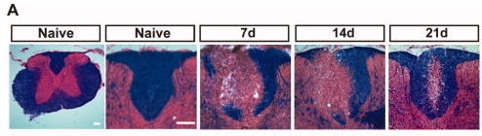
Lysophosphatidylcholine-induced demyelination
Focal injection into white matter tracts, e.g. dorsal column of spinal cord at thoracic level, corpus callosum
Inserts into membrane, forms micelles, causes membrane breakdown
Local loss of myelin and most oligodendrocytes
Spontaneous remyelination via OPC repopulation, differentiation to oligodendrocytes, new myelin formation
Lau et al. (2012) Ann Neurol 72(3):419-32

Slide 24
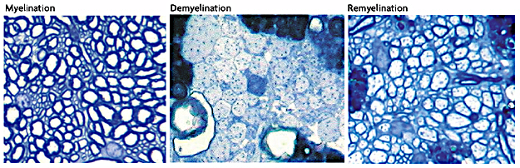
Ethidium bromide-induced demyelination
Focal injection into white matter tracts
DNA intercalating agent; affects all nucleated cells
Local loss of oligodendrocytes and astrocytes
Spontaneous remyelination involves OPCs and Schwann cells
Franklin and ffrench-Constant (2008) Nat Rev Neurosci 9(11):839-55

Slide 25
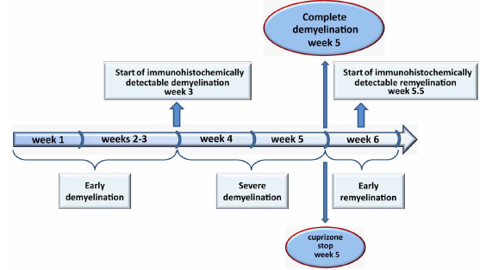
Cuprizone-induced demyelination
Cuprizone [oxalic acid bis(cyclohexylidene hydrazide)] is a copper chelator
Oral administration by adding to food (0.2%)
Mitochondrial dysfunction → metabolic stress → oligodendrocyte death → CNS demyelination in specific areas, e.g. corpus callosum
Gudi et al. (2014) Front Cell Neurosci 8:73

Slide 26
Cuprizone-induced demyelination
Steelman et al. (2012) Neurosci Res 72(1): 32–42
Acute demyelination followed by robust, spontaneous remyelination upon cessation of cuprizone
  as lesion evolves, demyelination and remyelination coincide
Activation of astrocytes, microglia/macrophages
Chronic demyelination with prolonged cuprizone consumption (12 weeks)
Minimal immune cell infiltration from the periphery

Slide 27
Targeted oligodendrocyte ablation
Genetically-modified mice allow targeted oligodendrocyte death
  Expression of inducible cell death genes in oligodendrocytes (OL) under control of specific promoters (e.g. myelin basic protein)
  Conditional expression of genes upon addition of a chemical inducer; timing of OL death controlled

Slide 28
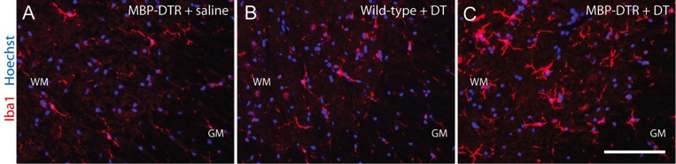
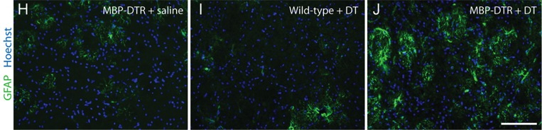
Increased microglial density and GFAP immunoreactivity
following OL apoptosis
Microglia
Astrocytes
Laura-Jane Oluich et al. J. Neurosci. 2012;32:8317-8330

Slide 29
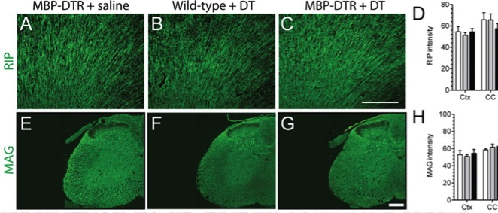
Maintenance of normal levels of CNS myelin
Brain
Spinal cord
Laura-Jane Oluich et al. J. Neurosci. 2012;32:8317-8330

Slide 30
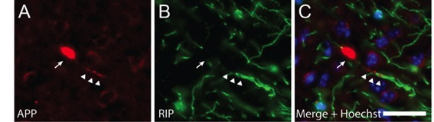
Pathological changes in axons after OL ablation
Brain
Laura-Jane Oluich et al. J. Neurosci. 2012;32:8317-8330

Slide 31
Experiments in the demyelination/remyelination/OL ablation models
Extent of demyelination/remyelination in WT vs KO/transgenic/conditional knockout
Modulation of demyelination/remyelination by various agents
Number/function of astrocytes, microglia, neurons, oligodendrocyte precursor cells and mature oligodendrocytes in WT vs KO/transgenic/conditional knockout
Presence, number and function of various immune cells in WT vs KO/transgenic/conditional knockout

Slide 32
Studying behavioural aspects of MS in animal models

Slide 33
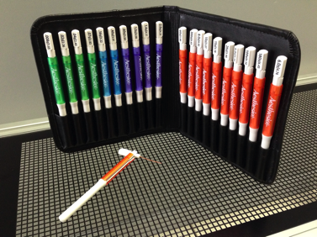
Measuring pain sensitivity
Mechanical allodynia
von Frey filaments/hairs
Measure threshold force to elicit nociceptive response
Re-assess after injury/disease induction
Decreased threshold force indicates allodynia
Cold allodynia
Drop of acetone on paw
Measure response time (licking, biting, lifting, guarding)
Increased response time indicates allodynia
http://www.ugobasile.com/catalogue/category/pain_and_inflammation/product/37450_275_von_frey_hairs_.html

Slide 34
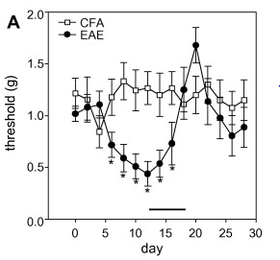
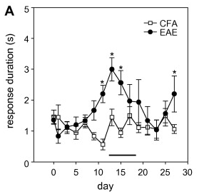
EAE mice are more sensitive to
mechanical and cold stimuli
Response to mechanical stimulus (von Frey hairs)
Response to cold stimulus (acetone)
Olechowski et al. (2009) Pain 141: 156-164

Slide 35
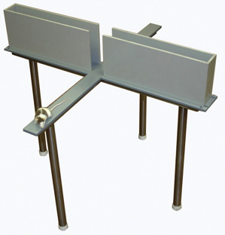
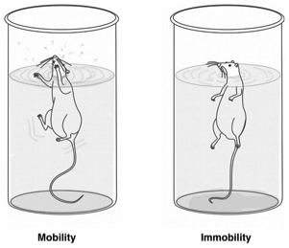
Measuring anxiety and depression
Elevated plus maze test
Forced swim test
http://www.stoeltingco.com/anymaze/mazes/anxiety-depression/elevated-plus-maze.html
Rev. Bras. Psiquiatr. (2013) vol.35 supl.2, http://dx.doi.org/10.1590/1516-4446-2013-1098
Used to assess anxiety
Measure time spent in open arms vs. closed arms
Models learned helplessness as a depressive behaviour
Measure time to stop swimming (just floating)

Slide 36
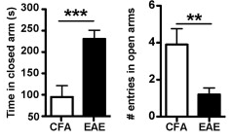
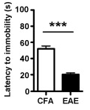
EAE mice show anxiety and depressive-like behaviour
Elevated plus maze test
Forced swim test
Acharjee et al. (2013) Brain Behav Immun 33:164-72

Slide 37
Summary: various aspects of MS can be studied using animal models
Several animal models are used to study MS
  EAE
  Virus-induced demyelination: e.g. TMEV
  Toxin-based demyelination
    Focal: lysophosphatidylcholine, ethidium bromide
    Systemic: cuprizone
  Targeted OL ablation
Various aspects of MS can be studied
  Immune responses
  Demyelination
  Remyelination
  Neurodegeneration
  Behaviour

Slide 38
Questions?
Stefanie Black blacks@ucalgary.ca

