Slide 1
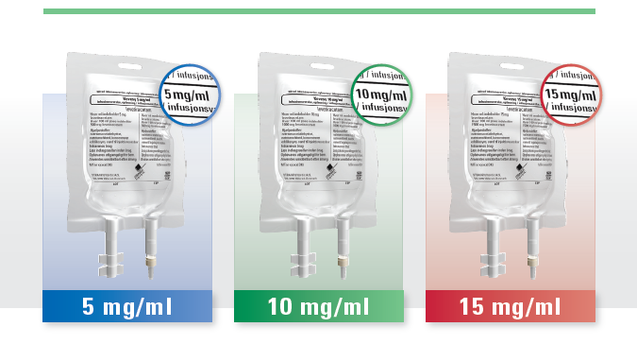
The gold-standard for epilepsy now available in unique, ready-to-use bags

Slide 2
Content
An insight into the epilepsy market
Levetiracetam
Levetiracetam vs. other epilepsy treatments
Products
Kevesy product description
Kevesy vs. Keppra®
Main benefits of Kevesy in ready-to-use bags

Slide 3
An insight into the epilepsy market
Growing market
Crowded & competitive market
Major contributor to growth: expanding number & growing uptake of 3rd-generation AEDs, led by lacosamide (Vimpat, UCB)
US, big 5 & Japan: uptake of 3rdG AEDs will drive 2% annual growth over the next 8 years
2ndG AEDs (eg. levetiracetam) will maintain their major market sales leader position through 2021
2ndG agents continue to displace older, 1stG AEDs across the major markets
3rdG AEDs will not supersede 2ndG drugs. 3rdG drugs will primarily be used as late-line adjunctive therapies in patients not responding to conventional treatments
Forecast: <15% of patients will be prescribed 3rdG AEDs between now and 2022
2011
$2.9 billion
2016
$3.7 billion
2022
$4.1 billion
http://www.fiercebiotech.com/press-releases/epilepsy-drug-market-will-increase-800-million-2016-primarily-due-uptake-pr#ixzz2rser5FrO
http://www.epilepsyresearch.org.uk/researchers-predict-epilepsy-market-will-grow-2-annually-through-2022/

Slide 4
The target: Neurologists and epileptologists
Treatment
Treated by: neurologists, epileptologists, pediatricians, neurosurgeons, internists, family physicians
1st line treatment: drugs
If drugs do not work:
surgery
special diet (ketogenic)
implanted device programmed to stimulate the vagus nerve (VNS therapy)
2nd generation | 3rd generation
Levetiracetam (Keppra®, UCB) | Lacosamide (Vimpat®; UCB)
Lamotrigine (Lamictal®, Lamictal XR; GSK) | Ezogabine (Potiga®; Valeant/ GSK)
Pregabalin (Lyrica®; Pfizer) | Eslicarbazepine acetate (Stedesa®; Sunovion/Eisai/Bial)
Midazolam (Buccolam®; ViroPharma) | Perampanel (Fycompa®, Eisai)
 | Rufinamide (Banzel®; Eisai)
Gold standard
Notes:
The ketogenic diet is a high-fat, adequate-protein, low-carbohydrate diet that in medicine is used primarily to treat difficult-to-control (refractory) epilepsy in children. The diet forces the body to burn fats rather than carbohydrates. Normally, the carbohydrates contained in food are converted into glucose, which is then transported around the body and is particularly important in fuelling brain function. However, if there is very little carbohydrate in the diet, the liver converts fat into fatty acidsand ketone bodies. The ketone bodies pass into the brain and replace glucose as an energy source. An elevated level of ketone bodies in the blood, a state known as ketosis, leads to a reduction in the frequency of epileptic seizures.
First generation anticonvulsants to treat epilepsy:
Phenytoin (Dilantin)
Carbamazepine (Tegretol / Carbatrol)
Phenobarbital
Valproate (Depakote)
Ethosuximide (Zarotin)
Primidone (Mysoline)

Slide 5
Levetiracetam vs. other epilepsy treatments
Levetiracetam is especially close to fulfilling the desirable characteristics for an AED¹
HIGH SUSTAINED, RELIABLE EFFICACY
1
RAPID PENETRATION OF BLOOD BRAIN BARRIER
2
LINEAR PHARTMACOKINETICS
10
3
MINIMAL PLASMA PROTEIN BINDING
NO INTERACTIONS WITH OTHER MEDICATIONS AND CONCOMITANT AEDs
9
LEVETIRACETAM
4
NO INDUCTION OR INHIBITION OF HEPATIC ENZYMES
POSSIBILITY OF RAPID DOSING WITH NO MAJOR RISK OF IDIOSYNCRATIC REACTIONS
8
5
RENAL ELIMINATION IS PREFERABLE TO HEPATIC METABOLISM
7
6
BROAD SPECTRUM OF INDICATIONS
ELIMINATION HALF-LIFE TO 12-24 HOURS
http://co.uk.desitin-live.spotmedia.de/fileadmin/web_files_en/products/Levetiracetam/Levetiracetam-Interview-Prof-Steinhoff.pdf
Patsalos (2004)
Perucca E, Johannessen SI. The ideal pharmacokinetic properties of an antiepileptic drug: how close does levetiracetam come? Epileptic Disord. 2003; 5, Supple 1:S17-26.

Slide 6
Levetiracetam vs. other epilepsy treatments
Levetiracetam is widely regarded as a gold-standard epilepsy treatment
Levetiracetam possesses the best overall clinical profile:
Broad indication label (broadest range of approved epilepsy indications of all drugs in the epilepsy market)
Strong efficacy profile
Has demonstrated short and long-term efficacy as an add-on therapy or monotherapy in the management of a variety of epilepsy conditions in both placebo-controlled and non-inferiority trials¹
Highest efficacy relative to other epilepsy drugs (32-42% responder rate)²
Safe and well tolerated. Good therapeutic window
Straightforward pharmacokinetics
Lack of known drug-drug interactions (important factor in the management of epilepsy given the frequent use of combination therapies)
¹Keppra Product Analysis; Datamonitor; May 2012; ²Cereghino et al. 2000; Shoroyon et al. 2000; Ben-Menachem and Falter 2000; ³Product Profiles: Epilepsy; Datamonitor; December 2011

Slide 7
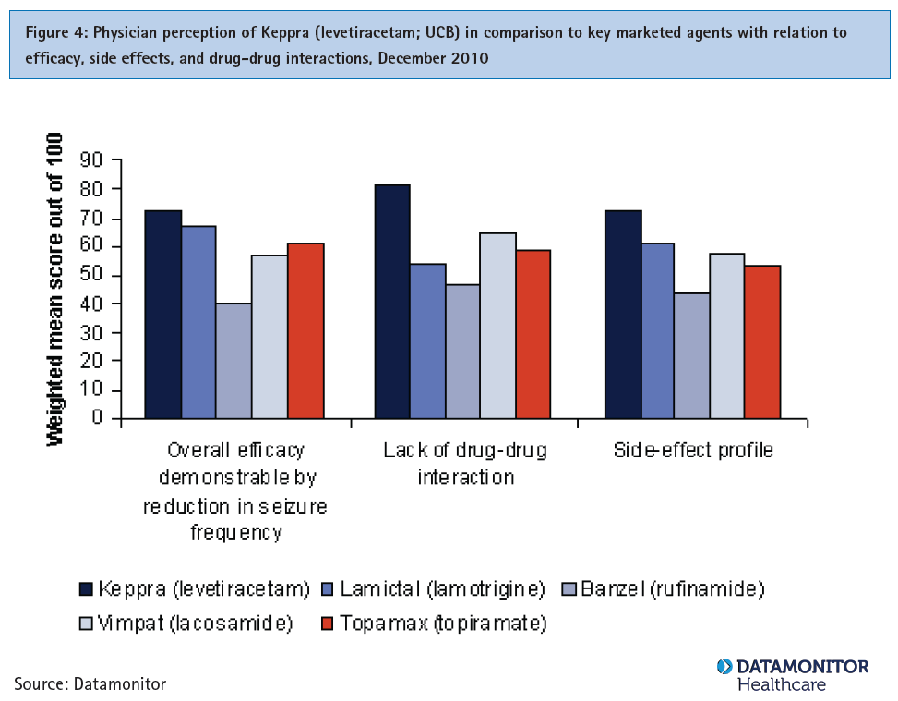
Levetiracetam vs. other epilepsy treatments
Levetiracetam is viewed by physicians as the most favourable epilepsy treatment with relation to efficacy, side-effect profile and drug-drug interactions¹
Gold-Standard
Viewed by physicians as the most favourable epilepsy treatment with relation to efficacy, side-effect profile and drug-drug interactions
¹Keppra Product Analysis; Datamonitor; May 2012; survey among 180 neurologists in US, Japan, France, Germany, Spain, Italy & UK

Slide 8
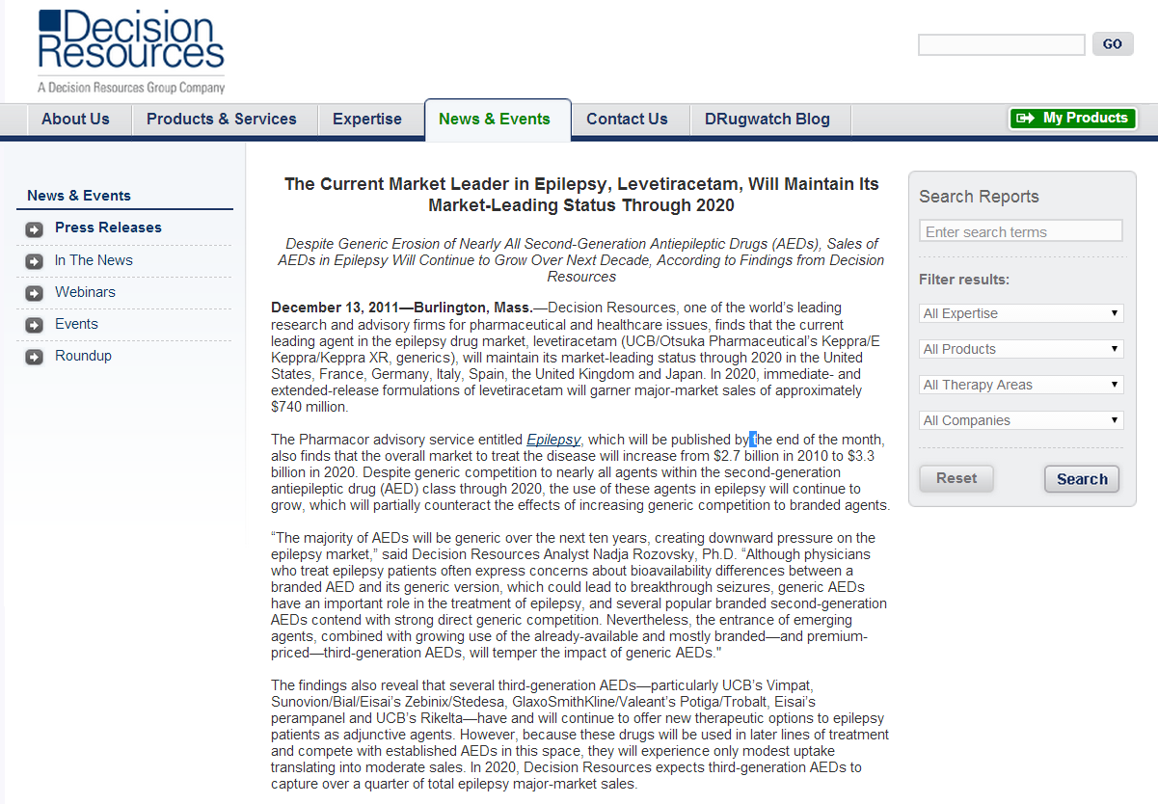
http://decisionresources.com/News-and-Events/Press-Releases/Epilepsy-121311

Slide 9
Levetiracetam - products
Originator | Keppra® (UCB, Belgium) Concentrate for solution for infusion, 100 mg/mL, 5 mL single use vial Oral film-coated tablets (250 mg, 500 mg, 750 mg, 1000 mg) Oral solution in bottle (100 mg/mL) Keppra® XR (UCB, Belgium) Film-coated extended-release tablets (500, 750 mg) → only in the US
Generics | Oral formulations: +++ Injectable: ++ US: Sun Pharma, Innopharma + X-Gen, Hospira, Sagent Pharmaceuticals EU: Sun Pharma, Desititn, Hexal, Ratiopharm, Mylan, UCB… Australia: Sandoz → none in ready-to-use bags
Notes:
US
Sun Pharma: 500mg/5mL vials (FDA Approval June 2010)
Innopharma + X-Gen: 500mg/5mL vials (FDA Approval Aug 2011)
Hospira: 500mg/5mL vials
Sagent Pharmaceuticals (preservative-free vial). Launch announced Nov 2013
EU
Sun (EMA approval Dec 2011)
Australia
Sandoz: 500mg/5mL vials

Slide 10
Kevesy – Product description (1)
Active substance | Levetiracetam
Brand name | Kevesy 5 mg/mL solution for infusion (500mg levetiracetam) Kevesy 10 mg/mL solution for infusion (1000mg levetiracetam) Kevesy 15 mg/mL solution for infusion (1500mg levetiracetam)
Pharmatherapeutic group | Antiepileptic (ATC code: N03AX14)
Pharmaceutical form | Solution for infusion (ready-to-use, single use)
Presentation | Flexible plastic NexcelTM bag 500mg / 1000mg / 1500mg levetiracetam in 100mL PVC and latex free Dual-port with closure caps Aluminium over wrap Cartons of 10 bags
Notes:
US
Sun Pharma: 500mg/5mL vials (FDA Approval June 2010)
Innopharma + X-Gen: 500mg/5mL vials (FDA Approval Aug 2011)
Hospira: 500mg/5mL vials
Sagent Pharmaceuticals (preservative-free vial). Launch announced Nov 2013
EU
Sun (EMA approval Dec 2011)
Australia
Sandoz: 500mg/5mL vials

Slide 11
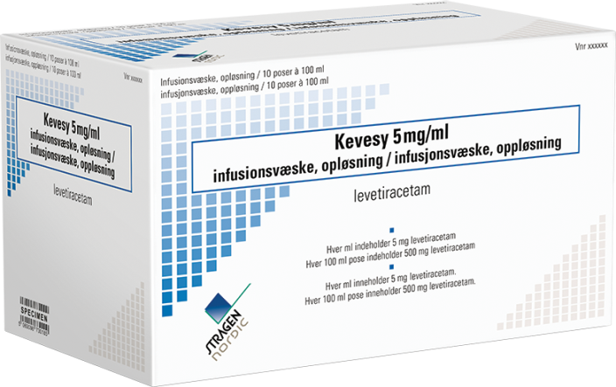
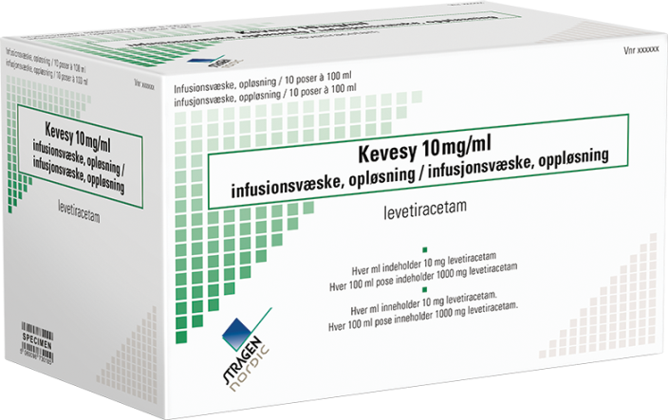
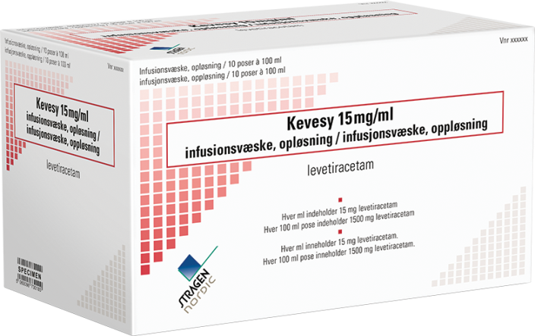
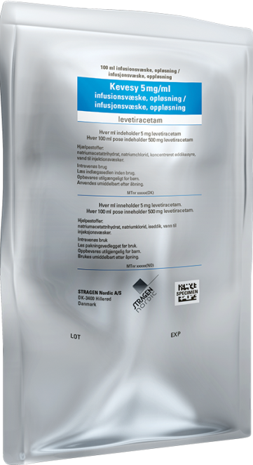
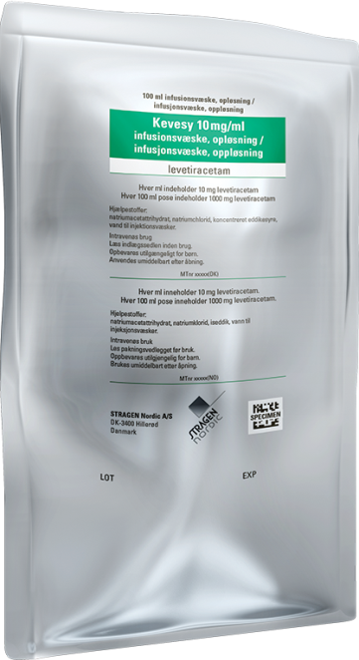
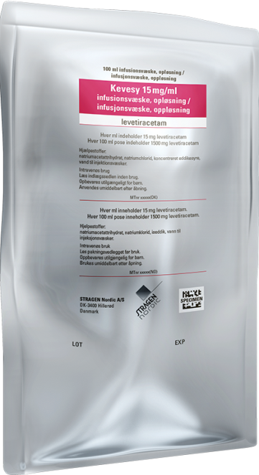
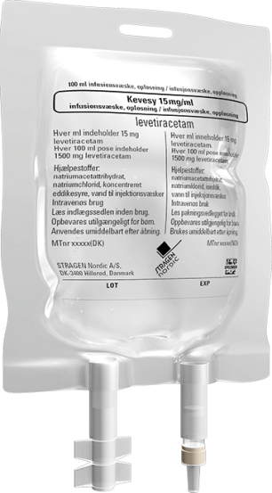
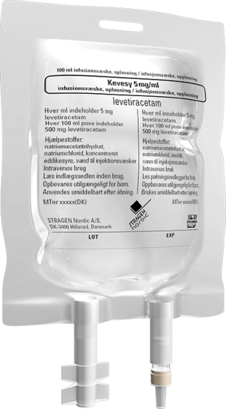
Kevesy – Product description (2) – Nordic packaging

Slide 12
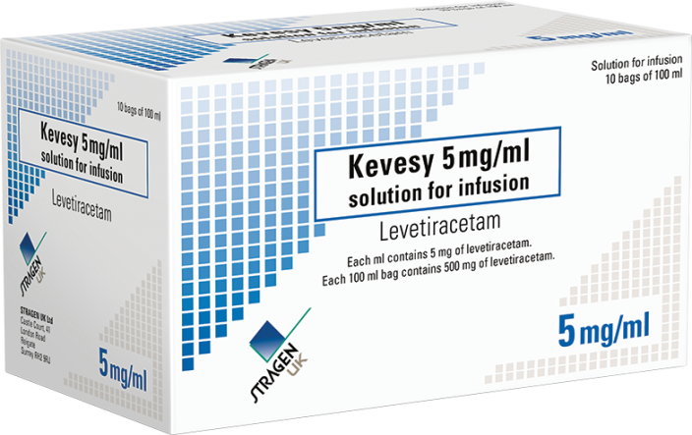
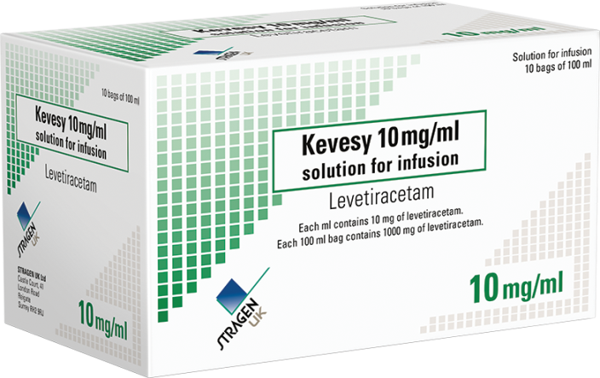
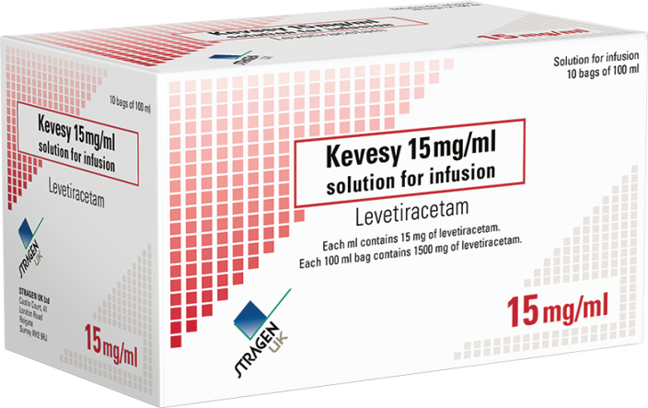
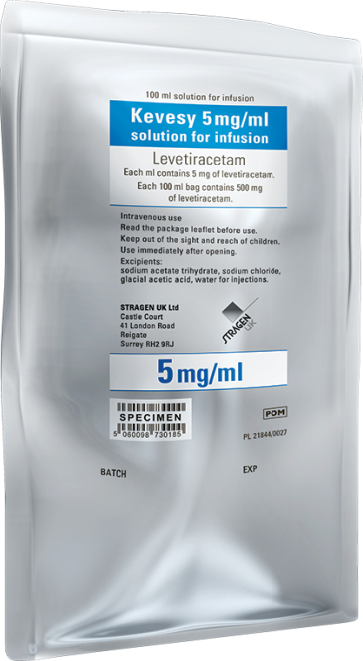
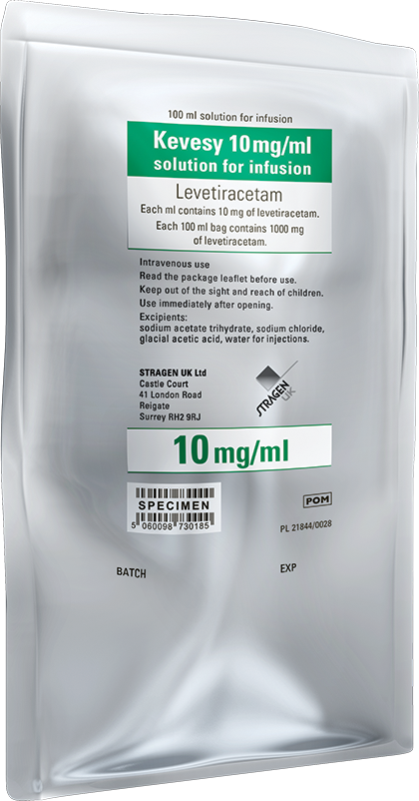
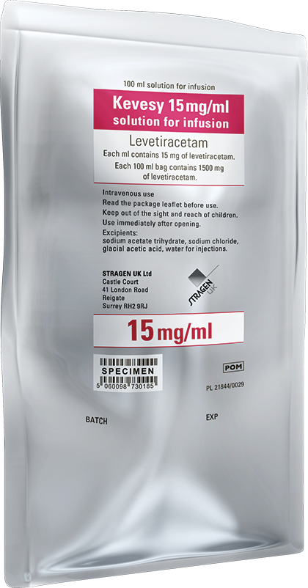
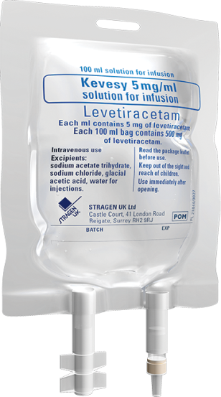
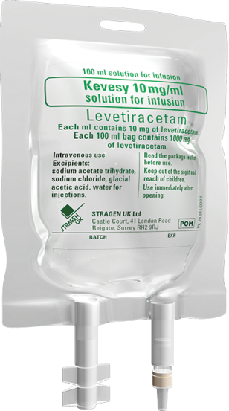
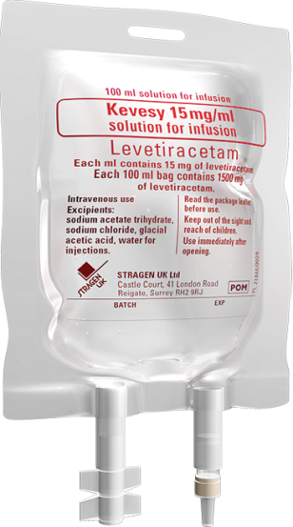
Kevesy – Product description (3) – UK packaging

Slide 13
Kevesy – Product description (4)
Indications | Monotherapy: Partial Onset Seizures (≥16 y/o) Adjunctive therapy: Partial Onset Seizures (≥4 y/o) Myoclonic Seizures in Patients with Juvenile Myoclonic Epilepsy (≥12 y/o) Primary Generalized Tonic-Clonic Seizures with idiopatic generalized epilepsy (≥12 y/o)
Excipients | Sodium acetate, glacial acetic acid, sodium chloride, water for injections
Manufacturing | European (GMP compliant)
Shelf life | 3 years
Storage precautions | Store below 25°C
Notes:
US
Sun Pharma: 500mg/5mL vials (FDA Approval June 2010)
Innopharma + X-Gen: 500mg/5mL vials (FDA Approval Aug 2011)
Hospira: 500mg/5mL vials
Sagent Pharmaceuticals (preservative-free vial). Launch announced Nov 2013
EU
Sun (EMA approval Dec 2011)
Australia
Sandoz: 500mg/5mL vials

Slide 14
Kevesy – Product description (5)
Dosing | Twice a day Monotherapy: ≥16 y/o: 1000-3000mg/day (1 bag 10mg/mL to 2 bags 15mg/mL) Add-on therapy: 12-17 y/o, ≥50Kg: 1000-3000mg/day 4-10 y/o or 12-17 y/o ≤50Kg: 20-60mg/Kg/day
Pregnancy & lactation | Should not be used unless necessary
Side effects | Very common: Somnolence, headache, dizziness Nose & throat inflammation Common: Anorexia, depression, anxiety, nervousness, weight changes, memory troubles, hair loss.. Side effects should decrease over time
Notes:
US
Sun Pharma: 500mg/5mL vials (FDA Approval June 2010)
Innopharma + X-Gen: 500mg/5mL vials (FDA Approval Aug 2011)
Hospira: 500mg/5mL vials
Sagent Pharmaceuticals (preservative-free vial). Launch announced Nov 2013
EU
Sun (EMA approval Dec 2011)
Australia
Sandoz: 500mg/5mL vials

Slide 15
Kevesy vs Keppra® (1)
 | Kevesy®; Stragen | Keppra®; UCB
Active substance | Levetiracetam | Levetiracetam
Container | Dual port flexible plastic Nexcel® bag (100 mL ) in aluminium overwrap | Glass vial (5 mL )
Pharmaceutical form | Ready-to-infuse solution | Concentrate for dilution
Strength (mg/mL) | 5; 10; 15 | 100
Drug/container (mg) | 500; 1000; 1500 | 500
Directions for Use | Ready-to-Use | Dilute with 100 mL infusion media to 5 mg/mL concentration before infusion
Directions for Administration | Infuse over 15 minutes | Infuse over 15 minutes
Indication | Monotherapy: Partial Onset Seizures Adjunctive therapy: Partial Onset Seizures Myoclonic Seizures in Patients with Juvenile myoclonic Epilepsy Primary Generalized Tonic-Clonic Seizures
Notes:
US
Sun Pharma: 500mg/5mL vials (FDA Approval June 2010)
Innopharma + X-Gen: 500mg/5mL vials (FDA Approval Aug 2011)
Hospira: 500mg/5mL vials
Sagent Pharmaceuticals (preservative-free vial). Launch announced Nov 2013
EU
Sun (EMA approval Dec 2011)
Australia
Sandoz: 500mg/5mL vials

Slide 16
Kevesy vs Keppra® (2)
 | Kevesy®; Stragen | Keppra®; UCB
Excipients | Sodium acetate Glacial acetic acid Sodium chloride Water for injections | Sodium acetate Glacial acetic acid Sodium chloride Water for injections
Diluents | n/a | Sodium chloride (0.9%) injection Lactated Ringer’s injection Dextrose 5% injection
Osmolarity | Isotonic 275-345 mOsm/kg | 359-420 mOsm/kg
Shelf life | 3 years | 2 years
Storage precautions | No special storage conditions | Original product: none Diluted product: use immediately after dilution. If not used immediately, no longer than 24h at 2 to 8°C (unless dilution has taken place in controlled and validated aseptic conditions).
Pharmacodynamic & pharmacokinetic profile | identical
Notes:
US
Sun Pharma: 500mg/5mL vials (FDA Approval June 2010)
Innopharma + X-Gen: 500mg/5mL vials (FDA Approval Aug 2011)
Hospira: 500mg/5mL vials
Sagent Pharmaceuticals (preservative-free vial). Launch announced Nov 2013
EU
Sun (EMA approval Dec 2011)
Australia
Sandoz: 500mg/5mL vials

Slide 17
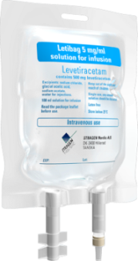
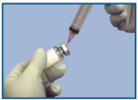
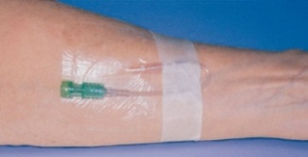
Main benefits of Kevesy in RTU bags (1)
Reduced handling
Time saving → fastest availability in case of emergency
Material saving
Significantly reduced risk of microbial contamination
Reduced needle injuries
Reduced medication errors*
Immediate drug availability
↓ cost
↑ safety
*Extemporaneous compounding of i.v. drugs has been shown to result in 9% errors

Slide 18
Main benefits of Kevesy in RTU bags (2)
Terminally sterilised bags Enhanced probability of maintaining sterility of the product as compared to the concentrated vials, which require additional handling in the hospital pharmacy
3 strengths available adapted to different posology needs:
500mg/100mL
1000 mg/100mL
1500mg/100mL
Reduced hospital waste of empty syringes and needles
Same efficacy as the branded original product (Keppra®) & meeting the highest quality standards

Slide 19
The gold-standard for epilepsy now available in unique, ready-to-use bags
Thank you!

Slide 20
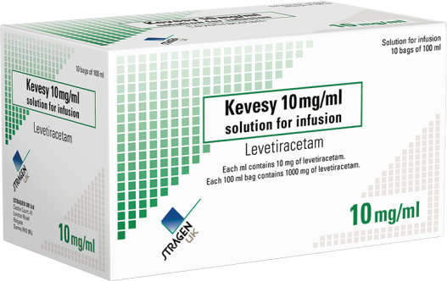
The gold standard for epilepsy now available in unique, ready-to-use bags
Kevesy
levetiracetam
5 mg/mL
10 mg/mL
15 mg/mL
solution for infusion
Thank you!

