Slide 1
UNIVERSITY OF PORT HARCOURT
FACULTY OF SCIENCE
DEPARTMENT OF ANIMAL AND ENVIRONMENTAL BIOLOGY
SEMINAR PRESENTATION
ON
OIL EXPLORATION AND ITS EFFECTS, REMEDIES AND CONTROL IN THE NIGER DELTA
PRESENTED
BY
ALLAPUTA, ELIZABETH NENGI
U2014/5550131
COURSE TITLE: SEMINAR
COURSE CODE: AEB 481.2
SUPERVISOR: PROF. G. AGU
SEMINAR CO-ORDIANTOR: PROF. F.O. NDUKA, DR U.I DANIEL
MAY, 2018.

Slide 2
INTRODUCTION
Oil spillage is a global issue that has been occurring since the discovery of crude oil, which was part of the industrial revolution
It is responsible to the ecological degradation of Niger Delta.
It has also generated a lot of tension due to mismanagement problems associated with it.
It has been a major indicator of abuse of natural resources of the region.
In Niger Delta, it started since 1958.

Slide 3
CAUSES OF OIL SPILLAGES IN NIGER DELTA
Oil spillage occurs majorly due to the following:
Pipeline and tanker accident
sabotage
oil production operations
Illegal bunkering
Pipe line vandalism

Slide 4
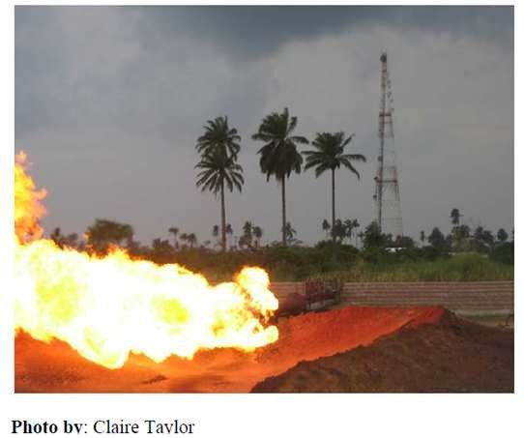
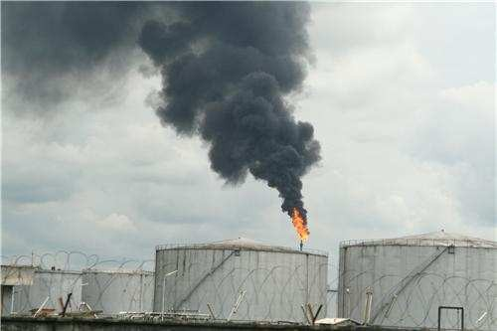
EFFECTS OF OIL SPILLAGE
Natural gas flaring
Depletion of fish populations
Water
Loss of mangrove forests (Deforestation)
Hyacinth invasion
Acid rain
Toxicity to humans
Figure 10: Gas flaring site at Bonny Island, Rivers State.

Slide 5
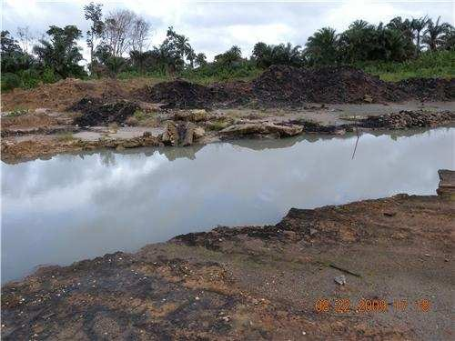
Loss of vegetation
Oil spillage causes mangrove forests to disappear.
Some of the mangrove species common in Niger Delta that disappears due to iol spillage include:
Rhizophora racemosa
Nypa frutican
Avicenia africana
Figure 6: Oil Impacted Site in Ogoniland showing loss in vegetation cover

Slide 6
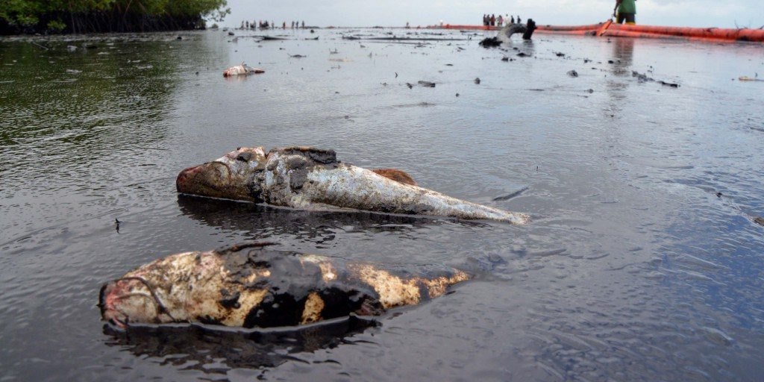
Fish kills (shell fish)
Oil spillage causes rupturing and eventually death of shell and fin fishes
It also affect the quality of aquatic food consumed by man.
Plate 4: fish kills

Slide 7
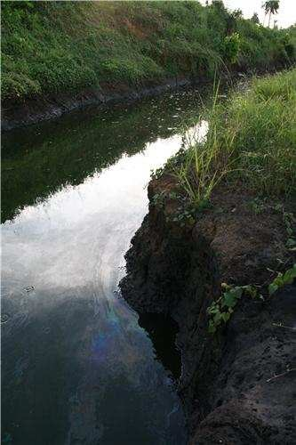
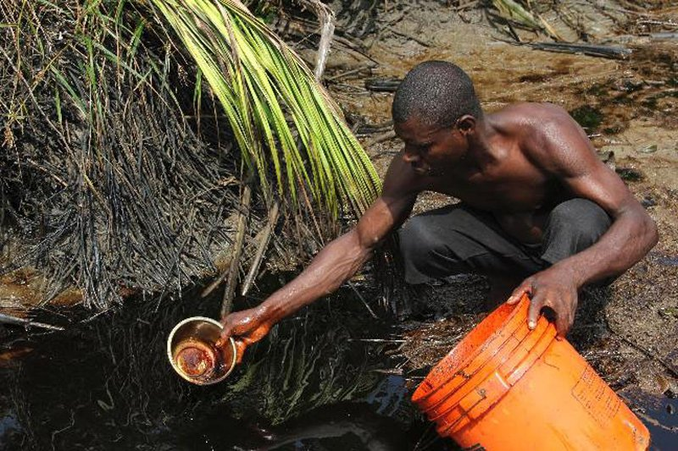
Water quality problems
Oil spillage causes contamination of
water quality
It also affects the physicochemistry
of water
Plate 6: water contamination

Slide 8
REMEDIES OF OIL SPILLAGE
The use of biological remediation can be used to detoxify and restore ecosystems damaged by oil spills.
Bioremediation involves biological components in the remediation or cleanup of a specific site.
A study conducted in Ogbogu located in one of the largest oil producing regions of Nigeria has utilized two plant species to clean up spills.
The first stage of cleanup involves Hibiscus cannabinus, a plant species indigenous to West Africa.
The second stage of bioremediation involves a plant known as Vetiveria zizaniodes, a perennial grass species.

Slide 9
CONTROL OF OIL SPILAGE
Oil spillage can be controlled through the following ways:
Illegal bunkering activities should be checked
Pipeline vandalism should be avoided
Government should establish security outfit that will check the activities of hoodlums on oil wells and pipelines
Pipeline installation companies should also use quality materials that can resist rusting during installing
Movement should also be restricted around pipelines.

Slide 10
CONCLUSION
Oil exploration in Nigeria has had sever environmental and human consequences for the indigenous people who inhabit the area surrounding oil extractions.
They include destruction of wildlife and biodiversity, loss of fertile soil.
Pollution of air and drinking water
Degradation of farmland and damage to aquatic ecosystem.

Slide 11
RECOMMENDATIONS
The roles and responsibilities of all the stakeholders in the monitoring and control of oil exploration and exploitation activities in the region must be clearly defined.
Communities through ‘Oil Spill Monitoring and Control Committees’ should educate their people on the need to stop ‘sabotage induced spills’ by making them realise that any damage to the environment is a damage to oneself.
However, any offender caught should be prosecuted according to the provisions of the law of the land.
Indigenous oil companies should be given priority in securing licenses to operate in the Niger-Delta region during a biding process organised by Directorate of Petroleum Resources (DPR).
This will reinforce their commitment as stakeholders as well as act as a palliative measure towards achieving peace in the region.

Slide 12
THANKS FOR LISTENING

