Slide 1
UNIVERSITY OF PORT HARCOURT
FACULTY OF SCIENCE
DEPARTMENT OF ANIMAL AND ENVIRONMENTAL BIOLOGY
SEMINAR PRESENTATION
ON
MYIASIS INFESTATION AND ITS APPLICATION IN MAGGOT THERAPY
PRESNTED BY
ONYEYAFORO EMMANUEL
U2014/5550078
COURSE COORDINATOR(S): PROF. (MRS.) F.O. NDUKA,
DR. U.I. DANIEL.
SUPERVISOR: DR. MRS. EZE.
MAY, 2018

Slide 2
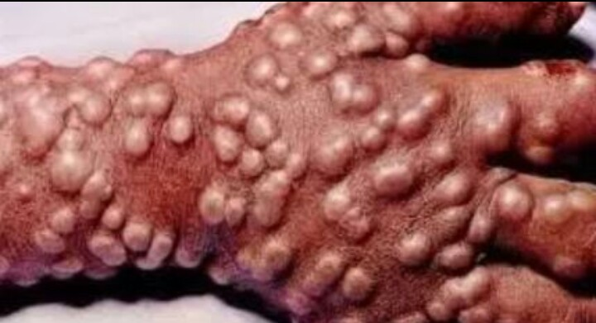
INTRODUCTION
WHAT IS MYIASIS?
Myiasis is the invasion of the organs and tissues of living mammals with dipterous larvae which grows on the host while feeding on the host's tissue.
TYPES OF MYIASIS INFESTATION
Cutaneous Myiasis
Fig. 1: Cutaneous myiasis on the hand
Source: Medscapephotos.com

Slide 3
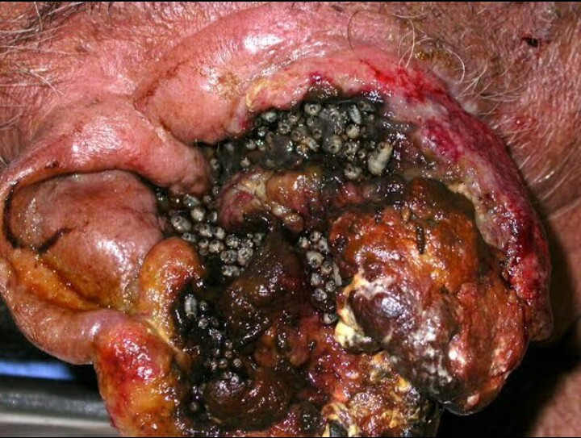
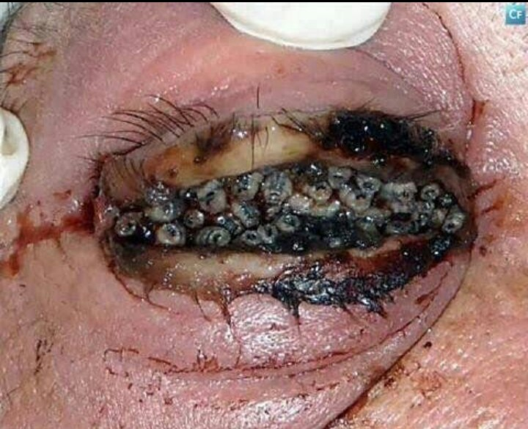
MIGRATORY/CREEPING MYIASIS
WOUND MYIASIS
Fig 2: Migratory Myiasis
Fig 3: Wound induced opthalmomyiasis
Source: Medscapephotos.com

Slide 4
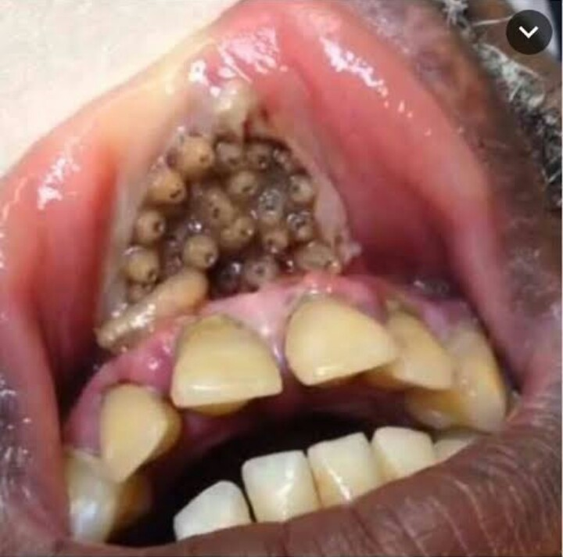
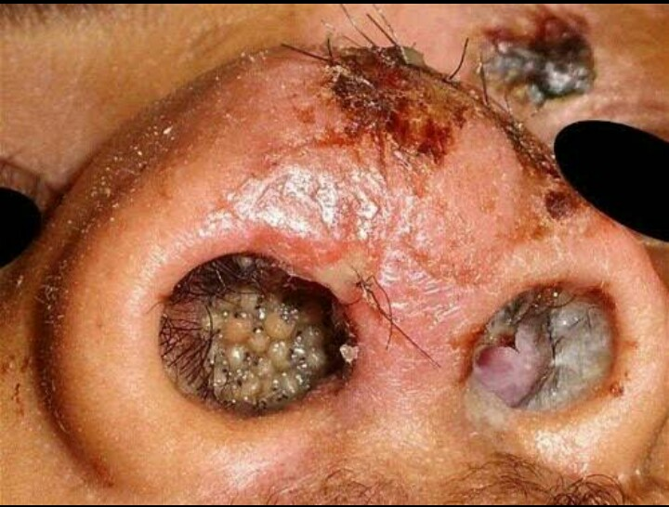
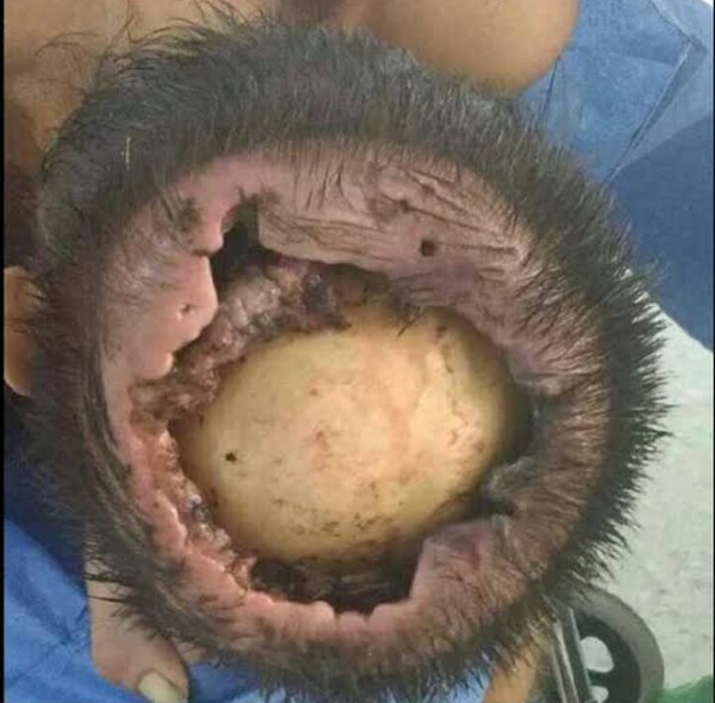
MYIASIS OF BODY CAVITIY
ACCIDENTAL MYIASIS
Fig 4: Oral Myiasis
Fig 6: Nasal Myiasis
Fig 5: Posttraumatic Myiasis
Source: Medscapephotos.com

Slide 5
SYMPTOMS OF MYIASIS
Each type of myiasis has symptoms peculiar to it;
TYPES OF MYAISIS | SYMPTOMS
Cutaneous myiasis | Skin ulcer Boils
Migratory/Creeping myiasis | Creeping sensation Painful swellings
Wound myiasis | Intense odour Pus-discharge
Myiasis of the body cavities | Erosion of bridge of the nose Buzzing sound Irritation, edema and pain
Accidental myiasis | Vomiting Diarrhea

Slide 6
DIAGNOSIS
Physical exam
Biopsy
Ultrasound
Blood tests
TREATMENTS
Depending on the location of the infestation we have ;
Suffocation of larvae with petroleum jelly
Surgical removal with anaesthesia such as lidocaine.
Application of topical or oral invermectin.
PREVENTION/CONTROL
Use of insect repellents.
Sleeping under treated nets.
Individuals traveling to endemic areas should be covered properly at times.

Slide 7
APPLICATION IN MAGGOT THERAPY
WHAT IS MAGGOT THERAPY?
Maggot therapy is an artificially induced myiasis.
It is a type of biotherapy involving the introduction of live disinfected maggots into non-healing skin and soft tissue wounds.
The larvae of Lucilia sericata, the common bottle green is most appropriate for this process because they are facultative and feed exclusively on dead tissue.

Slide 8
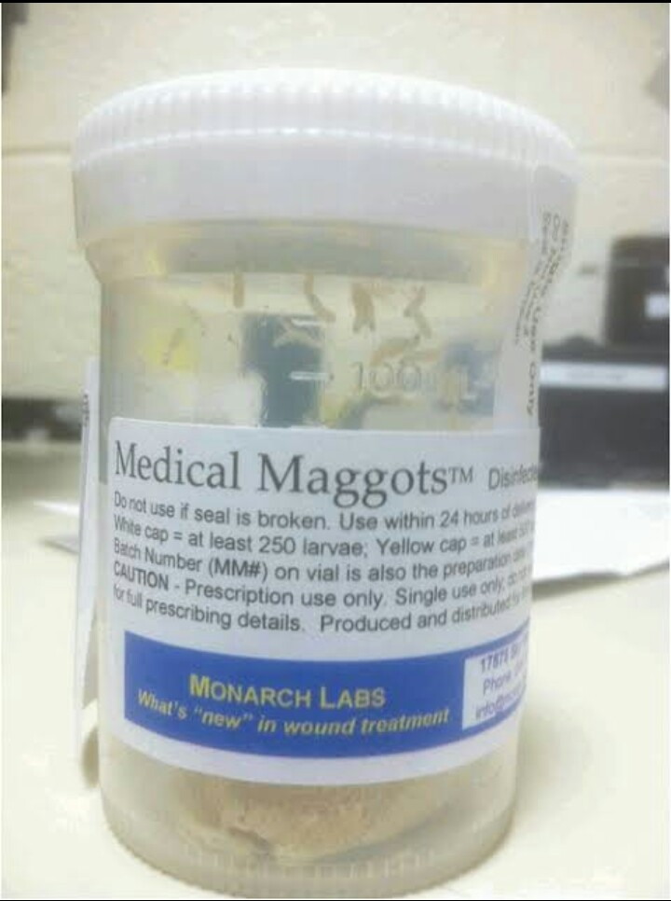
GENERAL MECHANISM OF ACTION
Following the extraction and culture of the fly's egg to form maggot, they are disinfected and introduced to a patient's wound.
The therapy has four main course of action which are:
DEBRIDEMENT
DISINFECTION
STIMULATION OF HEALING
BIOFILM INHIBITION AND ERADICATION
Fig 7: Culturing of maggots
Fig 8: Ready to be used maggots
Source: Medscapephotos.com

Slide 9
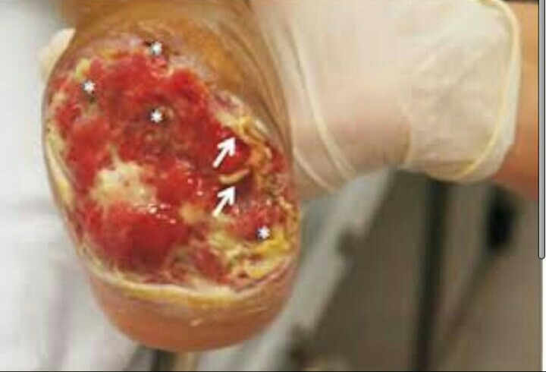
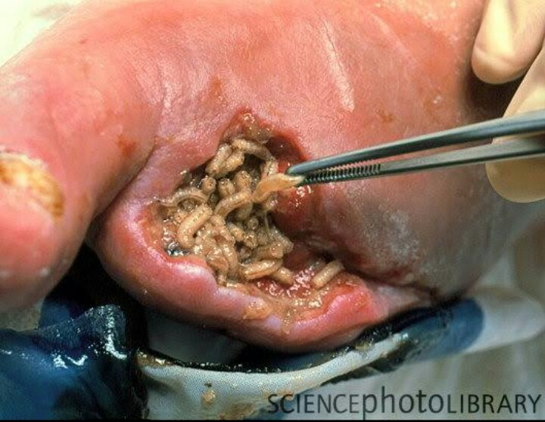
Fig. 9: Wound before the therapy
Fig. 10: Application of Medicinal Maggots
Source: Sciencephotolibrary.com

Slide 10
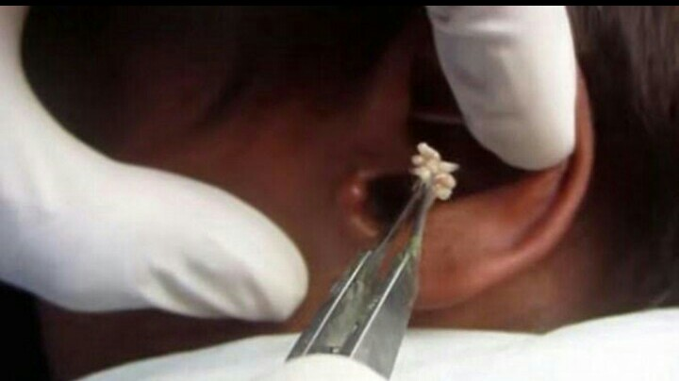
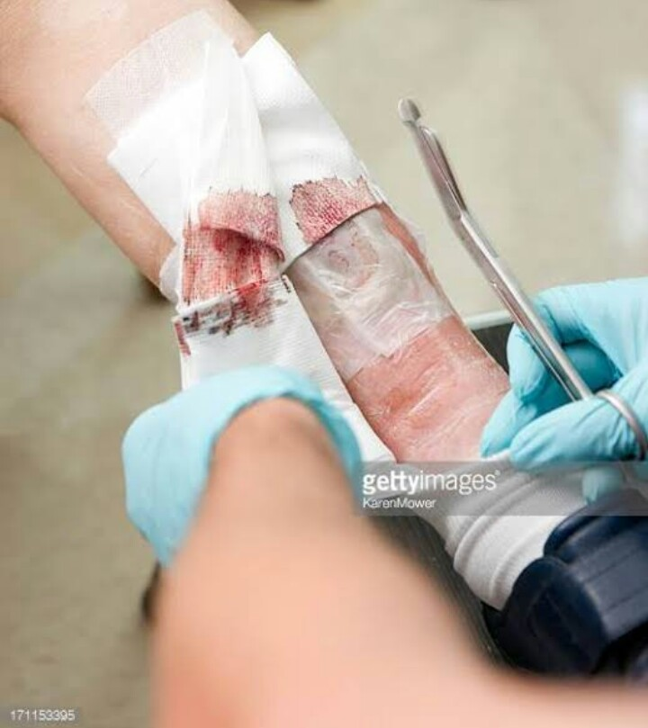
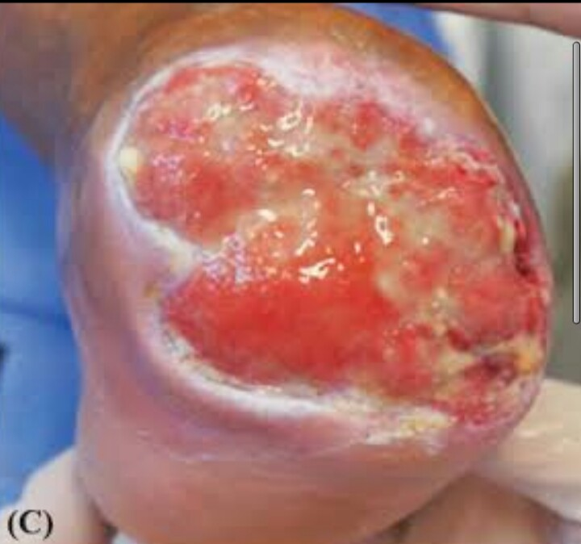
Fig. 11: Application of Medicinal Maggots
Fig. 12: Dressing of Wound
Fig. 13: Wound after the therapy
Source: Sciencephotolibrary.com

Slide 11
MEDICAL USES OF MAGGOTS THERAPY
Treating diabetic foot ulcer rather than amputation
Pressure ulcers
Chronic Osteomelytis
Chronic ulcers
Necrotic and soft tissue wounds

Slide 12
CONCLUSION
Though the effects of myiasis by obligate larvae of parasitic flies has critical effects in some cases, the larvae of Lucilia sericata has thrown a good light of importance on myiatical studies and its general application for the benefit of man and the society at large through maggot therapy.

Slide 13
RECOMMENDATIONS
Proves useful where antibiotics fail
For diabetic patients instead of limb amputation
It is particularly helpful in chronic osteomelytis

Slide 14
THANKS FOR YOUR AUDIENCE

