Slide 1
UNIVERSITY OF PORT HARCOURT FACULTY OF SCIENCES DEPARTMENT OF ANIMAL AND ENVIRONMENTAL BIOLOGY A SEMINAR PRESENTATION ON PRODUCTION OF BIODIESEL FROM WASTE VEGETABLE OIL BY MAFURU ERHOMO U2014/5550086
COURSE TITLE: seminar COURSE CODE: AEB 481.2 Seminar supervisor: prof (mrs) ibitoru hart SEMINAR coordinators: Prof. f. o. nduka dr. u. i. daniel may, 2018.

Slide 2
Waste Vegetable Oil (WVO) refers to vegetable oil which has been used in food production and is no longer viable for its intended use. Biodiesel is a renewable, biodegradable, environmentally benign energy substitution fuel which can fulfill energy needs without sacrificing engine’s operational performance. The process used to convert waste vegetable oil to Biodiesel is called TRANSESTERIFICATION. Transesterification involves stripping the glycerin from the fatty acids with a catalyst such as sodium or potassium hydroxide and replacing it with an anhydrous alcohol, that is, usually methanol.
INTRODUCTION

Slide 3
The Experimental Procedure of Making Biodiesel from Transesterification Process Includes:
Filtering The WVO To Remove Any Food Scraps Or Solid Particles.
Heating The WVO To Remove Any Water Content.
Performing Titration To Determine How Much Catalyst Is Needed.
Preparing Potassium Ethoxide.
Heating Of WVO, Mixing The Potassium Ethoxide While Stirring.
Settling & Remove The Glycerin.
Checking The Quality.
Washing And Drying.
Comparing With Standard Characteristics

Slide 4
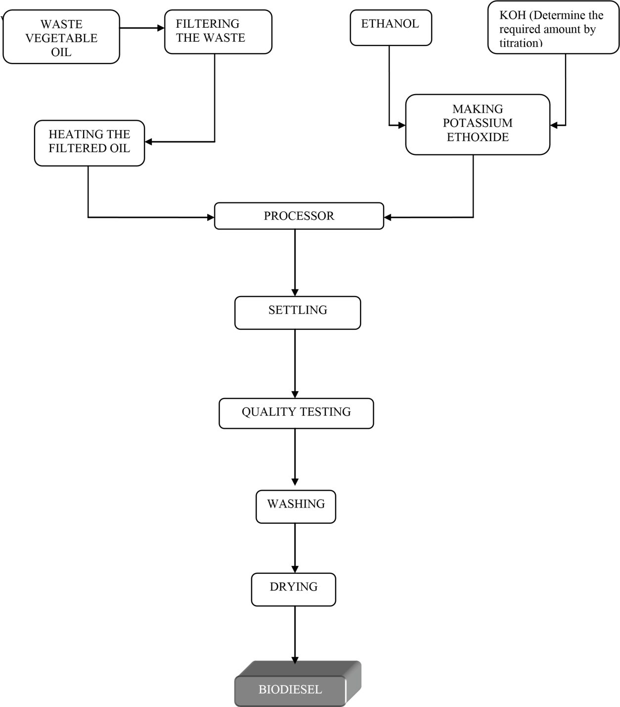
Fig 1: Flow Chart of the Production Process

Slide 5
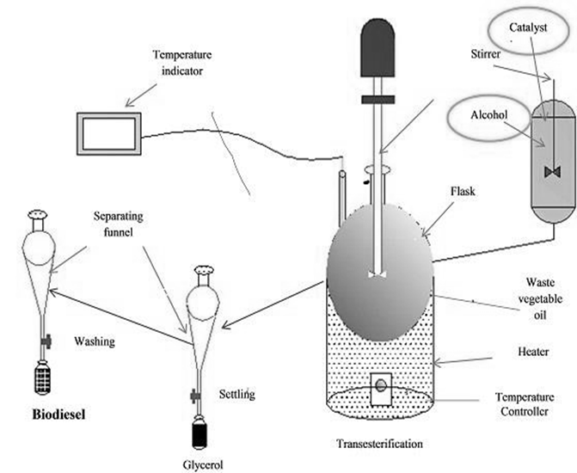
Plate 1: Experimental Setup of the Production Process

Slide 6
Table 1. Differences Between Biodiesel
And Petro Diesel
BIODIESEL | PETRO-DIESEL
It manages global warming. | It emits greenhouse gases.
Super lubrication agent which cleans deposits of petroleum diesel from pipes and tanks. | Possesses no such property.
Higher cetane number. | Lower cetane number.
Environment friendly and highly economical. | It is an imported product for most nations and it is less economical.
High flash point of 300 – 400ºF. Lower flash point of 125ºF.

Slide 7
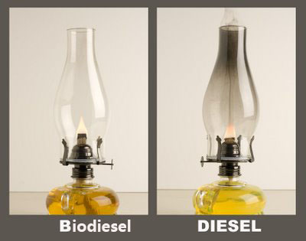
Plate 2: Difference Between Biodiesel And Petro-diesel
Source: bjultrasonic.com

Slide 8
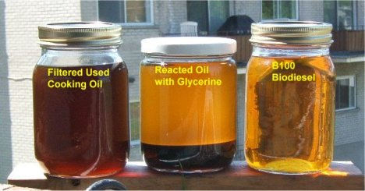
.
Plate 3: WVO at Different Stages of Production
Source: treehugger.com

Slide 9
Biodiesel is gaining more importance as an attractive fuel due to the depleting fossil fuel resources. Further study should be done on the production of biodiesel to reduce our dependence on fossil fuel. The environmental benefits cannot be overlooked either since it is renewable and sustainable even as they reduce greenhouse gas (GHG) emissions unlike petroleum-based fuels.
CONCLUSION

Slide 10
Thanks and god bless
you for listening

