Slide 1
MUSIC OF MEDIEVAL, RENAISSANCE AND BAROQUE PERIODS
MUSIC 9

Slide 2
MUSIC OF MEDIEVAL PERIOD

Slide 3
Medieval Period (700-1400)
also known as the Middle Ages or Dark Ages that started with the fall of the Roman Empire.
During this time, the Christian Church influenced Europe’s culture and political affairs.

Slide 4
MUSIC GENRES

Slide 5
Medieval Music (Gregorian Chant)
Monophonic plainchant was named after Pope Gregory I, who made this the approved music of the Catholic Church.
Although it was originally transmitted orally, scholars agreed to put it in notation to assist dissemination of chants across Europe.

Slide 6
Medieval Music (Gregorian Chant)
Characteristics:
monophonic
free meter
modal
usually based on Latin liturgy
use of Neume notation

Slide 7
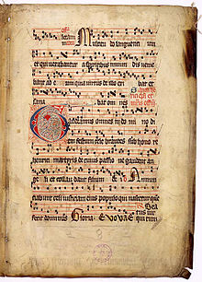
Medieval Music (Gregorian Chant)
"Gaudeamus omnes," from the Graduale Aboense, was scripted using square notation

Slide 8
Medieval Music (Troubadour Music)
During the latter part of the Medieval Period, secular music which was not bound by Catholic traditions emerged.
Most of these songs were performed across Europe by groups of musicians called Troubadours.

Slide 9
Medieval Music (Troubadour Music)
Characteristics
usually monophonic
sometimes with improvised accompaniment
tells of chivalry and courtly love
originated in France
written in the French language

Slide 10
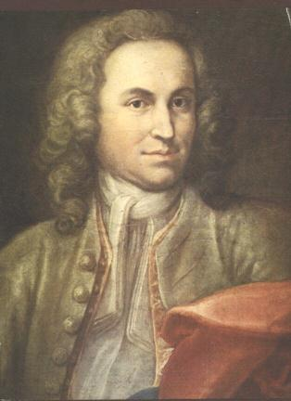
Famous Medieval Composer
ADAM DE LA HALLE
France (c. 1237-1288)
also known as Adam le Bossu (Adam the Hunchback)
one of the oldest secular composers whose literary and musical works include chansons and poetic debates
Notes:
He was the son of a well – known citizen of Arras, Henri de la
Halle. He received his education at the Cistercian Abbey of Vaucelles, near
Cambral. Adam was destined for the church but he eventually married. His
patrons were Robert II, Count of Artois, and Charles of Anjou, brother of Louis
IX.
He was a French-born
trouvére, poet and musician, whose literary and musical works include
chansons and jeux-partis (poetic debates) in the style of the trouveres,
polyphonic rondel and motets in the style of early liturgical polyphony.

Slide 11
Famous Medieval Composer
ADAM DE LA HALLE
France (c. 1237-1288)
his works include:
Le Jeu de Robin et de Marion
La Chanson du roi de Sicile

Slide 12
MUSIC OF RENAISSANCE PERIOD

Slide 13
Renaissance Period (1400-1600)
the term Renaissance comes from the word renaitre which means “rebirth, revival, and rediscovery”
is a period of looking back to the Golden Age of Greece and Rome
The invention of printing paved the way for a wide distribution of renaissance compositions

Slide 14
Renaissance Period (1400-1600)
the emergence of the bourgeois class, renaissance music became popular as entertainment and activity for amateurs and the educated
lute was the prominent instrument
also known as the “golden age” of a capella choral music

Slide 15
Renaissance Period (1400-1600)
discovery of the actual position of earth in the solar system by Copernicus
the invention of compass creating a wider navigation not only of the lands but also of the oceans
Martin Luther’s Protestant reformation.

Slide 16
Renaissance Music
Characteristics:
mostly polyphonic
imitation among the voices is common
use of word painting in texts and music
melodic lines move in a flowing manner
melodies are easier to perform because these move
along a scale with a few large leaps

Slide 17
MUSIC GENRES

Slide 18
Renaissance Music (Mass)
is a form of sacred musical composition that sets texts of the Eucharistic liturgy into music

Slide 19
Renaissance Music (Mass)
Characteristics:
Polyphonic
may be sung a cappella or with orchestral accompaniment
Text may be:
syllabic (one note set to each syllable)
neumatic (a few notes set to one syllable)
melismatic (many notes to one syllable)

Slide 20
Renaissance Music (Mass)
Five Main Sections of Mass:
Kyrie (Lord Have Mercy)
Gloria (Glory to God in the Highest)
Credo (I Believe in One God)
Sanctus and Benedictus (Holy, holy and Blessed Is He)
Agnus Dei (Lamb of God)

Slide 21
Renaissance Music (Madrigal)
a secular vocal polyphonic music composition which originated from Italy
it is written and expressed in a poetic text and sung during courtly social gatherings
it is the most important secular form during the Renaissance period

Slide 22
Renaissance Music (Madrigal)
Characteristics:
polyphonic
sung a cappella
through–composed
frequently in 3 to 6 voices

Slide 23
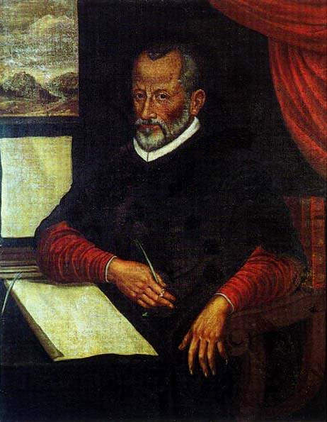
Famous Renaissance Composer
GIOVANNI PIERLUIGI DE PALESTRINA
Rome (c. 1525-1594)
the greatest master of Roman Catholic Church music
majority of his compositions are sacred music

Slide 24
Famous Renaissance Composer
GIOVANNI PIERLUIGI DE PALESTRINA
Rome (c. 1525-1594)
his work includes:
Pope Marcellus Mass (Kyrie)

Slide 25
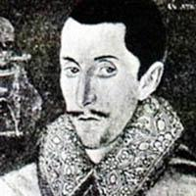
Famous Renaissance Composer
THOMAS MORLEY
England (c. 1557-1602)
most famous composer of secular music in his time
most of his madrigals are light and easy to sing with some aspects of Italian style

Slide 26
Famous Renaissance Composer
THOMAS MORLEY
England (c. 1557-1602)
his work includes:
Fire, Fire, My Heart
Sing and Chant It
Fantasie
April Is In My Mistress’ Face
It Was A Lover and His Lass

Slide 27
MUSIC OF BAROQUE PERIOD

Slide 28
Baroque Period (1685-1750)
the word Baroque is derived from the Portuguese word “barroco” which means “pearl of irregular shape”
the arts highlighted grandiose and elaborate ornamentation

Slide 29
Baroque Period (1685-1750)
new instrumental techniques and changes in musical notation were developed
major and minor tonality was also created in this period

Slide 30
Baroque Period (1685-1750)
Characteristics:
melodies sound elaborate and ornamental
melodies are not easy to sing or remember
primarily contrapuntal textures with some homophony
dynamic contrast – alternation between loud and soft
music genres

Slide 31
Baroque Period (1685-1750)
Characteristics:
0rchestra consists of strings and continuo
harpsichord and organ are the keyboard instruments that are commonly used

Slide 32
Baroque Period (1685-1750)
New forms:
binary – AB
ternary – ABC
ground bass
fugue

Slide 33
MUSIC GENRES

Slide 34
Baroque Music (Concerto)
A form of orchestral music that employs a solo instrument accompanied by an orchestra

Slide 35
Baroque Music (Concerto Grosso)
A form of orchestral music during the Baroque Period wherein the music is between:
a small group of solo instruments called concertino and
the whole orchestra called tutti

Slide 36
Baroque Music (Fugue)
a contrapuntal piece, developed mainly by imitative counterpoint
it is usually written in 3 or 4 parts, with a main theme called “subject”
the entire piece grows mainly from a single brief tune of strong musical character

Slide 37
Baroque Music (Oratorio)
a large scale musical composition for orchestra and voices that incorporates narratives on religious themes
usually performed without the use of costumes, scenery, or action
usually written in the native language for the intended audience

Slide 38
Baroque Music (Oratorio)
a large scale musical composition for orchestra and voices that incorporates narratives on religious themes
usually performed without the use of costumes, scenery, or action
usually written in the native language for the intended audience

Slide 39
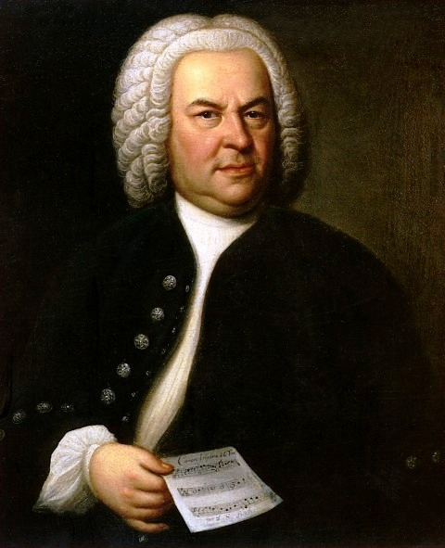
Famous Baroque Composer
JOHANN SEBASTIAN BACH
Germany (c. 1685-1750)
his personal and deep faith is shown in his sacred music
he was known for his compositions for organ, orchestra, and oratorio

Slide 40
Famous Baroque Composer
JOHANN SEBASTIAN BACH
Germany (c. 1685-1750)
his works includes:
Concerto grosso
Masses
Cantatas
Fugues
Others

Slide 41
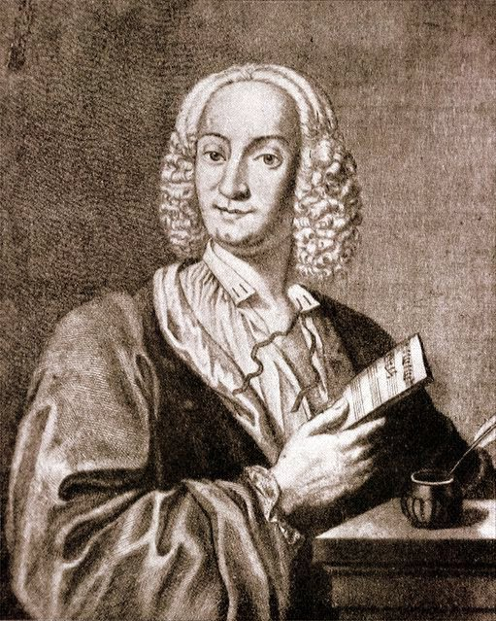
Famous Baroque Composer
ANTONIO LUCIO VIVALDI
Venice (c. 1678-1741 )
nicknamed il Prete Rosso ("The Red Priest")
one of the greatest Baroque composers
known mainly for composing instrumental
concertos, especially for the violin

Slide 42
Famous Baroque Composer
ANTONIO LUCIO VIVALDI
Venice (c. 1678-1741 )
his work includes:
Four Seasons:
Spring
Autumn
Summer
Winter

Slide 43
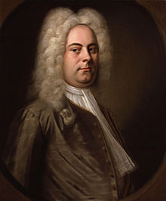
Famous Baroque Composer
GEORGE FRIDERIC HANDEL
Germany (c. 1685-1759)
remembered for his operas and oratorios
England’s favourite composer

Slide 44
Famous Baroque Composer
GEORGE FRIDERIC HANDEL
Germany (c. 1685-1759)
his work includes:
Samson
Messiah (Hallelujah)

