Slide 1
Introduction to Video Editing using Cyberlink Power Director 13
PEPSI P. DULDULAO
T-III/OIC EPSA

Slide 2
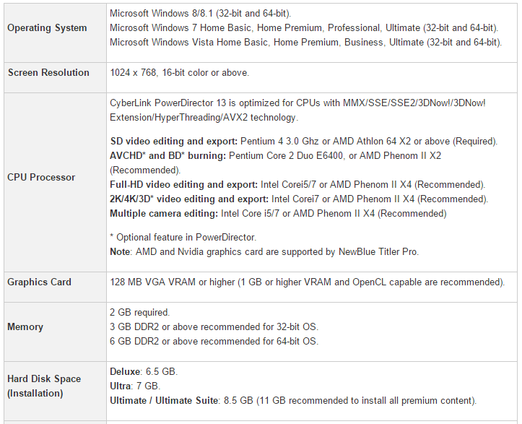
Minimum System Requirements for Cyberlink Power Director 13

Slide 3
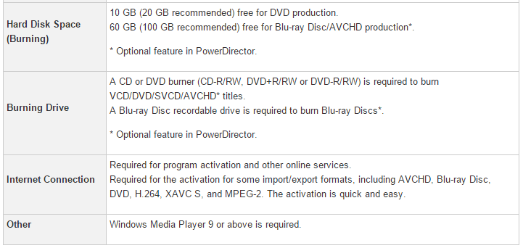
Minimum System Requirements for Cyber link Power Director 13

Slide 4
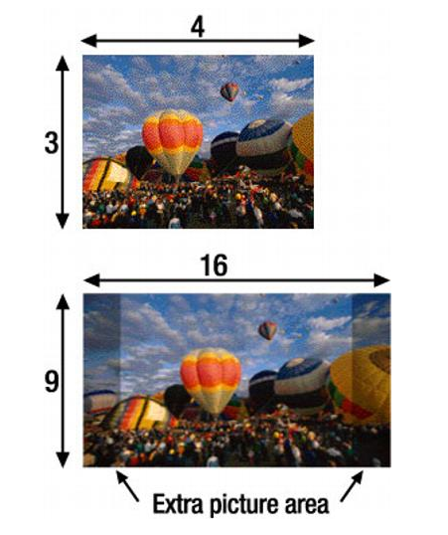
Screen format/Aspect Ratio
16:9
4:3
Notes:
Aspect ratio is defined as the ratio of width to height of an image. A 4:3 aspect ratio means that for every 4 inches of width in an image, you will have 3 inches of height. In mathematical terms, that comes out to the screen being 33% wider than it is high. A 16:9 aspect ratio means that for every 16 inches of width in an image, you will have 9 inches of height. Unlike the 4:3 aspect ratio, a 16:9 aspect ratio is 78% wider than high.

Slide 5
Editing Modes

Slide 6
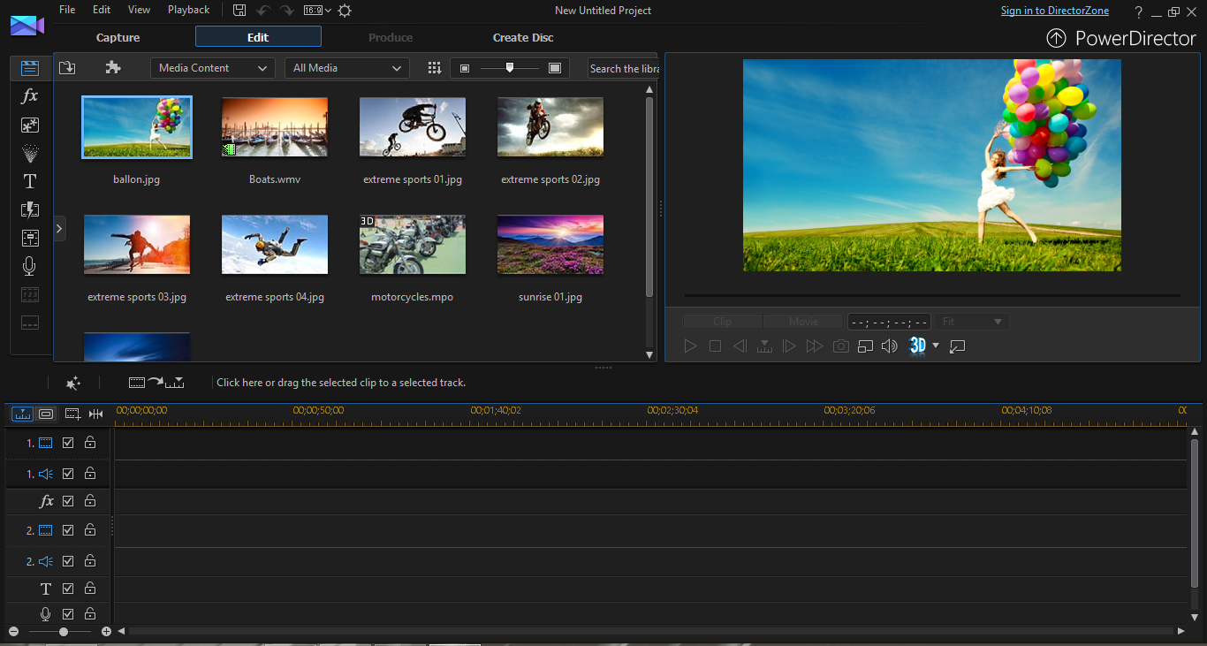

Slide 7
Workspace
Media room-imported images, videos
Effects- “fx”
PiP room “picture in picture”
Particle room-animated graphics
Title room-for titles, headings and texts
Transition room
Audio Mixing Room-
Voice over recording room
Notes:
Simple workspace for PD 13

Slide 8
Tips when editing
Place your media files (images, video, audio etc.) in a single folder.
Plan your project (story board/story line)
Transitions, Pips, Particles and other enhancements must suit the purpose/theme of your project.
Give credit to where/whom it is due.
Save your project from time to time.
There is no hard and fast rule in the sequence of putting up your project.
Story line (arranging videos and images on the timeline) >transitioning> titling> inserting audio / v-o

Slide 9
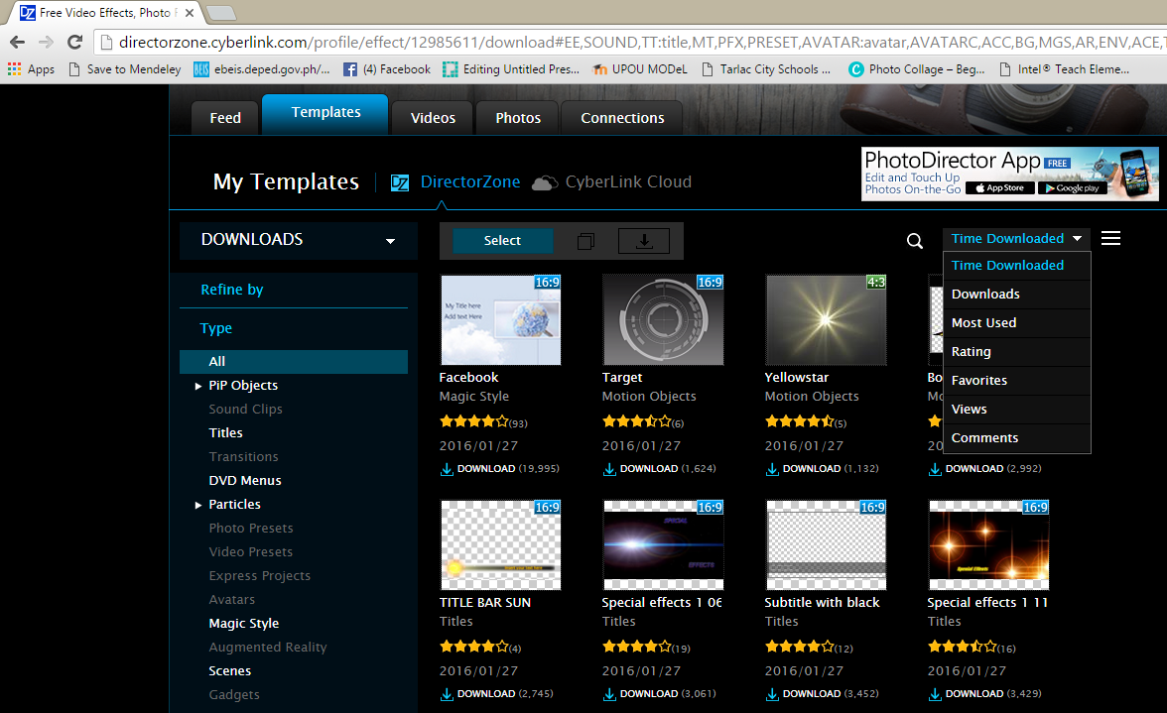
Director Zone

Slide 10
Workshop
Using the full feature editor of your video editing software, create a 3 to 5-minute feature presentation of your respective schools (including beginning and end credits)
The feature may showcase the following: brief history, vision/mission, school community, faculty and staff, learners, school facilities, outstanding achievements, activities/programs/projects, alumni, etc.
Make use of any appropriate music for your audio background.
Record a voice-over to be included in the AVP as part of the narration.
Apply captions/titles/headings and texts whenever necessary
Produce the vid in mp4 format.

