Slide 1
UNIVERSITY OF PORTHARCOURT, FACULTY OF SCIENCES, DEPARTMENT OF ANIMAL AND ENVIRONMENTAL BIOLOGY. A SEMINAR PRESENTATION ON ‘ECOLOGICAL EFFECTS OF INVASIVE SPECIES; A CASE STUDY OF WATER HYANCITH (Eichhornia crassipes )’ BY IROH JENNIFER.C. U2014/5550006 supervisor: dr. b.b. babatunde COURSE CODE: AEB COURSE COORDINATORS: PROF f.o. NDUKA, DR U.I. DANIEL DATE: 30th may,2018.

Slide 2
OUTLINE
INTRODUCTION.
Structure of the water hyacinth.
ADVERSE EFFECTS OF WATER HYACINTH. (ecological)
BENEFICIAL EFFECTS OF WATER HYACINTH.
Control methods.
CONCLUSION.

Slide 3
introduction
Originally from South America,
water hyacinth, Eichhornia crassipes , is one of the world’s most prevalent invasive aquatic plants.
Water hyacinth is a floating vascular plant.
it causes major ecological and socio-economic changes (Center, 1994).
It commonly forms dense, interlocking mats due to its rapid reproductive rate and complex root structure (Mitchell, 1985).
Water hyacinth reproduces both sexually and asexually.
Ten to 100% of existing seeds are found to germinate within six months, with dry conditions promoting germination (Ueki & Oki, 1979).
Nutrients and temperature are considered the strongest determinants for water hyacinth growth and reproduction (Wilson et al. 2007).
Salinity constraints generally limit water hyacinth establishment in coastal areas and within estuaries (Mangas-Ramirez & Elias-Gutierrez, 2004).

Slide 4
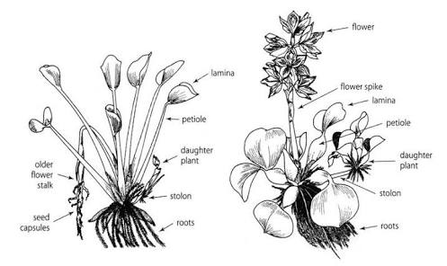
Structure of the water hyacinth
Fig. 1 fig. 2

Slide 5
ADVERSE EFFECTS OF WATER HYACINTH
IT reduces the water quality by reducing phytoplankton productivity and dissolved oxygen concentration
Water hyacinth can change water quality by altering water clarity and reducing nitrogen, phosphorous concentration.
It also affects the temperature of the water and prevents light penetration.
It outcompetes submersed phytoplanktons and macrophytes. Because it is free floating, it monopolizes the light and nutrient from water columns, this in turn affects zooplankton productivity.
They change the diets of fishes through prey availability. Their mats can reduce natural predation and fisheries catchability and reduce breeding, nursery and feeding grounds.
It affects boating access, navigability and recreation and pipe systems for agriculture, industry and municipal water supply.

Slide 6
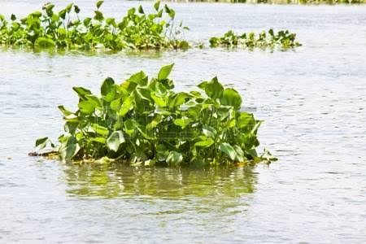
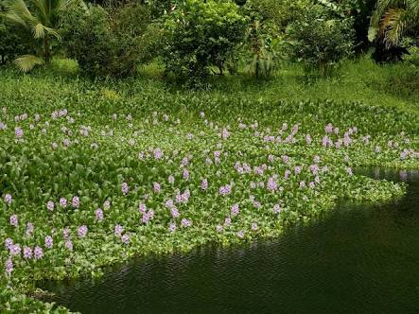
AN EXAMPLE OF water hyacinth infestation.
Fig. 3 fig. 4

Slide 7
Beneficial effects of water hyacinth.
In Songhai farm in rivers state, they are used to reduce the smell of feaces in the holding pits while they are being converted to gas for domestic and industrial purposes.
acts as a substrate for macroinvertebrates like the snails and arachnids
The mats (roots) of the water hyacinth could be used for local craft work like making of mats, hats, baskets etc.
In polluted waters, it helps reduce heavy metal concentration by absorbing these metals from the water.
Water hyacinth also has been found to stabilize pH levels and temperature in experimental lagoons, thereby preventing stratification and increasing mixing within the water column.

Slide 8
Examples of craft work made from the mats.
Fig. 5 fig.6

Slide 9
Control methods of the water hyacinth.
There are basically 3 types of control methods used for the treatment of water hyacinth. They are:
Mechanical methods
Chemical methods
Biological methods

Slide 10
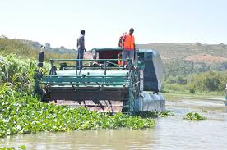
Mechanical control methods
This involves harvesting plants and insite cutting. It also involves the use of heavy duty machines if it is a large water body. This may lead to emission of pollutants, however, this method immediately opens up physical space.
fig 6.

Slide 11
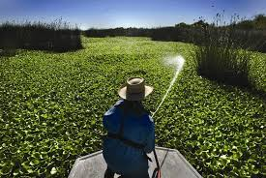
Chemical control methods
This involves the use of herbicides. Although this is very effective, it can cause serious deoxygenation of water after prolonged use.
fig. 7

Slide 12
Biological control methods
This involves the introduction of biological species that can feed or displace the water hyacinth.
Neochetina eichhorniae and N. bruchi are two commonly used weevil species from the plant’s native range (Sosa et al., 2007).
It is better and safer than the other two methods
Sometimes the introduced species could become pests and cause problems too.

Slide 13
Conclusion
Aside the ecological effects, the water hyacinth also has adverse socio economic effects. Cost of remediation is usually very high in most countries. It has both good and bad sides and the keyword for getting the best out of this plant is balance.

Slide 14
references
Albano prezetal. (2011) a first report of water hyacinth (eichhornia crassipes) soil seed banks in Africa. Journal of botany, 04, 33-24.
Andrew cohen & brent foster (2000) the regulation of biological pollution: preventing exotic species invasions from ballast water discharged into California coastal waters.
Bartodziej W. & Weymouth G. (1995) Water bird abundance and activity on water-hyacinth and Egeria in the St-Marks River, Florida. Journal of Aquatic Plant Management, 33, 19-22. Brendonck L., Maes J., Rommens W., Dekeza N., Nhiwatiwa T., Barson M., Callebaut V., Phiri C., Moreau K., Gratwicke B., Stevens M., Alyn N., Holsters E., Ollevier F. & Marshall B. (2003) The impact of water hyacinth (Eichhornia crassipes) in a eutrophic subtropical impoundment (Lake Chivero, Zimbabwe). II. Species diversity. Archiv Fur Hydrobiologie, 158, 389-405.

Slide 15
Thank you!!!

