Slide 1
UNIVERSITY OF PORT HARCOURT
FACULTY OF SCIENCE
SEMINAR PRESENTATION
On
CONSERVATION OF WILDLIFE: PROTECTING ENDANGERED FAUNA IN NIGERIA
PRESENTED BY
IGBANIBO B. ISAAC
U2014/5550059

Slide 2
INTRODUCTION
Wildlife is use to describe any non-domesticated vertebrate species i.e animals that are out of the direct control of man.
Endangered fauna are animals at a high risk of going extinct.
Available literature have shown that man is the major cause of animals going extinct.

Slide 3
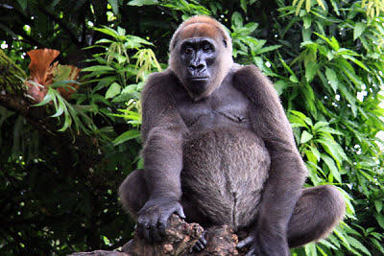
ENDANGERED FAUNA IN NIGERIA
Fig 1.
The Cross River gorilla is restricted to a small area of highland forest on the border of Cameroon and Nigeria.

Slide 4
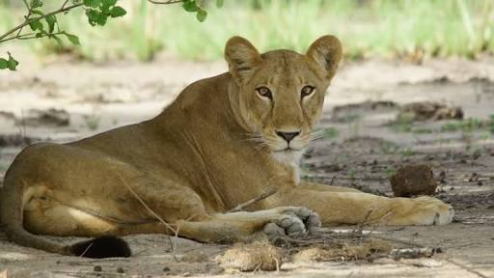
Fig 2.
The West african lion population in West Africa that is listed as Critically Endangered on the IUCN Red List

Slide 5
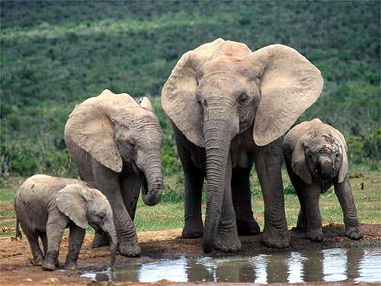
Fig 3
The forest elephants in Nigeria found in Ondo, Osun and Ogun states are more threatened by deforestation

Slide 6
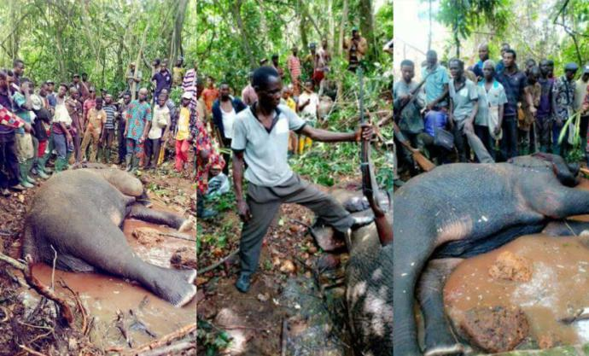
Fig4.
Man kills elephant: what it means for our
wildlife conservation.

Slide 7
CAUSES OF WILDLIFE EXTINCTION
Destruction and loss of wild habitats
Pollution
Excess hunting and poaching

Slide 8
WILDLIFE CONSERVATION
There are two ways of conserving wildlife
Ex situ conservation
In situ conservation

Slide 9
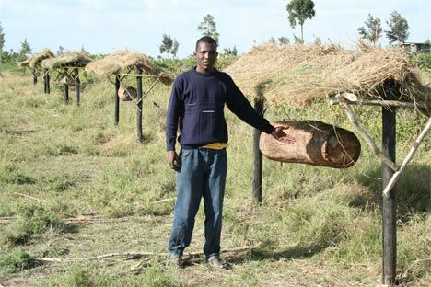
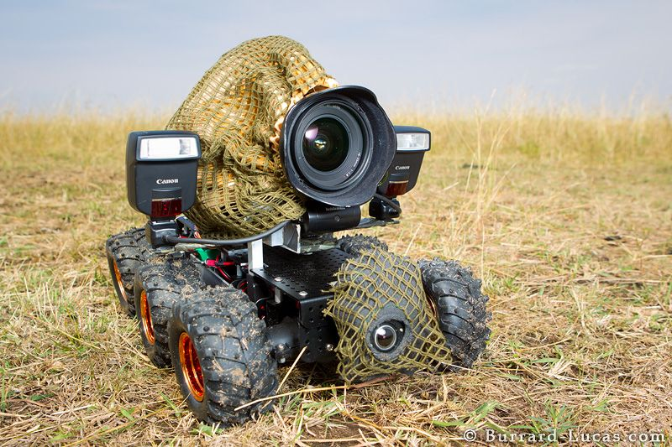
TECHNOLOGY IN WILDLIFE CONSERVATION
Fig5. Fig6.

Slide 10
WHY PRESERVE ENDANGERED SPECIES
Medical use
Generates Revenue
Bio regulators

Slide 11
CONCLUSION
Protection of these endangered fauna should be our priority, as scientists said earlier in a research - Cows to soon be the biggest land animals in the next 10 years.

Slide 12
THANK YOU

